Slide 1
One Way Functions
Chapter 2, Lane-Ogi, Group B
Yang Feng
Anis Zaman
Ethan Johnson
Amin Mosayyebzadeh
Fall 2015, Midterm II

Slide 2
Agenda
Definitions
Chapter 2 of Lane and Ogi’s The Complexity Theory Companion
Theorem 2.5, has 2 claims
Quiz in last 15 min of the class.
Hint Hint: Try to understand the definitions

Slide 3
One Way Function (OWF)?
Function that is easy to compute but HARD TO INVERT
No known One Way Function, (OWF), yet to be found!!
But there are candidates!!
Requirements to be a One Way Function, f:
f can be computed in Polynomial Time (PTIME)
f can’t be inverted in PTIME
f is honest
f, a PTIME computable function
X
Y
has NO such g that is PTIME computable

Slide 4
What is Honesty?
Definition 2.1: Honesty
A function f is honest if the following holds:
(∃ polynomial q)
(∀ y∈ range (f) )
(∃ x)
[ |x| ≤ q(|y|) Λ f(x) = y]
f can shrink its input by no more than polynomial

Slide 5
Why Honesty
Why Honesty?
f being honest means: For each range element y = f(x), there is an x that is at most polynomially longer than y (i.e., for which f(x) is not more than “polynomially” shorter than x)
Intuitively: function cannot drastically “shrink” its input
Better reflects intuitive notion of non invertibility - no “length tricks”
Examples
Notes:
If function is not honest the existence of one-way functions would be trivially true, since any function that exponentially shrinks the input would be clearly a one-way function

Slide 6
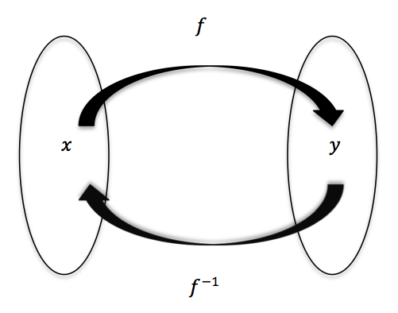
Polynomial Invertibility
Definition 2.2:
A function (possibly non total) f is PTIME invertible
if there is a possible (possibly non total) PTIME
computable function g such that:
(∀y ∈ range (f))
[ y ∈ domain(g) ⋀ g(y) ∈ domain(f) ⋀ f(g(y)) = y]
simply means f can be reversed engineered in somewhat similar amount of time

Slide 7
Last Definition...
Definition 2.4: One to One
A function f is one to one if:
(∀ y ∈ Σ* ) [ || {x | f(x) = y }|| ≤ 1 ]
Simple High School algebra:
(∀ x₁ ,x₂ ∈ Σ* ) [ f(x₁) = f(x₂) ⇒ (x₁= x₂) ]

Slide 8
Now what?
Now we know what One Way Function (OWF) is!!!
A function f is one way if :
f is polynomial-time computable,
f is not polynomial time invertible,and
f is honest

Slide 9
Theorem 2.5
One-way functions exists if and only if P ≠ NP
One-to-one one way functions exist if and only if P≠ UP
We shall prove this theorem for the rest of the class session.
Note: Proof of 2 is simple modification of part 1. SO PAY CLOSE ATTENTION while we prove 1

Slide 10
Things to prove:
One-way functions exists if and only if P ≠ NP
if: P ≠ NP ⇒ One Way Function Exists
only if: One Way Function Exists ⇒ P ≠ NP
2. One-to-one one way functions exist if and only if P ≠ UP
if : P ≠ UP ⇒ one-to-one one way functions exist
only if : One-to-one one way functions exist ⇒ P ≠ UP

Slide 11
1(a) if: P ≠ NP ⇒ One Way Function Exists
Assume P ≠ NP
Let A ∈ NP - P
∃ a NPTM, N such that L(N) = A
Goal: Find a one way function f

Slide 12
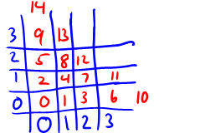
1(a) if: P ≠ NP ⇒ One Way Function Exists ...
Quest for the magical f:
Assume some standard nice pairing function < •, • > :
PTIME computable and invertible
a bijection between Σ* x Σ* and Σ*
Consider a function f :
A process to uniquely encode 2 things into one. Example
Remember:
L(N) = A and
A ∈ NP - P

Slide 13
1(a) if: P≠NP ⇒ One Way Function Exists ...
BIG PICTURE!
NP
Will show f is polynomial time computable, honest, hard to invert
For the sake of contradiction assume f is easily invertible in PTIME
Establish A ∈ P
Lead to a contradiction A ∈ P & A ∈ NP-P
P = NP
A
A
P
Remember:
L(N) = A and
A ∈ NP - P

Slide 14
1(a) if: P≠NP ⇒ One Way Function Exists ...
Quest for the magical f:
f that takes paired values <x, w> as input
Our Claim:
f is polynomial time computable
f is honest
Remember:
L(N) = A and
A ∈ NP - P

Slide 15
1(a) if: P≠NP ⇒ One Way Function Exists ...
f is computable in PTIME?
checking whether w is an accepting path by running N on input x is clearly polynomial
f is honest?
If w is an accepting path, no path in N can be longer than some polynomial p(|x|). If w is not an accepting path, |w| might not be polynomial. But honesty only requires that some short preimage for 1x exist (easy to come up with one).
Also, PTIME computability and invertibility of pairing function “prevents f from destroying the honesty condition”
Notes:
As we only need at least one honest preimage for every output, then this solves our concern about w

Slide 16
1(a) if: P≠NP ⇒ One Way Function Exists ...
We are almost there!
Showed that our f is
computable in polynomial time ✅
honest ✅
hard to invert

Slide 17
1(a) if: P≠NP ⇒ One Way Function Exists ...
BIG PICTURE!
NP
Showed f is polynomial time computable, honest
Need to show hard to invert
For the sake of contradiction assume f is “easily” invertible in PTIME
Gives us A ∈ P
Will construct a DPTM M, s.t L(M) = A
Lead to a contradiction A ∈ P & A ∈ NP-P
P = NP
A
P
“easily” means in polynomial time

Slide 18
1(a) if: P≠NP ⇒ One Way Function Exists ...
Goal: Show f is hard to invert
Assume f is invertible via a polynomially computable function g
g allows us to accept A in PTIME
We get A ∈ P
We will show that A ∈ P by constructing a
DPTM M such that L(M) = A
Assumed
NP
A
A
Remember:
L(N) = A and
A ∈ NP - P
P

Slide 19
1(a) if: P≠NP ⇒ One Way Function Exists ...
Construction M:
Goal: Show f is hard to invert
Notes:
g(0x) computation happens in PTIME

Slide 20
1(a) if: P≠NP ⇒ One Way Function Exists ...
Construction M:
On input x∈ Σ*, check if 0x ∈ domain of g
if not, REJECT!
Goal: Show f is hard to invert

Slide 21
1(a) if: P≠NP ⇒ One Way Function Exists ...
Construction M:
On input x∈ Σ*, check if 0x ∈ domain of g
if not, REJECT!
if yes:
compute g(0x), which returns <x,w>
test if w is an accepting path in N(x)
if yes, ACCEPT!
Otherwise, REJECT!
Goal: Show f is hard to invert
PTIME
Mr. RABBIT
will use this construction in 2(a)

Slide 22
1(a) if: P≠NP ⇒ One Way Function Exists ...
M accepts A in deterministic polynomial time
Under our assumption P ≠ NP
Just showed a DPTM for M and L(M) = A
Showed A ∈ P
Assumed A ∈ NP - P
Contradiction!
NP
A
A
P

Slide 23
What actually happened?
We constructed DPTM M assuming a inverse of f, g existed, which is polynomial time computable
But g does not exist i.e no polynomial time computable inverse of f exists
f ⁻¹ must not be polynomially computable, f ⁻¹ is HARD to invert
f must not be polynomially invertible
Vola!!! f is now a One Way Function ✅

Slide 24
Where are we so far?
One-way functions exists if and only if P ≠ NP
if: P ≠ NP ⇒ One Way Function Exists ✅
only if: One Way Function Exists ⇒ P ≠ NP
2. One-to-one one way functions exist if and only if P ≠ UP
if : P ≠ UP ⇒ one-to-one one way functions exist
only if : One-to-one one way functions exist ⇒ P ≠ UP

Slide 25
1(b) only if: One Way Function Exists ⇒ P≠NP
Reverse our previous strategy: given a one-way function f, assume P=NP, lead to contradiction.
Let p be f’s honesty polynomial
Think of this language:
What does this language “mean”?
Prefixes of the inverse of z, i.e. f ⁻¹(z), that are sufficiently short (for honesty)

Slide 26
1(b) only if: One Way Function Exists ⇒ P≠NP
Clearly L is NP: guess a string y, then check if f(pre.y) = z.
Since we assumed P=NP, L is also P!
We’ll use this fact to invert f “easily” (in P-time) - contradicting that f is a one-way function.

Slide 27
1(b) only if: One Way Function Exists ⇒ P≠NP
Goal: given z, find its inverse with respect to f in polynomial time
(find x such that f(x) = z)
Since (we assumed) L ∈ P, there is a DPTM accepting L.
If <z, pre> is in L, pre is a prefix of z’s inverse
We can check “easily” (P-time) whether something is in L!
What can we do with this?

Slide 28
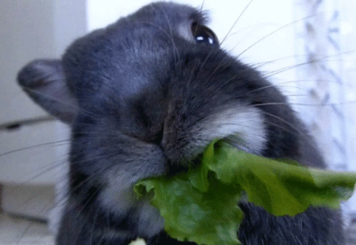
1(b) only if: One Way Function Exists ⇒ P≠NP
Complexity rabbit says…
Search ALL the prefixes!

Slide 29
1(b) only if: One Way Function Exists ⇒ P≠NP
Searching all the prefixes:
Check if f(є) = z; if so we are done (є is an inverse), if not go to next step.
Is 0 a prefix of a suitably short inverse?
If NO, then 1 must be a prefix!
Either way, we determine the first bit.
Are we done yet? (is this prefix the whole inverse?)
Check if f(pre) = z. If yes, we’re done! Otherwise, we need to find out the next bit…
(Let b be the bit we’ve already figured out.) Is b0 a prefix of a suitably short inverse?
If no, then b1 must be a prefix…
Now we have the second bit (c), check if f(bc) = z...

Slide 30
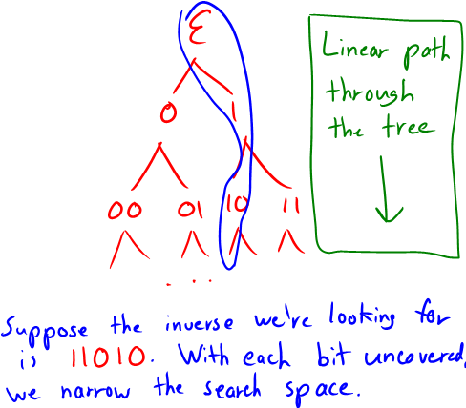
1(b) only if: One Way Function Exists ⇒ P≠NP
Can think of this as a search as a tree:
At each step, we discover one more bit of the inverse.
We will make progress with each step: if the next bit isn’t 0, it must be 1. No exponential expansion!
Hence prefix search is linear in the length of the inverse!
The honesty polynomial bounds the length of the inverse

Slide 31
Recap
We started with a one way function f
We supposed P = NP
We examined a language L that lets us check if a string is a prefix of f ⁻¹(z)
Since P = NP, L ∈ P
We used L to search for the inverse in polynomial time
Thus f can be inverted in polynomial time. Contradiction!
Hence our assumption was wrong: P ≠ NP

Slide 32
Where are we so far?
One-way function exists if and only if P ≠ NP
if: P ≠ NP ⇒ One Way Function Exists ✅
only if: One Way Function Exists ⇒ P ≠ NP ✅
2. One-to-one one way function exists if and only if P ≠ UP
if : P ≠ UP ⇒ one-to-one one way functions exist
only if : One-to-one one way functions exist ⇒ P ≠ UP

Slide 33
What is UP?
NP
A complexity class like (NP, P) that has unique witness
L ∈ UP if:
NP machine N accepts x ∈ L
For all such x, the computation of N(x) has
at most 1 accepting path
UP = { L | ∃ NPTM, N such that L = L(N), and ∀ x∈ L, N(x) has at most 1 accepting path }
UP
P

Slide 34
2(a) if: P ≠ UP ⇒ one-to-one one way functions exist
Let A ∈ UP - P
∃ NPTM, N such that A = L(N)
Consider function f:
Mr. RABBIT
will SAVE US!!!
Goal: want to show f is 1-to-1 one way function
Notes:
Notice how we tweaked our function f. Being in UP guarantees at most 1 accepting path. So we do not change 0x
but there is going to be tons of non accepting path w, we need to map every such tuple to an unique output.
That’s why we make it 1<x,w>

Slide 35
Where are we now?
One-way function exists if and only if P ≠ NP
if: P ≠ NP ⇒ One Way Function Exists ✅
only if: One Way Function Exists ⇒ P ≠ NP ✅
2. One-to-one one way function exists if and only if P ≠ UP
if : P ≠ UP ⇒ one-to-one one way functions exist ✅
only if : One-to-one one way functions exist ⇒ P ≠ UP

Slide 36
2(b): only if : 1-to-1 one way functions exist ⇒ P ≠ UP
No changes from 1(b)
Replace “one way function” with “1-to-1 one way function” and “NP” with “UP” - same argument holds
Only difference: there is only one path in the prefix search tree that will lead us to an inverse.
We were ignoring the extras anyway (see special note)
1-to-1 one way functions exist ⇒ P ≠ UP!!!

Slide 37
Big Picture!!
Got introduced to One Way Function (1-to-1 as well)!
Existence of One Way Function is tied to whether P=NP
For 1-to-1 One Way Function, it is tied to a more strongly regulated version of NP i.e. UP (***)
Next class we will expand on *** to cover a constant bounded version of UP

Slide 38
One way Functions
Chapter 2.2 Hem-ogi
Group B:
Yang Feng
Anis Zaman
Ethan Johnson
Amin Mosayyebzadeh

Slide 39
Reminder
one-to-one one-way functions are characterized by P ≠ UP
one-way functions is characterized by P ≠ NP
P ≠ UP ⇒ P ≠ NP,
the converse has never been established
I am the Rabbit, but I have just eaten a carrot

Slide 40
Note
one-to-one function f is completely unambiguous in terms of inversion
each element of range(f) has exactly one inverse
"constant-to-one" functions are called bounded-ambiguity functions. They are often referred as "O(1)-to-one" functions
potato, potato, ...

Slide 41
Definition 2.6: Bounded-Ambiguity Functions
For each k ≥ 1, we say that
a (possibly non-total) function f is k-to-one if (∀y ∈ range(f ))[ ll{ x l f(x) = y}ll ≤ k]
We say that
a (possibly non-total) function f is of bounded-ambiguity if there is a k ≥ 1 such that f is k-to-one.
compare it with one-to-one function:
(∀y ∈ range(f ))[ ll{ x l f(x) = y}ll ≤ 1]
Notes:
To Do example or picture k to one

Slide 42
Big picture
We are going to prove that
Unambiguous one-way functions exist ⇔ Bounded-ambiguity one-way functions exist

Slide 43
Theorem 2.7
one-to-one one-way functions exist ⇔ constant-to-one one-way functions exist

Slide 44
Proof
“Only if” direction is easy:
All one-to-one functions are constant-to-one functions, so the "only if" direction holds
We will show the “if” direction

Slide 45
Definition 2.8
A language L is in UP_{≤k}, k ≥ 1, if there is an NPTM N such that
1. (∀x ∈ )[N(x) has at least one and at most k accepting paths]
and
2. (∀x ∈ )[N(x) has no accepting paths]

Slide 46
Recall
Part 2 of Theorem 2.5
one-to-one one-way functions exist ⇔ P ≠ UP

Slide 47
Fact 2.8
For each k ≥ 2, k-to-one one-way functions exist ⇔ P ≠ UP_{≤k}
It can be proved by exactly analogous proof of Theorem 2.5

Slide 48
Proving the “if” direction
We know that:
P ≠ UP ⇔ one-to-one one-way functions exist
P ≠ UP_{≤k} ⇔ k-to-one one-way functions exist (from previous slide)
If we show that P ≠ UP ⇔ P ≠ UP_{≤k}, then
one-to-one one-way functions exist ⇔ k-to-one one-way functions exist
We will use induction that:
for all k ∈ {1, 2, 3, . . .}, P = UP ⇒ P = UP_{≤k}

Slide 49
Proving the “if” direction
We know that:
P ≠ UP ⇔ one-to-one one-way functions exist
P ≠ UP_{≤k} ⇔ k-to-one one-way functions exist (from previous slide)
If we show that P ≠ UP ⇔ P ≠ UP_{≤k}, then
one-to-one one-way functions exist ⇔ k-to-one one-way functions exist
We will use induction that:
for all k ∈ {1, 2, 3, . . .}, P = UP ⇒ P = UP_{≤k}

Slide 50
Induction
holds for k = 1:
P = UP ⇒ P = UP_{≤1}
Assume:
P = UP ⇒ P = UP_{≤k'}
prove:
P = UP ⇒ P = UP_{≤k'+1}
P ≠ UP ⇔ P ≠ UP_{≤k}

Slide 51
Proving P = UP ⇒ P = UP_{≤k'+1}
(Assuming P = UP ⇒ P = UP_{≤k'} )
L
B
x’s paths = K’+1
Assume P = UP
Let L be an arbitrary member of UP_{≤k'+1}·
Let N be an NPTM –having at most k' + 1 accepting paths on each input– that accepts L (recall Definition 2.8)
Consider the set
B = { x I N(x) has exactly k' + 1 accepting paths}
Clearly, B ∈ UP, via the machine that on each input x guesses each lexicographically ordered (k'+1)-tuple of distinct computation paths and that accepts on such a path exactly if each of the k' + 1 guessed paths is an accepting path on input x.
by our P =UP assumption, B ∈ P

Slide 52
K’+1 or K’, that is the question
So, we are excluding elements with k’+1 paths (Set B)
since B ∈ P, the set
D = {x I x ∉ B ∧ x ∈ L( N)} is in UP_{≤k'}
L
D
1 ≤ x’s paths ≤ k'
B
x’s paths = K’+1

Slide 53
Proving D in UP_{≤k'}
We construct a TM M such that:
We first deterministically check whether x is in B
Using some P algorithm for B.
Under our current assumptions, B ∈ P. So some such algorithm exists.
If x ∈ B we reject
If x ∉ B we directly simulate N(x).
This simulation will have at most k' accepting paths
x ∉ B precludes there being exactly k'+1 paths
N's choice precludes there being more than k' + 1 paths
Since D ∈ UP_{≤k'}, we conclude
from our assumption that P = UP,
from our inductive hypothesis (which was P= UP⇒ P = UP_{≤k'})
⇒ D ∈ P.
Notes:
boxes to show B and D

Slide 54
Prove
Since P is closed under union, B ∪ D ∈ P.
However
L = B ∪ D ⇒ L ∊ P
L is an arbitrary member of UP_{≤k'+1}
⇨ P = UP ⇒ P = UP_{≤k'+1}

Slide 55
One Way Functions
Chapter 2, Lane-Ogi, Group B
Yang Feng
Anis Zaman
Ethan Johnson
Amin Mosayyebzadeh
Fall 2015, Midterm II

Slide 56
Two-argument (denoted 2-ary) one-way functions
f(x,x’) = y

Slide 57
Strong
Total
Commutative
Associative
⇔
One-Way Functions Exist
One-Way Functions Exist

Slide 58
2-ary function honesty
Definition 2.10:
We say a 2-ary function f: ∑* x ∑* ➝ ∑* is honest if
This definition only requires that each element of range(f) have one
appropriate pair (x, x’).

Slide 59
2-ary function invertible
f(x,x’) = y
g(y) = (x,x’)
Definition 2.11:
We say a 2-ary function f: ∑* x ∑* ➝ ∑* is polynomial-time invertible if there is a polynomial-time computable function g such that, for each y ∈ range(f),
where the projection functions first(z) and second(z) denote, respectively, the first and second components of the unique ordered pair of strings that when paired give z.

Slide 60
2-ary one-way function
We say a 2-ary function f: ∑* x ∑* ➝ ∑* is one-way if
f is polynomial-time computable,
f is not polynomial time invertible,and
f is honest
Are this familiar?

Slide 61
2-ary function s-honesty
We say a 2-ary function f: ∑* x ∑* ➝ ∑* is s-honest if
How to understand it? See next page.

Slide 62
2-ary function invertible
f(x1,x2) = y
g(y, x1) = something similar to x2
f(x1, ) = y
( ,x2)
g
f
x1
y
(y,x1)
domain(f)
range(f)
domain(g)

Slide 63
2-ary function strongly noninvertible
We say a 2-ary function f: ∑* x ∑* ➝ ∑* is strongly noninvertible if it is s-honest and yet neither of the following conditions holds.

Slide 64
2-ary function associative and commutative
We say a 2-ary function f: ∑* x ∑* ➝ ∑* is associative if
We say a 2-ary function f: ∑* x ∑* ➝ ∑* is commutative if
multiplication of integers? concatenation of strings?

Slide 65
Proposition 2.17
The following are equivalent.
One-way functions exist.
2-ary one-way functions exist.
P ≠ NP.

Slide 66
(2) ⇒ (1)
Let 〈・,・〉be a pairing function used before
Let f : ∑* x ∑* ➝ ∑* be any 2-ary one-way function:
g(z) = f(first(z),second(z))
where, first(z) and second(z) denotes the first and second component of the pair mapped to z.

Slide 67
(1) ⇒ (2)
Let h : ∑* ➝ ∑* be a one-way function:
h’(x,y) = 〈h(x), h(y)〉

Slide 68
One Way Functions
Chapter 2, Lane-Ogi, Group B
Yang Feng
Anis Zaman
Ethan Johnson
Amin Mosayyebzadeh
Fall 2015, Midterm II

Slide 69
Two-argument (denoted 2-ary) one-way functions
f(x,x’) = y

Slide 70
Strong
Total
Commutative
Associative
⇔
One-Way Functions Exist
One-Way Functions Exist

Slide 71
2-ary function honesty
Definition 2.10:
We say a 2-ary function f: ∑* x ∑* ➝ ∑* is honest if
This definition only requires that each element of range(f) have one
appropriate pair (x, x’).

Slide 72
2-ary function invertible
f(x,x’) = y
g(y) = (x,x’)
Definition 2.11:
We say a 2-ary function f: ∑* x ∑* ➝ ∑* is polynomial-time invertible if there is a polynomial-time computable function g such that, for each y ∈ range(f),
where the projection functions first(z) and second(z) denote, respectively, the first and second components of the unique ordered pair of strings that when paired give z.

Slide 73
2-ary one-way function
We say a 2-ary function f: ∑* x ∑* ➝ ∑* is one-way if
f is polynomial-time computable,
f is not polynomial time invertible,and
f is honest
Are this familiar?

Slide 74
2-ary function s-honesty
We say a 2-ary function f: ∑* x ∑* ➝ ∑* is s-honest if
Intuitively:
f doesn’t shrink its output drastically relative to either of its inputs individually
Not the same as regular honesty - a dishonest function can still be s-honest if it shrinks output drastically relative to both of its inputs together
Example:

Slide 75
2-ary function strong noninvertibility
f(x1,x2) = y
g(y, x1) = something similar to x2
f(x1, ) = y
(x1,x2)
y
g
f
(y,x1)
domain(f)
range(f)
domain(g)

Slide 76
2-ary function strongly noninvertible
We say a 2-ary function f: ∑* x ∑* ➝ ∑* is strongly noninvertible if it is s-honest and yet neither of the following conditions holds.

Slide 77
2-ary function associative and commutative
We say a 2-ary function f: ∑* x ∑* ➝ ∑* is associative if
We say a 2-ary function f: ∑* x ∑* ➝ ∑* is commutative if
multiplication of integers? concatenation of strings?

Slide 78
Proposition 2.17
The following are equivalent.
One-way functions exist.
2-ary one-way functions exist.
P ≠ NP.

Slide 79
(2) ⇒ (1)
Let 〈・,・〉be a pairing function used before
Let f : ∑* x ∑* ➝ ∑* be any 2-ary one-way function; then
g(z) = f(first(z),second(z))
where first(z) and second(z) denotes the first and second component of the pair mapped to z, is also one-way.

Slide 80
(1) ⇒ (2)
Let h : ∑* ➝ ∑* be a one-way function; then
h’(x,y) = 〈h(x), h(y)〉
is clearly one-way.

Slide 81
Strong
Total
Commutative
Associative
⇔
One-Way Functions Exist
One-Way Functions Exist

Slide 82
Only if direction ⇒ EASY
S. T. C. A. One Way Function exist
⇒
2-ary one-way functions exist
------------------------------------------------------------------------------------------------
By Proposition 2.17
⇒
One-way functions exist

Slide 83
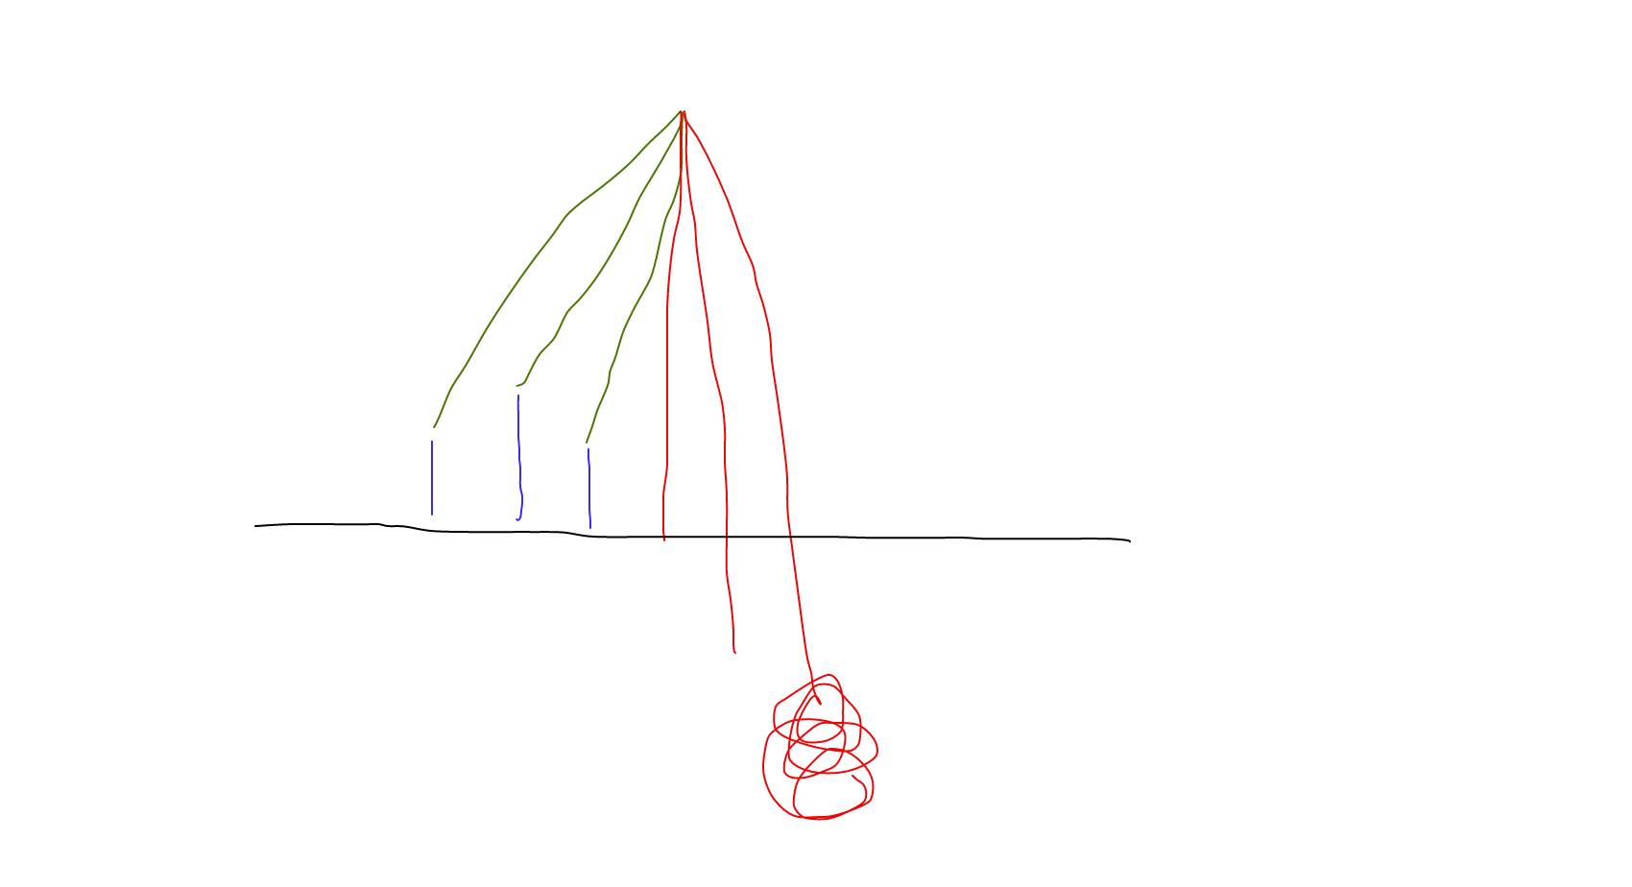
If direction ⇐
NP
N’
Assume P ≠ NP, ∃ NPTM N’ such that L(N’) ∈ NP-P
∃ NPTM N such that L(N) = L(N’). WLOG, assume that on each input x, each computation path of N(x) has exactly p(|x|) bits. We also require p(n) > n.
P

Slide 84
If direction ⇐
We will assume One-Way Functions exist.
We will construct a one-way function that is strongly noninvertible, total, commutative, and associative.

Slide 85
If direction ⇐
Witness: A witness for x is an accepting path of N(x).
Let W(x) be the set of all witnesses for x∈L(N).
p(n) > n ⇒ A string can never be a witness for its own membership.
Since L(N) ∈ NP, each witness for x has length polynomially related to |x|.

Slide 86
If direction ⇐
Let t be any fixed string such that t ∉ L(N). Our magic function is:
Intuitively:
u and v are interpreted as pairs <x, x> or <x, w> - w is a witness for x
These two pairs represent zero, one, or two (not necessarily unique) witnesses for x
If input is of “wrong form” (x’s don’t match, or neither pair has a witness), output the “garbage dump” <t, t1>. Otherwise, output the input with one less witness instance.
Removing information - expensive (NP) to find witnesses
Notes:
What is W?

Slide 87
If direction ⇐
Let us verify that f is a strongly noninvertible, total, commutative, associative, 2-ary one-way function.
Total and polynomial-time computable?

Slide 88
If direction ⇐
Honest?
First two cases easy since we chose N such that all paths for N(x) are p(|x|) bits
Third case (“garbage dump”) seems obviously dishonest (due to fixed length), but since we have only one such case, we can choose our honesty polynomial large enough to allow the smallest string that maps to <t, t1>.

Slide 89
If direction ⇐
Commutative?

Slide 90
If direction ⇐
s-honest?

Slide 91
If direction ⇐
strongly noninvertible?

Slide 92
If direction ⇐
strongly noninvertible:
Approach:
Assume f is not strongly noninvertible
Will lead to a contradiction L(N) ∈ P (=> assumption is wrong)
Assumed L(N) ∈ NP -P
strongly noninvertible?

Slide 93
If direction ⇐
Assume f is not strongly noninvertible via function g in PTIME
Since f is s-honest, at least one of the 2 conditions of strong non invertibility holds from Definition 2.14

Slide 94
If direction ⇐
Assume f is not strongly noninvertible via function g in PTIME
Given an output and one argument, the other argument can be computed in polynomial-time
Thus, at least one of the 2 conditions of strong non invertibility holds from Definition 2.14
WLOG suppose that Case 2 of definition (see previous slide) holds
If x ∈ L(N),
g( <x,x>, <x,x> ) outputs <x, w> where w ∈ W(x)

Slide 95
If direction ⇐
If x ∈ L(N),
g( <x,x>, <x,x> ) outputs <x, w> where w ∈ W(x)
Going to show a DPTIME algorithm to check an input x ∈ L(N)
On input x, compute g( <x,x>, <x,x> )
Reject, if output is not of the form <x, w>
Otherwise simulate N(x) using w as computation path
Accept if N(x) accepts
Reject otherwise
if x ∉ L(N), g( <x,x>, <x,x> ) outputs anything, but since testing membership is PTIME, we can not be fooled!!

Slide 96
If direction ⇐
Showed a DPTIME algorithm to test membership in L(N)
So L(N) ∈ P
But we assumed L(N) ∈ NP - P
Contradiction!!
Our assumption that f is not strongly noninvertible is wrong
So f is strongly non invertible
Done!!!

Slide 97
If direction ⇐
The only one left: associative?
f(f(z,z'), z") = f(z,f(z', z"))?

Slide 98
If direction ⇐
We say a string a is legal if
f(f(z,z'), z") = f(z,f(z', z"))
first part not all equal
first part all equal
〈t,t1〉
3 legal
0,1 legal
〈t,t1〉
2 legal
〈first(z),q〉
Third is not
〈first(z),first(z)〉
Third is
〈first(z),first(z)〉
〈t,t1〉
〈first(z),first(z)〉

Slide 99
If direction ⇐
z=〈x,w〉 z’=〈x’,w’〉 z’’=〈x’’,w’’〉
f(f(z,z'), z") = f(z,f(z', z"))
if x ≠ x’ f(z,z’) =〈t,t1〉 f(<x,w>,<x’,w>)
if x ≠ x’’ f(<x,w>,<x’,w>) f(<x,w>,<x’,w>)
if x’ ≠ x’’ f(<x,w>,<x’,w>) f(z,z’) =〈t,t1〉

Slide 100
If direction ⇐
We say a string a is legal if
f(f(z,z'), z") = f(z,f(z', z"))
first part not all equal
first part all equal
〈t,t1〉
3 legal
0,1 legal
〈t,t1〉
2 legal
〈first(z),q〉
Third is not
〈first(z),first(z)〉
Third is
〈first(z),first(z)〉
〈t,t1〉
〈first(z),first(z)〉

Slide 101
If direction ⇐
z=〈x,w〉
z’=〈x,w’〉
z’’=〈x,w’’〉
if w is witness, and w’, w’’ are not,
f(z,z’)=〈x,x〉or 〈t,t1〉
f(〈x,x〉,z’’) = 〈t,t1〉

Slide 102
If direction ⇐
We say a string a is legal if
f(f(z,z'), z") = f(z,f(z', z"))
first part not all equal
first part all equal
〈t,t1〉
3 legal
0,1 legal
〈t,t1〉
2 legal
〈first(z),q〉
Third is not
〈first(z),first(z)〉
Third is
〈first(z),first(z)〉
〈t,t1〉
〈first(z),first(z)〉

Slide 103
If direction ⇐
z=〈x,w〉
z’=〈x,w’〉
z’’=〈x,w’’〉
if w,w’ are witnesses,
w’’=x, f(z,z’)=〈x,min(w,w’)〉 f(z’’,〈x,min(w,w’)〉) =〈x,x〉
w’’≠x, f(z’,z’’) =〈t,t1〉

Slide 104
If direction ⇐
We say a string a is legal if
f(f(z,z'), z") = f(z,f(z', z"))
first part not all equal
first part all equal
〈t,t1〉
3 legal
0,1 legal
〈t,t1〉
2 legal
〈first(z),q〉
Third is not
〈first(z),first(z)〉
Third is
〈first(z),first(z)〉
〈t,t1〉
〈first(z),first(z)〉

Slide 105
If direction ⇐
z=〈x,w〉
z’=〈x,w’〉
z’’=〈x,w’’〉
if w,w’, w’’ are witnesses
f(z,z’)=〈x,min(w,w’)〉
f(x,min(w,w’),z’’) = 〈x,min(w,w’,w’’)〉

Slide 106
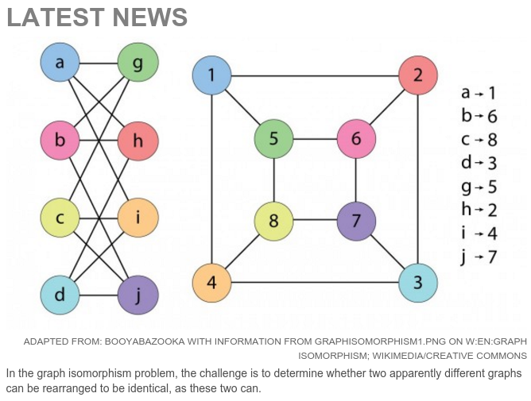
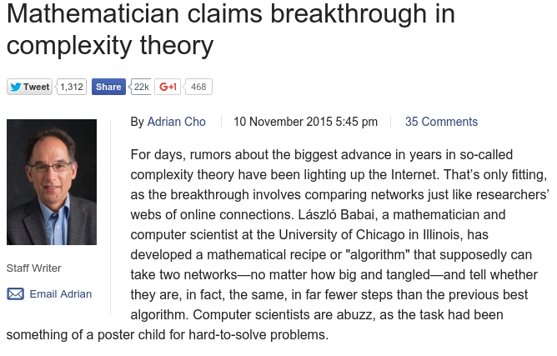
http://news.sciencemag.org/math/2015/11/mathematician-claims-breakthrough-complexity-theory

