Slide 1
The Tournament Divide and Conquer Technique
Daniel Rubery
Georgiy Platonov
Mohammad Rafayet Ali
Xiong Zhang

Slide 2
K-tournaments
Consider the set of k people playing a game with the following properties:
Game consists of multiple matches, with only two players in each match
Each player play against each other exactly once.
Every match has a winner
Such a setting can be represented by a directed graph.

Slide 3
Example: 4-tournament

Slide 4
Curious fact about tournaments
The interesting fact about tournaments is that we can select a very small subset of players such that each player not from that subset defeats someone from that set.
How small?
A logarithmically small!

Slide 5
Theorem 3.1:
Let G = (V, E) be a k-tournament, where V = {1, …, k} is the set of nodes or players, and E is the set of edges or matches.
Then there exists a subset H of V, such that:
1)
2)

Slide 6
Example: 7-tournament

Slide 7
Example: 7-tournament

Slide 8
Example: 7-tournament

Slide 9
Example: 7-tournament

Slide 10
Proof of Theorem 3.1:
In a k-tournament, each player plays exactly k - 1 games.
There must be at least one player who lost to at least ⌈(k - 1)/2⌉ other players.
Add this player to H.
Remove the nodes corresponding to that player and to all the players who defeated him from the graph. The resulting graph has at most ⌈k/2⌉ - 1 vertices.
Apply the same procedure to the new graph.
Since at each step we decrease the size of graph by factor of 2 (at least), we end up with at most ⌊log (k + 1)⌋ steps, so |H| ≤ ⌊log (k + 1)⌋.

Slide 11
Definitions
P-sel
A language L is P-selective if there is a polynomial-time function f such that:
f(x,y) is either x or y
If x∈L or y∈L, f(x,y)∈L
Notice that f(x,y) can do anything if x and y are not in L, so in some sense, f(x,y) selects which string is “more likely” to be in L
Example:
For a fixed real number r, {<a,b> | a/b < r}

Slide 12
Definitions
P/poly
Can be thought of as having “small circuits” that decide each length
Easier to think of it as polynomial amount of advice
More generally, for a class of languages C and class of functions F, let C/F denote the class of languages L such that:
There exists a language A∈C, and h(n) such that |h(n)|∈F, and L = {x | <x,h(|x|)>∈A}
So P/poly is equivalently:
There is a language A∈P and h(n) of polynomial length such that x∈L iff <x,h(|x|)>∈A

Slide 13
Connection Between Tournaments and P-sel
If L is P-selective, let f be a P-selector for L
Then for a given length n, f gives a tournament on L^{=n}
We have an edge from a to b if f(a,b) = b
Note: This requires f(a,b) = f(b,a)
Then Theorem 3.1 gives a set H with at most log(2^{n}+1) ≤ n+1 strings
Every string in L^{=n} is either in H, or beats a string in H
Furthermore, any string in H or that beats a string in H is in L^{=n}

Slide 14
P-sel ⊆ P/poly
Recall our definitions. To show a language L is in P/poly, we need a function g and a language A∊P such that:
x∊L iff <x,g(|x|)>∊A
So let g(n) encode the, at most, n+1 strings in H
|g(n)| is polynomial in n
Then A is accepted by the following deterministic Turing machine:
On input <x,y> do the following:
For each h in y, accept if x=h or f(x,h)=x
If we fail all the above, reject
Then x∊L iff <x,g(|x|)>∊A, so L is in P/poly
In fact, since g(n) has at most n+1 strings of length n, it has quadratic length
So we can strengthen this result to P-sel ⊆ P/quadratic

Slide 22
Theorem 3.10
What does it mean?

Slide 23
Theorem 3.10
What does it mean?
How to prove this?
Hint Hint: We’ll use Theorem 3.9 (if G is a k-tournament, we can find a “core” node which has a relatively short distance (<=2) to any other nodes)

Slide 24
Theorem 3.10
What we have: a selector function f for set L
What we want: a linear advice function and an “interpreter” set A
Consider this advice function g:
This is great, now we have a linear advice (=n+1) and it seems to be useful, but how to construct the set A (the interpreter) based on the advice function?

Slide 25
Theorem 3.10
The interpreter is defined as:
So if x is in L, by construction of the advice function we know <x, g(|x|)> is in A
What if x is not in L?

Slide 26
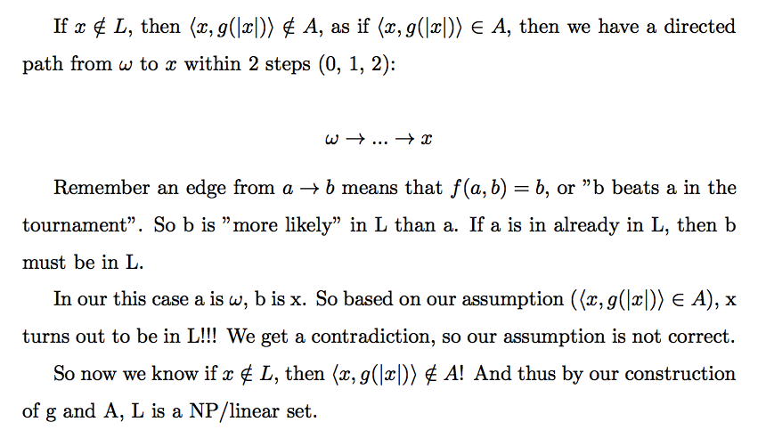

Slide 27
This is the end of lecture 1.

Slide 28
The Tournament Divide and Conquer Technique
Daniel Rubery
Georgiy Platonov
Mohammad Rafayet Ali
Xiong Zhang

Slide 29
Attention
We’ll have an in-class quiz at the end of this lecture.
In the quiz you need to show some understanding to the material covered today.
During the quiz you can’t use today’s slides, but you can take a sheet of note during the lecture (if you didn’t do it before) and use it in the quiz.
Be prepared!

Slide 30
Recap
At the end of last lecture we proved Theorem 3.10:

Slide 31
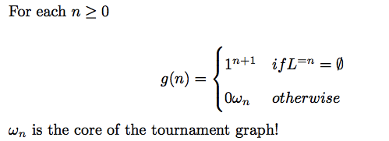
And remember we constructed an elegant advice function:
The length of the advice string here is n + 1, but is it optimal? Or can we have even shorter advice strings, like in the length n ?

Slide 32
No, not a chance!

Slide 33
Theorem 3.13
We’ll show that n bits simply cannot hold enough information to disambiguate a certain family of semi-feasible sets.
How?
A direct way is to find a set L that is
semi-feasible (i.e. P-sel set)
but is not NP/n

Slide 34
Construction Strategy
We want to construct a set L, consisting mostly of holes.
Holes?
That means at widely spaced lengths, our set will include exactly some (possibly empty) left cut of strings of that length, and at other lengths it will be empty.
What does it mean?

Slide 35
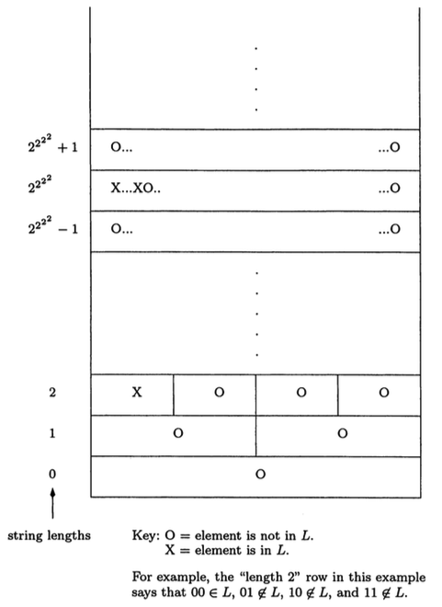
Interesting
lengths
Holes

Slide 36
Construction Strategy
We want to construct a set L, consisting mostly of holes.
Yet we will ensure that the set is of limited complexity, so we can conduct a brute-force search for strings.
So P(olynomial) selector function exists!!

Slide 37
Weird Notation for Length of Strings

Slide 38
3 Conditions for the Construction

Slide 39
2 Claims
Translation?
There is a semi-feasible set (satisfying the 3 requirements) which is not NP/n .

Slide 40
Hint: It’s not surprising if we have questions for both of the claims later!

Slide 41
Proof of Claim 3.14
Let L satisfy the 3 requirements, to prove L is semi-feasible, we need to construct a P-selector function f for L

Slide 42
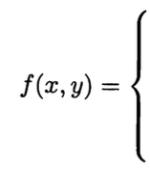
Proof of Claim 3.14
Let’s go through all the cases one by one:
Can you see that by this construction, if one of (x, y) is in L, then the output of f(x,y) is in L!

Slide 43
But is this function P time computable?
For the first 3 cases: clearly yes, since we only need to check the length of x and y
For the last 2 cases, the trickiest part is in computing whether or not min{x, y} is in L. Is this part P time computable?

Slide 44
Recall that Q is of the form:
In the last two cases, if
Then the following must hold:
Why?

Slide 45
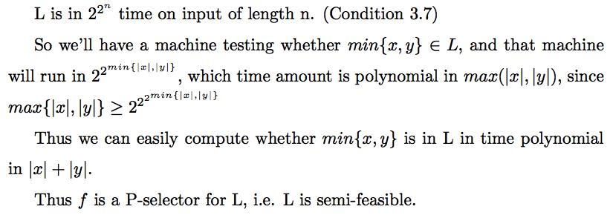

Slide 54
This is the end of the lecture 2.

Slide 55
The Tournament Divide and Conquer Technique
Daniel Rubery
Georgiy Platonov
Mohammad Rafayet Ali
Xiong Zhang

Slide 56
Lecture 3
Unique solutions collapse the Polynomial Hierarchy

Slide 57
Motivation
Looking at functions that give a satisfying assignment of clauses. We want some kind of function such that for any F in SAT, f(F) is a satisfying assignment of F
If there is a deterministic polynomial time function f, then P=NP
There definitely exists an FP function with NP oracle.
We will define a weaker function, between FP and FP^{NP}, whose existence implies PH = NP^{NP}

Slide 58
Definitions
Let f be a multivalued function. set-f(x) denotes the set of all values that are an output of f(x). If f(x) has no output then set-f(x) is the empty set.
We consider any given nondeterministic polynomial-time machine N to implicitly compute a (potentially partial) multivalued function, namely, the function f_{N} defined by the set set-f_{N}(x) = { y | some computation path of N(x) outputs y }. NPMV denotes the class of functions computed in this sense by nondeterministic polynomial-time machines.

Slide 59
More definitions
A (potentially partial) multivalued function f is said to be single-valued if ∀x(||set-f(x)|| ≤ 1). NPSV denotes the class of all single-valued NPMV functions.
Given a multivalued functions f and g, we say that g is a refinement of f if
∀x(set-g(x) ⊆ set-f(x)), and
∀x(set-g(x) = ∅ ⇒ set-f(x) = ∅).

Slide 60
Yet more definitions
Let F be any (possibly partial, possibly multivalued) function class. We say a set L is F-selective if there is a multivalued function f ∈ F such that
∀x, y(set-f(x, y) ⊆ {x, y}), and
∀x, y((x ∈ L ∨ y ∈ L) ⇒ (set-f(x,y) ⊆ L ∧set-f(x,y) ≠ ∅)).

Slide 61
Theorem 3.21
If all NPMV functions have NPSV refinements, then PH = NP^{NP}.

Slide 62
We will use the following two lemmas:
NPSV-sel ∩ NP ⊆ (NP ∩ coNP)/poly. (Lemma 3.25)
NP ⊆ (NP ∩ coNP)/poly ⇒ PH = NP^{NP}. (Lemma 3.26)

Slide 63
Proof of Lemma 3.25: NPSV-sel ∩ NP ⊆ (NP ∩ coNP)/poly
Let L be a language in NPSV-sel∩NP. Let N_{L} be a NPTM accepting L, and f an NPSV selector.
WLOG, for any x,y we have set-f(x,y) = set-f(y,x).
Now we construct an NP∩coNP interpreter A and an advice function g.
Let A be all strings of the form <x, <<a₁,a₂,…,a_{z}>, <w₁,...,w_{z’}>>> such that:
z = z’
∀i (w_{i} is an accepting path of N_{L} on a_{i})
∃i (x∈set-f(x,a_{i}))

Slide 64
Proof of Lemma 3.25: NPSV-sel ∩ NP ⊆ (NP ∩ coNP)/poly
Clearly, A is in NP.
A̅ is also in NP, as follows:
Accept any syntactically ill-formed input, or if z ≠ z’
Deterministically check that each w_{i} is an accepting path of a_{i}
Reject if, for some i, x = a_{i}
Since we now know each a_{i} is in L, set-f(a_{i},x) must have exactly one value
For each i, non-deterministically choose a path for f(a_{i},x)
If it outputs nothing, reject
If it outputs x, reject
If it outputs a_{i}, continue
Accept if each path gives f(a_{i},x) = a_{i}.

Slide 65
Proof of Lemma 3.25: NPSV-sel ∩ NP ⊆ (NP ∩ coNP)/poly
Create a tournament on L^{=n}. If a,b ∈ L^{=n}, then there is an edge from a to b if set-f(a,b) = {b}.
Now use Theorem 3.1 to get a set H with at most n+1 strings. For every x∈L^{=n}, there is an h∈H, such that x=h or set-f(x,h) = {x}.
Then our advice function is g(n) = <<h₁,h₂,...,h_{n}>,<w₁,w₂,...,w_{n}>>, where each w_{i} is an accepting path of h_{i}. This is polynomial length in n.
x ∈ L iff <x, g(|x|)> ∈ A
So L∈(NP∩coNP)/poly, and since L was arbitrary in NPSV-sel∩NP, we get the Lemma.

Slide 66
Proof of Lemma 3.26: NP ⊆ (NP ∩ coNP)/poly ⇒ PH = NP^{NP}
By theorem 1.16 (Karp-Lipton)
NP ⊆ P/poly ⇒ PH = NP^{NP}.
This result relativizes, i.e.
∀A(NP^{A} ⊆ P^{A}/poly ⇒ PH^{A} = NP^{NP^A}).

Slide 67
Proof of Lemma 3.26: NP ⊆ (NP ∩ coNP)/poly ⇒ PH = NP^{NP}
Assume NP ⊆ (NP ∩ coNP)/poly. Then SAT ∈ (NP ∩ coNP)/poly via some B ∈ NP ∩ coNP, and some advice g in poly.
From
∀A(NP^{A} ⊆ P^{A}/poly ⇒ PH^{A} = NP^{NP^A})
we have
NP^{B} ⊆ P^{B}/poly ⇒ PH^{B} = NP^{NP^B}.

Slide 68
Proof of Lemma 3.26: NP ⊆ (NP ∩ coNP)/poly ⇒ PH = NP^{NP}
Having
NP^{B} ⊆ P^{B}/poly ⇒ PH^{B} = NP^{NP^B},
we are going to prove that
NP ⊆ (NP ∩ coNP)/poly ⇒ NP^{B} ⊆ P^{B}/poly
and
PH^{B} = NP^{NP^B} ⇒ PH = NP^{NP}.

Slide 69
Proof of Lemma 3.26: NP ⊆ (NP ∩ coNP)/poly ⇒ PH = NP^{NP}
It is easy to prove that
NP ⊆ NP^{B} ⊆ NP^{NP ∩ coNP} = NP
So NP = NP^{B}

Slide 70
Proof of Lemma 3.26: NP ⊆ (NP ∩ coNP)/poly ⇒ PH = NP^{NP}
For any L∈NP, let h be a reduction from L to SAT.
Let pad_{n}(x) add dummy clauses to a SAT formula so that it is length n, and let l(n) be the maximum length of h(x) for x in {0,1}^{n}.
x∈L iff h(x)∈SAT iff pad_{l(n)}(h(x))∈SAT iff {<pad_{l(n)}(h(x)),g(l(n))>}∈B
So L can be decided with advice g’(n) = <l(n),g(l(n))>
By the advice interpreter:
{<x,<len,w>> | <pad_{len}(h(x)), w>∈B}, which is P^{B}
So NP=NP^{B}⊆P^{B}/poly

Slide 71
Proof of Lemma 3.26: NP ⊆ (NP ∩ coNP)/poly ⇒ PH = NP^{NP}
By Karp-Lipton, PH^{B} = NP^{NP^B}
Finally, note that
B ∈ NP ∩ coNP, PH^{B} = PH and NP^{NP^B} = NP^{NP}.
So
NP ⊆ (NP ∩ coNP)/poly ⇒ PH = NP^{NP}.

Slide 72
Theorem 3.21
Now, using these two lemmas, we can prove Theorem 3.20, as follows.
Construct a NPMV-selector for SAT by set-f(x,y) = {x,y}∩SAT.
This is NPMV by guessing an argument and assignment of variables, then outputting the argument if the assignment is valid.
By the hypothesis of the Theorem, f has a NPSV refinement g.
Then g is a NPSV selector for SAT.
Then SAT∈NPSV-sel.

Slide 73
Theorem 3.21
SAT∈NPSV-sel. Will show that this gives NP⊆NPSV-sel.
For any NP language L, let h polynomial many-one reduce L to SAT.
Then define g’(x,y) =
{x} if g(h(x),h(y)) = h(x)
{y} if g(h(x),h(y)) = h(y)
∅ otherwise
Then g’(x,y) is an NPSV-selector for L, so L∈NPSV-sel, and NP⊆NPSV-sel.

Slide 74
Theorem 3.21
So we have that, if every NPMV function has an NPSV refinement, then NP⊆NPSV-sel.
Lemma 3.25 says NPSV-sel∩NP⊆(NP∩coNP)/poly
So NP⊆(NP∩coNP)/poly
This is the hypothesis of Lemma 3.26, so PH = NP^{NP}

Slide 75
Thank you!

