Slide 1
Reliable Group Communication
Quanzeng You & Haoliang Wang

Slide 2
Topics
Reliable Multicasting
Scalable Multicasting
Atomic Multicasting
Epidemic Multicasting

Slide 3
Reliable Multicasting
A message that is sent to a process group should be delivered to each member of that group. (ideal)
Problems
During the communication a process joins the group
Should the new joint process receive this msg.
What happens if a process crashes during the communication.

Slide 4
What is reliable communication
Presence of faulty processes
All nonfaulty group members receive the message
All processes operate correctly
Every message should be delivered to each current group member.
Notes:
Faulty: How to reach the agreement of what the group actually looks like before a msg can be delivered, and various ordering constraints.

Slide 5
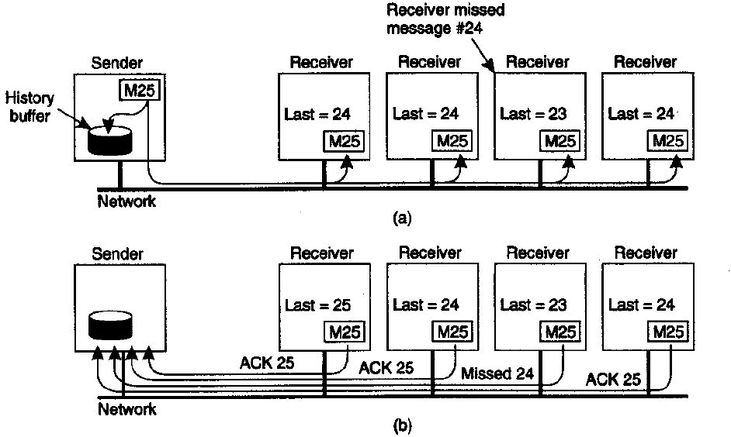
Basic Reliable-Multicasting Schemes (BRMS)
Assumption
Processes do not fail
Processes do not join or leave the group
However, with unreliable multicasting channels.
Assume messages are received in the order they are sent.
Retransmission choices:
Receiver send requesting msg to sender
Sender automatically retransmit msg within a certain time
Design trade-off: p-to-p retransmission, piggybacked ack
Notes:
Do not join or leave the group during the communication.

Slide 6
Scalability in Reliable Multicasting
Issues with BRMS
Sender needs to keep a history buffer
Until every receiver has returned ACK msg
Cannot support large numbers of receivers
Solutions:
Only return feedback when missing a msg

Slide 7
Nonhierarchical Feedback Control
Key: Reduce number of feedback msgs
feedback suppression
Features:
Never ack successful multicast msg
Report the miss of a msg (NACK)
Msg missing detection is left to the application
Assume retransmissions are always multicast to entire group

Slide 8
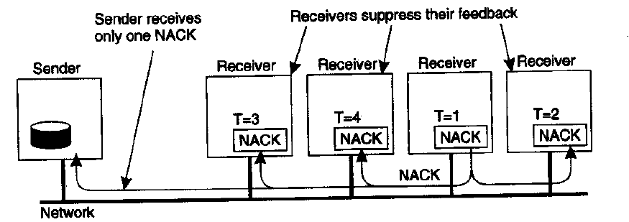
Nonhierarchical Feedback Control
The first retransmission request leads to the suppression of others.

Slide 9
Issues
Still need history buffer
May force the sender to keep a msg forever
Ensuring only one request for retransmission
accurate scheduling of feedback msg at each receiver
Across a wide-area network is not easy
Interruptions (NACK) to processes which have successfully received the msg
Solutions
Dynamically group the processes that have not received msg into a separate multicast group
Group processes that tend to miss the same messages in a new group (share the same multicast channel)
Notes:
These msgs are useless to them (THE NACK )
Dynamically group: need highly efficient manner.
Prediction of behavior: Processes tend to miss the same msgs are grouped together.

Slide 10
Hierarchical Feedback Control
Improve Scalability of SRM
Assistance from receivers
A hierarchical solution
Scale with large groups of receivers
Notes:
Receivers assist senders to retransmit msgs when it receives a NACK msg.

Slide 11
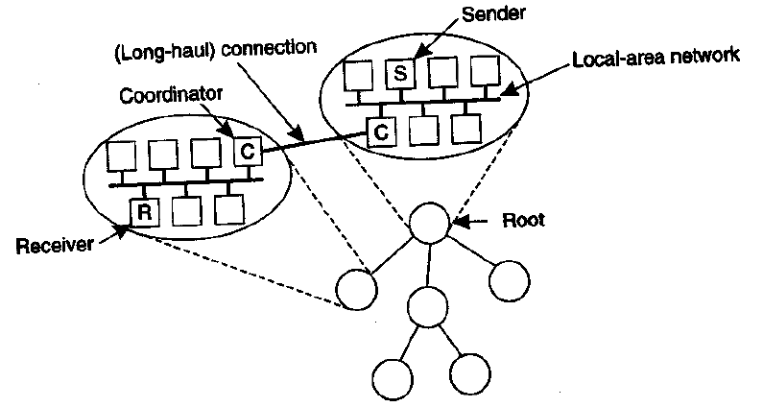
Hierarchical Feedback Control
Local coordinator has its own history buffer
MSG for coordinator
From coordinator of parent group
Problems
Need dynamic construction of the tree
Use underlying network structure

Slide 12
Reliable Multicasting
In the presence of process failure
A message is delivered to either all processes or to none at all.
Virtual Synchrony

Slide 13
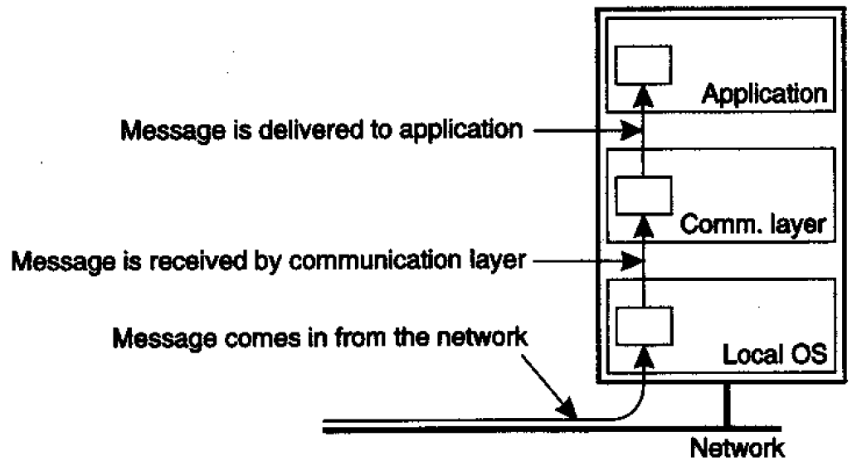
Virtual Synchrony
Communication Layer
Define process failures in terms of process groups and changes to group membership
Comm layer:
Send and receive msgs
Msgs locally buffered in comm. layer

Slide 14
Virtual Synchrony
Basic Definitions
Group view
The view when sender sent msg m
Each process has the same view
View change
Change in group membership
View change takes place by multicasting vc msg

Slide 15
Requirement
Two multicast msgs simultaneously in transit:
m and vc
Nothing or ALL: Guarantee m is either delivered to all processes in G before vc or m is not delivered at all
Requirement for reliable multicast protocol
Only one case in which m is allowed to fail:
Group membership change is due to the sender of m crashing

Slide 16
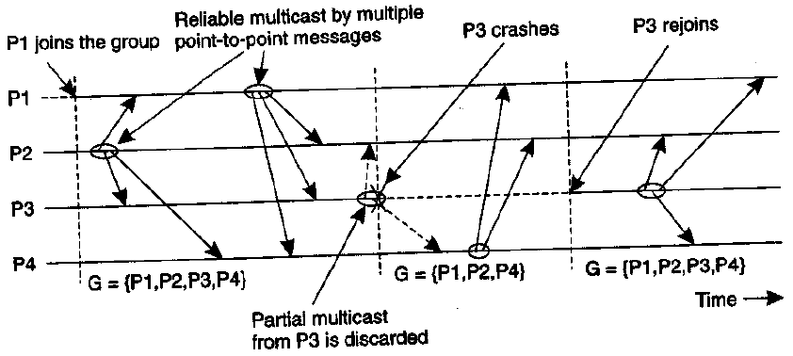
Virtually Synchronous
Sender crashes during the multicast, then the msg is either be delivered to all remaining processes or ignored by each of them.
A view change acts as a barrier across which no multicast can pass

Slide 17
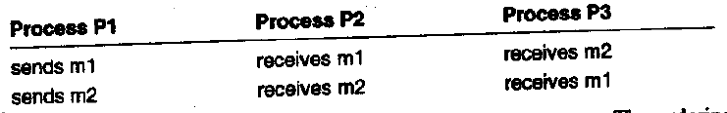
Message Ordering
Four different orderings
Unordered multicast, FIFI-ordered, Causally-ordered, Totally ordered
Unordered multicast

Slide 18
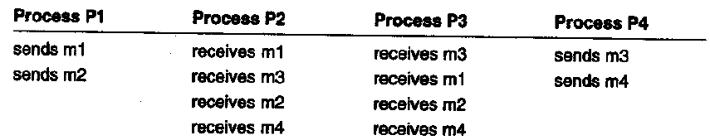
Message Ordering
FIFO-ordered multicast
Causally-ordered multicast
Causality between different msgs is preserved.
Implemented using vector timestamps

Slide 19
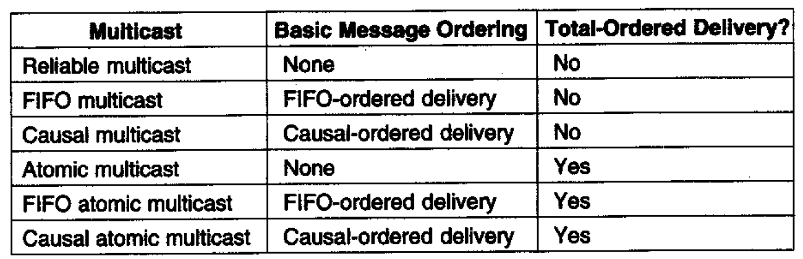
Different versions of virtual synchrony

Slide 20
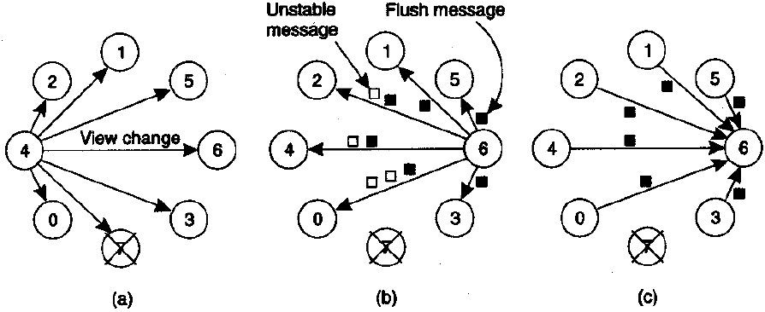
Implementation of Virtual Synchrony
Assume two views differ by at most one process
No process failure while a new view change is announced

Slide 21
Scalability Challenges
Large scale distributed system
Mundane transient problems
Both SRM and Virtual Synchrony have poor scalability
Notes:
When we talk about a group communication protocol, we hope it will work in a large scale distributed system. However, when the group size increases, the probability of randomized low-level perturbations like packet loss and scheduling delay will also increases. In the spinglass paper, this is called mundane transient problems. Following sildes will show that both SRM and virtual synchrony perform badly under the influence of mundane transient problems. For SRM protocol, it will suffer the request and retransmission storm. And the virtual synchrony protocol will have throughput instability, micro partition and convoy effects.

Slide 22
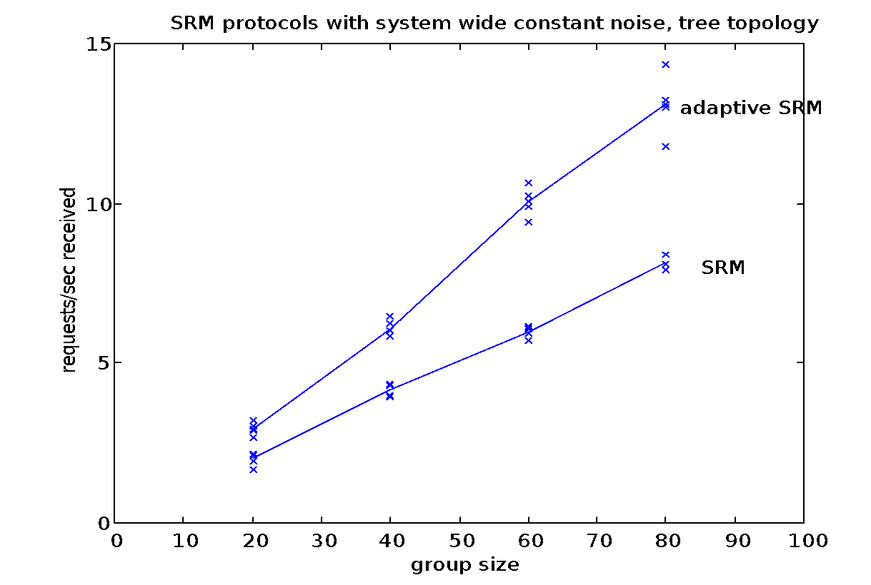
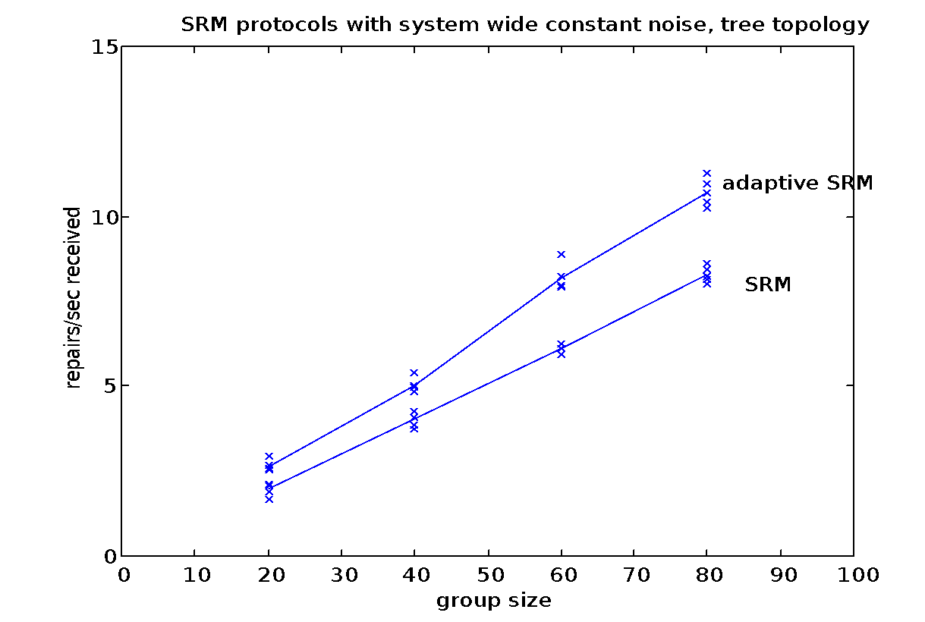
Scalability Challenges - SRM
Request and Retransmission Storm
Linear growth of overhead with system size, or even quadratic under worst cases
Notes:
Let’s first look at the request and retransmission storm of the SRM protocol.
Compared with virtual synchrony, which provides strong reliability guarantees, the receiver-driven best-effort SRM protocol has relatively weak reliability goals. Therefore it should scales well. However, studies shows that it is not the case.
Here is a experimental result of the SRM protocol with increasing group size. We can see that with larger group size, both the number of request and retransmission grows almost linearly. It’s showed in the paper that under certain scenarios, this overhead growth might be quadratic.

Slide 23
Scalability Challenges - Virtual Synchrony
Throughput instability
Performance decreases with higher perturbation rate and larger group size
250
Virtually synchronous Ensemble multicast protocols
group size: 32
group size: 64
32
group size: 96
200
150
average throughput on nonperturbed members
100
96
50
0
0
0.1
0.2
0.3
0.4
0.5
0.6
0.7
0.8
0.9
perturb rate
Notes:
For virtual synchrony protocol, we have throughput instability problem.
First focusing on the 32-member case, we can see that the throughput decreases as the perturbation rate increase, which is quite obvious because virtual synchrony model forces the sender to buffer the message and resend until all members have acknowledged the reception.
Comparing the throughput of different group size, we can see that with larger group size, the performance is more vulnerable to perturbations.

Slide 24
Scalability Challenges - Virtual Synchrony
Micropartition
To sustain stable throughput, failure detection is set aggressively
Healthy processes are frequently kicked out
Leave and rejoin are costly
Notes:
To solve the throughput instability problem, the system designer may set failure detection to be aggressive and hope the system will kicked out failure processes to sustain a stable throughput. However, due to the frequent perturbation in large scale system, healthy processes will be frequently mis-kicked out and request for rejoin. Because leave and rejoin are costly, these actions will yield high overhead.

Slide 25
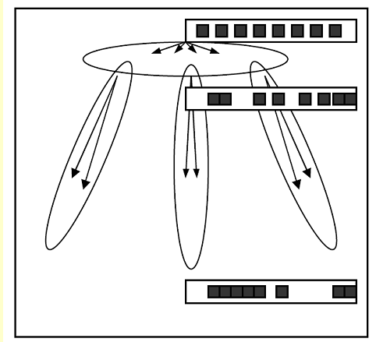
Scalability Challenges - Virtual Synchrony
Convoy
Transmission bursts in a tree-based system
Increasingly bursty layer by layer
Poor utilization of network bandwidth
Notes:
Another problem is the convoy effect. For example, in a tree-based system, due to some reasons, a message is lost and waiting for retransmission. Because of the FIFO order, subsequent messages will be delayed for further transmission, which will create a convoy. Once the missing message is received, the node will send all of these messages, creating a bursty transmission phenomenon, which will trigger flow control. The flow control will drop some packets, which in turn make things worse. This phenomenon will be increasingly worse layer by layer. The network bandwidth will be poorly utilized, resulting a bad performance.

Slide 26
Scalability Challenges
Goal
Guarantees of scalability, performance, stability of throughput even under stress, and even when a significant rate of packet loss is occurring.
Solution
Epidemic Protocol
Notes:
From these examples, we can see that both SRM and virtual synchrony cannot meet our requirement on scalability. Our goal for the group communication protocol in a large scale system is that…… The solution is the epidemic protocol.

Slide 27
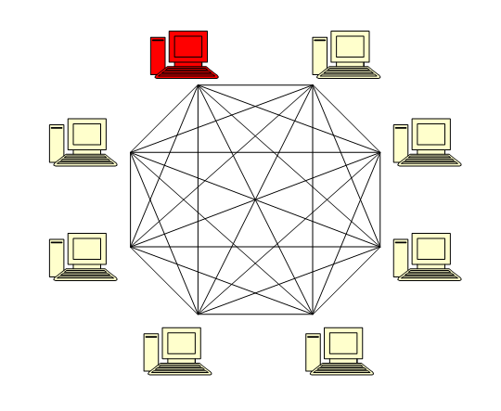
Epidemic Protocol
Analogy of epidemic or rumor spreading (gossip protocol)
Notes:
The epidemic protocol is analogy of epidemic or rumor spreading. So it’s also known as gossip protocol.
For group communication, the epidemic protocol can be showed as follows.
The red one is a infective node, and it will randomly infect another node.

Slide 28
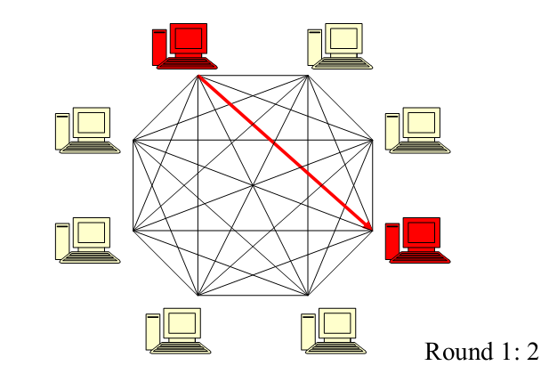
Epidemic Protocol
Analogy of epidemic or rumor spreading (gossip protocol)
Notes:
Now there two infective nodes and each of them will randomly choose another node to infect

Slide 29
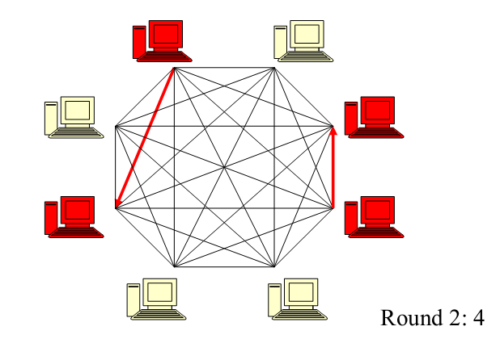
Epidemic Protocol
Analogy of epidemic or rumor spreading (gossip protocol)

Slide 30
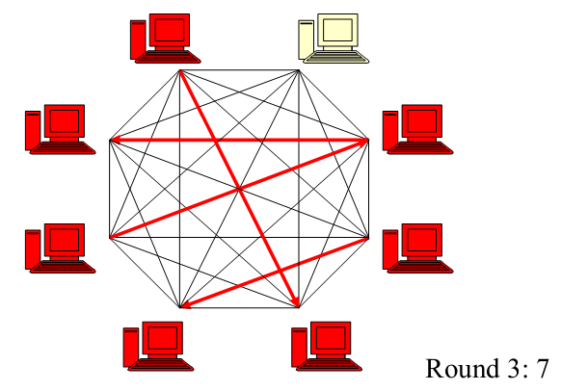
Epidemic Protocol
Analogy of epidemic or rumor spreading (gossip protocol)
Notes:
Eventually all the nodes in the system will be infected.

Slide 31
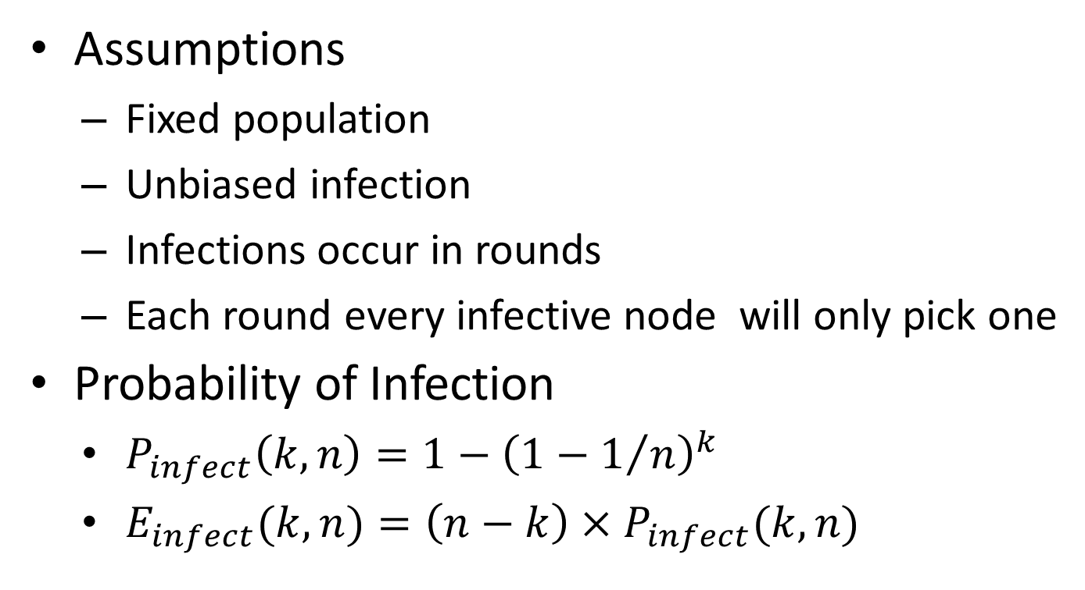
Epidemic Protocol
Assumptions
Fixed population
Unbiased infection
Infections occur in rounds
Each round every infective node will only pick one
Probability of Infection
$P_{infect}\left(k, n\right)=1−{\left(1−1/n\right)}^{k}$
$E_{infect}(k, n)=\left(n−k\right)×P_{infect}(k, n)$
Notes:
Now, we want to calculate the probability of infection. First, we have these three assumptions.

Slide 32
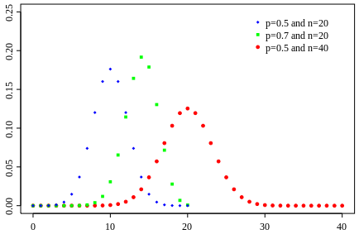
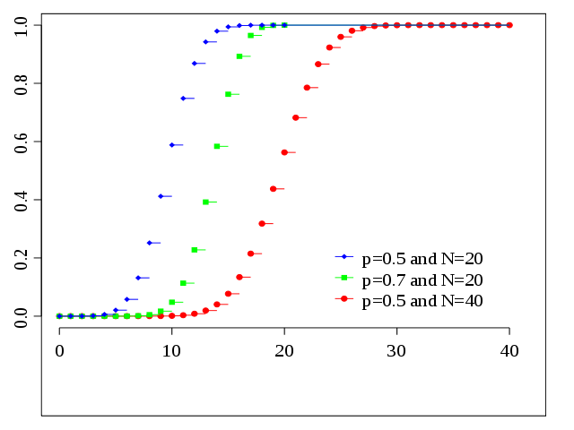
Epidemic Protocol
Binomial Distribution

Slide 33
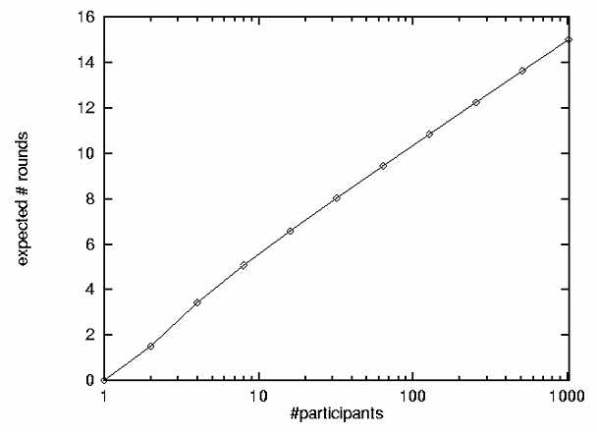
Epidemic Protocol
Propagation Time
Time to complete infection: O(log n)

Slide 34
Update Propagation Model
Anti-Entropy
Monotonicity
Order preservation
Implementation
Ordered update logs are maintained at each node
Each update is assigned with (timestamp, node id)
Compare incoming updates with the log and decide to merge / rollback and merge / discard
Notes:
We have a basic understanding of the propagation in the epidemic model. Now lets see the how epidemic model are implemented in group communication that is eh update propagation model. One popular update propagation model is anti-entropy. Entropy I think it’s a word from physics, meaning the disorder. Anti-entropy therefore means a order preservation property called monotonicity. In real life, a rumor can be heard twice from different persons. However, in communication system, we need monotonicity to ensure that no update are received and performed twice.
This is how we implemente the anti-entropy. It’s more like the consistency of distributed transactions.

Slide 35
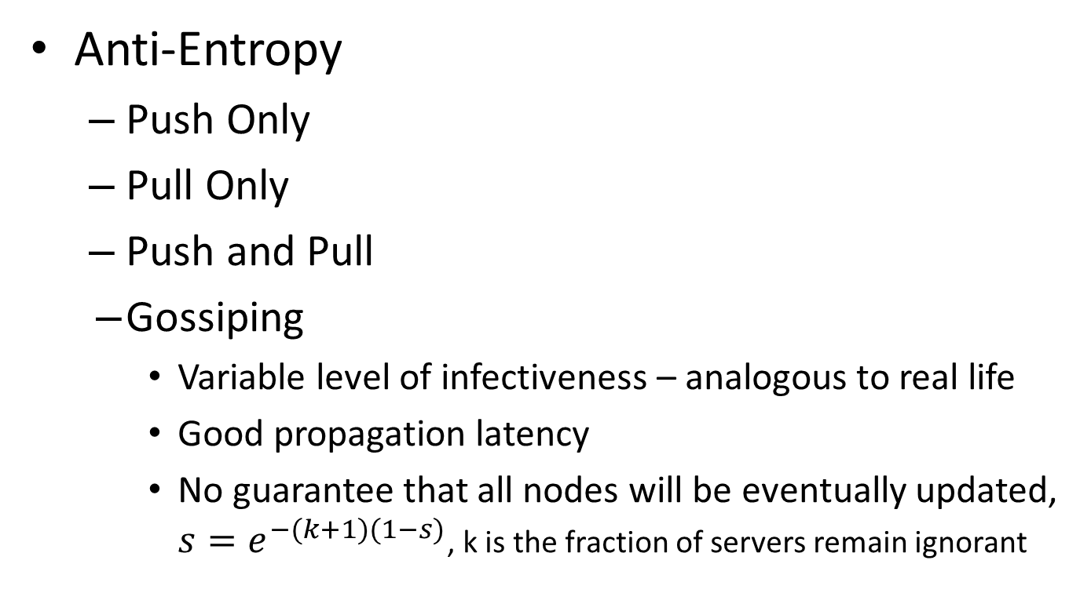
Update Propagation Model
Anti-Entropy
Push Only
Pull Only
Push and Pull
Gossiping
Variable level of infectiveness – analogous to real life
Good propagation latency
No guarantee that all nodes will be eventually updated, $s=e^{−(k+1)(1−s)}$, k is the fraction of servers remain ignorant
Notes:
There are several type of how updates are propagated between nodes. Push only approach starts quickly and ends slowly. On the contrary, the pull only approach starts slowly and ends quickly. Push only and pull only are expected to have the same number of round before update spreads to the entire group. Push and pull approach will decrease the number of rounds, but the overhead per round will increase.
Gossiping approach is analogous to real life. If one node P is just updated, it becomes more infective and will push the update to a randomly selected node Q. If P found that Q is already updated, P may lose the interest to further spreads the update. It has good propagation latency. But it provides no guarantee that all nodes will be eventually updated.

Slide 36
Optimization
Unreliable Multicast
Rapidly distribute messages with message loss (gap)
Gap Repairing
Processes periodically gossip to a random process to exchange digests of its current received messages and repair gaps
Notes:
From the previous slides, we can see that the large propagation latency is a issue to epidemic protocol. In the paper of spinglass, several optimization techniques are used to improve the epidemic protocol. First is the gap repairing techniques. To solve the slow propagation time issue, an unreliable multicast is used to rapidly distributed the messages to several nodes. There will definitely be packet loss. So the nodes will periodically gossip with a randomly selected node to exchange digests of current received messages. The node will compare its message with the digests and if messages misses, it pull the missing message or solicit the missing message and wait that message to be pushed.

Slide 37
Start by using unreliable multicast to rapidly distribute the message.

Slide 38
Periodically (e.g. every 100ms) each process sends a digest describing its state to a randomly selected group member.

Slide 39
Recipient checks the gossip digest against its own history and solicits any missing message from the process that sent the gossip

Slide 40
Processes respond to solicitations received and retransmit the requested message.

Slide 41
Optimization
Bounded Overhead of Gossiping
For a given process, amount of data retransmitted will be bounded and excess requests will be ignored
Hash scheme is used to spread the buffering load around the system
Notes:
The gap repairing in the previous slide is very costly. The gossip round may last much longer.
However, such scenario may be showed up in real system.
Therefore, we need to avoid sending too much gap repairing request, in other words, the overhead of gap repairing must be bounded.

Slide 42
Optimization
Hierarchical Gossip
The gossips are weighted so that nearby processes over low-latency links are preferred
Each node maintains a subset of full system membership
Increase the rate of gossip to compensate the increasing propagation delays
The weight of each node is adjusted to sustain constant load on routers

Slide 43
Scalability
Each gossip round = 1 message sent + 1 message received (with high probability) + retransmit a bounded amount of data
Loads between nodes are constant which means almost unlimited scalability
In reality, scalability is limited due to propagation latency and group membership tracking

Slide 44
Scalability

Slide 45
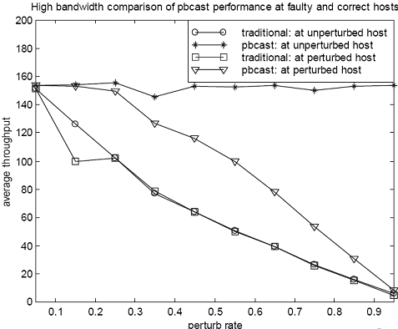
Scalability

Slide 46
Reliability
Tunable reliability
Replicate messages in the buffer across the system
Increasing reliability by increasing the time length before a message is garbage collected

Slide 47
Summary
SRM is a best-effort group communication protocol. Reliability is not guaranteed
Virtual synchrony is a reliable group communication protocol
Both SRM and virtual synchrony do not scale well
Gossip-based protocols can provide good scalability while providing probabilistic reliability guarantees

Slide 48
Reference
Bimodal multicast, Kenneth P. Birman, et.al.
Spinglass: Secure and Scalable Communication Tools for Mission-Critical Computing, Kenneth P. Birman, et.al.
Distributed Systems, Principles and Paradigms, Andrew S. Tanenbaum, et.al.

