Slide 1


PREVENTION OF SUICIDE IN OLDER ADULTS
Is There a Role for Technology?
Yeates Conwell, MD
Director, Office for Aging Research and Health Services
Director, Geriatric Psychiatry Program
University of Rochester Medical Center
Injury Control Research Center on Suicide Prevention: ICRC-S

Slide 2
OUTLINE
Demography of aging
Epidemiology of suicide in later life
Approaches to prevention
  Indicated
  Selective
  Universal
Strengths, limitations, and potential for technology solutions

Slide 3
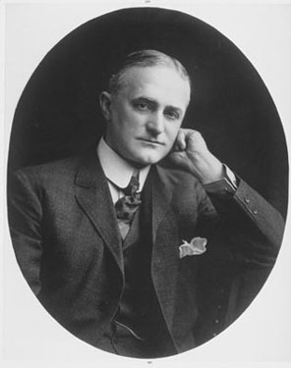
“My work is done. Why wait?”
George Eastman
March 14, 1932
Age 77

Slide 4
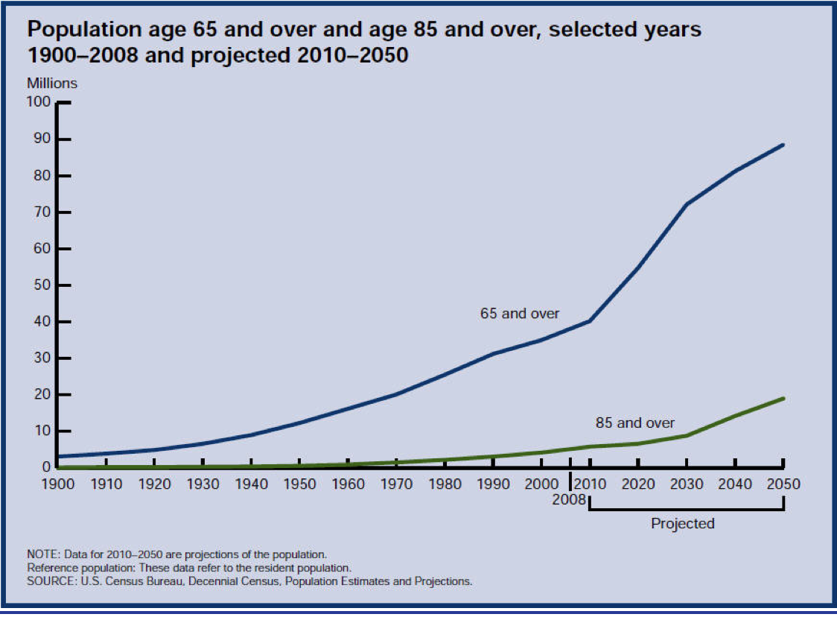

Slide 5
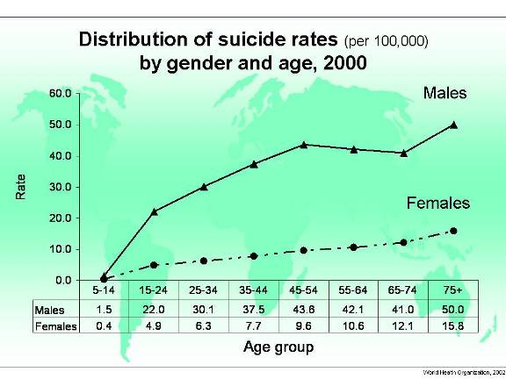
Worldwide Suicide Rates, WHO

Slide 6
Suicide Rate by Age, Sex, Race
U.S., 2010
Notes:
≥65 = 5960 of 15.6% of suicides

Slide 8
Significance
Older adults are the most rapidly growing segment of the population.
Older adults have higher rates of suicide than other segments of the population.
In successive cohorts the problem may be worse.
Suicidal behavior is more lethal in later life than at other points in the life course.

Slide 9
ATTEMPTED : COMPLETED SUICIDE
General population
Older adults
Deaths
Hospitalizations
Emergency
Dept visits
1
2
4
1
5
30

Slide 10
METHODS OF SUICIDE IN THE U.S.
Total
Age > 65

Slide 11
PSYCHOPATHOLOGY
PERSONALITY, COPING STYLE
SOCIAL CONTEXT
PHYSICAL HEALTH
FIREARM ACCESS
FUNCTIONING

Slide 12
RISK FACTORS FOR SUICIDE AMONG OLDER ADULTS
Depression – major depression, other
Prior suicide attempts
Co-morbid general medical conditions
Often with pain and role function decline
Social dependency or isolation
Family discord, losses
Personality inflexibility, rigid coping
Access to lethal means

Slide 13
PSYCHOPATHOLOGY
PERSONALITY, COPING STYLE
SOCIAL CONTEXT
Elderly man with rigid personality and chronic back pain
… and depressed.
PHYSICAL HEALTH
… isolated from social supports..
… becomes unable to work
FIREARM ACCESS
FUNCTIONING

Slide 14
PREVENTION FRAMEWORK
HOW DO WE PREVENT
SUICIDE IN ELDERS?
(Approaches to Prevention)

Slide 15
POPULATION DISTRIBUTION OF SUICIDE RISK
Mortality
threshold
Population
Low High
Suicide Risk
Modified from Crosby

Slide 16
Institute of Medicine Terminology:
“LEVELS” OF PREVENTIVE INTERVENTION
“Indicated” – symptomatic and ‘marked’ high risk individuals – interventions to prevent full-blown disorders or adverse outcomes.
“Selective” – high-risk groups, though not all members bear risks – prevention through reducing risks.
“Universal” – focused on the entire population as the target – prevention through reducing risk and enhancing health.

Slide 17
INDICATED APPROACH
Mortality
threshold
Identify and treat
high-risk individuals
Population
Low High
Suicide Risk
Modified from Crosby

Slide 18
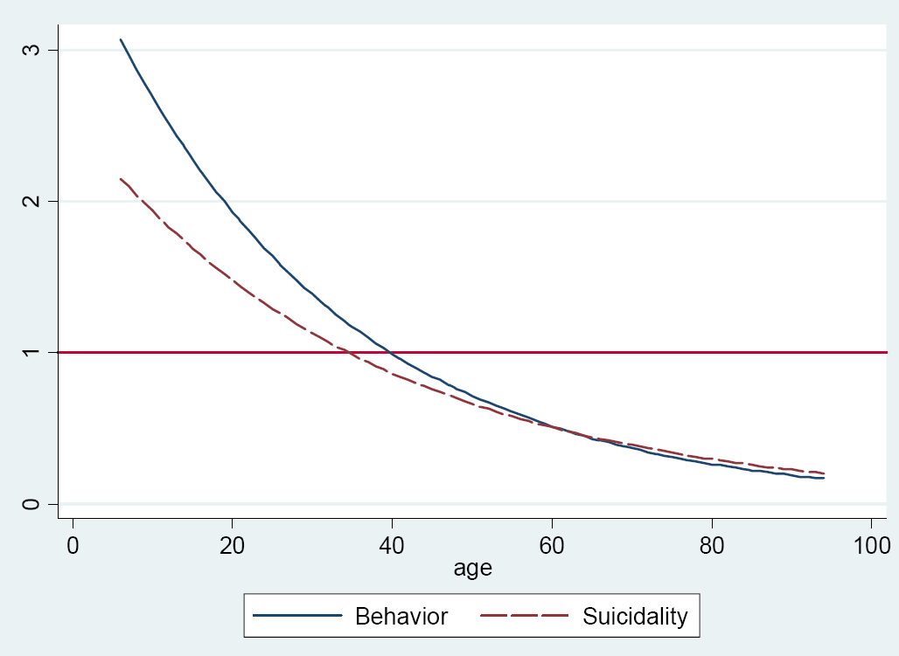
Odds Ratios for Suicidality and Suicidal Behavior for Active Antidepressant Relative to Placebo by Age
(Stone et al, BMJ 2009)

Slide 19
INDICATED PREVENTION
Objective: Detect (systematic screening) and aggressively treat depression in older adults – meds, psychotx.
Challenges: Treatments work, if you can get them to the pt and s/he will accept them.
Solutions?
  MH care delivery in primary care context
    Integrated care; decision support tools; EMR
    Telehealth – Computer-based therapies; remote assessment and treatment

Slide 20
SELECTIVE APPROACH
Mortality
threshold
Identify and treat
groups with high risk characteristics
Population
Low High
Suicide Risk
Modified from Crosby

Slide 21
Review of Social Factors in Late Life Suicide

Slide 22
Cumulative incidence of suicide by social integration category in the Health Professionals Follow-up Study
Men, ages 40 – 75 years
Tsai et al, Ann Intern Med. 2014;161:85-95.
Notes:
Design: Prospective cohort study initiated in 1988. Setting: United States.
Participants: 34 901 men aged 40 to 75 years. The Health Professionals Follow-up Study (HPFS) is an ongoing prospective cohort study of men in the United States who were aged 40 to 75 years when the study was initiated in 1986 (14). Women were not eligible for participation. dentists, optometrists, osteopathic physicians, pharmacists, podiatrists, and veterinarians
Measurements: Social integration was measured with a 7-item index that included marital status, social network size, frequency of contact, religious participation, and participation in other social groups. Vital status of study participants was ascertained through 1 February 2012. The primary outcome of interest was suicide mortality, defined as deaths classified with codes E950 to E959 from the International Classification of Diseases, Ninth Revision.
Results: Over 708 945 person-years of follow-up, there were 147 suicides. The incidence of suicide decreased with increasing social integration. In a multivariable Cox proportional hazards regression model, the relative hazard of suicide was lowest among participants in the highest (adjusted hazard ratio [AHR], 0.41 [95% CI, 0.24 to 0.69]) and second-highest (AHR, 0.52 [CI, 0.30 to 0.91]) categories of social integration. Three components (marital status, social network size, and religious service attendance) showed the strongest protective associations. Social integration was also inversely associated with all-cause and cardiovascular-related mortality, but accounting for competing causes of death did not substantively alter the findings.
Conclusion: Men who were socially well-integrated had a more than 2-fold reduced risk for suicide over 24 years of follow-up.

Slide 23
Cumulative incidence of suicide by social integration category in the Nurses’ Health Study
Women, ages 46 – 71 years
Tsai et al, JAMA Psychiatry. 2015;72(10):987-993.
Notes:
DESIGN: Nurses’ Health Study, an ongoing nationwide prospective cohort study of nurses in the United States. Beginning in 1992, a population-based sample of 72 607 nurses 46 to 71 years of age were surveyed about their social relationships. The vital status of study participants was ascertained through June 1, 2010.
EXPOSURES Social integration was measured with a 7-item index that included marital status, social network size, frequency of contact with social ties, and participation in religious or other social groups.
MAIN OUTCOMES: The primary outcome of interest was suicide,
RESULTS During more than1.2 million person-years of follow-up (1992-2010), there were 43 suicide events. The incidence of suicide decreased with increasing social integration. In a multivariable Cox proportional hazards regression model, the relative hazard of suicide was lowest among participants in the highest category of social integration (adjusted hazard ratio, 0.23 [95% CI, 0.09-0.58]) and second-highest category of social integration (adjusted hazard ratio, 0.26 [95% CI, 0.09-0.74]). Increasing or consistently high levels of social integration were associated with a lower risk of suicide.
These findings were robust to sensitivity analyses that accounted for poor mental health and serious physical illness.
CONCLUSIONS: Women who were socially well integrated had a more than 3-fold lower risk for suicide over 18 years of follow-up.

Slide 24
SELECTIVE PREVENTION
Objective: Reduce social isolation; increase fxnl independence, social connectedness, meaning in life
Challenges: Physical isolation (driving, ambulation, sensory impairment); reduced social network
Solutions?
  Social networking
  Other?

Slide 25
UNIVERSAL APPROACH
Mortality
threshold
Targets entire population regardless of risk status
Population
Low High
Suicide Risk
Modified from Alex Crosby

Slide 26
UNIVERSAL PREVENTION
Objectives: Reduce age-based bias (ageism); give older adults a contributing role in society; restrict access to firearms by vulnerable individuals.
Challenges: Deeply embedded social and cultural values and beliefs.
Solutions?
  Public service/education campaigns
  Legislation
  Other?

Slide 27
OPTIMAL SUICIDE PREVENTION =
Indicated
+
Selective
+
Universal
“MULTI-LAYERED SUICIDE PREVENTION”

Slide 28
Contact information:
Yeates Conwell, MD
University of Rochester Medical Center
300 Crittenden Boulevard
Rochester, NY 14642 USA
Yeates_Conwell@urmc.rochester.edu

Slide 29
EXAMPLES
http://www.touchstreamsolutions.com
Skype
http://vscm.selfhelp.net
Aging & Engaging
http://in2l.com
Your idea!

Slide 30
CHARACTERISTICS OF COMPLETED SUICIDE BY AGE
Conwell et al. AJGP 6:112-128, 1998

Slide 31
CHARACTERISTICS OF COMPLETED SUICIDE BY AGE
Conwell et al. AJGP 6:112-128, 1998

Slide 32
LETHALITY OF LATE LIFE SUICIDE
Older people are
  more frail (more likely to die)
  more isolated (less likely to be rescued)
  more planful and determined
Implying
  Interventions must be aggressive (indicated)
  More distal prevention is key (selective and universal)

Slide 33
THE RELATIONSHIP OF SOCIAL CONNECTEDNESS AND SUICIDE

Slide 34
Tele-Help/Tele-Check Service for the Elderly
Target: Social isolation, functional impairment
18,641 service users in Padua, Italy
January 1, 1988 thru December 31, 1998
Mean age = 80.0 years
84% women, 73% lived alone
Suicides observed = 6
expected = 20.9
Among women
DeLeo et al., Br J Psychiatry 181:226-229, 2002

Slide 35
THE SENIOR CONNECTION (TSC)

Slide 36
The Senior Connection (TSC)
U01 CE001942-01
OBJECTIVE: To examine whether linking socially disconnected seniors with peer supports is effective in reducing risk for suicide.
AIMS:
  Compare TSC vs. CAU on proximal (SI, DI) and distal (social connectedness) risk factors
  Test mediation.

Slide 37
The Senior Connection (TSC)
U01 CE001942-01
RCT DESIGN:
  Sample: 400 primary care pts ≥60 yrs who endorse feeling lonely or like a burden on others.
  Intervention: Peer companion trained and supervised by aging services network agency
  Control: Care as usual (no companion)
  Outcome measures:
    Depression, suicidal ideation, death ideation
    Structural and psychological connectedness

Slide 38
Brady Handgun Violence Prevention Act -- 1994
Ludwig & Cook, JAMA 2000
Nationwide requirement for waiting period and background checks for handgun sales in 1994
18 states previously met requirements = controls
32 states instituted new laws = intervention states
U.S. vital statistics, 1985-1997
Compared intervention and control states for changes in firearm homicide and suicide rates pre/post Brady
  controlling for population age, race, poverty and income levels, urban residence, and alcohol consumption

Slide 39
Differences in homicide and suicide trends from pre-Brady Act (1990-1993) and post-Brady Act (1994-1997) between treatment and controls states
Ludwig J. & Cook P.J.: JAMA. 2000;284(5):585-591
Notes:
For victims aged 21 years or older, none of the differences between the treatment and control states in any of the homicide or suicide measures are statistically significant at the traditional 95% level (Table 1).
On the other hand, firearm suicides to victims aged 55 years or older declined by 0.92 per 100,000 population (95% confidence interval [CI], −1.43 to −0.42) in the treatment states relative to the control states, equal to about 6% of the gun suicide rate to those aged 55 years or older in the control states during the period after the Brady legislation. We also observed a statistically insignificant increase in nongun suicides to this population (0.38 per 100,000; 95% CI, −0.04 to 0.80), a reduction in the proportion of suicides with a firearm of −2.2% (95% CI, −3.9 to −0.5), and a modest (though not statistically significant) reduction in the overall suicide rate (−0.54 per 100,000; 95% CI, −1.27 to 0.19).

Slide 40
RISK FACTOR: Psychiatric Dx in case/control studies of suicide in later life
ns = not significant

Slide 41
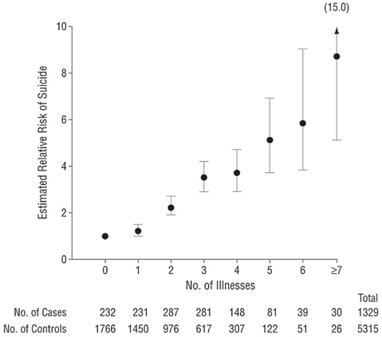
Medical Illness and Suicide Risk
Juurlink et al., Arch Intern Med 2004;164:1179-1184

Slide 42
FIREARMS IN THE HOME
Conwell et al. AJGP 10:407-416, 2002
P=.04
P=.02

