Slide 1

Digital Biomarkers
CSC 575: Intervention Strategies for Healthcare Applications
October 5, 2017

Slide 2
Acknowledgements
The Department of Neurology
Dr. Jamie Adams
Dr. Chris Tarolli
Dr. Ruth Schneider
The Department of Biostatistics and Computational Biology
Professor Ashkan Ertefaie
The Department of Computer Science
Professor Henry Kautz
Professor M. Ehsan Hoque
The Department of Electrical and Computer Engineering
Professor Gaurav Sharma
Karthik Dinesh

Slide 3
Outline
Rationale
Smartphones
Wearables
Future of digital biomarkers

Slide 4
Outline
Rationale
Smartphones
Wearables
Future of digital biomarkers

Slide 5
Digital biomarkers are objective measures of biology or health derived from digital devices
“…Imaging and genetics have revolutionized our understanding of health…Digital Biomarkers – objective, quantifiable measures of biology or health collected and measured through digital devices – can do the same.”
Source: Dorsey ER, A Digital Journal for a Digital Era. Digit Biomark 2017;1:1-3

Slide 6
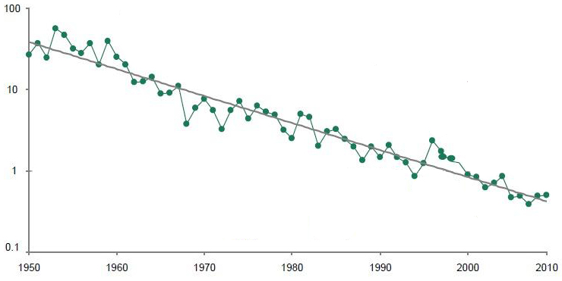

The productivity of the drug development industry continues to decline
New molecular entities per $1 billion in R&D (inflation adjusted), 1950-2010
NME/$1 billion
Source: http://www.forbes.com/sites/matthewherper/2011/06/27/the-decline-of-pharmaceutical-researchmeasured-in-new-drugs-and-dollars/

Slide 7

Our perspective of a patient’s illness experience remains episodic and limited to the clinic
Number of falls throughout day
Proportion of day spent sedentary
Number of words spoken
Speed of dialing the phone
Unified Parkinson’s Disease Rating Scale
Number of sleep interruptions
Unified Huntington’s Disease Rating Scale
Amyotrophic Lateral Sclerosis Functional Rating Scale
Duration of sleep
Alzheimer’s Disease Assessment Scale
Number
of turns
Timed Up and Go

Slide 8
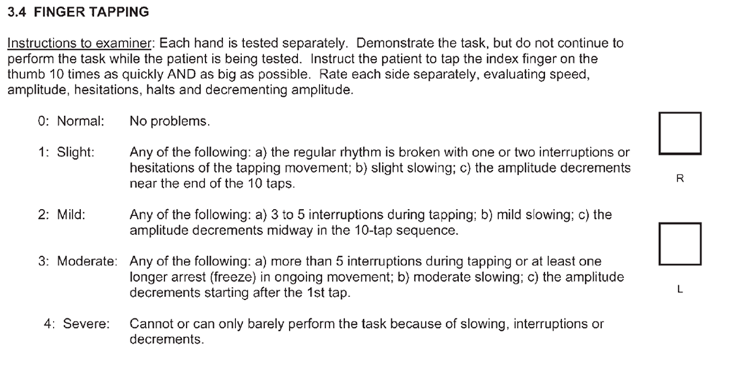
Many fields are limited by categorical, episodic, and subjective assessments …
Source: Movement Disorders Society. United Parkinson Disease Rating Scale, 2008

Slide 9
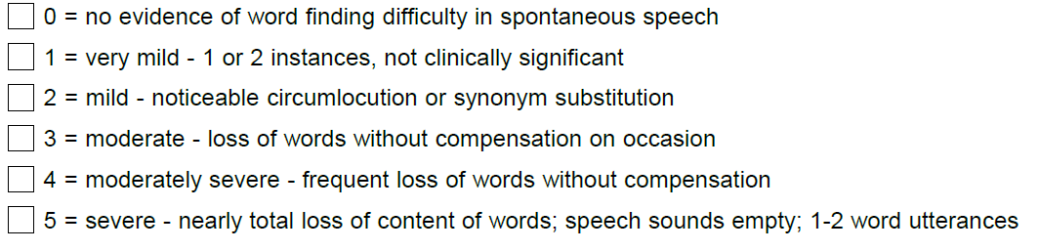
… including Alzheimer disease
Alzheimer’s Disease Assessment Scale – Cognitive subscale
Source: Alzheimer’s Disease Cooperative Study. Alzheimer’s Disease Assessment Scale – Cognitive subscale, 1992

Slide 10
These scales give false signals
Recent phase III trials in neurodegenerative disorders that failed to replicate phase II findings
Drug | Disease | Phase II Findings | Phase III Findings | N | Duration | Sponsor | Estimated Cost of Phase III
Solanezumab | Alzheimer disease | Alzheimer’s Disease Assessment Scale-Cognitive subscale score showed 1.9 points improvement over placebo for lowest dosage | Failed, unchanged Alzheimer’s Disease Assessment Scale-Cognitive subscale score | 2100 | 18 months | Eli Lilly | ~$600 million
Gammagard | Alzheimer disease | Alzheimer’s Disease Assessment Scale-Cognitive subscale score showed 5.4 points improvement over placebo | Failed, unchanged Alzheimer’s Disease Assessment Scale-Cognitive subscale score | 390 | 18 months | Baxter | ~$30 million
Coenzyme Q₁₀ | Parkinson disease | Total Unified Parkinson’s Disease Rating Scale score showed 1.2-5.3 points improvement over placebo | Failed, study terminated early due to futility | 600 | 16 months | National Institutes of Health | $14 million
Coenzyme Q₁₀ | Huntington disease | Total Functional Capacity score showed 0.34 improvement over placebo | Failed, study terminated early due to futility | 609 | 5 years | National Institutes of Health | ~$22 million
Creatine | Parkinson disease | Total Unified Parkinson’s Disease Rating Scale score showed 2.8 points improvement over placebo | Failed, study terminated early due to futility | 955 | 5 years | National Institutes of Health | ~$25 million
Dimebon | Huntington disease | Mini-Mental State Examination score showed 1.0 point improvement over placebo | Failed, no significant change compared to placebo | 403 | 6 months | Medivation | $5.6 million
Pridopidine | Huntington disease | Two previous studies using the Modified Motor Score showed 1.0-1.2 point improvement over placebo | Failed, no significant improvement | 400 | 6 months | Teva | ~$100 million
Source: The first frontier: digital biomarkers for neurodegenerative conditions. Digit Biomark 2017 doi.org/10.1159/000477383

Slide 11

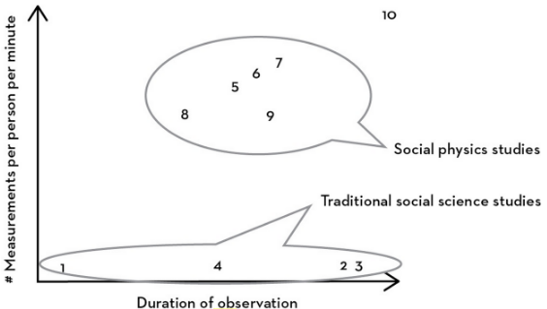
We need a new class of measurements that can provide objective, high frequency data
Social Physics
Current neurological trials
Framingham Heart Study
*
Modified from Pentland A. Social Physics: How Social Networks Can Make Us Smarter. New York, Penguin Books, 2015.

Slide 12
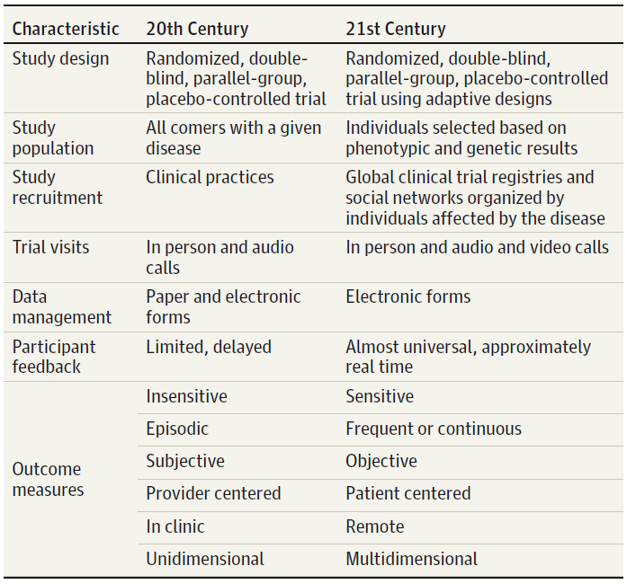
Future trials will incorporate new tools that transform clinical trials
Characteristics of 20th vs 21st century clinical trials
Source: JAMA Neurol. 2015 May;72(5):582-8.

Slide 13
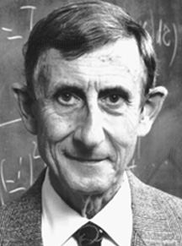
Scientific progress results from the development of new tools
Freeman Dyson (1997)
“New directions in science are launched by new tools much more often than by new concepts ... The effect of a tool-driven revolution is to discover new things that have to be explained.”
Imagined Worlds
Harvard University Press, Cambridge, MA

Slide 14
Outline
Rationale
Smartphones
Wearables
Future of digital biomarkers

Slide 15
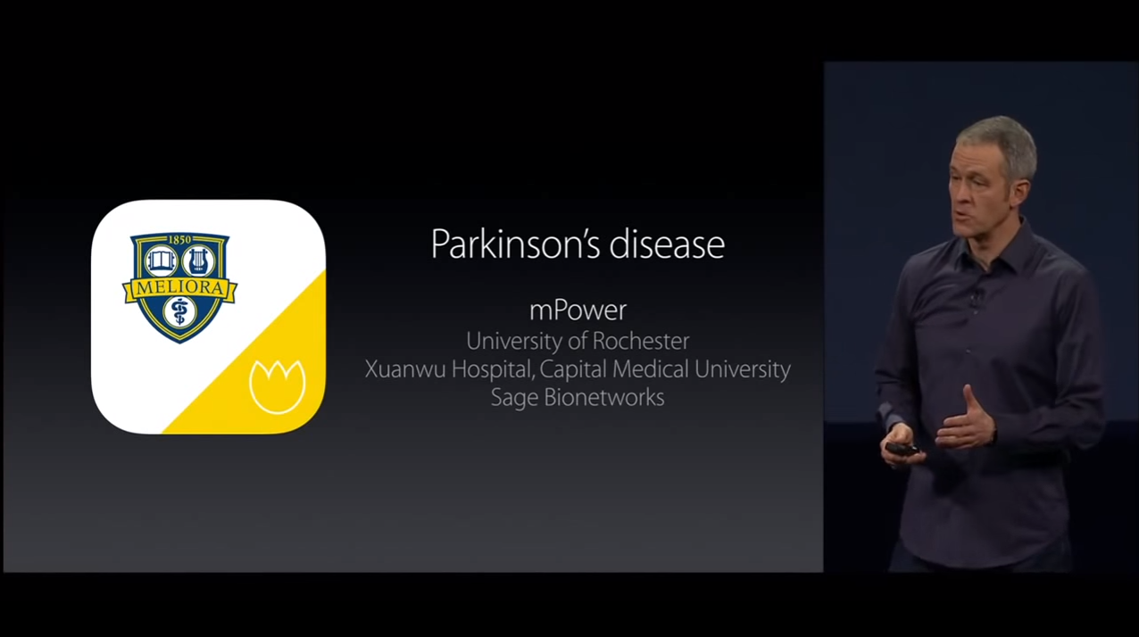
In 2015 Apple announced the release of smartphone applications for medical research
mPower smartphone application for Parkinson disease

Slide 16
Researchers are leveraging these apps to reach large populations
Condition | Name of the app (lead organization) | Participants enrolled as of 10/5/15 | Functionality of the application
Asthma | Asthma Health (Mount Sinai) | 7,770 | Surveys Electronic diary of symptoms and triggers Passive monitoring of activity and local air quality Medication reminders Educational information
Breast cancer | Share the Journey (Sage Bionetworks) | 2,508 | Surveys Randomization to daily expressive diary and exercise motivation Passive monitoring of movement, exercise and typing patterns Educational information
Cardiovascular disease | My Heart Counts (Stanford) | 44,841 | Surveys Passive monitoring of activity through phone or wearables Assessments of fitness and cardiovascular risk scores
Diabetes | GlucoSuccess (Massachusetts General Hospital) | 5,595 | Surveys on sleep, diabetes care, quality of life Blood glucose tracking Food logging Passive monitoring of physical activity
Parkinson disease | mPower (Sage Bionetworks) | 15,340 | Surveys Structured motor tasks Passive monitoring of activity and mobility
Source: Academic Medicine 2017;92:157-60

Slide 17
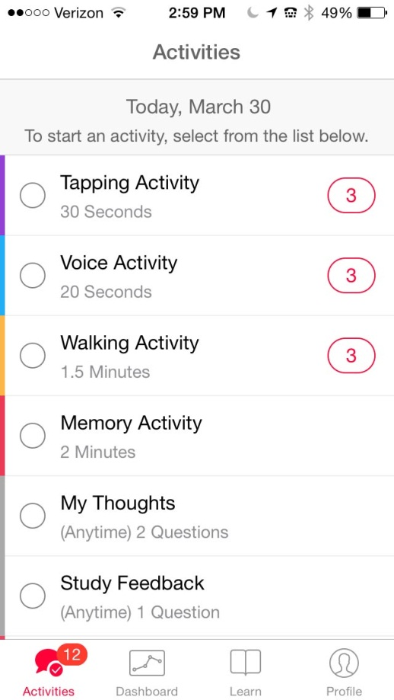
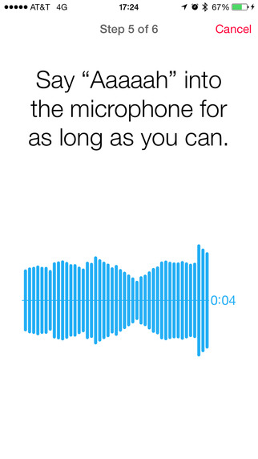
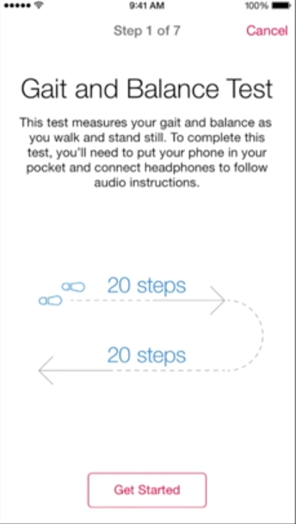
Smartphone research apps contain surveys, structured tests, and passive monitoring

Slide 18
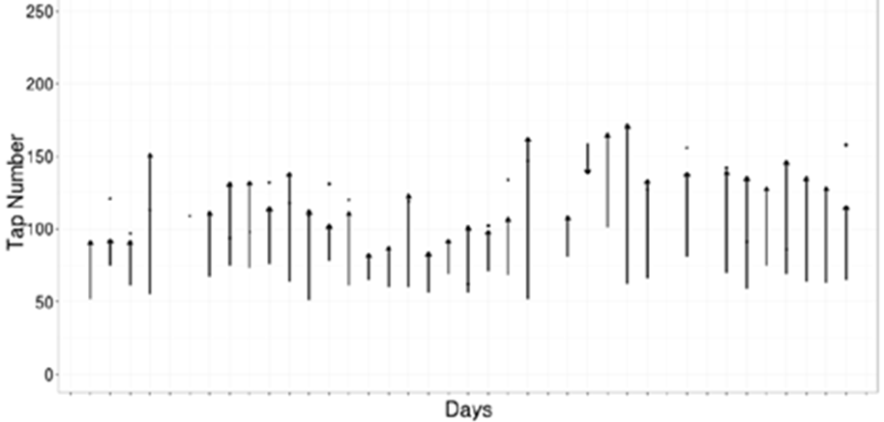
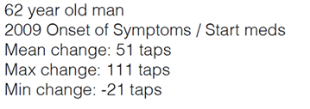
These apps can detect responses from medications
Tapping frequency in individual with Parkinson disease before and after medication
After levodopa
Before levodopa
Source: Sage Bionetworks

Slide 19
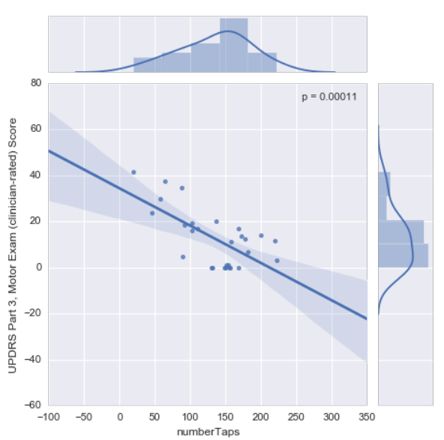
Early analyses suggest mPower tasks correlate with standard clinical assessments
Correlation between mPower’s finger tapping and MDS-UPDRS part 3 (motor) scores
MDS-UPDRS Part 3, motor exam score (clinician rated)
Number of taps

Slide 20

These applications can be incorporated into clinical trials …
Smart4SURE sub-study
Core aims
  To demonstrate feasibility of incorporating a smartphone research outcomes app in a phase 3 PD trial.
  To explore the changes obtained from smartphone sensors with the trial’s primary outcome measure (MDS-UPDRS).
  To explore the changes in motor and cognitive functions among individuals randomized to inosine versus placebo.
Smart4SURE press release
March 2017
BOSTON, MA -- Parkinson’s disease researchers at Massachusetts General Hospital (MGH) have launched an observational substudy designed to test the feasibility and accuracy of using patient-owned smartphones to measure symptoms of Parkinson’s disease. These efforts are part of a larger NIH-funded clinical trial, called a “Study of Urate Elevation in Parkinson’s Disease, Phase 3 (SURE-PD3),” which examines whether an oral medication called inosine can slow progression of Parkinson’s disease.

Slide 21
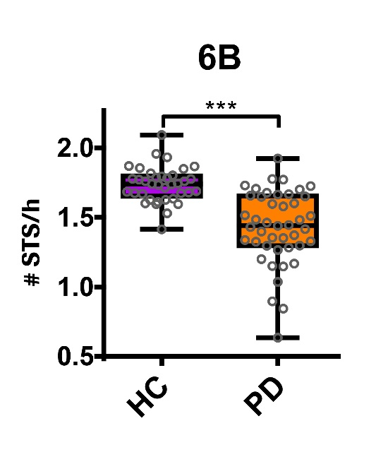
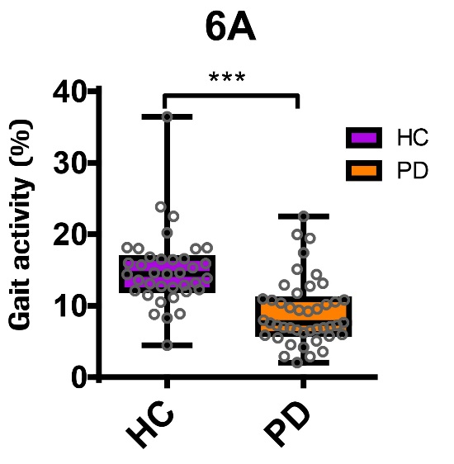
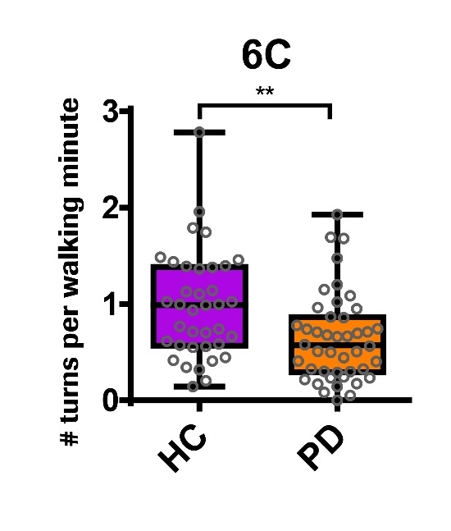
… and are being done so by pharmaceutical firms
Source: Lindemann et al., 2017

Slide 22
Despite the many benefits of health applications, they still face challenges
Limitation | Description | Solution
Selection bias | Most health applications and research studies are only available on iPhone | Make health applications available on Android devices using ResearchStack Over three quarters (77%) of Americans currently own smartphones
Retention | After initial interest in health applications interest and use wanes | Increase valuable feedback to participants Provide data relative to other participants Predict course of disease Increase engagement with healthcare team
Privacy | Study participants are concerned over the privacy of their health data | Disclose who has access to data Give study participants ability to choose who gets their data and for what purpose
Validation | Health applications need to be validated and their efficacy determined | Validate health applications in in-person observational studies Use in clinical trials for validation

Slide 23
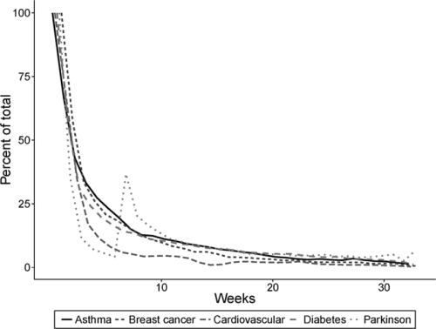
One of the main challenges for all mobile applications is retention
Active users of initial ResearchKit apps
Source: Academic Medicine 2017;92:157-60

Slide 24
Outline
Rationale
Smartphones
Wearables
Future of digital biomarkers

Slide 25
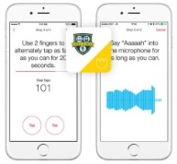
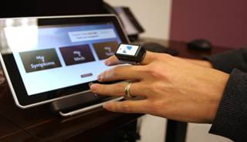

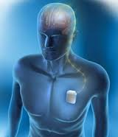
In addition to smartphones, other novel sensors can measure disease
Technology | Example | Benefits | Limitations
Portables |  | Readily accessible Continuous evaluation Multidimensional evaluation | Requires in-person validation Need smartphone Concern over privacy
Remote monitoring |  | FDA cleared device Perform high frequency evaluations in home | Limited to use in home Requires hardware Episodic evaluation
Wearables |  | FDA cleared device Well positioned to assess tremor | Provides narrow window of observation Requires person to wear it Limited functionality at present
Implantables |  | Opportunity for closed loop feedback Individualize care based on individual activity | Requires surgery Only applies to small proportion of patients
Sources: http://glneurotech.com/kinesia/products/homeview/, http://www.medtronic.com/patients/parkinsons-disease/therapy/, http://www.globalkineticscorporation.com/, http://parkinsonmpower.org/, http://www.ncbi.nlm.nih.gov/pubmed

Slide 26
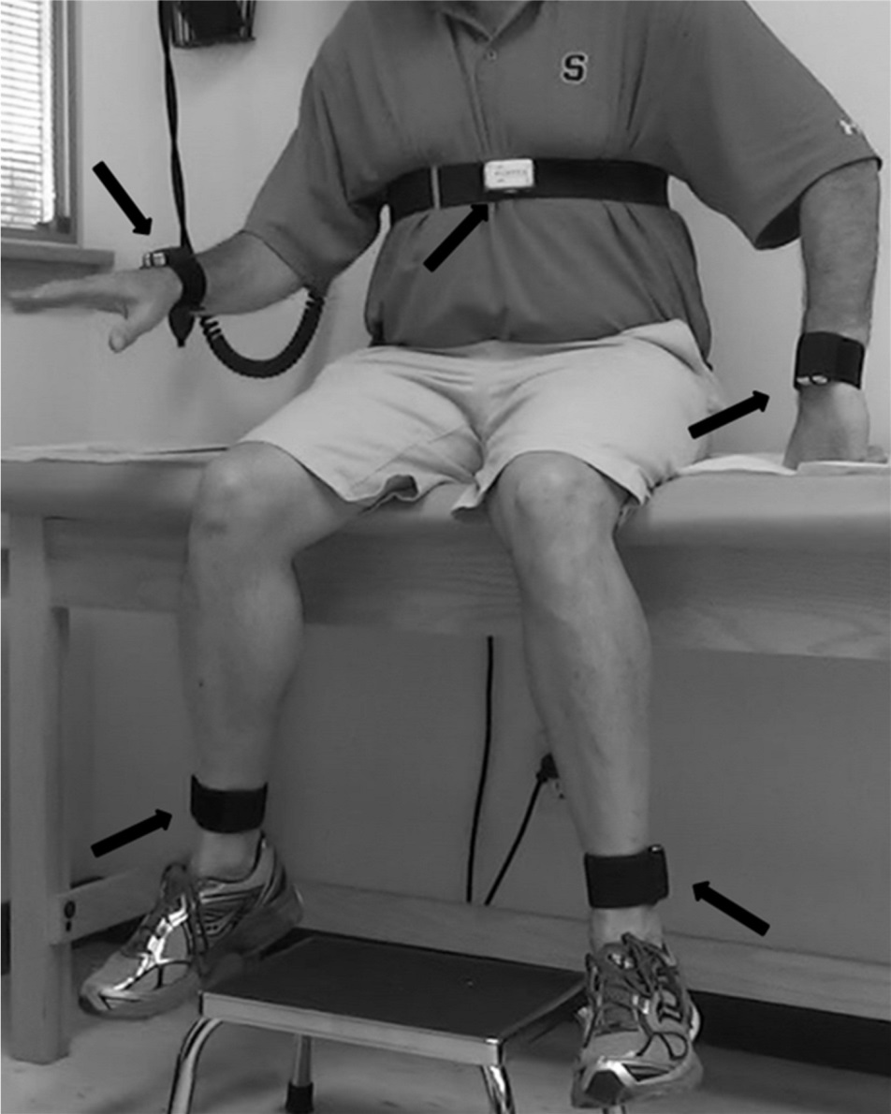
We conducted a pilot study of wearable sensors in Huntington disease
Pilot study
15 individuals with Huntington disease and five unaffected family members
Individuals wore five sensors (one for chest and one for each limb) in clinic and for one day at home
Wore chest sensor at home for an additional six days
Objective was to assess feasibility and ability to differentiate those with Huntington disease from controls
Sponsored by Auspex/Teva Pharmaceuticals; sensors from BioSensics
Source: Journal of Huntington’s Disease 2016;5:199-206

Slide 27
We found significant differences in gait in the clinic and more differences at home
Analysis of gait features during walking test in clinic and at home*
 | In Clinic |  |  | At Home
Feature | Control (n = 5) | HD (n = 15) | p-value | Control (n = 7812) | HD (n = 6987) | p-value
Step time standard deviation (seconds) | 0.03 ± 0.01 | 0.12 ± 0.04 | <0.0001* | 0.08 ± 0.05 | 0.13 ± 0.05 | <0.0001*
Maximum medial-lateral speed (meters/second) | 0.46 ± 0.08 | 0.59 ± 0.15 | 0.091 | 0.53 ± 0.22 | 0.66 ± 0.23 | <0.0001*
Average medial-lateral speed (meters/second) | 0.12 ± 0.02 | 0.18 ± 0.07 | 0.059 | 0.14 ± 0.05 | 0.19 ± 0.06 | <0.0001*
Maximum medial-lateral displacement (meters) | 0.14 ± 0.04 | 0.21 ± 0.11 | 0.179 | 0.22 ± 0.11 | 0.27 ± 0.13 | <0.0001*
Average medial-lateral displacement (meters) | 0.06 ± 0.03 | 0.09 ± 0.06 | 0.386 | 0.09 ± 0.06 | 0.11 ± 0.08 | <0.0001*
* Walking test was the Timed Up and Go test
Source: Journal of Huntington’s Disease 2016;5:199-206

Slide 28
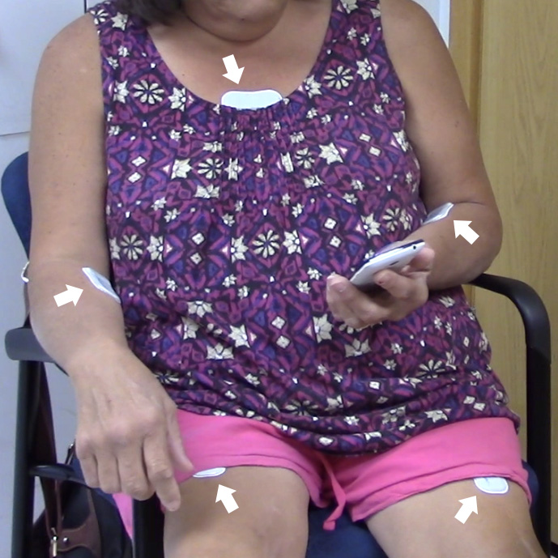
Recently we concluded a pilot study to evaluate wearable sensors for PD and HD.
MC10 BioStampRC
Sensor-MD Overview:
We enrolled 56 participants
  16 with Parkinson disease
  15 with Huntington disease
  5 with prodromal HD
  20 without a movement disorder
Participants wore 5 sensors on their chest and limbs
Aims of the study:
  Assess feasibility of data collection
  Compare sensor data to standard clinical assessments
  Develop algorithms to characterize abnormal movements
  Assess response to medication
  Detect and quantify previously unmeasured symptoms
Source: http://www.mc10inc.com/our-products/biostamprc

Slide 29
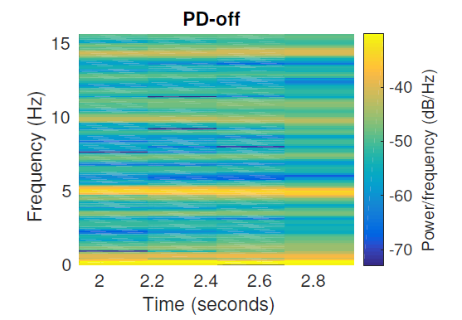
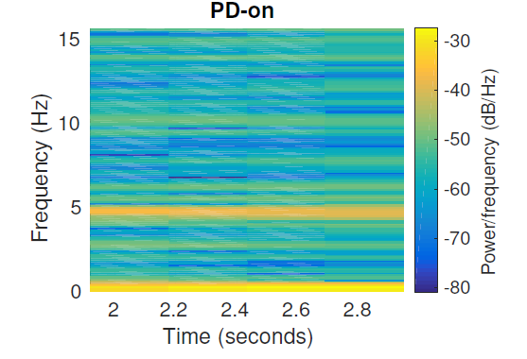
In addition, they can detect symptomatic changes due to medication
Preliminary
Spectrogram of energy distribution as a function of frequency for a PD participant with rest tremor
MDS-UPRDRS tremor score: 3
MDS-UPRDRS tremor score: 2
Source: Sensor-MD study

Slide 30
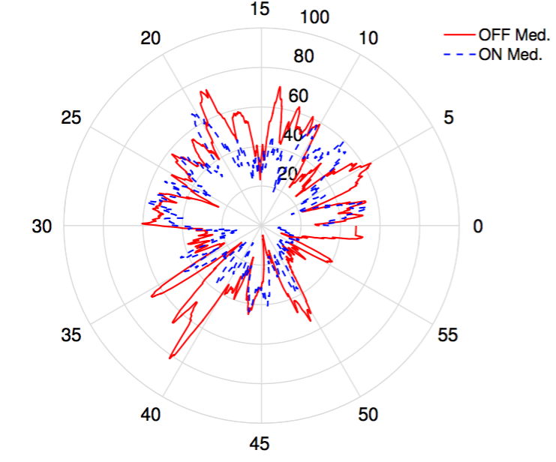
Not only can sensors track known motor symptoms over time…
Frequency and severity of tremor detected over one hour period
Preliminary
Source: Sensor-MD study (confidential)

Slide 31
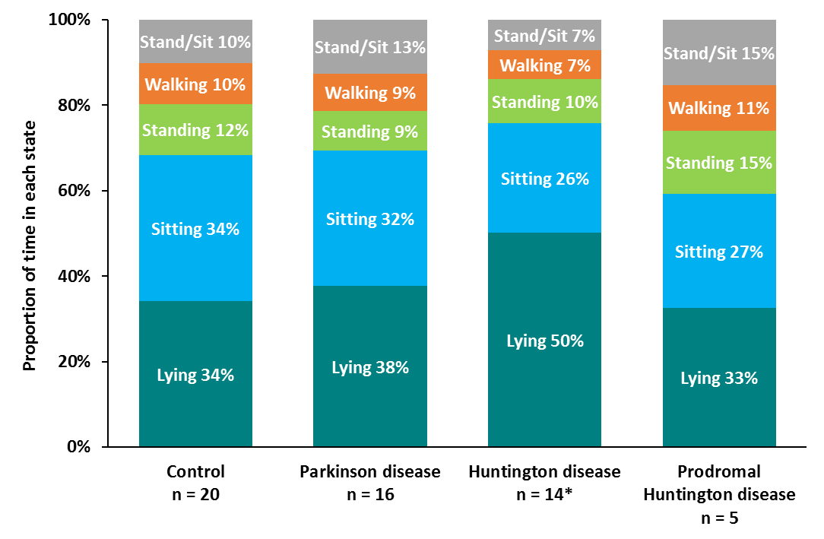
…they can also capture novel data objectively and continuously in clinic and at home
Preliminary
Proportion of day individuals spend lying down, sitting, standing, and walking

Slide 32
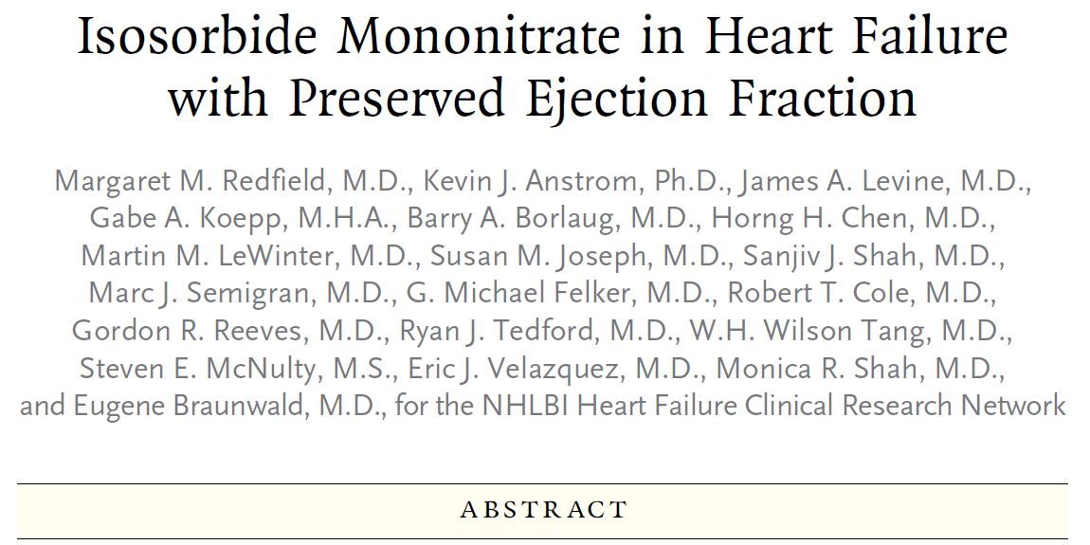
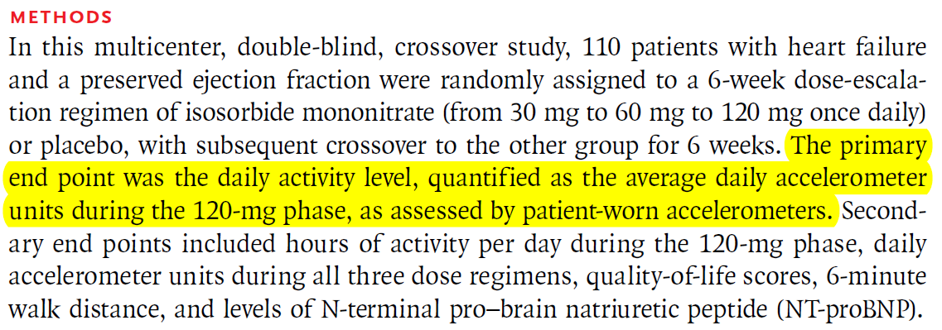
Novel objective measures are increasingly making their way into clinical trials
Accelerometers in a CHF trial
Source: New England Journal of Medicine 2015;373:2314-2324.

Slide 33
Outline
Rationale
Smartphones
Wearables
Future of digital biomarkers

Slide 34
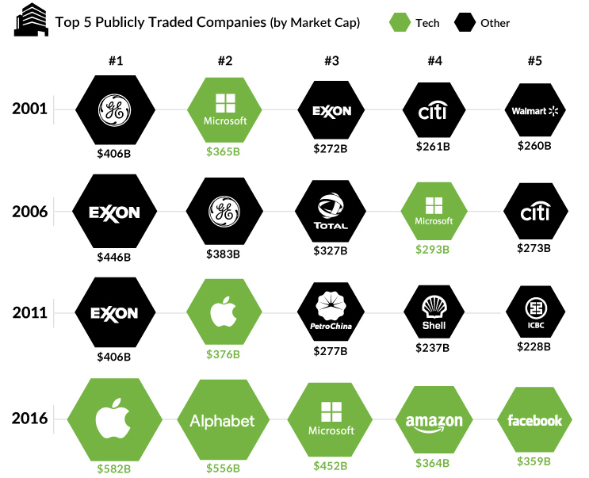
Technology will continue to re-shape the way we measure health
Top 5 largest companies by market capitalization, 2001 – 2016
Source: www.visualcapitalist.com

Slide 35
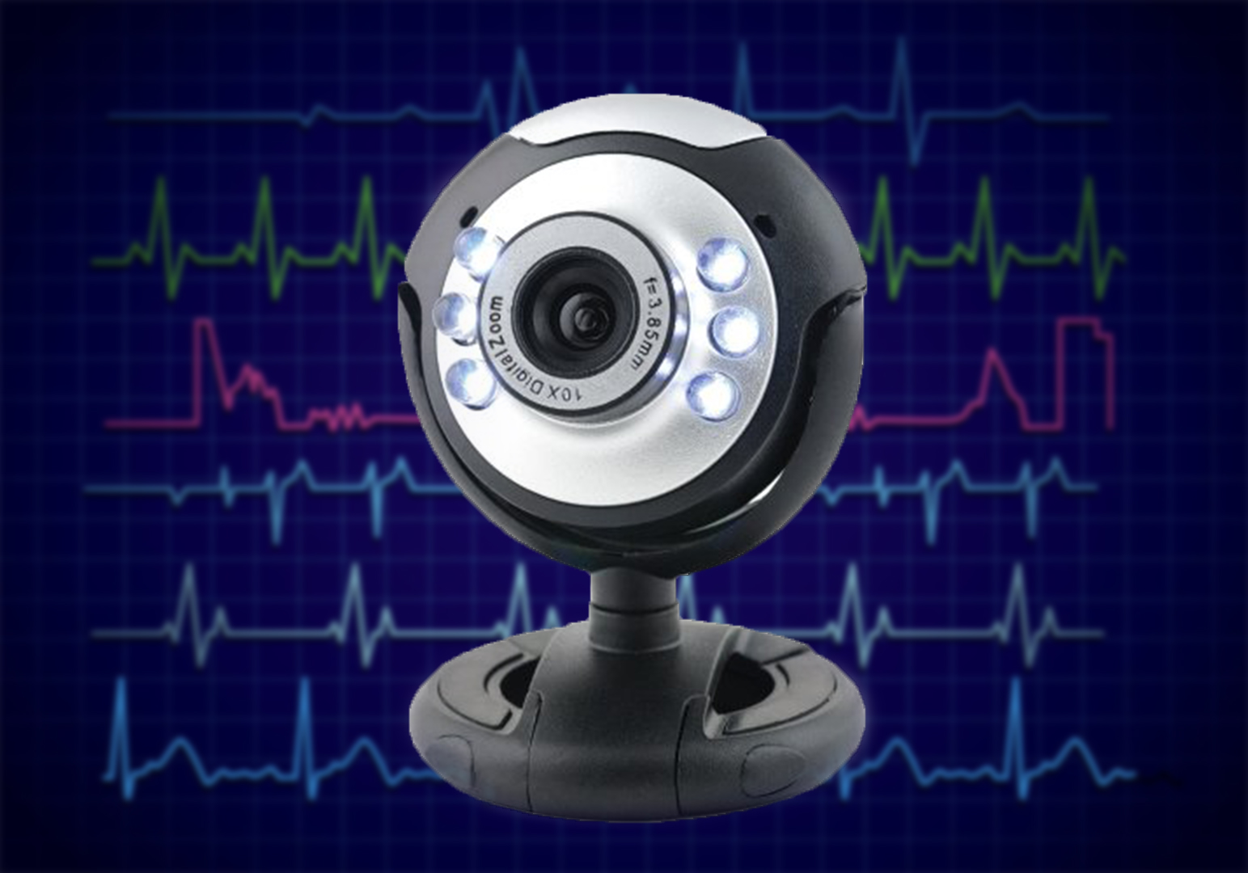
Detection of atrial fibrillation using contactless facial video monitoring
Source: Couderc et al. Heart Rhythm 2015;12(1):195-201

Slide 36
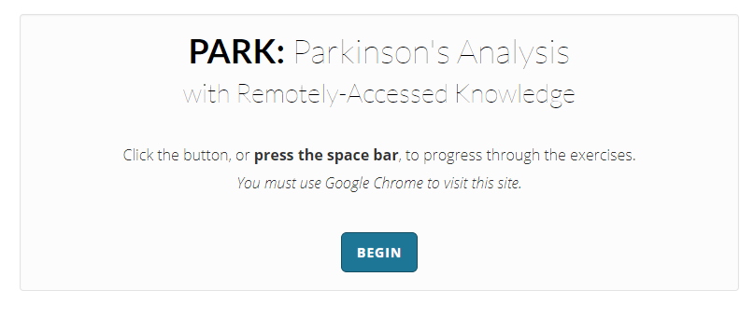
PARK performs automatic rating of PD through video analytics
Requires only webcam, microphone
and an internet connection.

Slide 37
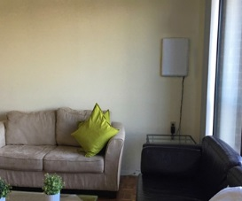
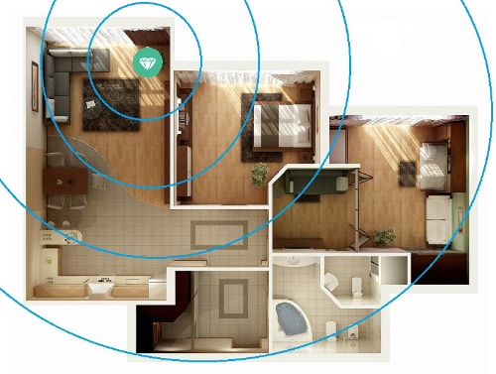
New research can use cellular waves to monitor gait and movement
Emerald
Sensor
Source: http://www.emeraldforhome.com/

Slide 38
This emerging field requires a new journal and a new community that we are creating

