Slide 1
The Spider – Machine Learning Toolbox for MATLAB
By S. Emre Eskimez

Slide 2
Installation
Download: http://people.kyb.tuebingen.mpg.de/spider/spider_jul2406.zip
Extract to any location you want.
Open MATLAB and navigate to folder that contains spider scripts.
You can use console or scripts at this folder. (Or add this folder to PATH and work on any folder.)
Type use_spider before using scripts.

Slide 3
Installation

Slide 4
Check if it works
Type:
X=rand(50)-0.5; Y=sign(sum(X,2)); r=train(svm,data(X,Y))
If there are no errors, you are good to go:

Slide 5
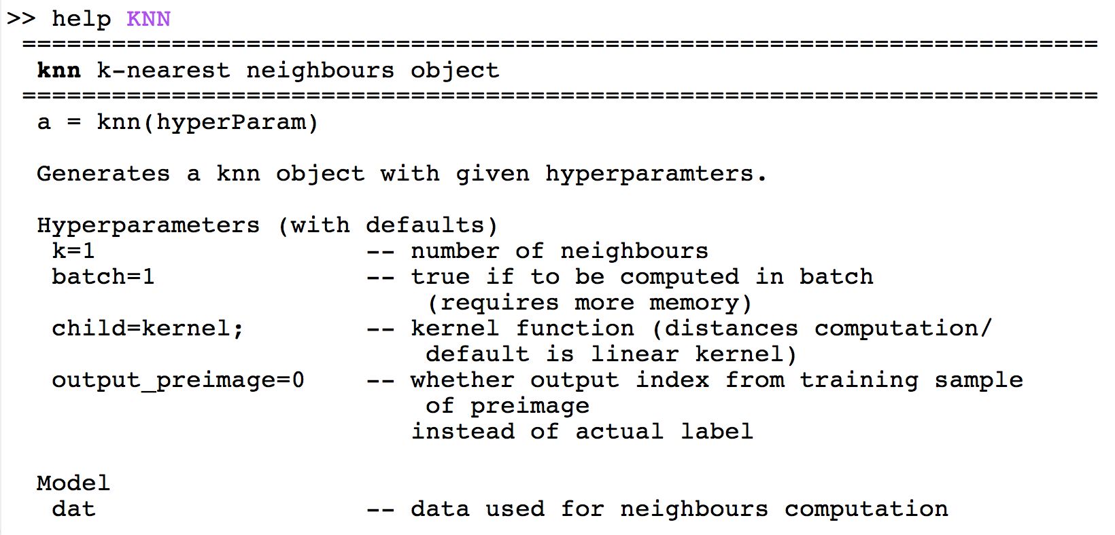
Getting help
If you want to know how scripts works (inputs, outputs), you can type help nameofscript

Slide 6
Getting help

Slide 7
Visit for more info
http://people.kyb.tuebingen.mpg.de/spider/

