Slide 1
Theano
Md. Iftekhar Tanveer
Rafayet Ali

Slide 2
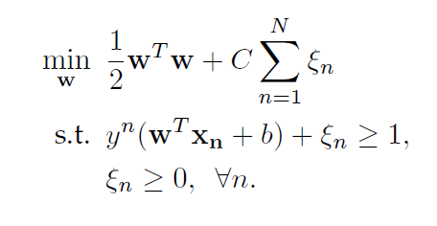
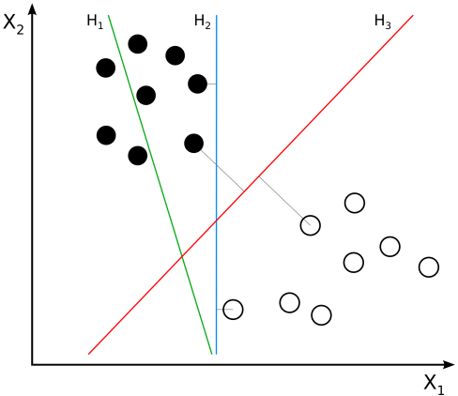
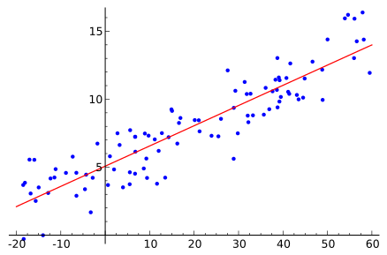
Why Theano?
Machine Learning is mostly about optimization
Support Vector Machine
min ||Y – wX - ε||²
^{w}
Linear Regression

Slide 3
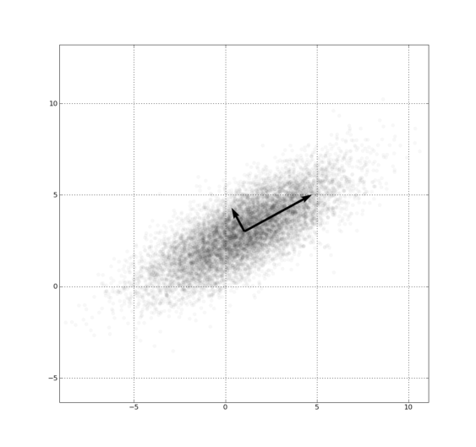
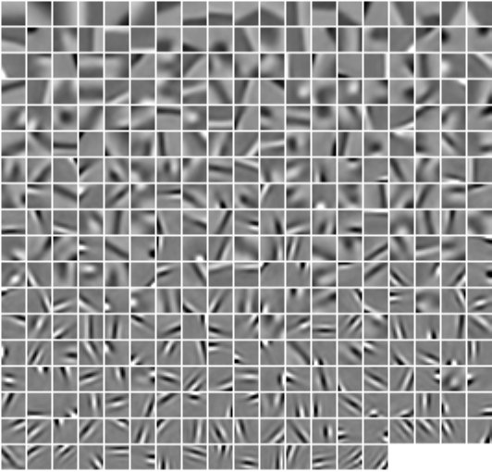
Why Theano?
w
Principal Component Analysis (PCA)
min
s. t.
Sparse Coding / Deep Learning

Slide 4
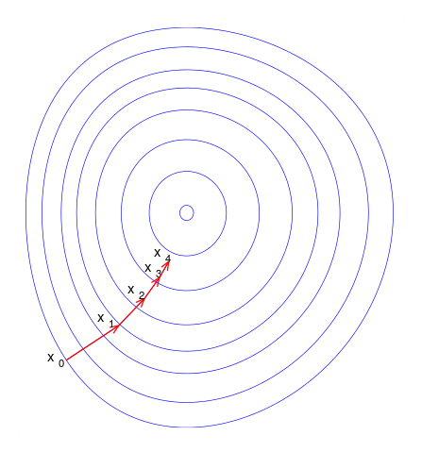
Why Theano?
A typical optimization algorithm – Gradient Descent
x'
f(x)
f '(x')
x ← x – γf'(x')

Slide 5
Why Theano?
Typically, the user needs to hand calculate the gradient of the objective function
Theano allows to calculate the gradients symbolically if you just provide the equation
L (w) = #$!!@()(@($%$w
Calculate the gradient Theano!!
#$!!@()(@($%$
Theano

Slide 6
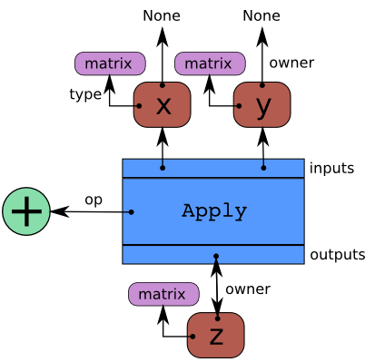
How It Works?
Given a symbolic equation, Theano creates a graph where nodes represent variables or operator and edges represents “operated on” relationships
Example:
x = T.dmatrix('x')
y = T.dmatrix('y')
z = x + y
Uses graph processing algorithms

Slide 7
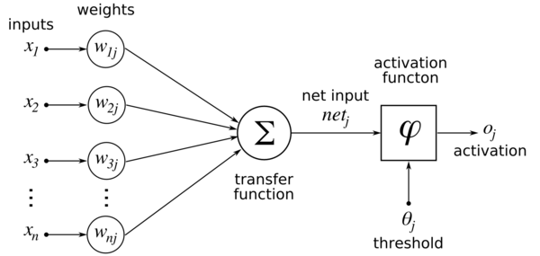
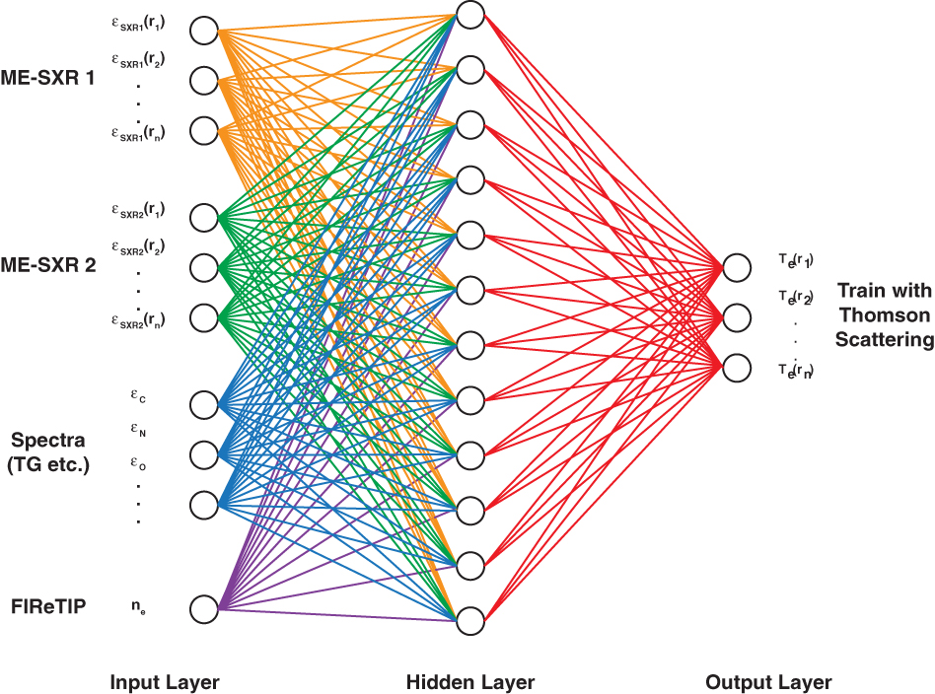
Applications/Where used?
Sparse Coding
Deep Learning
The optimization function becomes arbitrarily complicated based on the network and its connections.
Usually solved by backpropagation
Symbolic calculations make the calculation easier

Slide 8
Byproducts
Computations are done in one level higher, allowing better parallelization
Code is ready for GPU utilization
Dynamic C code generation
Speed and stability optimized
Data is interpreted – so there is room for “Just in Time (JIT)” optimization
Symbolic Computation Level
Theano
Numeric Computation Level

Slide 9
Example Time!

