Slide 1
By:
Raul Rodriguez
Walter Checefsky
(Added later)
http://orange.biolab.si/

Slide 2
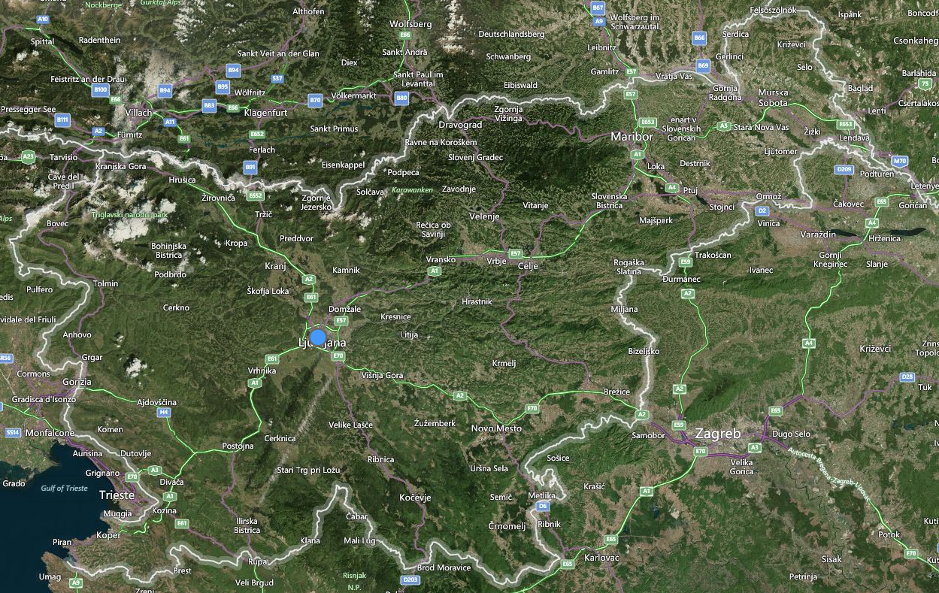
What is Orange?
Python based tool for data-mining, developed by the Bioinformatics laboratory of the faculty of Computer and Information Science at the University of Ljubljana in Slovenia.
Notes:
Orange started in 1996 as a C++ Machine Learning framework. Python Bindings were later developed and most major algorithms were added (in C++ or python).
In 2003 PyQt was used make a cool GUI. By 2009 over 100 widgets had been created and maintained. Major GUI redesign in 2013.
In the Journal of Machine Learning Research 14 (2013). http://eprints.fri.uni-lj.si/2267/1/2013-Demsar-Orange-JMLR.pdf

Slide 3
Why does Bioinformatics need this?
Learn about the interaction of different genes
Discover different methods of gene expression
Learn the structure of proteins
Find probable regions of protein encoding
Notes:
Systematic pairwise deletion of genes or inhibition of gene expression can be used to identify genes with related function, even if they do not interact physically. Epistasis refers to the fact that effects for two different gene knockouts may not be additive; that is, the phenotype that results when two genes are inhibited may be different from the sum of the effects of single knockouts.
SAGE (serial analysis of gene expression) is an alternate method of gene expression analysis based on RNA sequencing rather than hybridization. SAGE relies on the sequencing of 10–17 base pair tags which are unique to each gene. These tags are produced from poly-A mRNA and ligated end-to-end before sequencing. SAGE gives an unbiased measurement of the number of transcripts per cell, since it does not depend on prior knowledge of what transcripts to study (as microarrays do)
Gene function can be investigated by systematically “knocking out” genes one by one. This is done by either deletion or disruption of function (such as by insertional mutagenesis) and the resulting organisms are screened for phenotypes that provide clues to the function of the disrupted gene.
Putative genes can be identified by scanning a genome for regions likely to encode proteins, based on characteristics such as long open reading frames, transcriptional initiation sequences, and polyadenylation sites. A sequence identified as a putative gene must be confirmed by further evidence, such as similarity to cDNA or EST sequences from the same organism, similarity of the predicted protein sequence to known proteins, association with promoter sequences, or evidence that mutating the sequence produces an observable phenotype

Slide 4
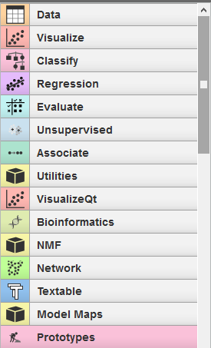
What’s it do?
Mainly well known for its Graphical User Interface (GUI)
You can script in Python too
Notes:
Data management and preprocessing:
for data input and output, data filtering and sampling, imputation, feature manipulation (discretization, continuization, normalization, scaling and scoring), and feature selection
Visualization:
Distributions, Scatter plots, Sieve Diagram
Classification:
with implementations of various supervised machine learning algorithms (trees, forests, instance-based and Bayesian approaches, rule induction), borrowing from some well-known external libraries such as LIBSVM
Regression:
including linear and lasso regression, partial least square regression, regression trees and forests, and multivariate regression splines
Evaluation:
with cross-validation and other sampling-based procedures, functions for scoring the quality of prediction methods, and procedures for reliability estimation
Evaluate:
Confusion matrix, ROC analysis, test learners, predictions
Associate:
Association rules
Unsupervised:
Clustering stuff
VisualizQT: visualize build with the python QT library!
Bioinformatics: get data from databases, different methods of gene expression analysis
NMF: Non-Negative Matrix Factorization,
Network: do network analysis… graphs, gross!
Textable: Deal with text data
Model Map: Make a map of a model
Prototypes: Looks like SQL stuff

Slide 5
Which algorithms can it use?
Decision trees (ID3, C4.5, CART)
Naïve Bayes
Instance Based Learning (kNN, ML-kNN)
Function Based Learning (regression analysis(log,lin,lasso,PLS,trees,mean), ANN, SVM(libSVM,liblinear))
Ensemble Learning (bagging, AdaBoost, random forest)
Hierarchical clustering (linkage-based)
Partition Based Clustering (k-means, partition around medoids, fuzzy-c-means)
ANN based clustering(self-organizing)
Association Rules(Apriori(sparse, attr.-value)), apriori-SD)
Notes:
Decision Tree: class-labeled training tuples. A flow-chart like structure, where each internal (non-leaf) node denotes a test on an attribute, each branch represents the outcome of a test, and each leaf holds a class label.
ID3: Calculate entropy of every attribute using data set S, Split S into subsets where ENTROPY is minimum, make a decision tree node containing that attribute, recur on subsets w/ remaining attributes.
C4.5: Similar to ID3. At each node, it chooses the attribute of the data that most effectively splits its set using INFORMATION GAIN (difference in entropy)
CART (classification and regression trees):
Naïve Bayes: Compute the prior probabilities (what kinda fruit is is? [Banana/Orange/Other]); Probability of evidence (prob of the features[Long/Sweet/Yellow]); Prob of Likelihood (if long, is banana?); Given an unknown with features: long, sweet, and yellow, is banana? (Mult. All 3 Prob of likelihood times prob banana) divide by (mult. Prob of evidence [long/sweet/yellow]) Treat events as independent ☺
kNN: if you had a graph of red and green dots, and wanted to find out where a new dot would be, you find out what color it’s nearest neighbors are. It’s probably that color.
ML-kNN: kNN first found, then using statistical info (# neighbors belonging to a particular class) Maximum a posteriori used to determine label
Regression Analysis: curve fitting stuff, PLS (Partial Least Squares). Lots of ind. X to lots of dep. Y; Lasso, Increasing penalty of non-relevant feature will eventually discard them (unlike ridge, where the feature stick around at low values); Regression Trees.
Bagging: running the trainer on new generated subsets randomly sampled from the data with replacement. The models from each training set are then combined by averaging(regression) or voting(classification)
AdaBoost: Output of learners are combined in a weighted sum. Weak learners are subsequently tweaked in favor of those instances misclassified by previous classifiers.
Random Forest: Made of many decision trees… “lol” “Like Bagging, but with feature bagging”
Linkage-based (Hierarchical clustering): construct nested partitions layer by layer via grouping objects into a tree of clusters. Agglomerative (bottom-up): individual clusters, slowly build up Divisive (top-down): Start with big cluster, slowly break down.
ANN: use nodes of adaptive weight neurons to try to approximate the non-linear functions of the imputs. Pertend to be real neurons
SVM: finding the optimal Hyper plane for separating data.
Clustering: grouping together sets of data that are around each other. K-means: cluster using mean, Medoid: use medoid, fuzzy c means: every datapoint belongs to every data set to a certain extent, with each iteration, it gets higher/lower degree of belonging
ANN based clustering: Used artificial neural networks to determine the clusters.
Association rules: Apriori: identify the frequent individual items in the database and extending them to larger and larger item sets as long as those item sets appear sufficiently in the database.

Slide 6
Type of input?
Tab delimited file
Top row is: Features
Type of data
Meta information to describe features
Data

Slide 7
Example Time!

Slide 8
Why isn’t it perfect?
No Spatial Data Analysis
No Time Series Analysis
No Parallelization
Only Naïve Bayes in the Bayes family
Less algorithm options than other frameworks
Locks you into python

