Slide 1
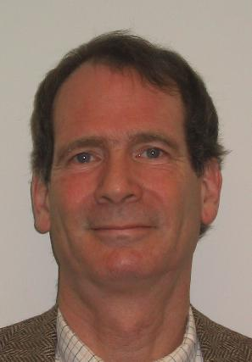
Chris Brown
Through the years with students and friends

Slide 2
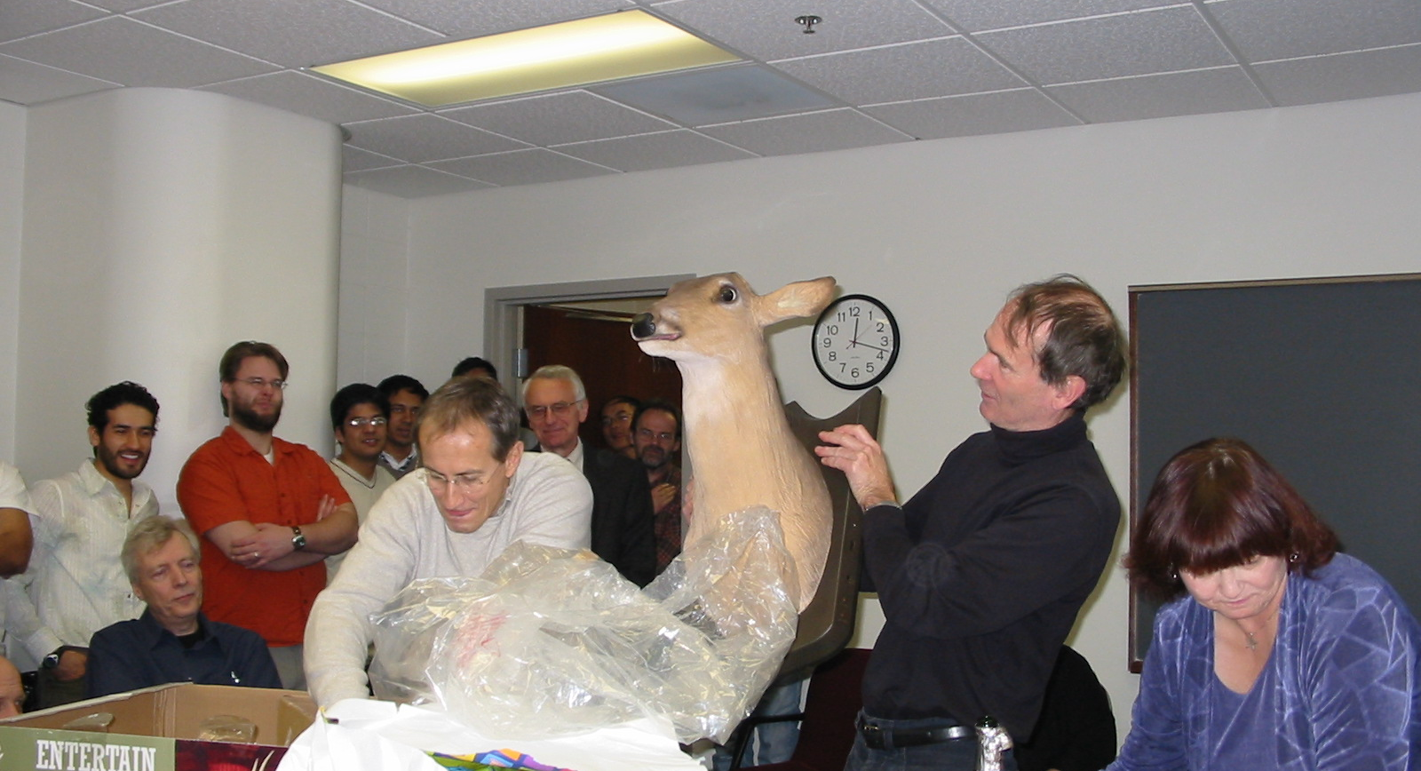
Happy 60th Birthday!

Slide 3
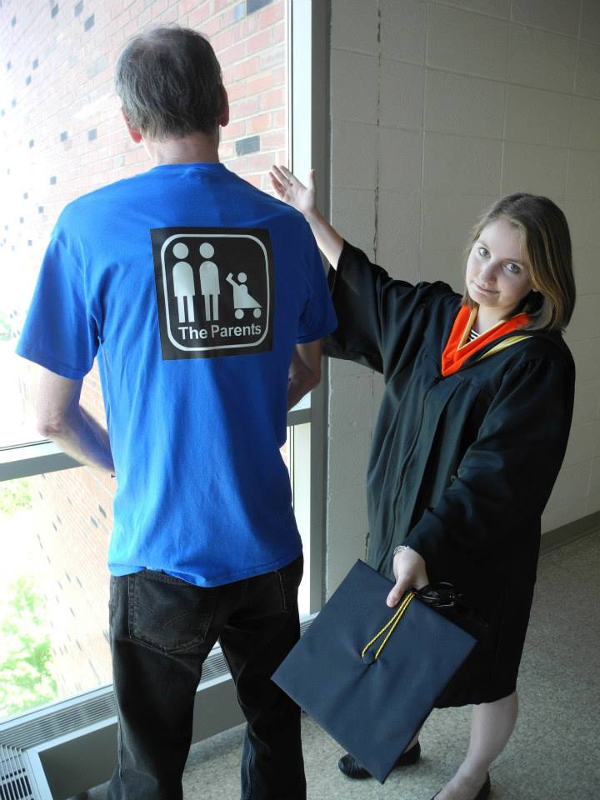
Emily Danchik “13 - CB is retiring?? Surely, the world is ending. I've attached a picture of him at my graduation in 2013, when he wore a shirt to congratulate the "sponsors" of the event: the parents! What a funny guy. Best wishes to him in his retirement.

Slide 4
Halloween with Suzanne

Slide 5
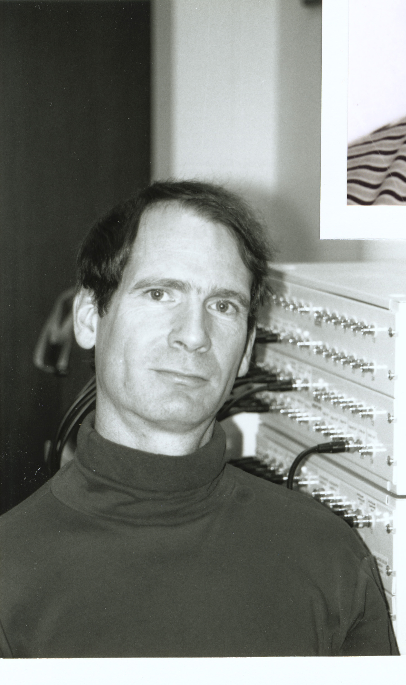
CSC Chair 1984-87

Slide 6
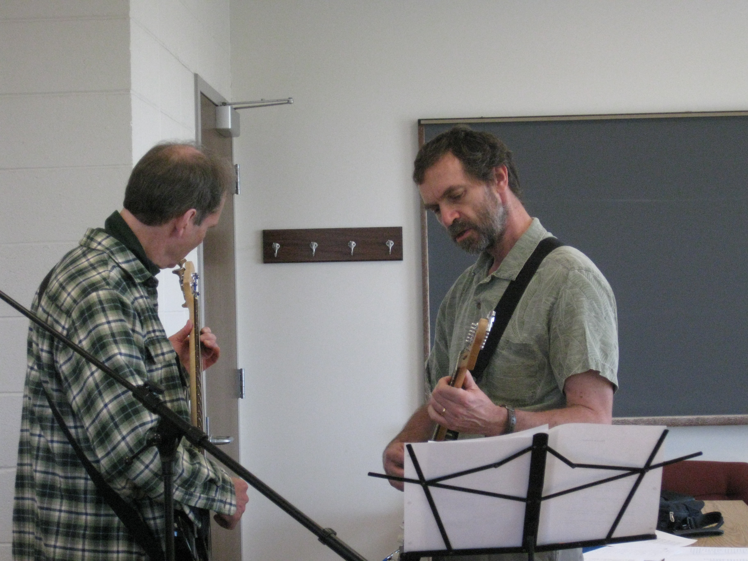
Algo-Rhythms Band Practice

Slide 7
Art Altman
CB Quote:
If anything in life troubles you, "roll a Gaussian over it"!

Slide 8
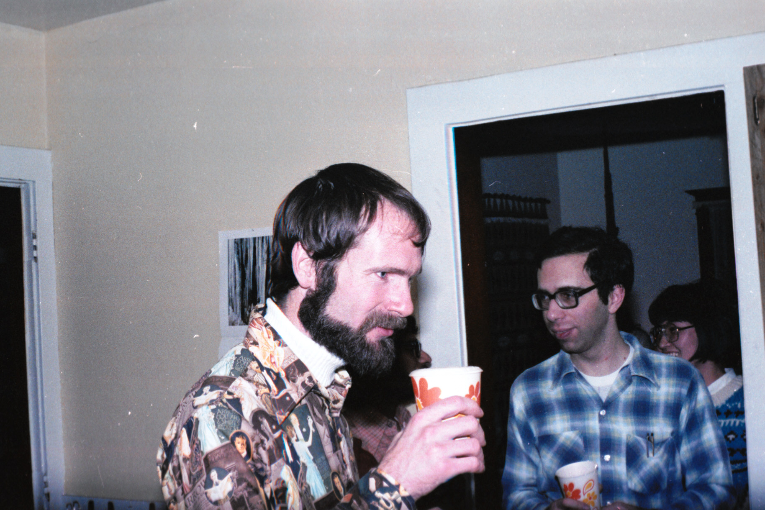
Early ‘80s party

Slide 9
William Luciw
Apart from his black beret and banjo combo (very hard to pull off), I remember the sense of whimsy Chris brought to class. I especially remember the advice about being able to find the relevant information for important decision making rather than trying to over-memorize. I applied his advice to a take-home exam question that dealt with providing computer vision advice to a startup, and later I did the same in a real start up. Best wishes with your retirement, Chris! Keep a-pickin' and-a grinnin'!

Slide 10
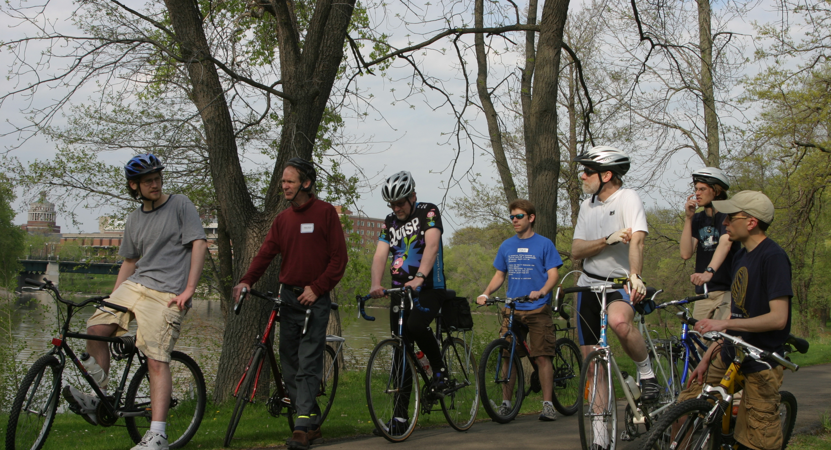
CSUG Bike Ride Spring ‘12

Slide 11
Elsner, Micha ’05 -
I don't have a specific good story, but I remember him being a helpful yet hands-off mentor for the robot project and really enjoyed his class.

Slide 12
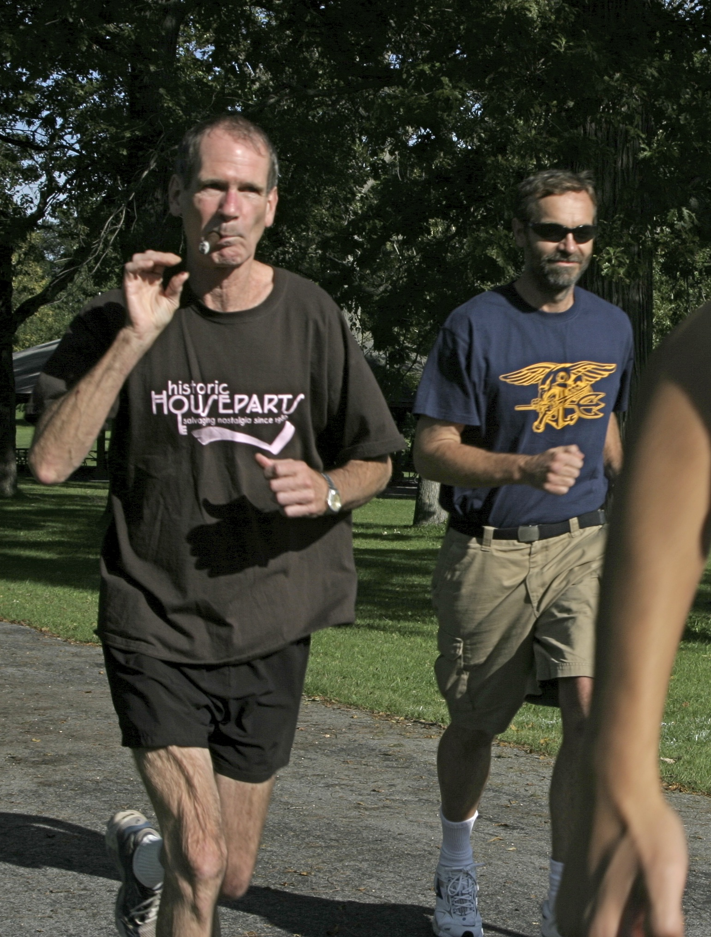

Slide 13
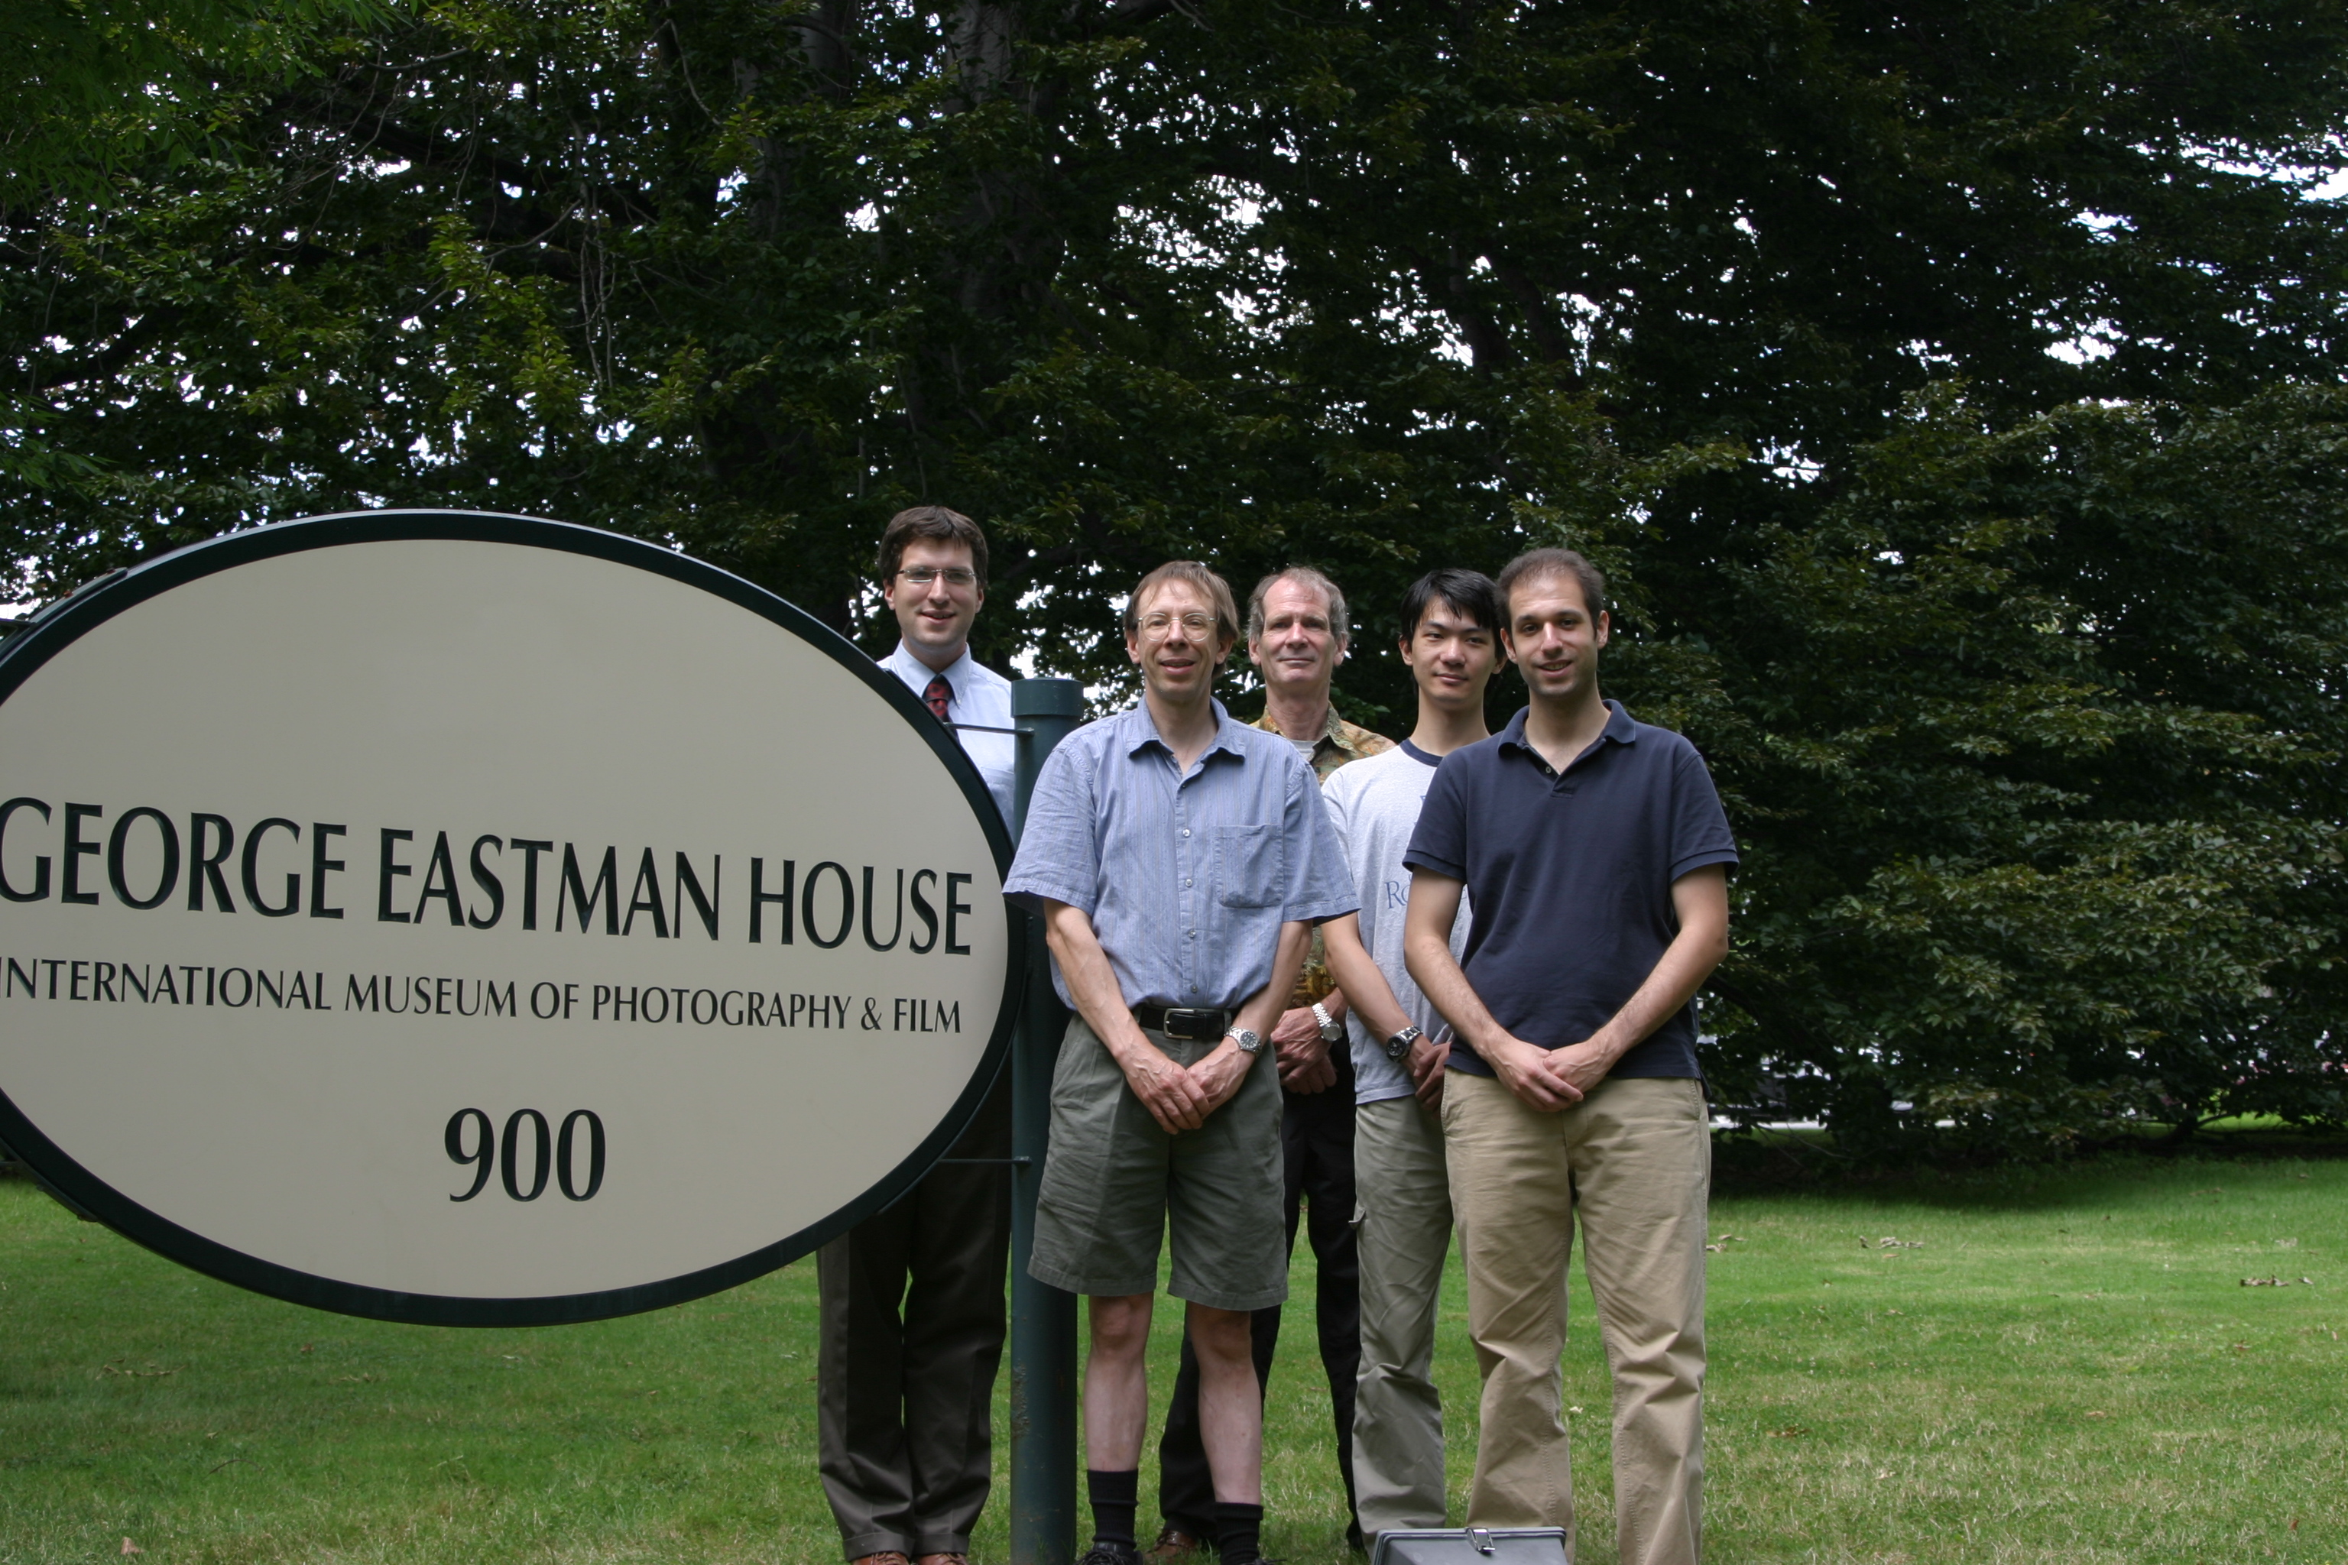

Slide 14
Mayur Thakur, PhD
It was the fall of 1999. I had been in the department for a couple of months. One afternoon in October I was in the student lounge and went to the fridge to get something when out of nowhere Count Dracula just appeared the frightened the hell out of me. As a first year international student, I hadn't heard of Halloween, but CB's entrance solidly filled the cultural gap. Happy trails, CB!

Slide 16
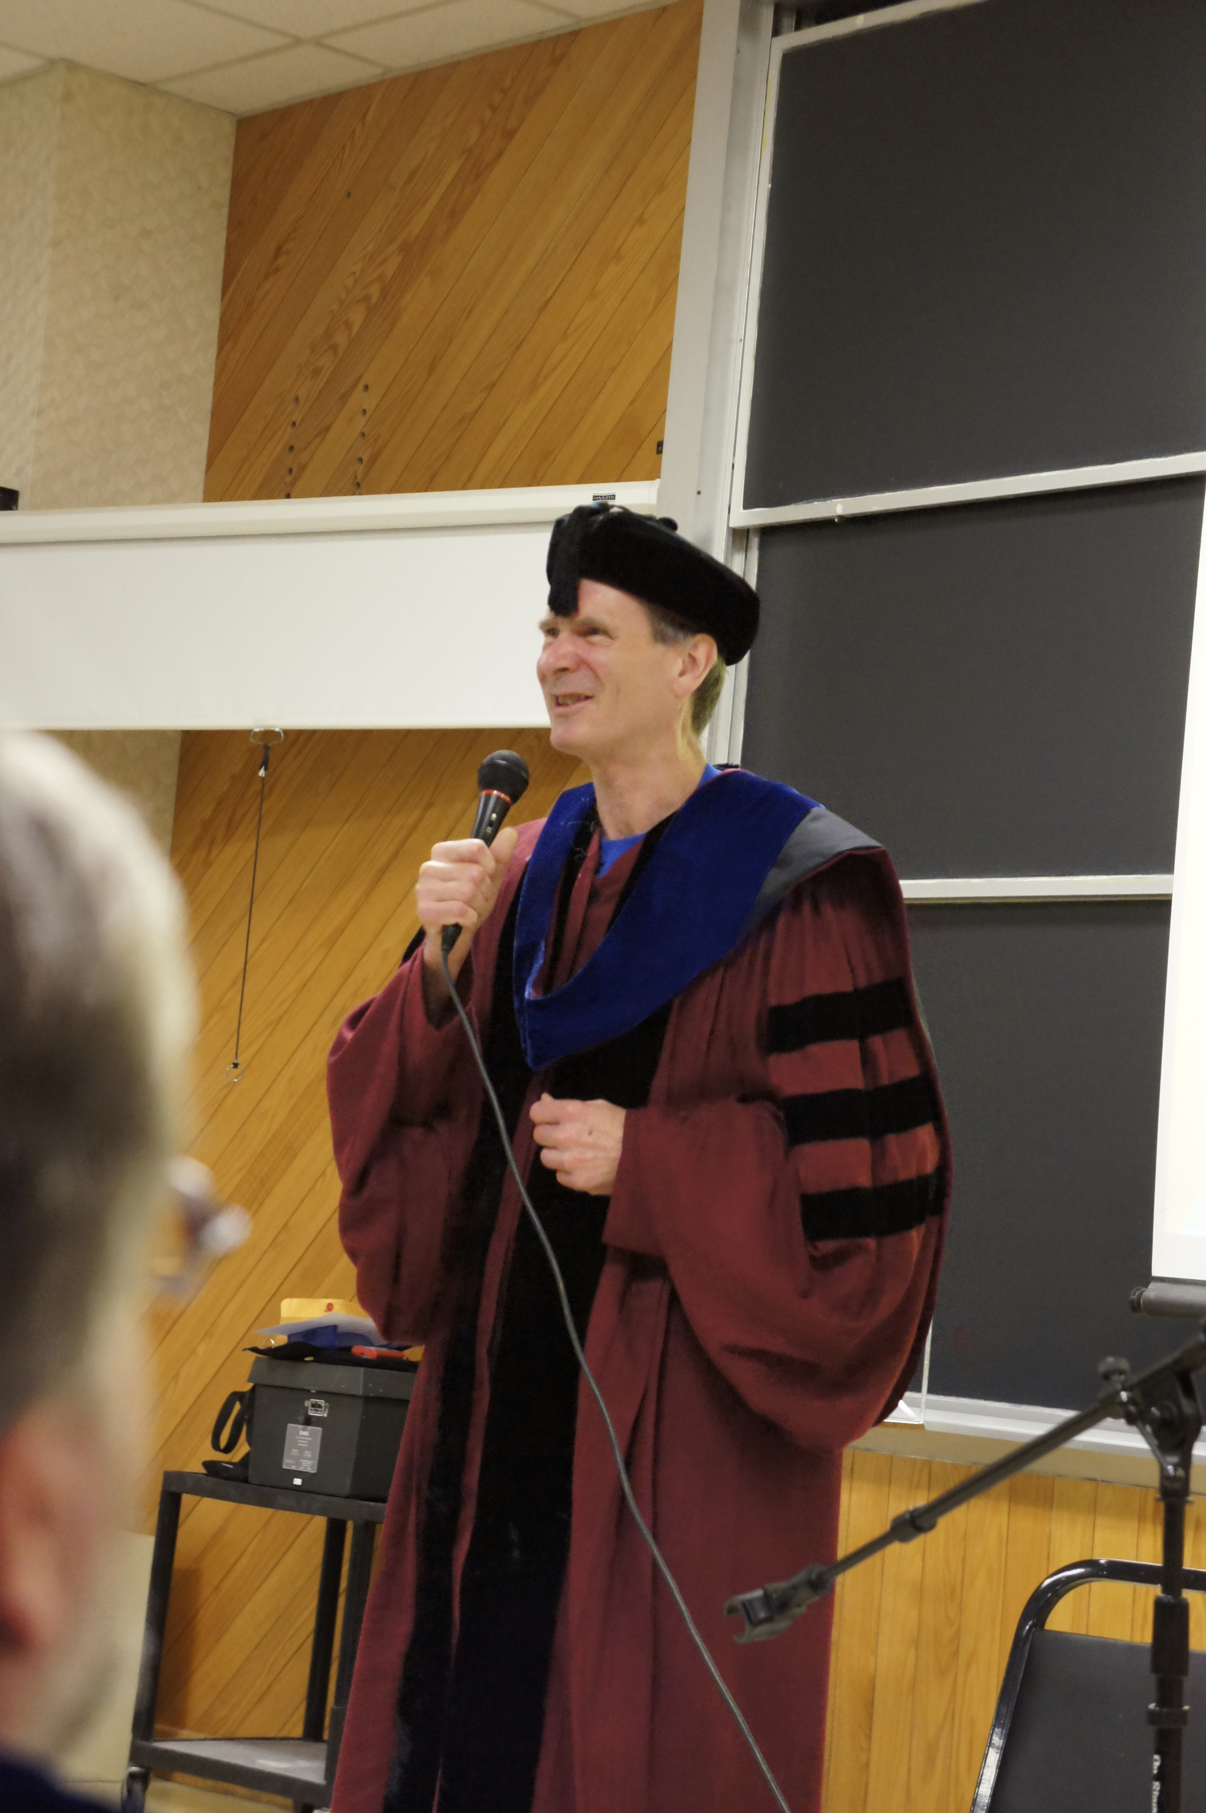

Slide 17
Mike Riffle ‘07
CB was my favorite professor in the department. I was never exactly a strong CS student, and bombing his cryptology course in 2006 was the only thing that provided me with the wake-up call I needed to get my act together. I know that he doesn't know the effect he had on me because I never told him, but I came back the next semester for his AI course and I worked my ass off because I wanted to show him that I could do the work. I ended up getting a pretty decent grade in that class, I think, and here I am 8 years later actually working in the field. Up until having CB as a teacher I never thought I'd actually work in this field. I thought I would get my degree, and put it on a shelf, and never use it, but working hard in his AI course made me realize that I'm not terrible at software development.

Slide 18
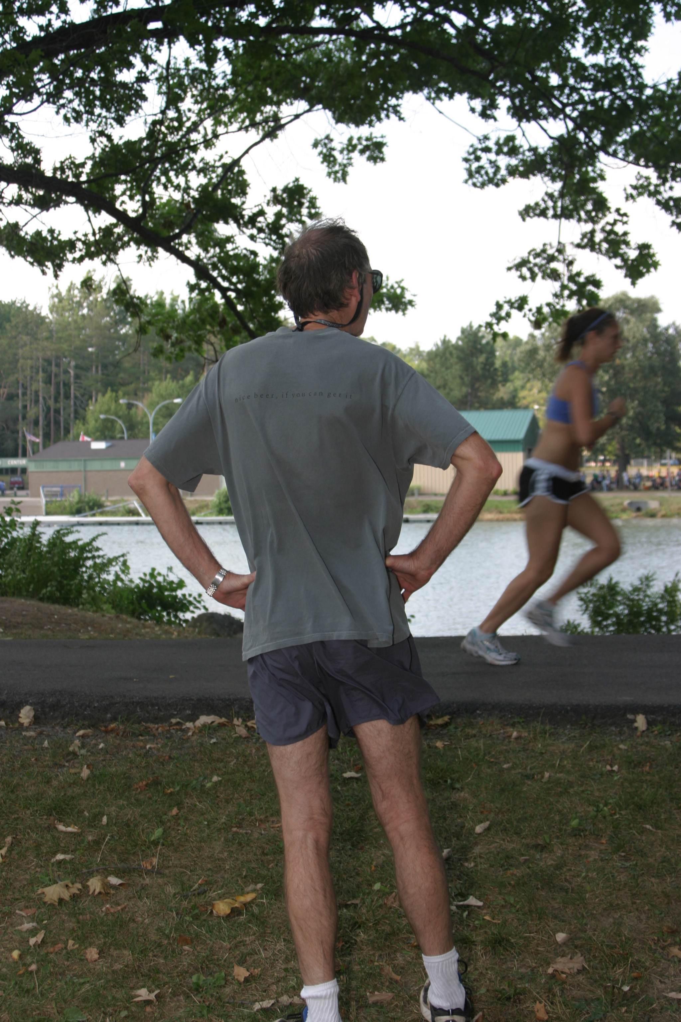
Cool Down?

Slide 20
Stuart Friedberg
CB was an excellent and collegial instructor. (I later discovered the "collegial" nature of faculty-student relations was quite unusual, almost unique to the Rochester CS program.) But CB had a couple of quirks which could be depended on. First, one learned to expect an "obligatory incomprehensible lecture" in each course, although students with a firmer grounding in mathematics probably found it less opaque. Second, he frequently put unsolved research problems on take-home exams. Fortunately, these were optional extra-credit questions. I enjoyed learning from Chris very much.

Slide 21
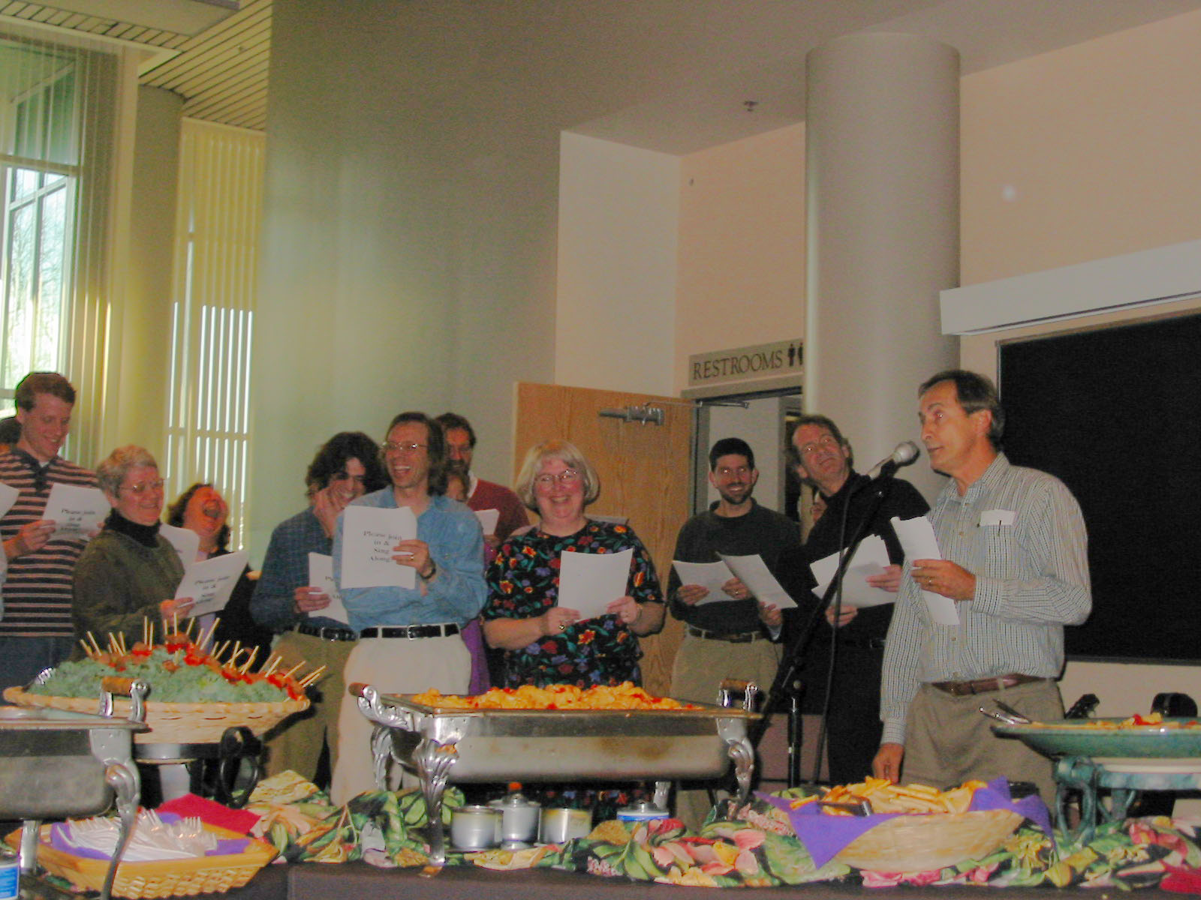
Jill’s Retirement Songfest

Slide 22
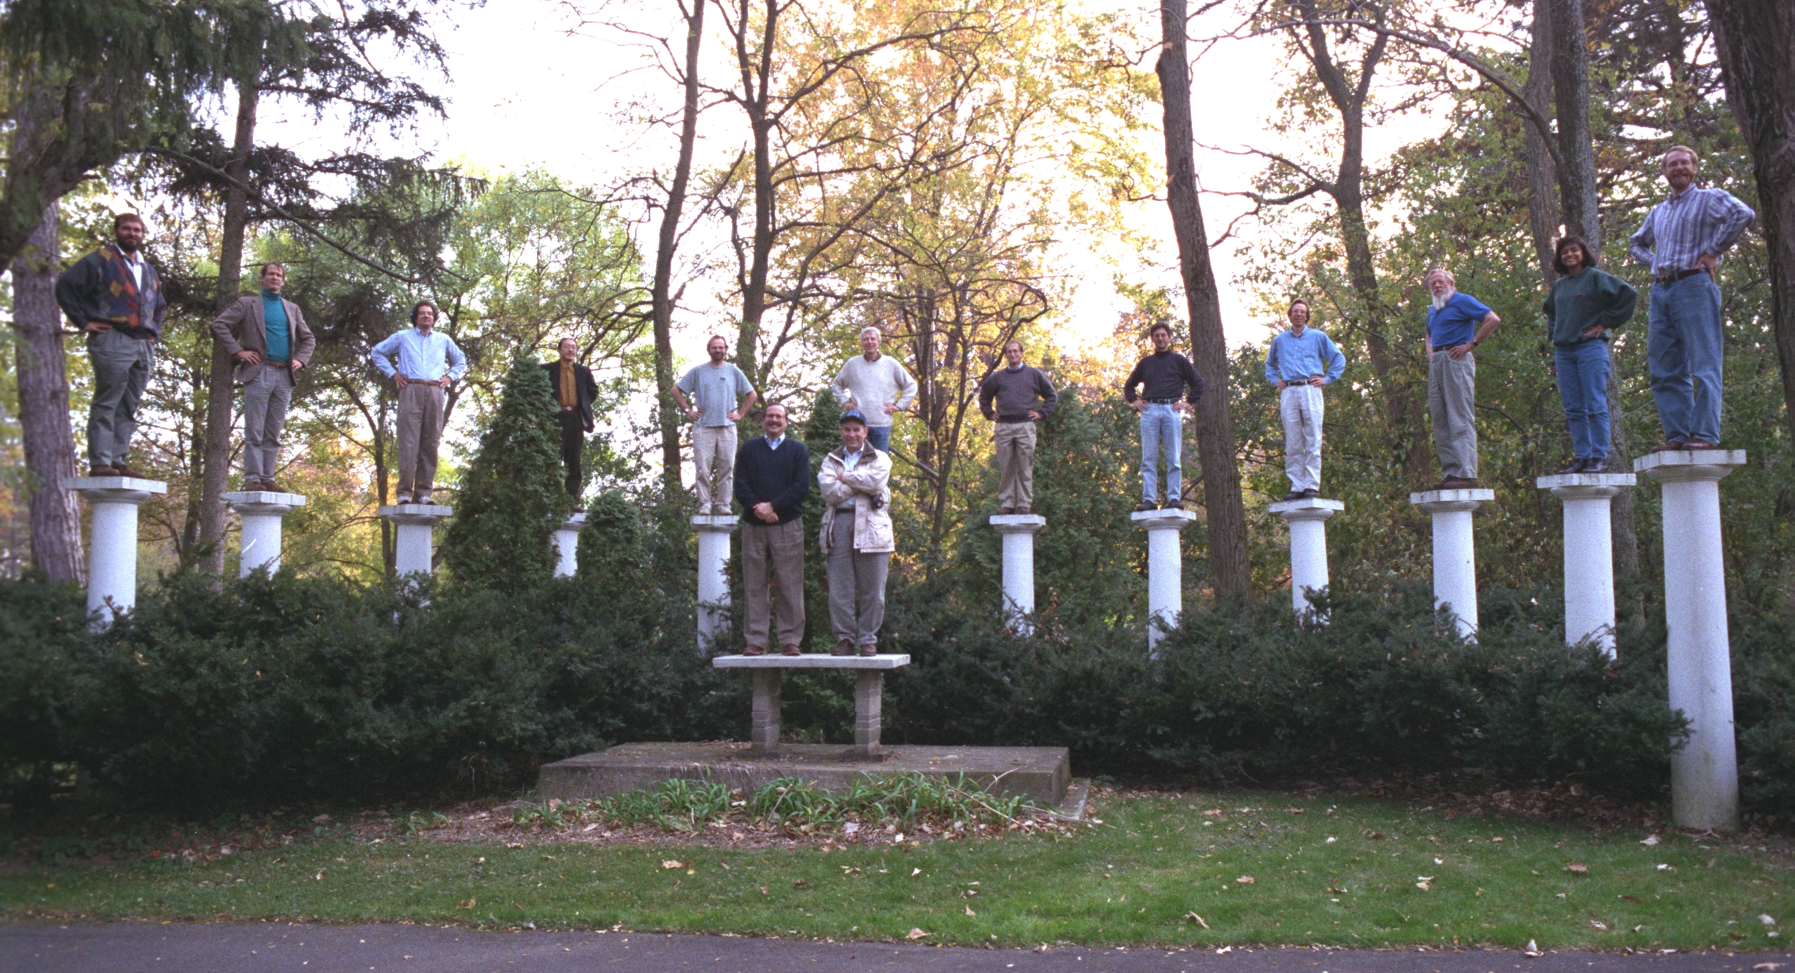
Faculty retreat – mid ’90s

Slide 23
Jason Freidman ‘07
I have tons of great memories of CB when he advised me and Aaron Rolett. He was always great at forcing us to learn and explore, while still being a great resource. When we were working on our robot sensor filtering, I have a great memory of him pretending not to know much about filtering noise until we discovered 'Kalman Filters' which were sort of industry standard, and then once we had an understanding of how they worked, he had a bunch of ancient C code so we wouldn't have to implement it all.

Slide 24
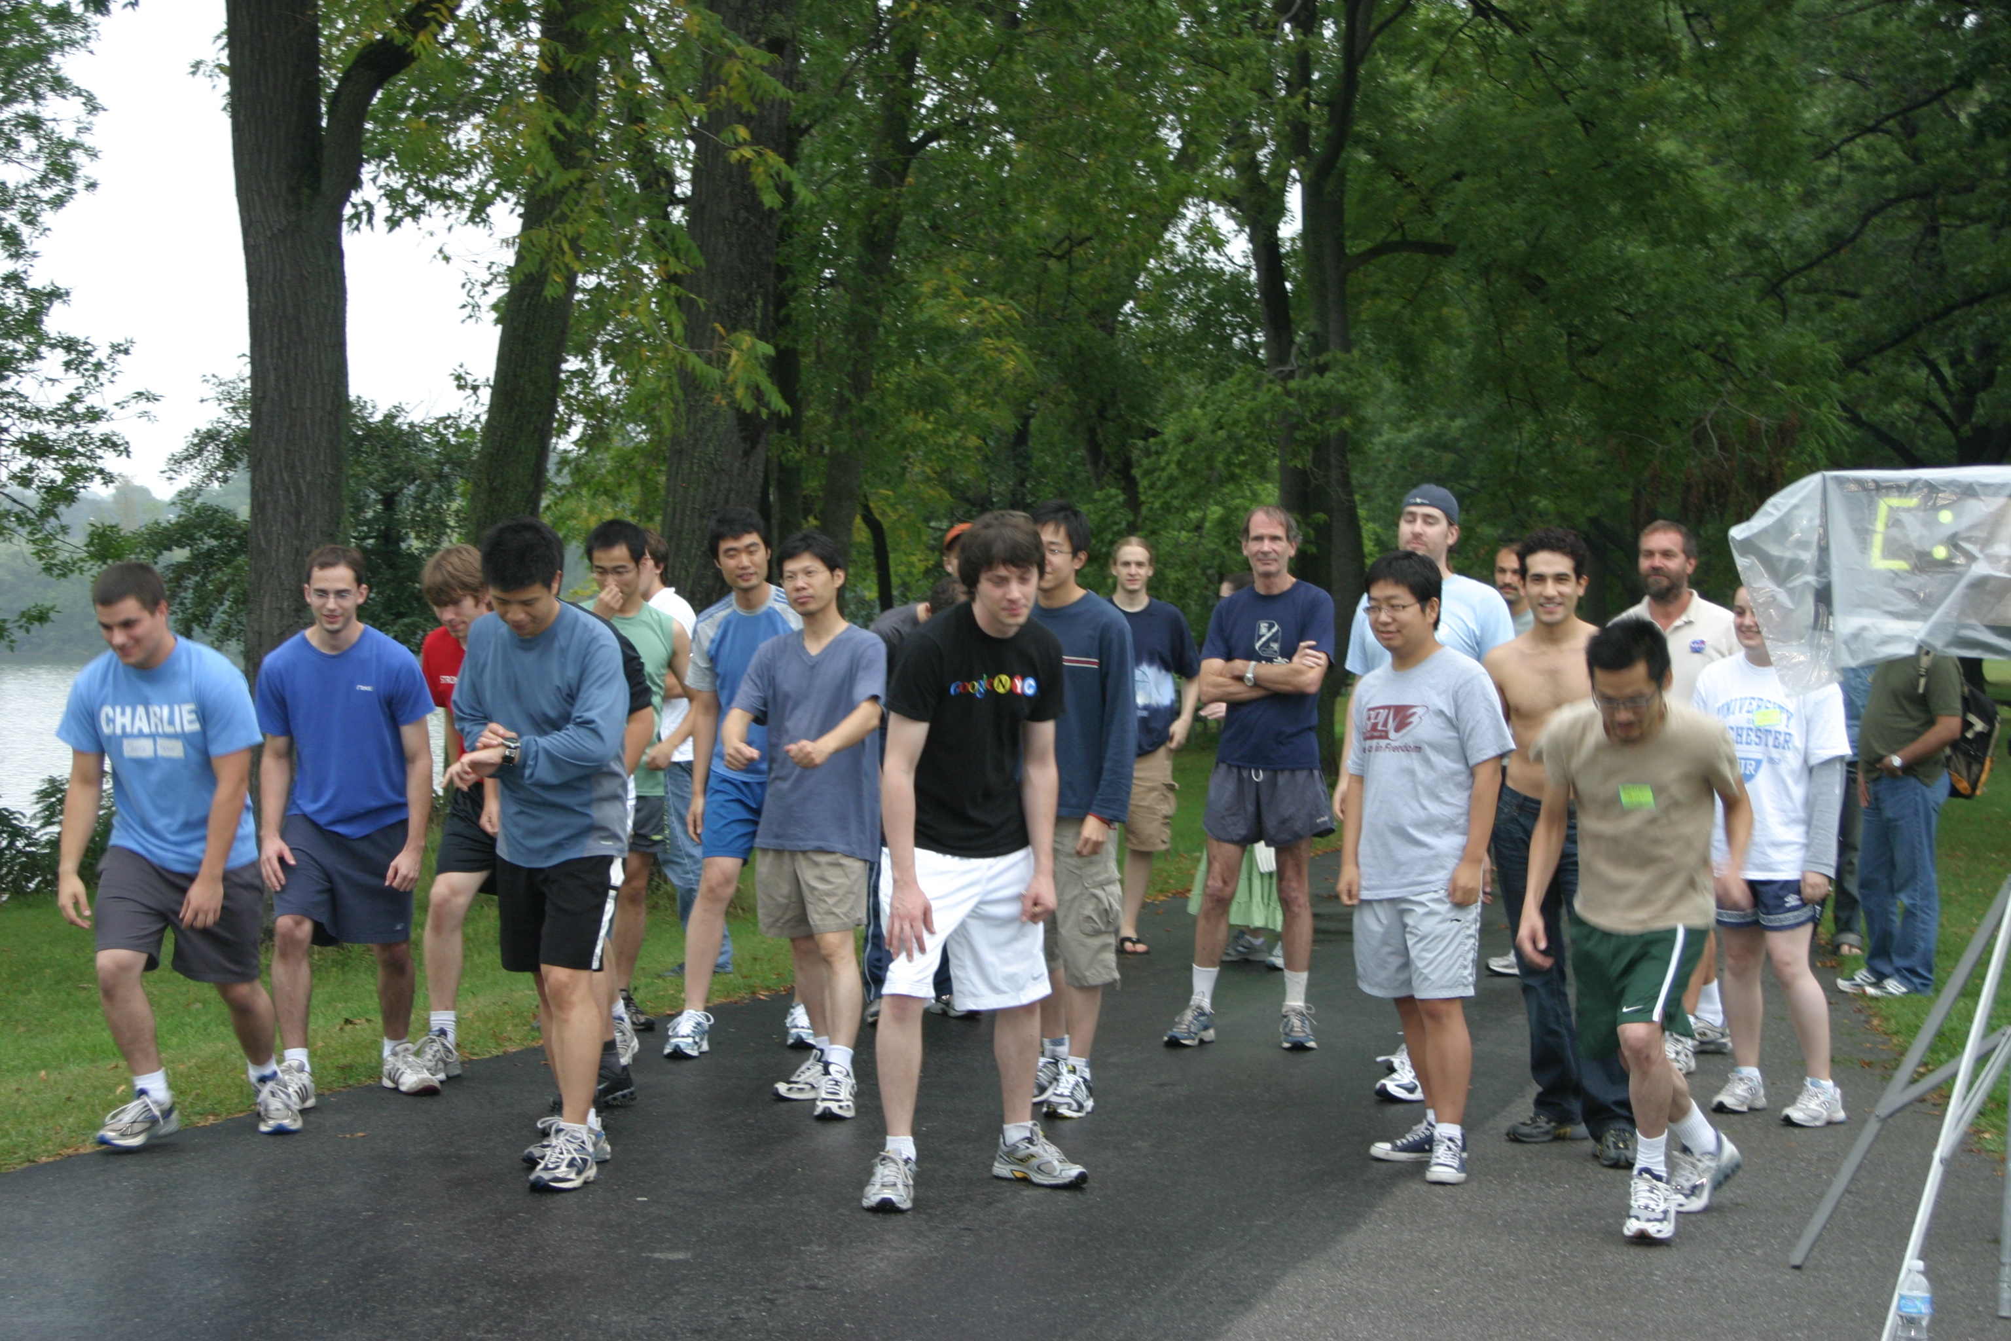

Slide 25
Matt Boutell, PhD
Chris is an all-around super guy. A Renaissance man, equally at home in the realms of vision algorithms, music, theatre, hunting, and horticulture. I When I was frantically looking for an advisor at the end of my first year, Chris took me on. The next four years, I spent who-knows-how-many hours in his office, asking for advice on my work. Now that I am a faculty member, I realize that I probably overstayed my welcome, but Chris never gave any sign that I was a burden. Rather he always believed in me and encouraged me, which meant a lot during the long path of dissertation topic searching, researching, and writing. Even now, I know I can count on Chris for advice, and have done so several times in the last 10 years since graduation. For all this, I am very grateful.

Slide 26
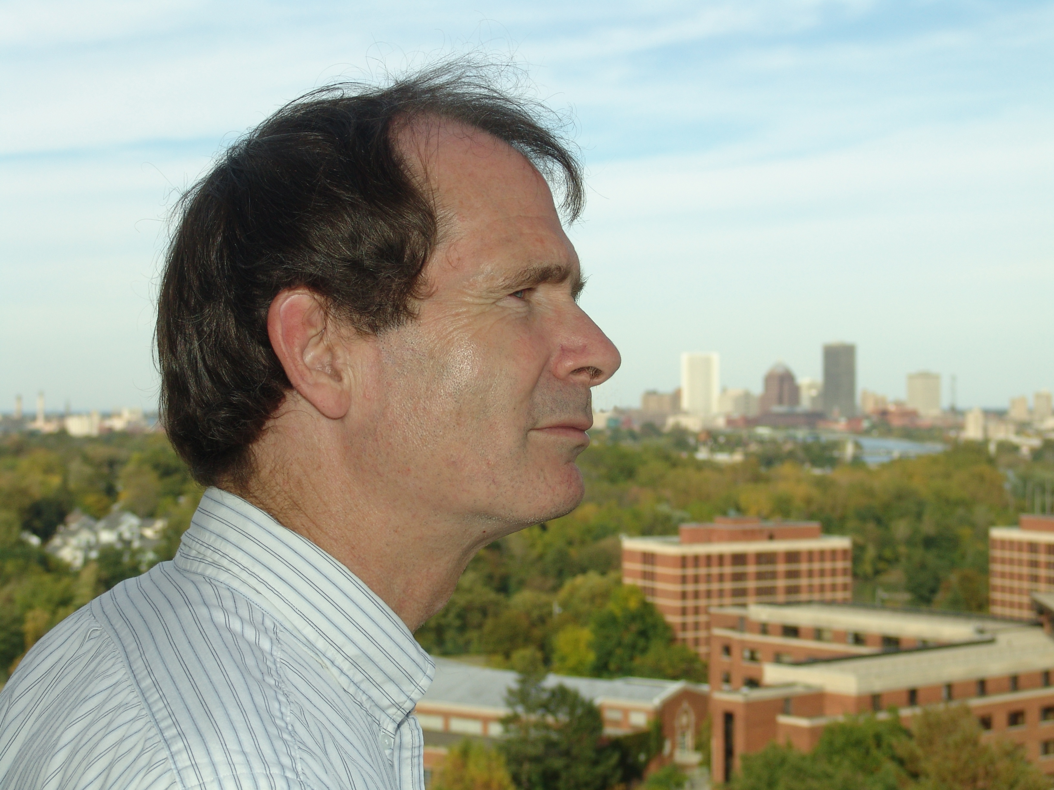

Slide 27
Jonathan Norwood ‘04
I would like to congratulate Chris Brown on his retirement and thank him for keeping me interested in Computer Science. At one point, I was considering dropping out of the program, but I was lucky enough to sign up from Chris' Introduction to Cryptology class. This class was the sole reason I ended up wanting to stay a CS major. Chris was able to show me that all of the painful and sometimes pedantic stuff that I'd been learning up to that point wasn't what computer science was about. We'd been learning about the tools used to solve problems, but forgot that there was an entire universe of real-world problems that could be solved quickly and elegantly through applying solid problem solving skills and using software to automate solutions. Above all else, Chris taught me that software is but a tool and that the real problem solving is still a creative effort. Thanks for all of the lessons, Chris.

Slide 28
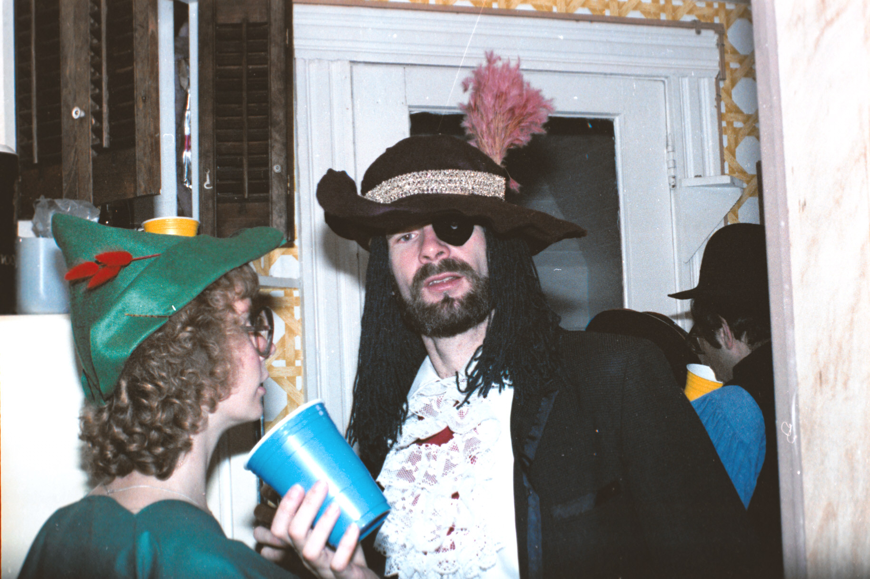

Slide 29
Continued on next slide
Around spring of 2001, fellow class of 2003 alumnus Jon Schmid came knocking at my door. It seemed that since an undergraduate robotics class had been cancelled, he had a crazy idea. Not only would we enter the AAAI robotics competition the summer of 2002, we would win it as well! I, as the reasonable 19-year-old that I was, knew that this was a pipe dream, but I like the excitement, was interested in robotics, and wanted to be a part of what could be something special. So we did what any group of plucky college students would do, we went begging for money. That took us to CB's office door.
I have to say at this point, that this moment in time is what made me as a computer scientist, a roboticist, and the person who I am today. It would be a great story to say that CB saw that this moment was upon our rag-tag group of inexperienced sophomores and acted accordingly. It would speak to his Machiavellian intelligence that he chose to support us at this exciting, albeit unreasonable, time. However, I think it was just that CB saw that we were excited and wanted to encourage us that led him to work on our behalf.

Slide 30
Dave Feil-Seifer ‘03
CB got us money for a robot, room to work, and funding to pay students over the summer. He gave us the best gift that he could have given us, to give us the resources we needed and then to leave us alone. We elected team leaders, coordinated fund-raising, and traveled over 2300 miles in the back of a cramped minivan to the competition. And, unreasonable as it still may sound, we won that competition, competing as the only undergraduate team.
CB believed in us, then left us alone to do what we wanted. That's what made us win. That's what made at least three of us earn advanced degrees after we left. Right now, I am an assistant professor at a research institution. And I can tell you, when a group of young students with too little experience and too much enthusiasm come knocking at my door with a crazy idea. I think of my friend and mentor CB, give them a room, a robot, and the freedom the follow a crazy path. It was the best gift that I got from CB, and the one that I'm most eager to pass on.

Slide 31
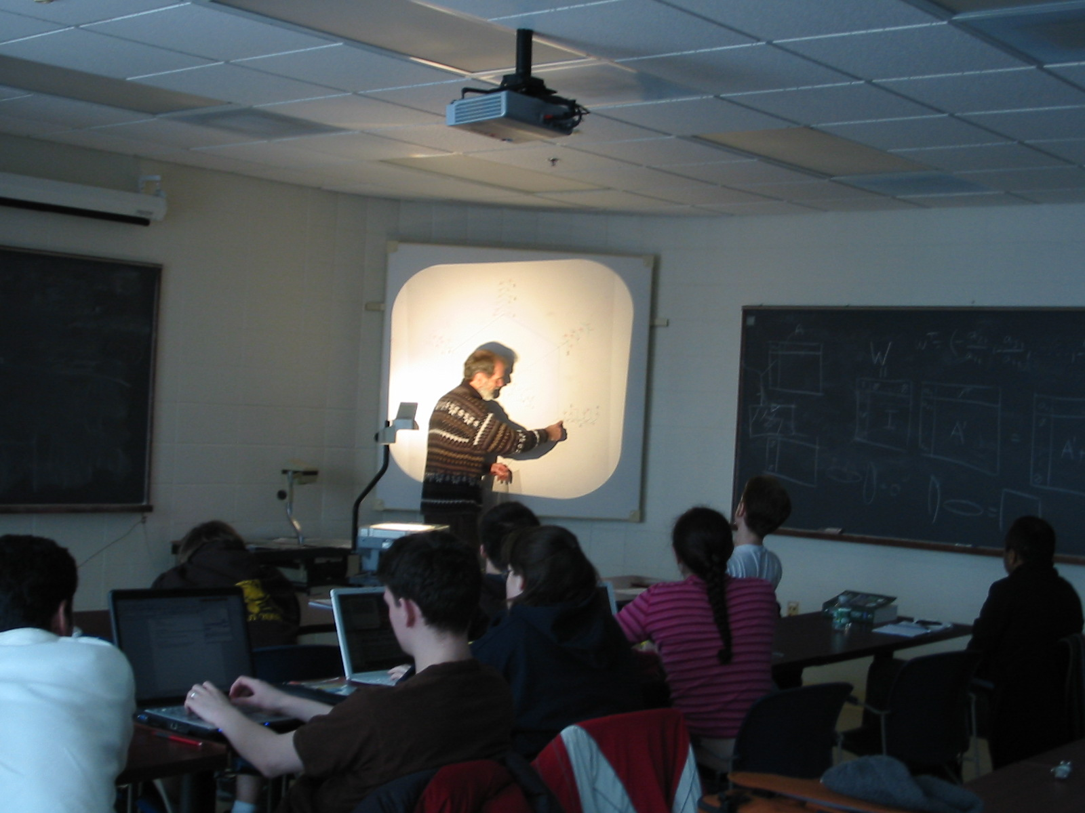

Slide 32
Lee Frankel-Goldwater ‘06
Chris Brown generously advised me for 2x independent studies, and inspires me as the kind of academic I would like to one day become: one who keeps his heart and his style personal, supports creative student efforts, and doesn't take the process more seriously than it has to be. A patient and kind person, and to this day the only professor I've ever seen sitting outside of the athletic center, shirtless, in the sun after a run, enjoying the glow of moment without worry, able to let go of expectations and allow himself to just be.

Slide 33
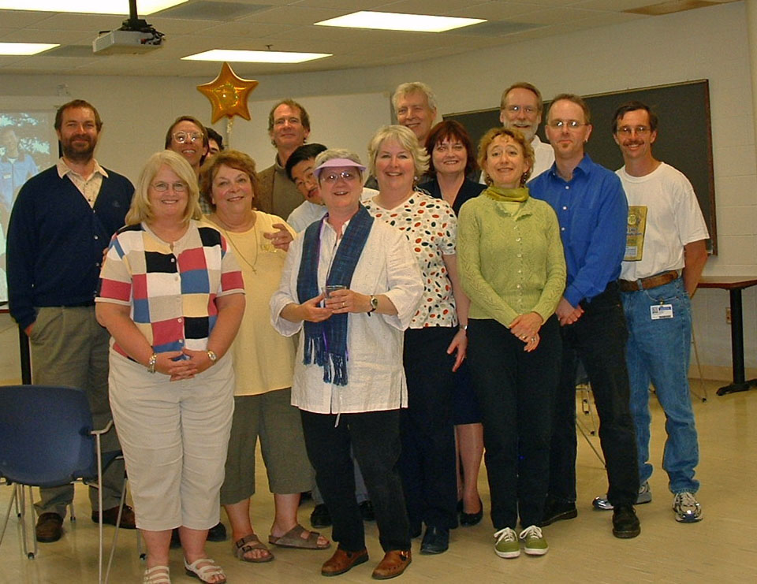

Slide 34
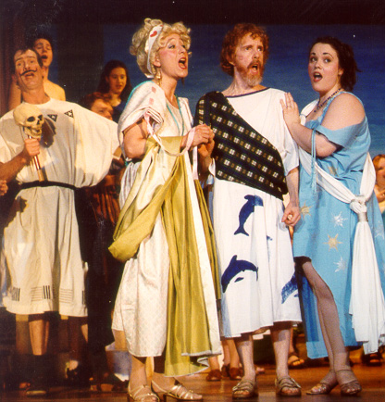
Off Monroe Players

Slide 35
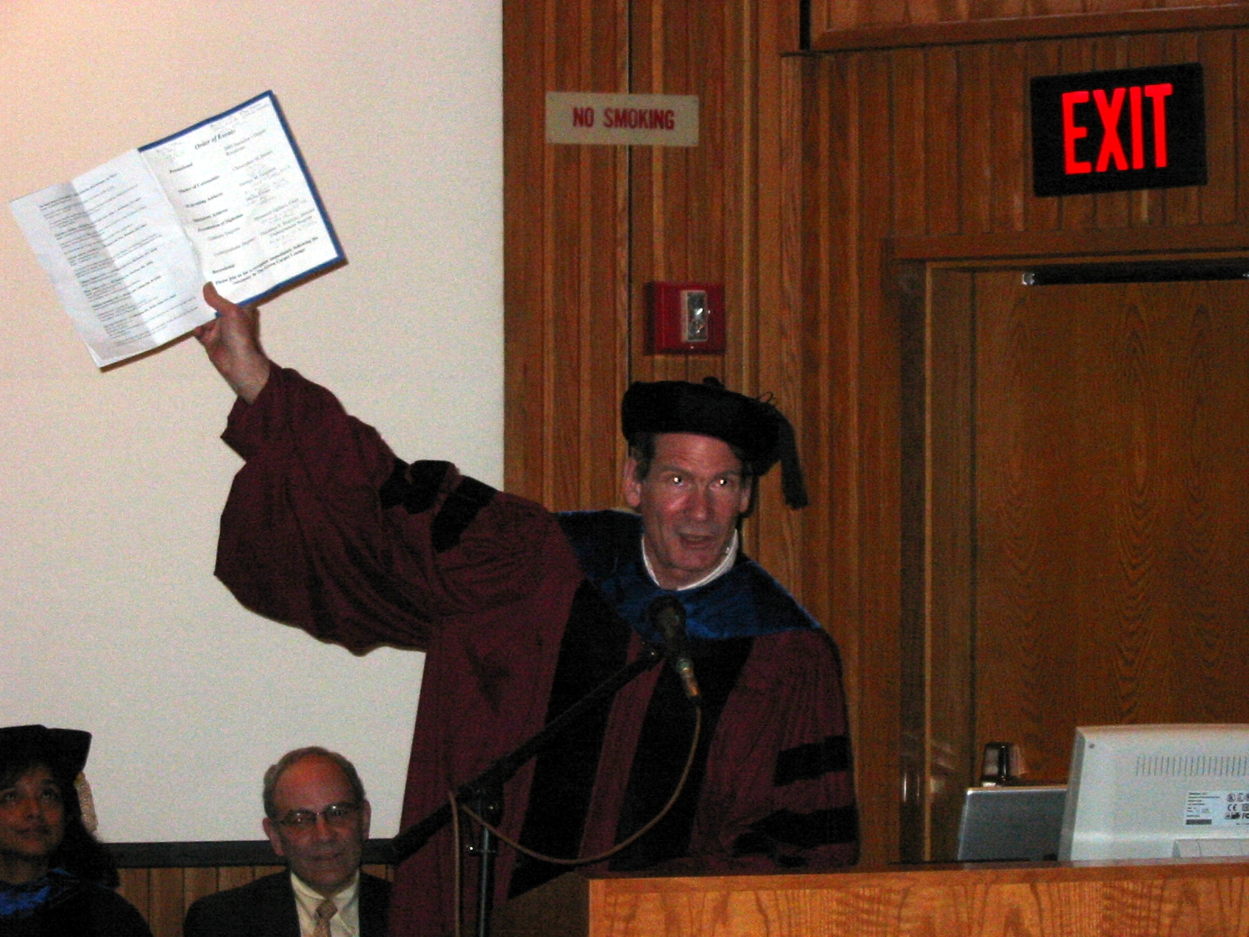
Peter Barnum ‘05
Nice to hear that CB is having a party. I found one picture of him from 2005 graduation, where he appears to be saying something dramatic and possibly wise.

Slide 36
Peter Barnum ‘05
I did find a list of a few CB quotes I collected during 2002-2005:
"I was the first person to answer a classified ad in the city paper."

Slide 37
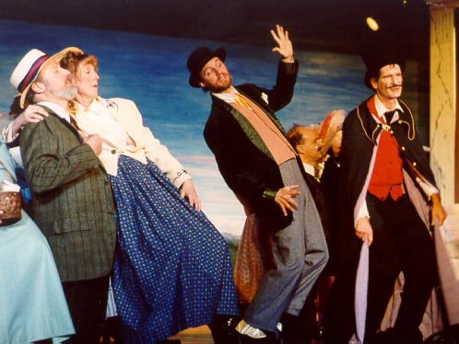

Slide 38
From Peter Barnum’s collection of CB Quotes
"You have to be conservative with these bloody computers. I'm growing to hate them cordially as I grow older."

Slide 39
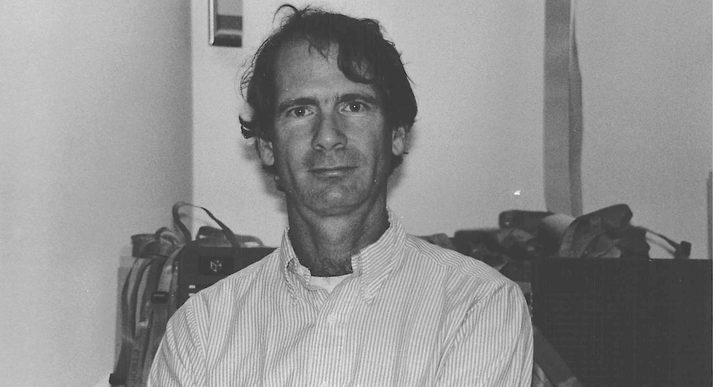
1987

Slide 40
From Peter Barnum’s collection of CB quotes
"You don't want to see symmetry out there in the jungle. It means someone's looking at you."

Slide 41
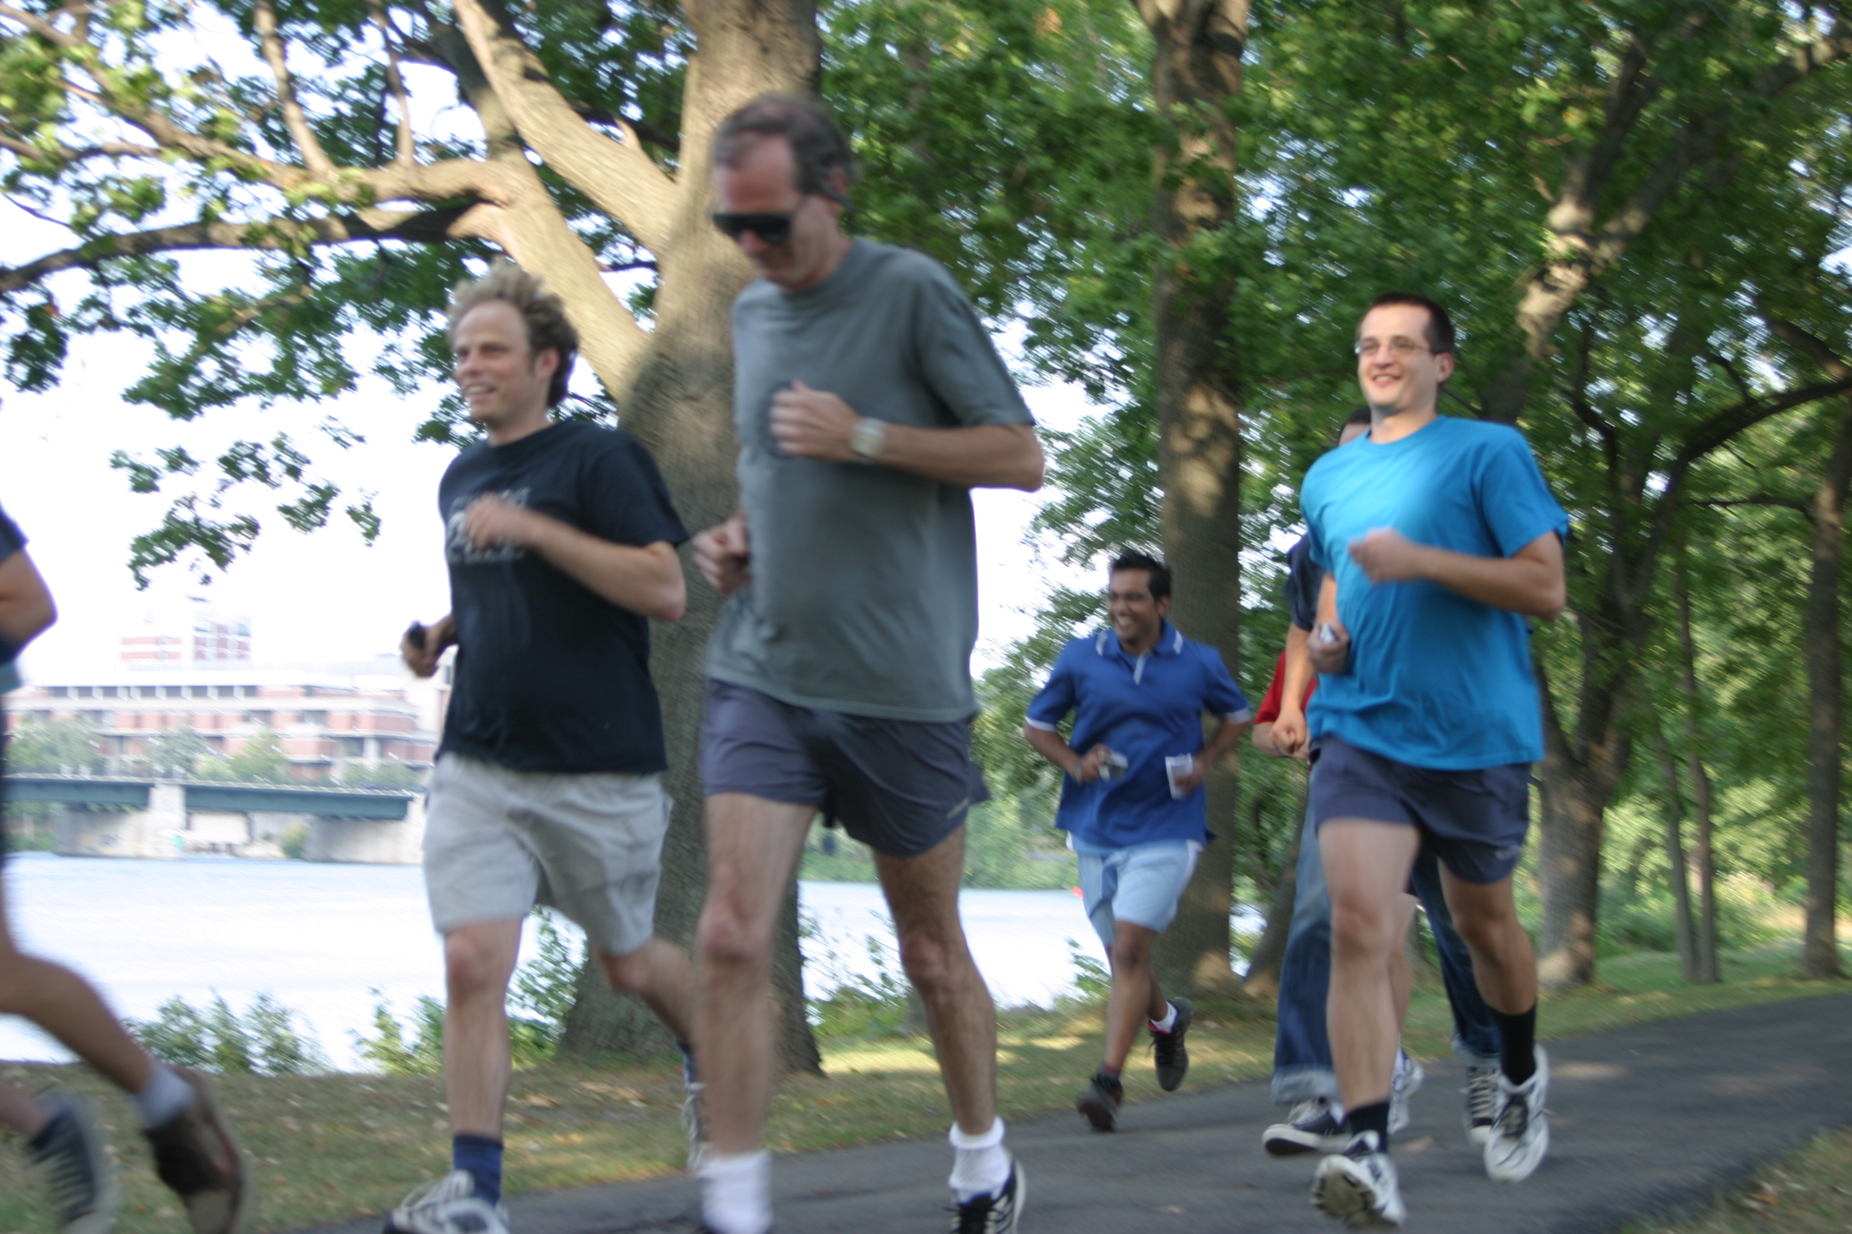

Slide 42
From Peter Barnum’s collection of CB Quotes
"Micromort: One millionth chance of death. Useful for Russian Roulette."

Slide 43
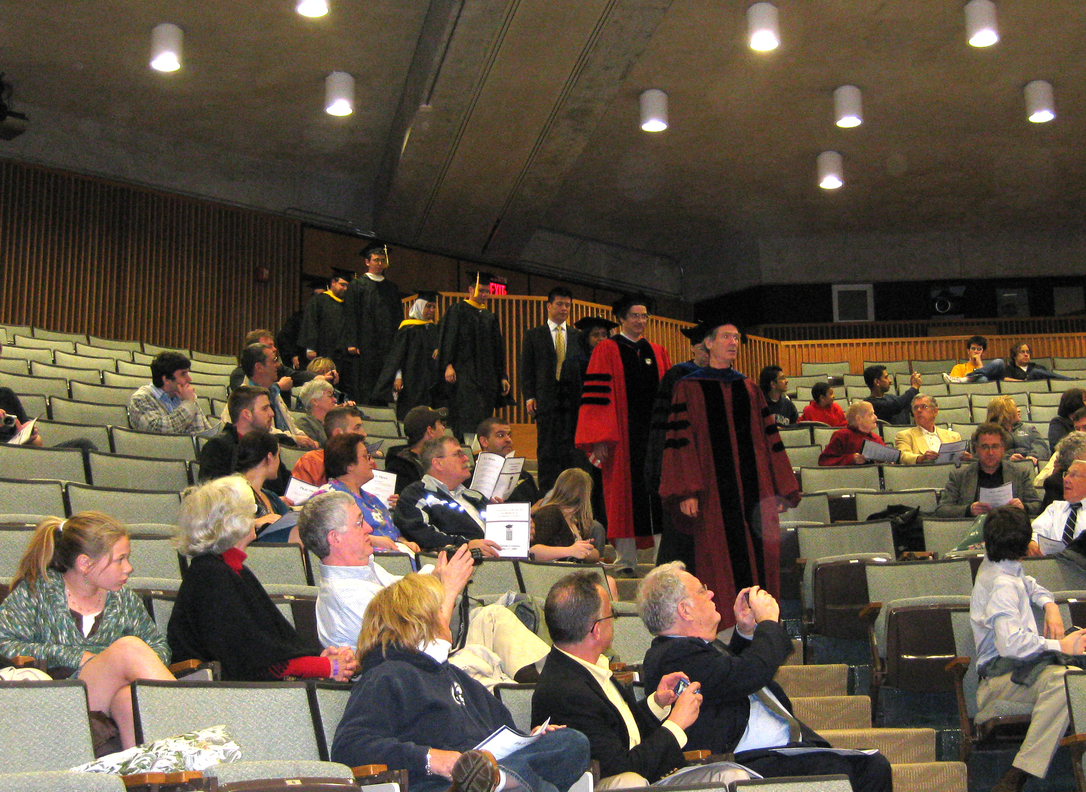

Slide 44
From Peter Barnum’s collection of CB Quotes
"Textbooks are for shit, they're written by people like me."

Slide 45
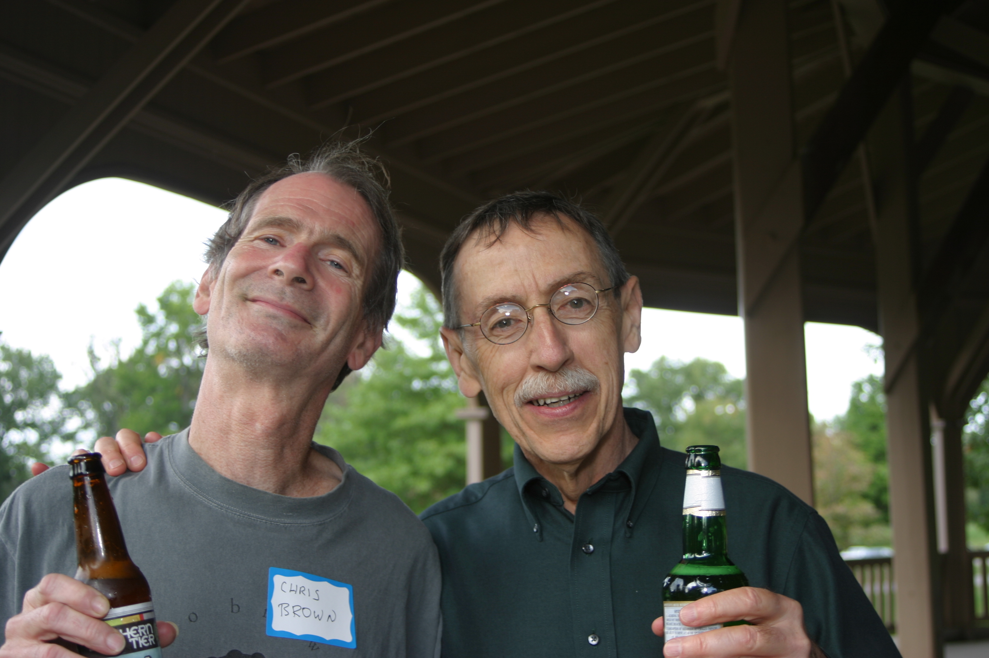

Slide 46
From Peter Barnum’s collection of CB Quotes
"It's just politically correct to make your instructor feel needed."

Slide 47
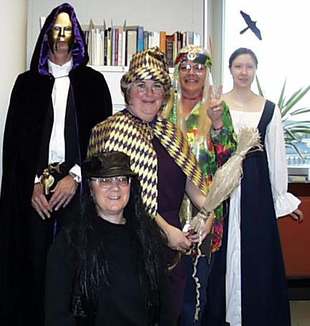

Slide 48
From Peter Barnum’s collection of CB quotes
"[Hough transform] is like the fraternity president of line detection."

Slide 49
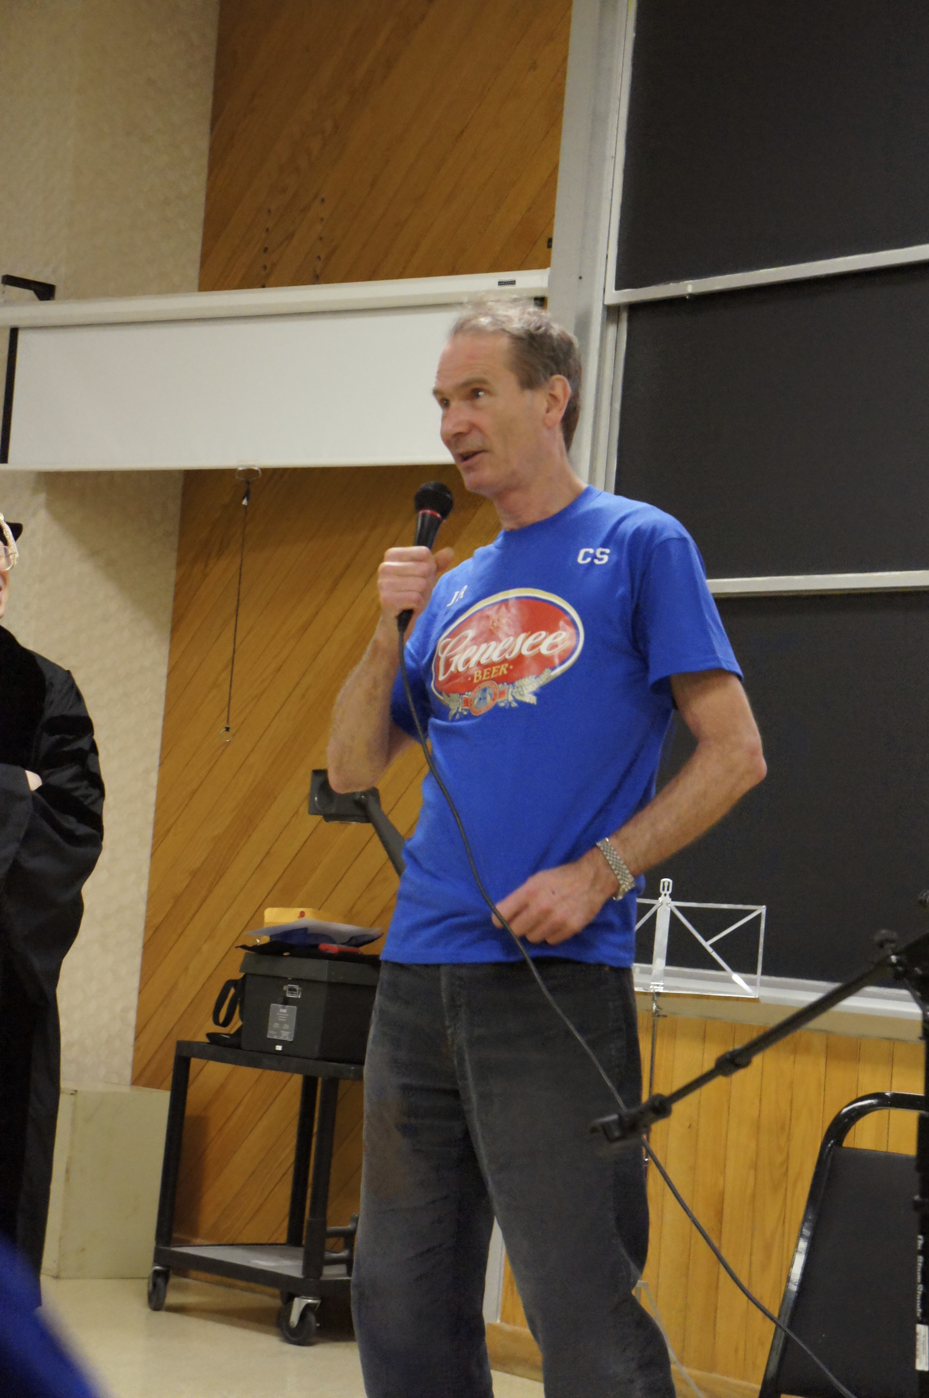
We are the CS Crowd!

Slide 50
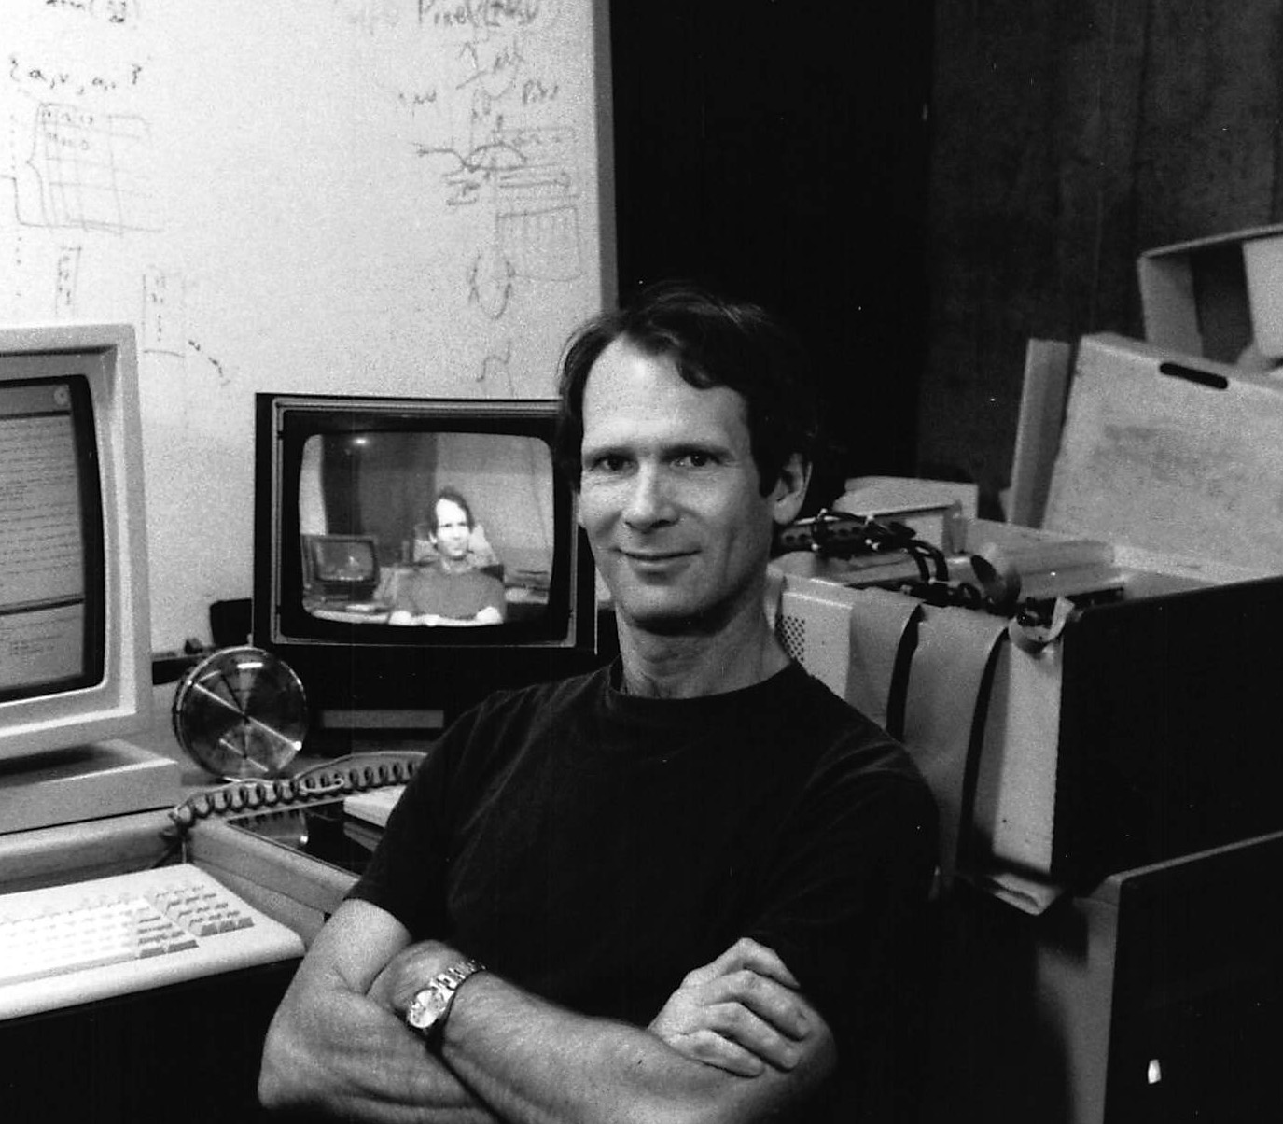

Slide 51
David Lu!! ‘07
I met a cute freshman girl the same semester that I was taking CB's CSC242: Artificial Intelligence class. I would often have to tell her that we couldn't hang out because of the heavy workload the class entailed. It was always "I have to work on the written assignment for 242" or "I need to finish programming the assignment for AI." It wasn't until most of the way through the semester that she realized that 242 and AI were the same class. She had just assumed they were separate based on the amount of work. However, it all worked out in the end, since I married the girl, and ended up teaching Artificial Intelligence (with the same textbook) last fall at Washington University. The high expectations for learning the material that CB had for us have served me well in the years of exploring computer science since I took that class, always pushing me to learn more.
Thanks CB.

Slide 52
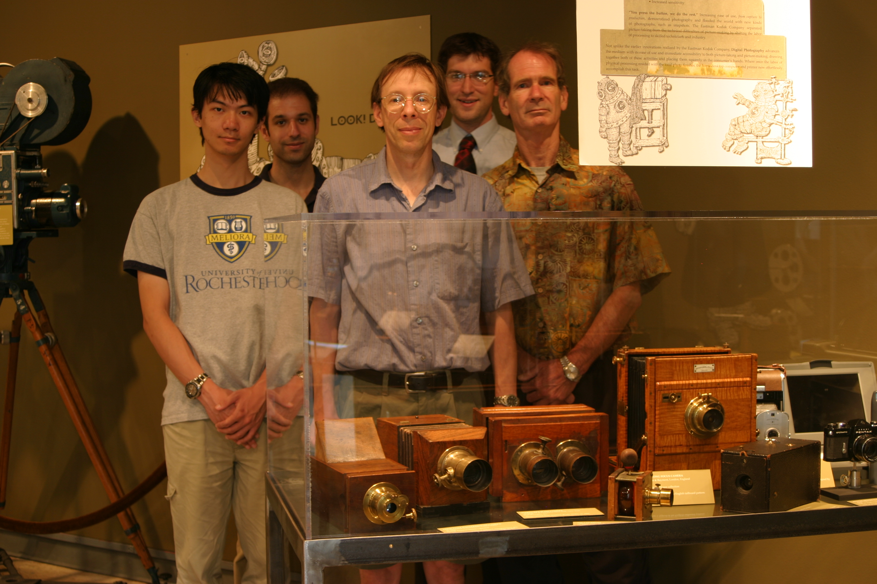

Slide 53
From Peter Barnum’s collection of CB quotes
"Never use a piece of prose only once."

Slide 54
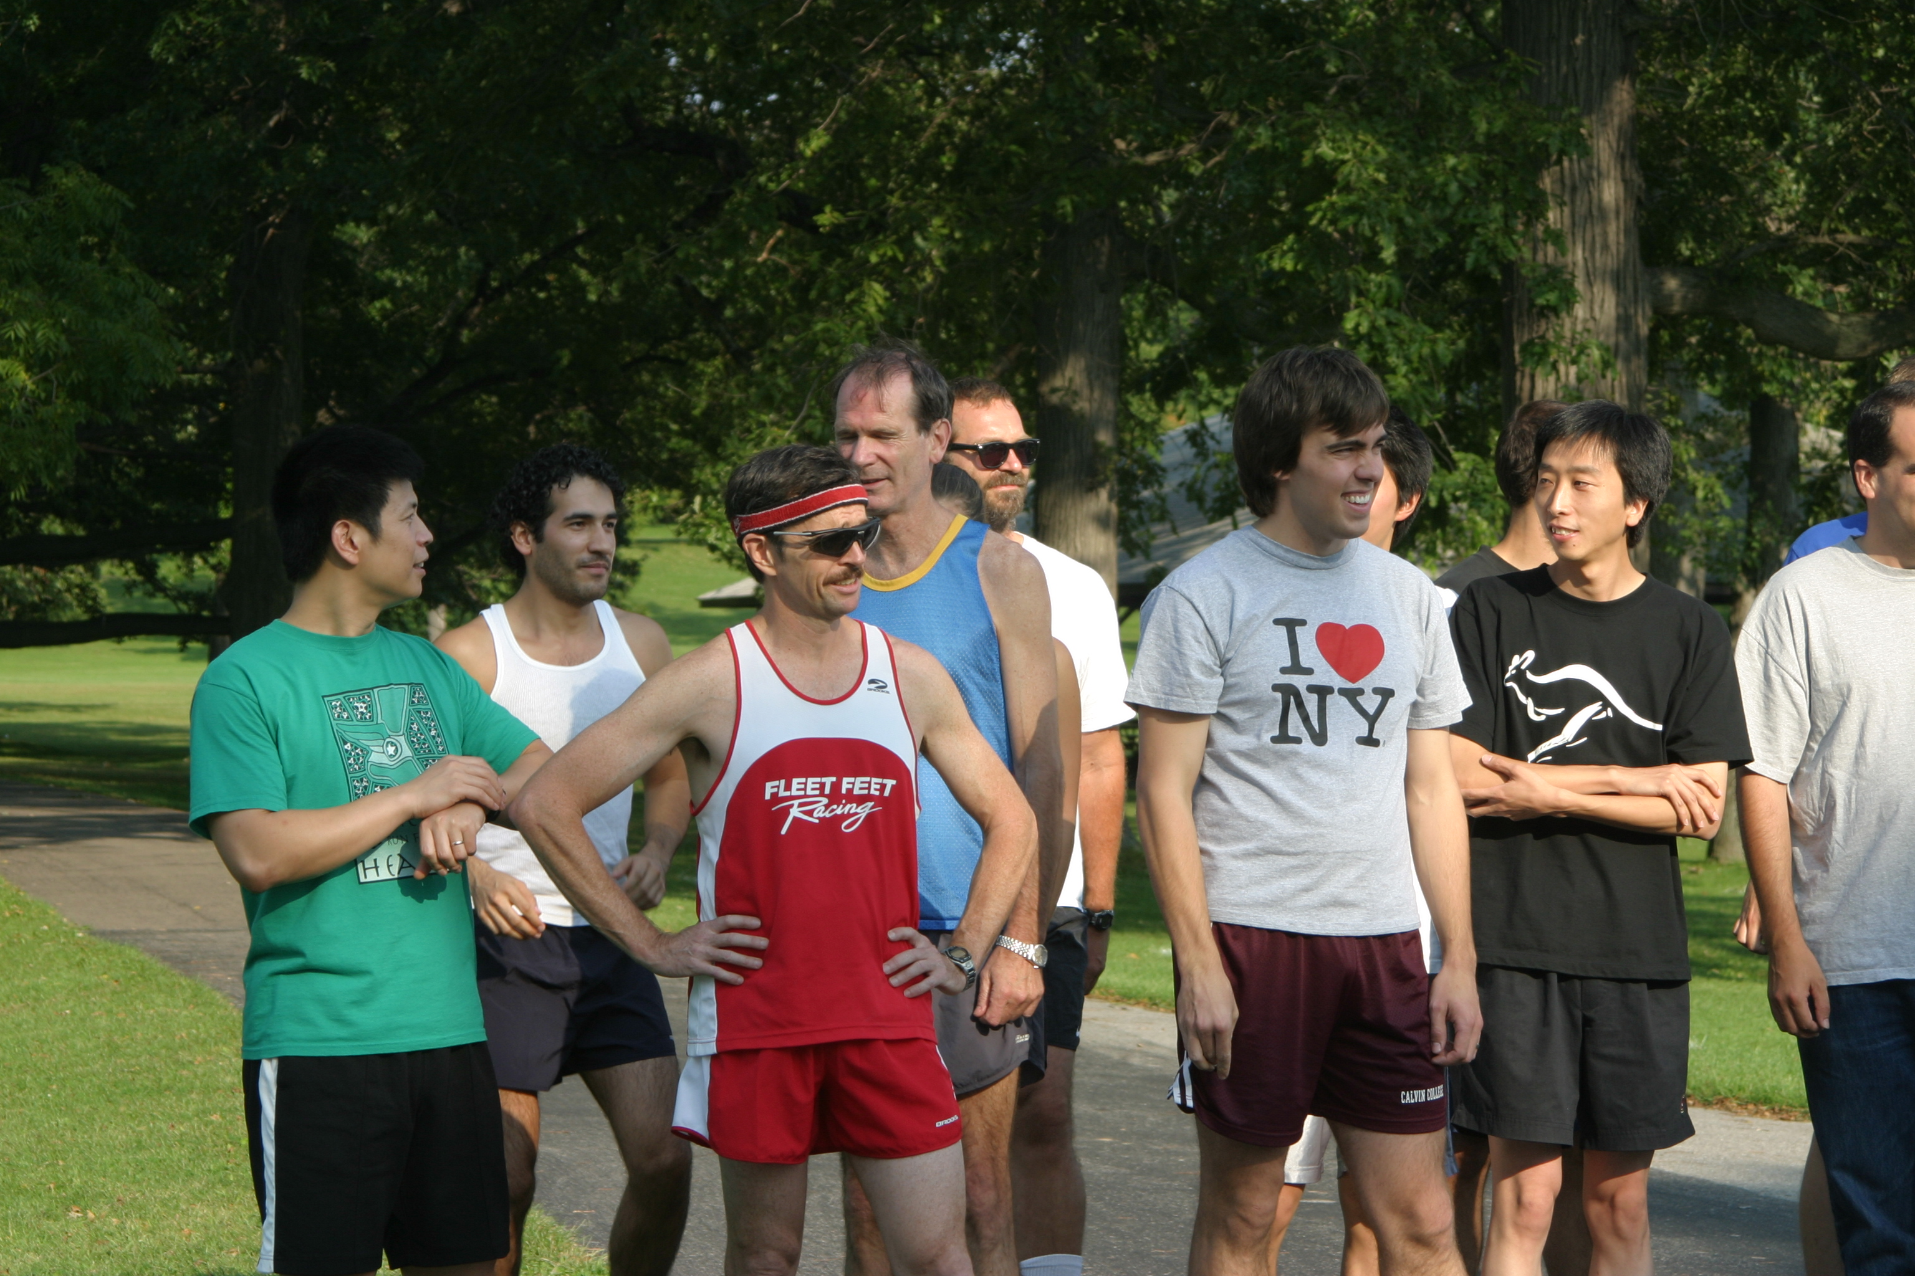

Slide 55
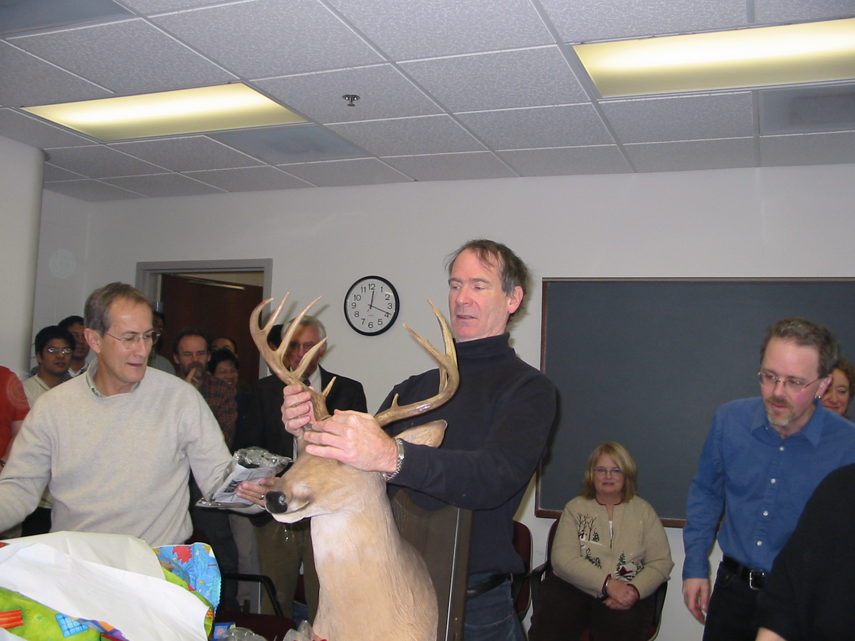

Slide 56
Ryan Korsak ‘07
I can't believe Chris Brown is retiring! I'm both happy for him and sad for the future generations of students who will be deprived of his tutelage. While I can't pick a single favorite professor from my time in Rochester, CB is certainly in the pantheon of the best.

Slide 57
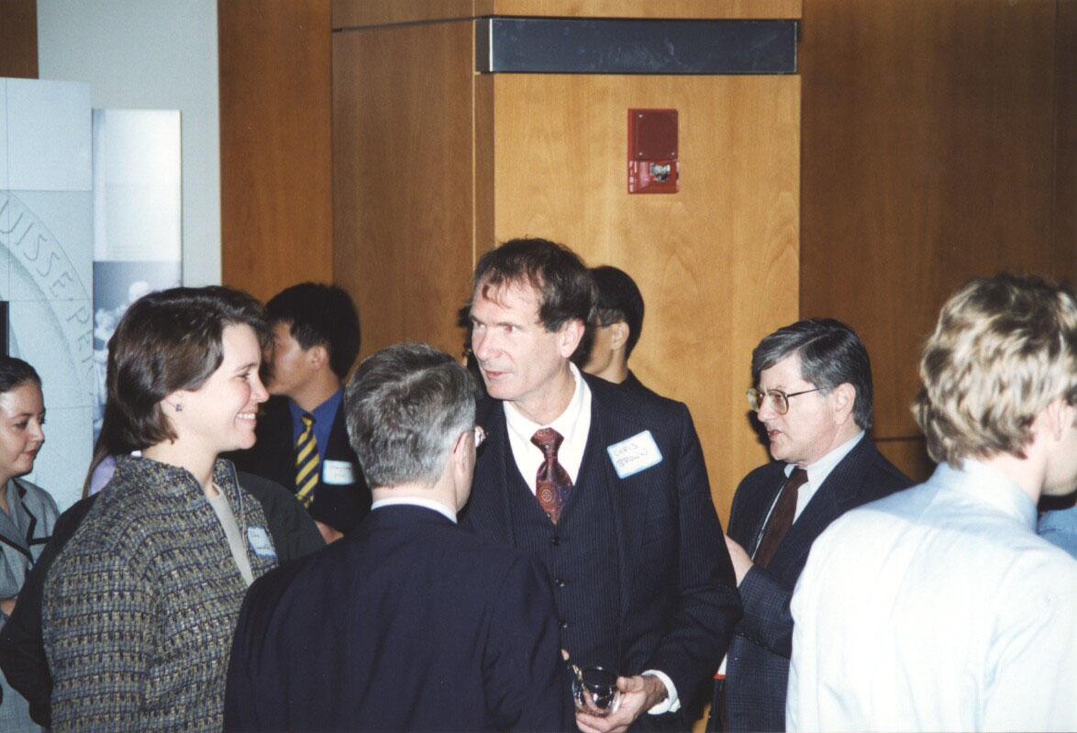

Slide 58
Andrew Richardson ‘11
It will be sad for Rochester to lose Chris Brown. His class was the only one I failed as a student, but he failed me because he had high standards, so I always admired his dedication to pushing students and not accepting substandard work.

Slide 59
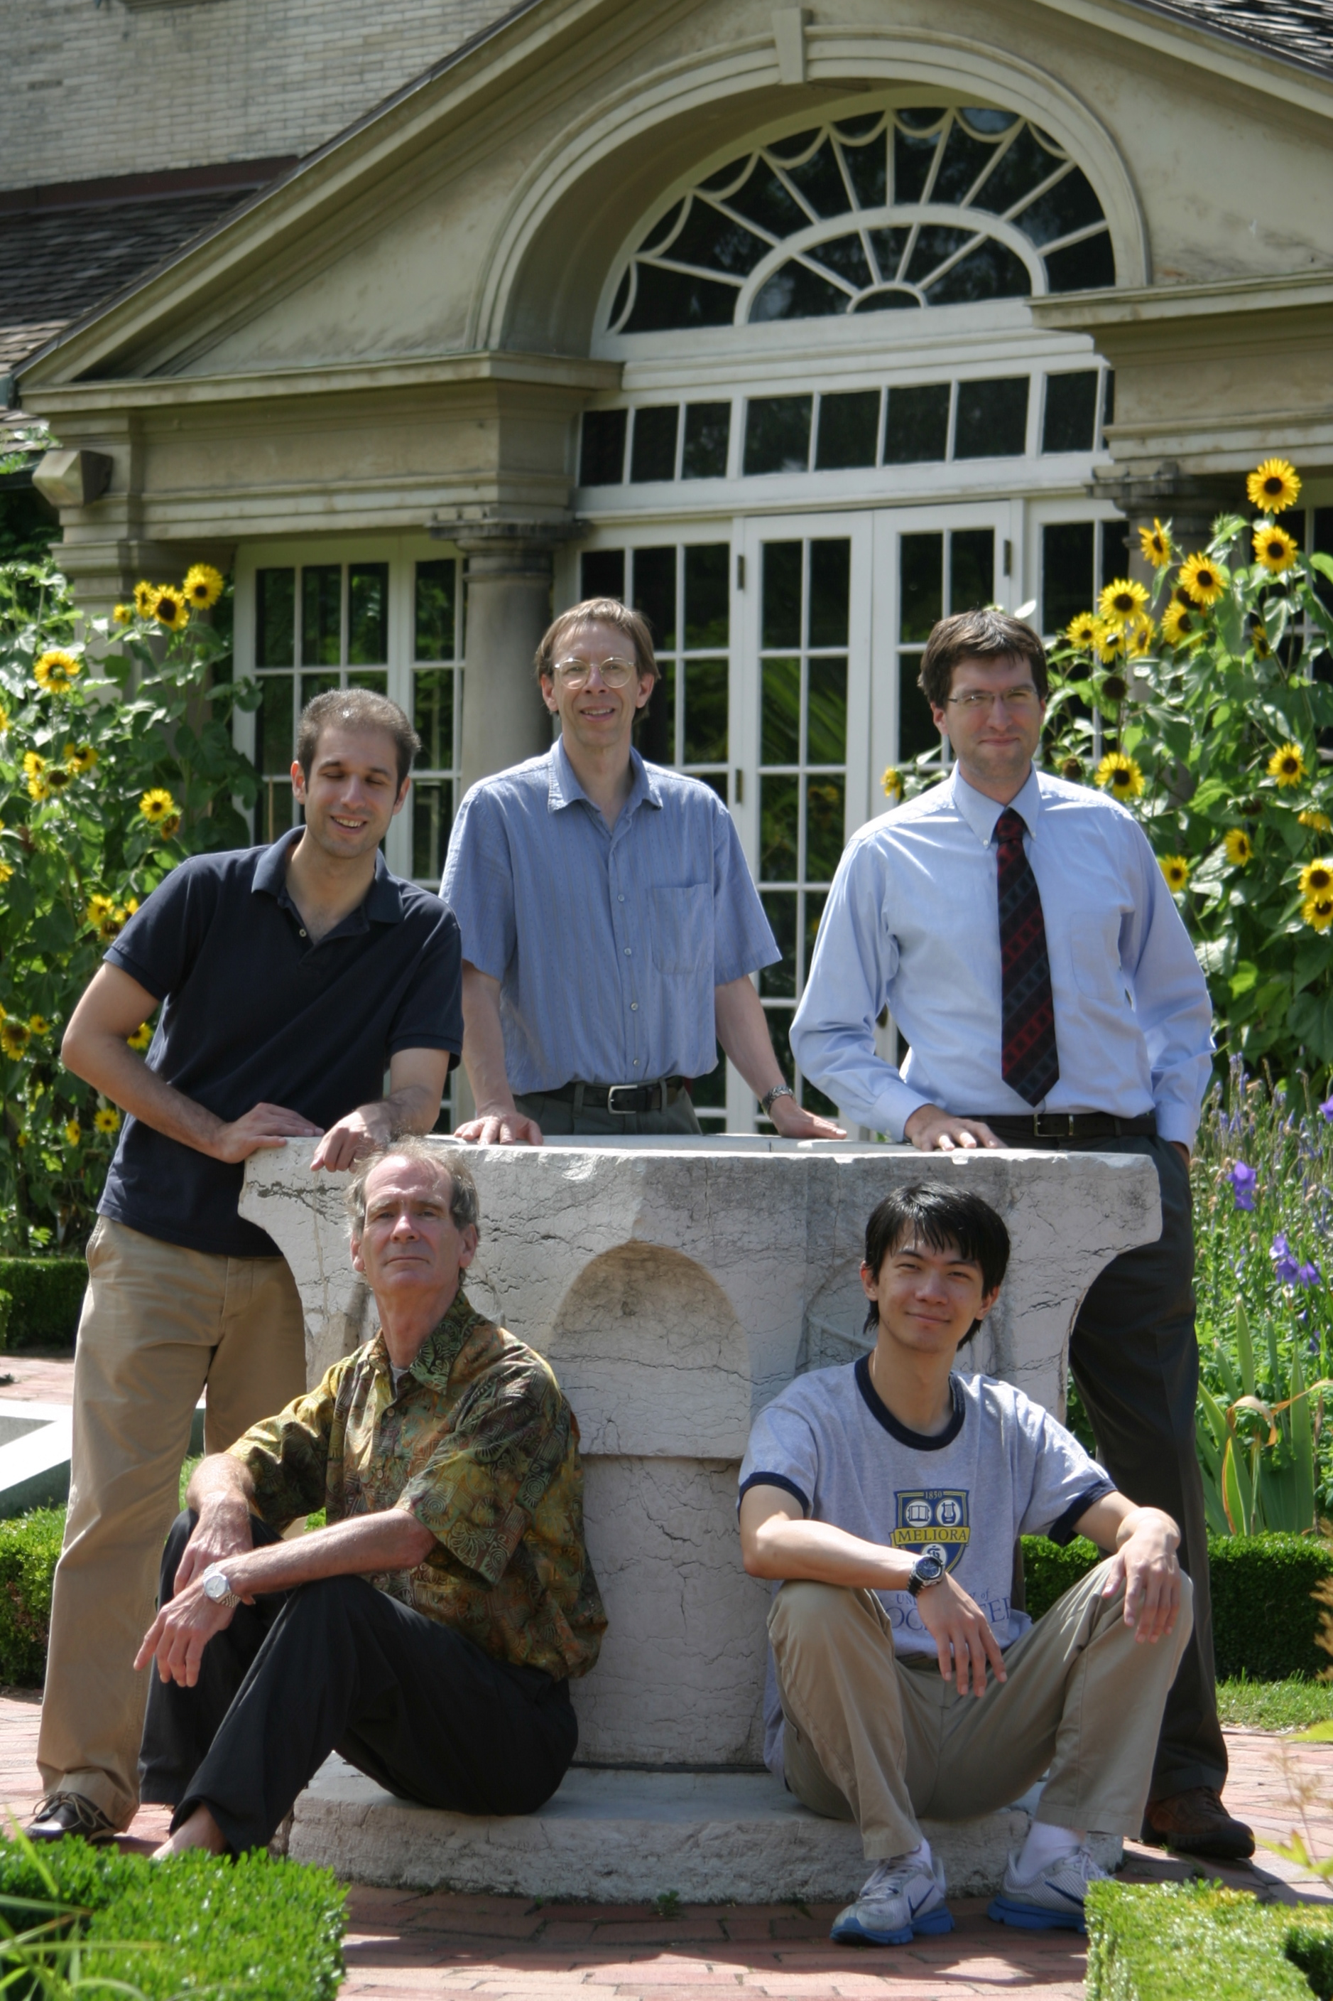

Slide 60
Michael Silverman ‘08
I still remember messing with Quagents back in Chris Brown's AI course. It was a lot of fun and I learned a ton.

Slide 61
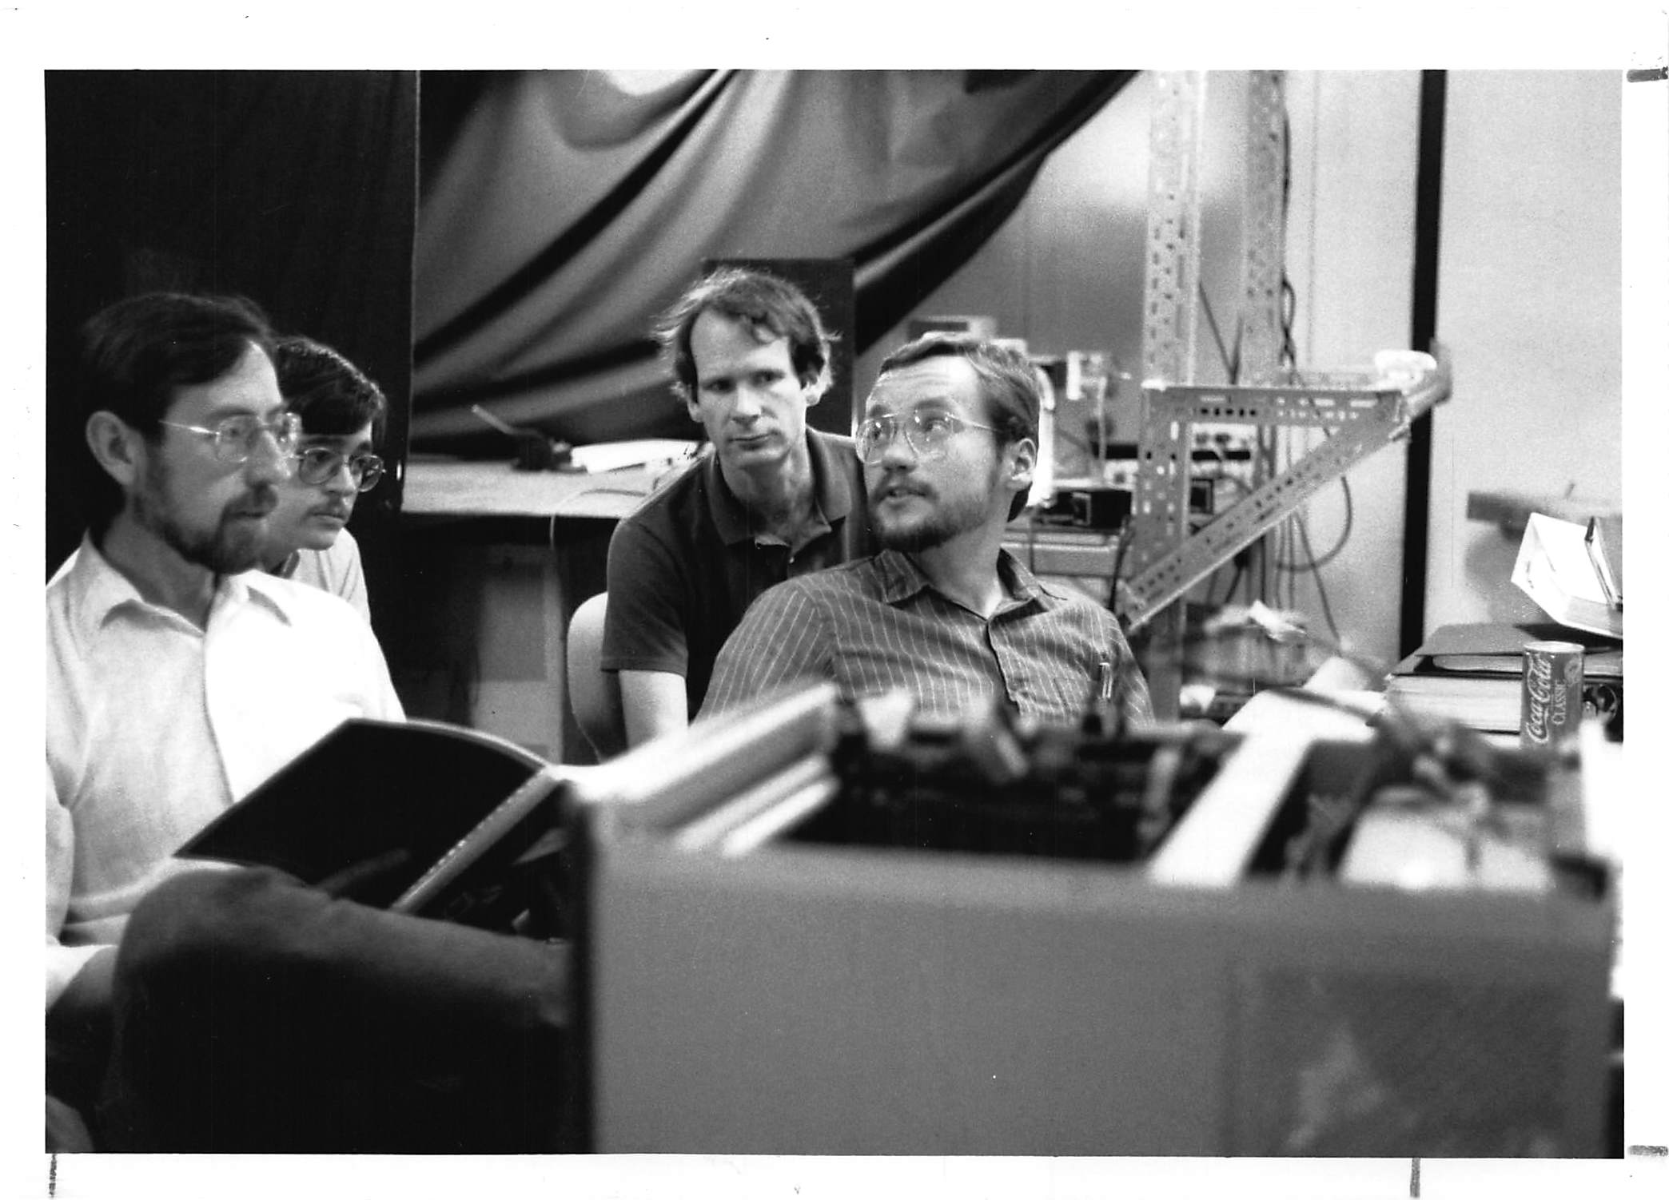

Slide 62
Jake Pershing ‘10
I took both CSC173 and CSC242 with CB, and really had a blast during both courses. Our instance of 173 was the first time CB had taught that course in a long time, and the impression we got is he changed things up and that the changes have been lasting. 242 was also a great experience, I'm still very much of the opinion that AI is a dark art, but it was fun to peer into some of the math/algorithms behind the truly hard problems in computer science. These aren't specific memories, (my clearest memories of CB involve his discussions with my wife about native Caribbean culture, and him yelling at Brad for falling asleep during class) but I carry a great fondness for CB, and wish him the very best!

Slide 63
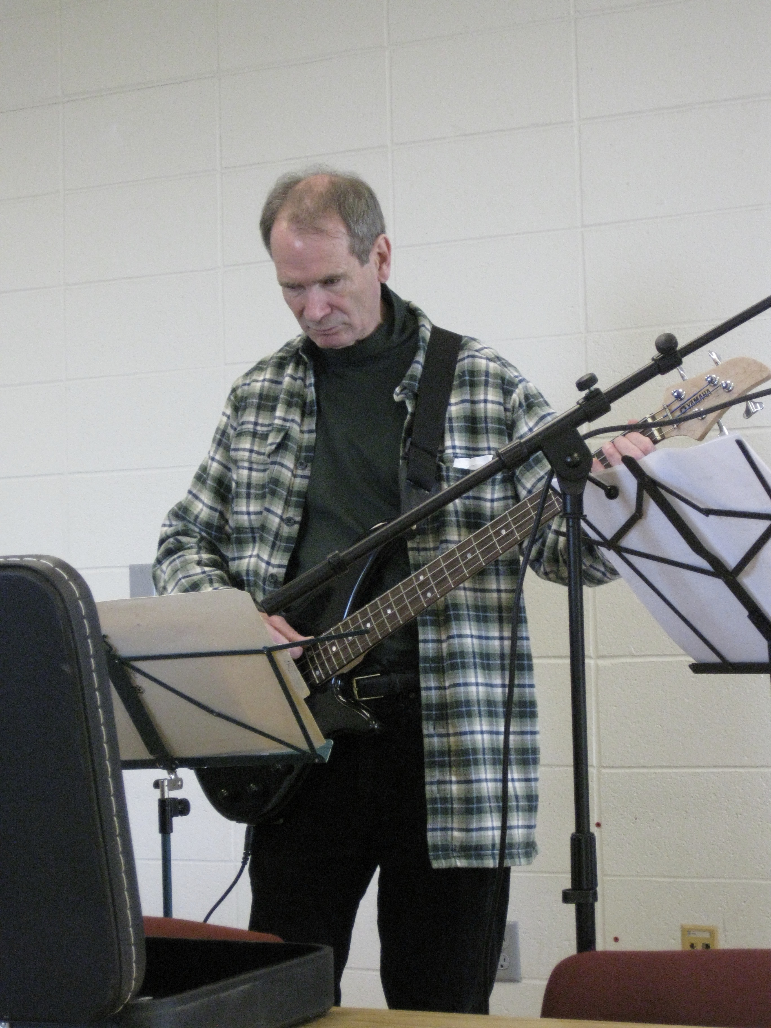

Slide 64
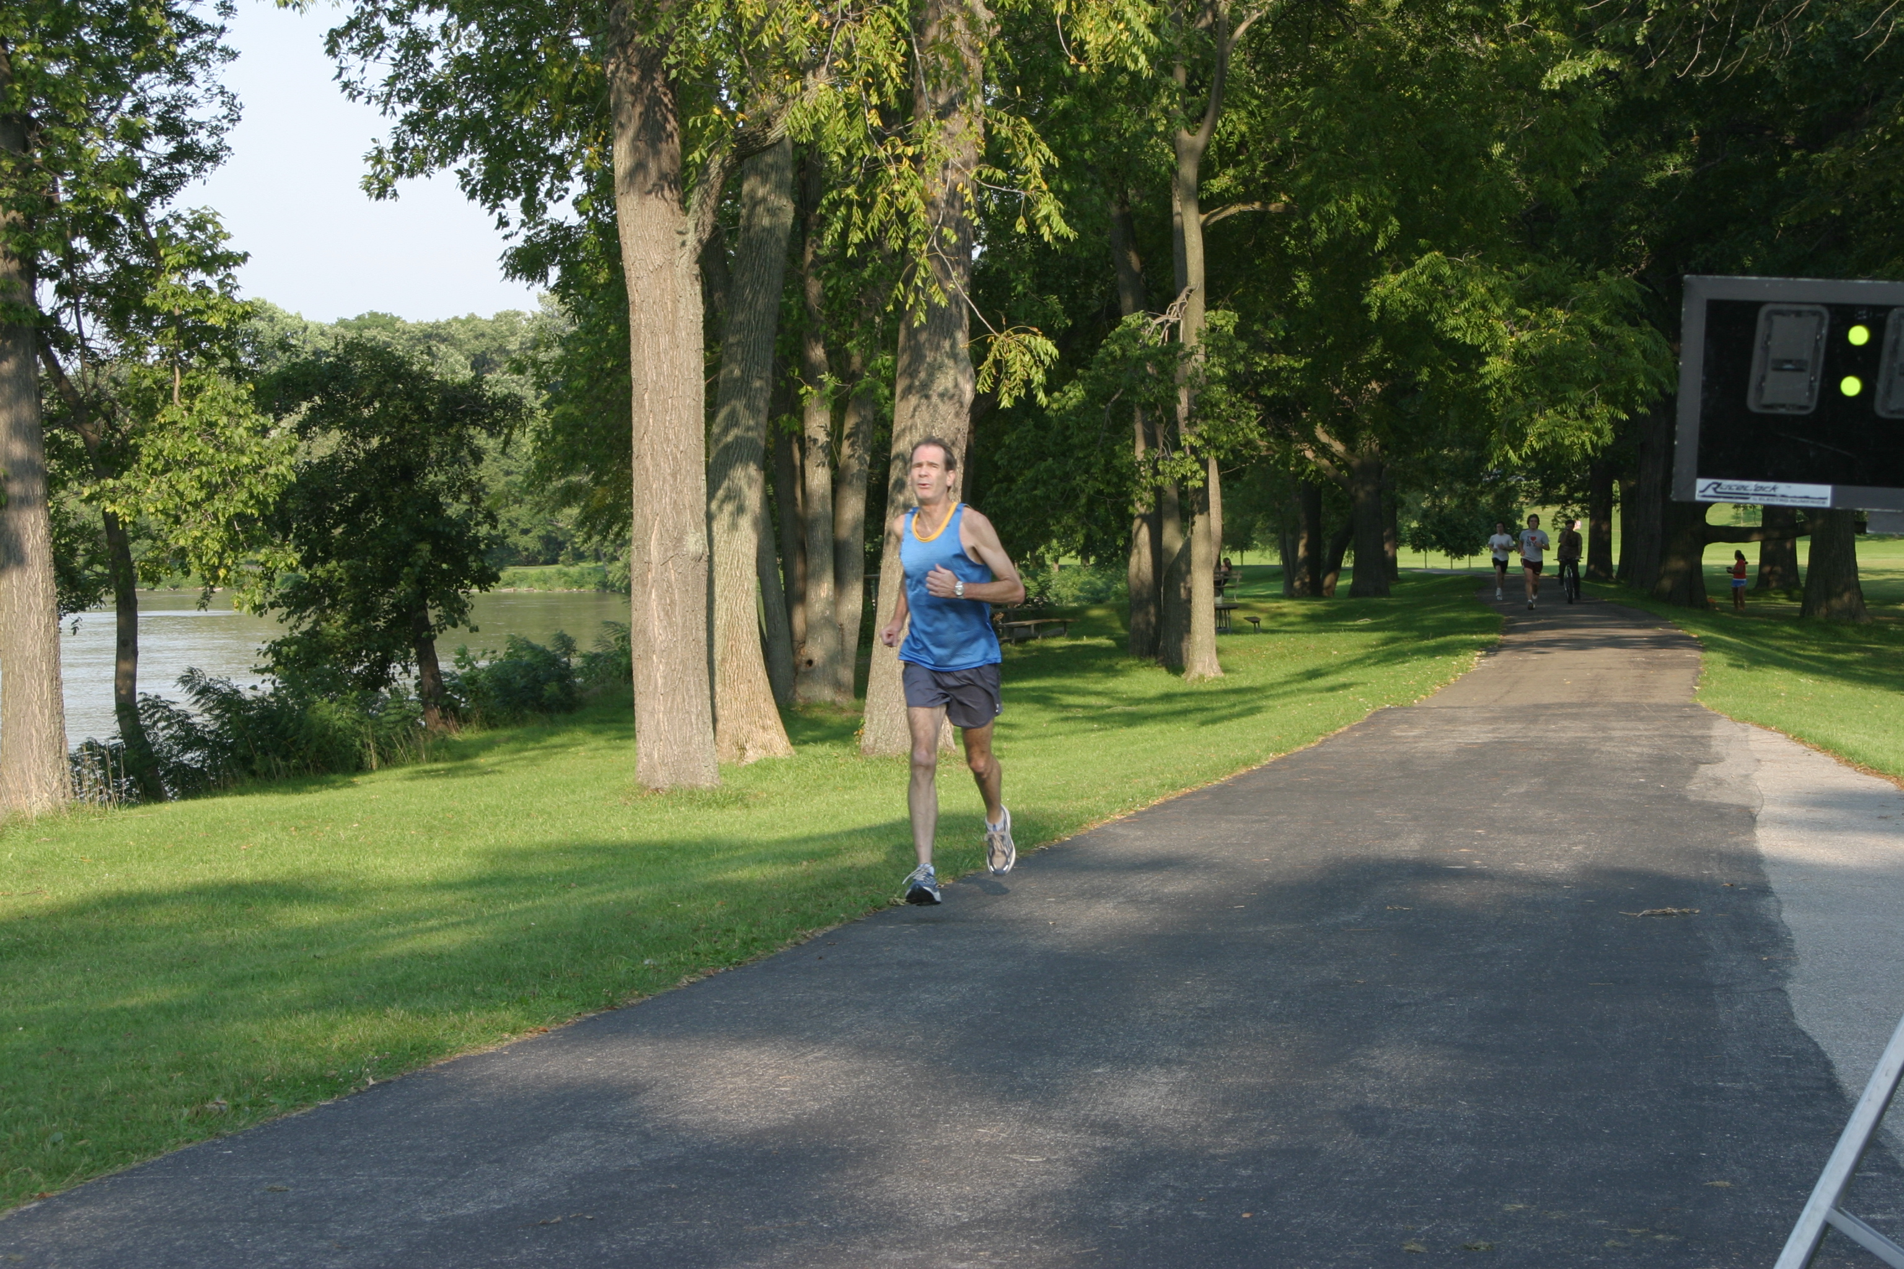

Slide 65
