Slide 1
Secure Guest Virtual Machine Support in Apparition
Ethan Johnson
Department of Computer Science
University of Rochester
In collaboration with Komail Dharsee and John Criswell

Slide 2
Two kinds of “VMs”
“Compiler-based VM”
“Guest VM”
Restricts expressivity of architecture through virtual instruction set
Enforces policy through instrumentation and run-time checks
A simulated full system
Managed by a hypervisor
Runs its own OS, apps independently
→ Examples: CLR,
Secure Virtual Architecture
(Criswell et al., SOSP ‘07)
→ VMX supports these

Slide 3
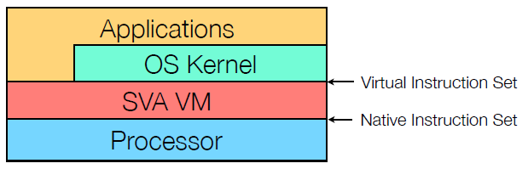
Compiler-based VMs:
Secure Virtual Architecture
Virtual ISA for secure low-level software
OS kernel in C/C++ compiles to extension of LLVM IR
Special virtual instructions replace kernel assembly code

Slide 4
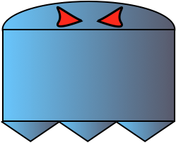
Protecting applications from the OS
Compiler-based VM can enforce many policies
Virtual Ghost lets user-space apps hide memory from kernel
(Criswell et al., ASPLOS ‘14)
Performance overhead only on kernel mode, not user mode
Virtual Ghost
Protected by
Software Fault Isolation (SFI)
User
Memory
Ghost
Memory
Kernel
Memory
0
2⁶⁴-1

Slide 5
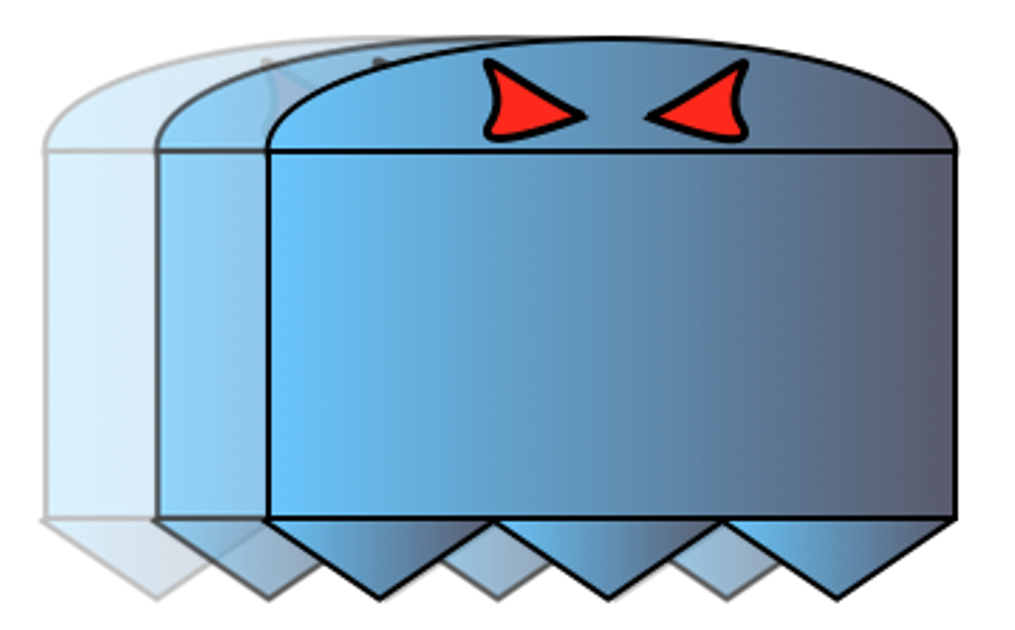
Side-channel protections
Apparition added side-channel protections to Virtual Ghost
(Dong et al., Usenix Security ‘18)
Prevents kernel, other apps from attacking ghost memory via:
  Last-level-cache side channels
  Page-fault side channels
Apparition

Slide 6
The other kind of VMs, in Apparition
Want to run hypervisors under Apparition
…but VMX isn’t part of the V-ISA
OK, so just extend the V-ISA. “How hard can it be?”
Software
V-ISA
■○●□ ■○●□ ■○●□
Native ISA
■○●□ ■○●□ ■○●□ ■○●□

Slide 7

Introducing “Shade”
Adds hardware virtualization support to Apparition
Preserves protections for ghost memory on the host
Mitigates side-channel attacks by guests and compromised kernel/hypervisor

Slide 8
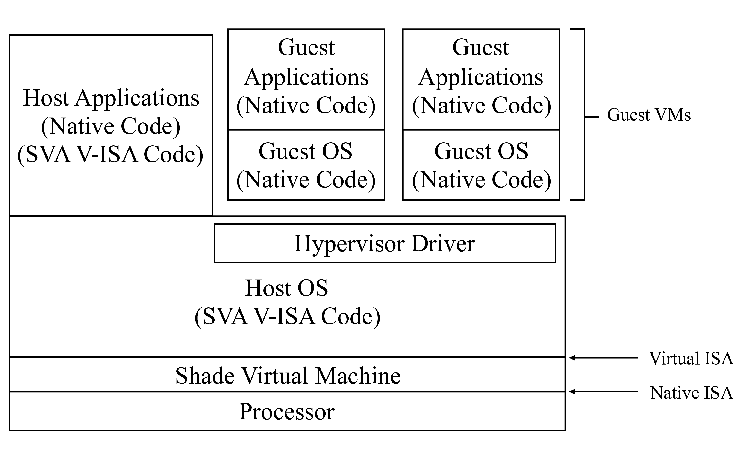
Shade architecture

Slide 9
Key challenges we address
Control flow integrity across VM entry/exit
Hypervisor manages EPT but must not access ghost memory
Over-powered guest could allow OS/hypervisor to escape Shade
Side-channel mitigations

Slide 10
Control flow integrity on VM entry/exit
VMX allows hypervisor to set arbitrary host state on exit
  …including RIP
  …and RSP, processor mode, segment registers…
Easy for hypervisor to corrupt CFI, defeat enforcement
Normal Control Flow
Hijacked Control Flow
Host
Host
Guest
Guest
VMLAUNCH
VMLAUNCH
Skips over SFI, CFI checks

Slide 11
Control flow integrity on VM entry/exit
Shade must take control of VM entry/exit
  Single virtual instruction for running a guest
    Function call semantics
  State saved/loaded from protected memory
VMCS lives in ghost memory
  Virtual instructions for reading and writing
  Checks on values written
Virtual instructions to access saved/loaded guest registers

Slide 12
Virtual instructions
Allocate/free VMCS
Load/unload VMCS onto processor
Get/set guest registers managed by Shade
Read/write VMCS fields
Run VM guest

Slide 13
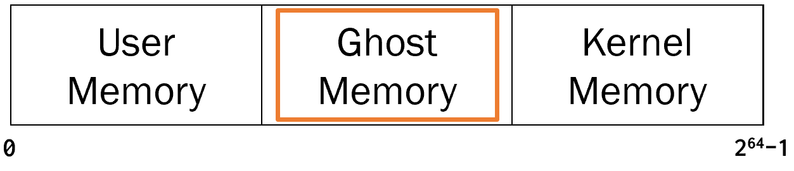

Protecting ghost memory
Hypervisor must be able to add/remove EPT mappings
But EPT could map protected memory into a guest
EPT
Guest VM
Guest VM
Hypervisor
Host OS

Slide 14
Protecting ghost memory
Similar problem exists for host OS page table config
Page tables stored in ghost memory
Virtual instructions for MMU config
  Shade tracks metadata on physical frame usage
Checks prevent insecure EPT mappings
  Ghost memory
  Host page-table pages (regular + extended)

Slide 15
Virtual instructions for EPT
Declare/undeclare PTP
Update mapping
Load root EPT pointer

Slide 16
Preventing over-powered guests
VMX allows guests to run native privileged code
  Not normally permitted in an SVA-based system
  No opportunity to add instrumentation
Guest effects on privileged state must be contained to guest
Nothing host kernel not allowed to do should persist after VM exit

Slide 17
Preventing over-powered guests
Some privileged state virtualized by hardware
  CR3 with extended paging
  Control registers saved/loaded atomically on entry/exit
Other privileged state must be managed by hypervisor
  Kernel MPX registers used by Shade for SFI
  Shade must handle save/load during entry/exit
Unused features can still be a threat
  New processor features, MSRs
  Shade checks VMCS writes to enforce safe defaults (VM exit)

Slide 18
Side-channel attacks
Cache partitioning with Cache Allocation Technology (CAT)
  Host kernel
  Shade VM
  Ghosting apps
Must switch partition on VM entry/exit
  VMs run in kernel/hypervisor partition
  Possible to give each VM its own partition
VMCS checks prevent guest access to CAT MSRs
L3 Cache Partitions
Host Kernel + Guest VMs
Shade VM
Ghosting App
Ghosting App
Ghosting App
Ghosting App

Slide 19
Empirical evaluation

Slide 20
Benchmarks
Extended Apparition prototype
  FreeBSD 9.0 kernel ported to V-ISA
  LLVM passes for SFI, CFI unmodified
LMBench kernel latency benchmarks
  Verify no new impact on host applications over Apparition
Hypervisor microbenchmarks
  Overheads of virtual instructions over native VMX operations
  Hypothesis: hypervisor latency dominated by other factors

Slide 21
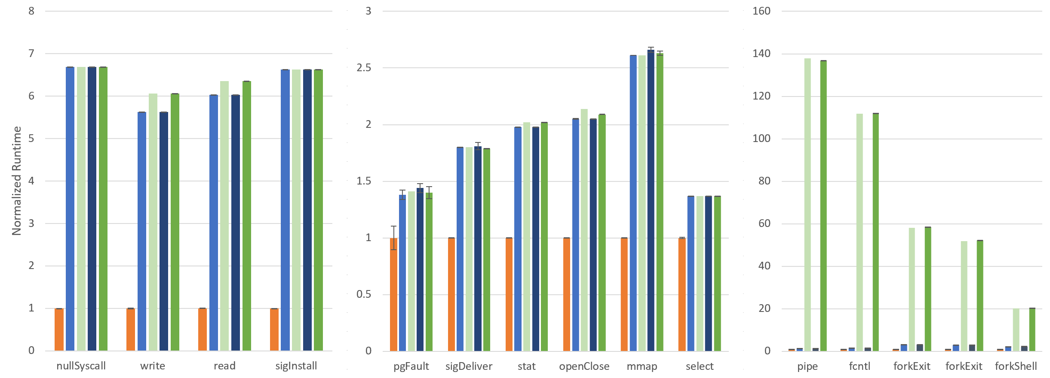
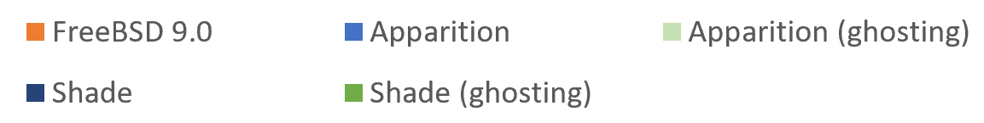
Host kernel benchmarks
Kernel execution only; lower overhead for applications
No new overheads over Apparition

Slide 22
Host kernel benchmarks - outliers
Only affect ghosting applications
No new overheads over Apparition
Due to side-channel protections
  Pre-allocating ghost memory affects fork()
  Cache partitioning

Slide 23
Hypervisor microbenchmarks
Overheads should not noticeably affect hypervisor performance

Slide 24
Future work
Port full commodity hypervisor
  FreeBSD’s bhyve
  VirtualBox
Protect guests from malicious hypervisor
  Mitigate cloud compromise scenarios
  VM exit handling, device virtualization pose challenges
Prevent exploitation of hardware bugs
  Processor bugs in VMX implementations

Slide 25
Summary
Using VMX in existing Apparition system would compromise security
We extend V-ISA to expose VMX in a “clean” way
Minimal impact on hypervisor performance

