Slide 1
FlashFQ: A Fair Queueing I/O Scheduler for Flash-Based SSDs
Kai Shen and Stan Park
University of Rochester

Slide 2
Flash I/O Fairness
NAND Flash storage devices achieve fast I/O without mechanical seek/rotation delay
High efficiency when no OS scheduling (passing requests to device without delay or reordering, Linux noop)
But fairness is important in multi-task systems and clouds
Concern: heavy I/O operations can unfairly block light operations (e.g., writes block reads, large I/O block small I/O)
Existing fair I/O schedulers are mostly timeslice-based
Linux CFQ, Argon [Wachs et al.’07], FIOS [Park and Shen’12]
Timeslice schedulers may exhibit poor responsiveness, particularly when there are large number of co-running tasks
Timeslice schedulers can’t easily exploit device parallelism

Slide 3
Fair Queueing Resource Scheduler
Originated in network packet scheduling
Weighted Fair Queueing [Demers et al.’89], Processor Sharing [Parekh’92] and others
Virtual time-based fairness
Virtual time roughly indicates accumulated resource use for a task
Balancing virtual time progression (equal resource usage) by dispatching the request from task with slowest virtual time
Management of under-utilizing tasks
Those who do not immediately use allotted resource
Prevent them from building up unused resources for bursty dispatches

Slide 4
Timeslicing vs. Fair Queueing
Timeslice scheduling
Fair queuing (more responsive)
Fair queuing (allow parallelism on parallel device)

Slide 5
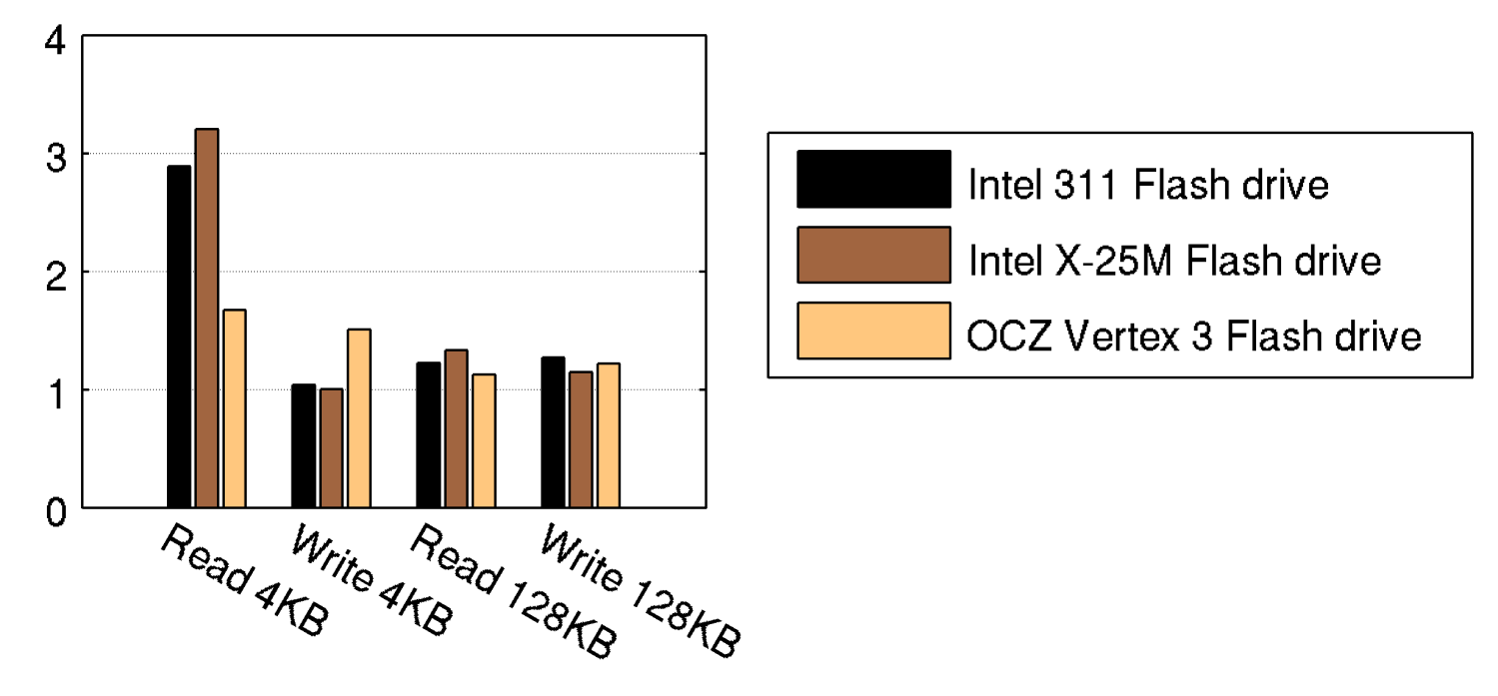
Concern: Loss of Spatial Locality
Fair queueing with frequent task switches loses spatial locality
Significant problem for mechanical disks
Less a problem for Flash drives
Logically random writes become physically sequential writes through block remapping at firmware
Ratio of random I/O latency
over sequential I/O latency

Slide 6
FlashFQ Design Basis
Build on SFQ(D) [Jin et al.’04]
A request’s start tag is roughly the owner task’s accumulated resource usage before its service (task virtual time)
Request dispatches are ordered based on their start tags for fairness
Parallel dispatches are allowed up to the depth D
Prevent under-utilizing tasks from building up unused resources
System virtual time: minimum virtual time of all active tasks
System virtual time is the lower bound of request start tags  bring forward the virtual time of under-utilizing tasks after inactivity  forfeiture of unused resources

Slide 7
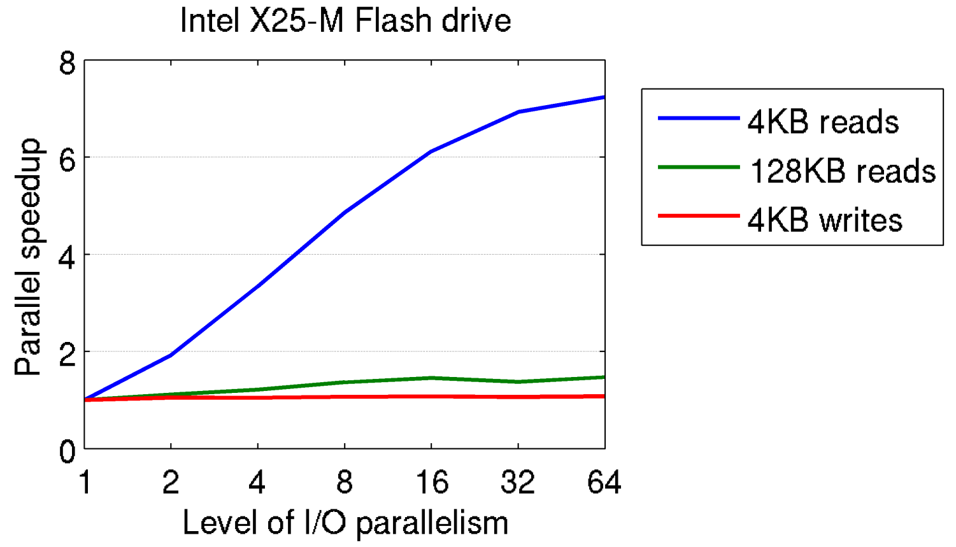
Challenge: Restricted Parallelism on Flash
Parallel I/O sometimes improves efficiency but interference exists among concurrently dispatched I/O operations
Challenge: exploit parallelism but manage interference

Slide 8
Solution: Throttled Dispatch
Given interference, parallel dispatches without control leads to unfairness
E.g., a writer would utilize much more resource than a reader does
Our Approach:
Account for each task’s resource usage
Throttled dispatch – block a task if its resource usage is excessively ahead of the slowest task, who will then catch up at less interference

Slide 9
Challenge: Deceptive Idleness
Existing fair queueing schedulers are work-conserving
They never idle the device when there is pending work
Deceptive idleness
An active task that issues the next I/O request a short time after receiving the result of the previous one temporarily appears idle
Work-conserving schedulers fail to recognize deceptive idleness
Known to cause poor performance on disks [Iyer and Druschel’01]
Little performance impact on Flash, but cause poor fairness
While a task is deceptively idle, the system virtual time may advance while forfeiting its resources

Slide 10
Solution: Anticipation for Fairness
Anticipation: Let a task stay “active” continuously when deceptive idleness appears between its consecutive requests
System virtual time considers such “active” task’s next anticipated request as a hypothetical outstanding request
Throttled dispatch also considers such “active” task when deciding whether another task is an excessive resource over-user
Work-conserving or not
Anticipation #2 may idle the device while there is pending work  wasted resources
Anticipation #1 maintains the work-conserving property
Differentiated anticipation timeouts

Slide 11
Discussion: Knowledge of Request Cost
Need to know a request’s resource use before it completes
Finish-time-based fair queueing
Start-time-based fair queueing that allows parallelism
We estimate an I/O operation’s resource use based on its type (read/write) and size
For reads and writes respectively, we assume a linear model (non-zero offset) between the I/O size and its resource use

Slide 12
Implementation Issues
We implement FlashFQ in the OS (Linux) to regulate I/O resource by concurrent applications
Can also be implemented in a virtual machine monitor to manage I/O resource among VMs
Queue plugging and request merging
Critical performance enhancement technique
Complication for fair queueing scheduler (re-computing virtual time tags for requests and tasks)
I/O context: the Linux resource principal to receive fairness
Hard to use (impossible to group multiple threads together)
Bug on process grouping
Journaling daemon, inappropriately, has a unique I/O context by itself

Slide 13
Evaluation Setup
Demonstrate the fairness and responsiveness of FlashFQ
Compare against several alternatives:
Raw device I/O (Linux noop)
Linux CFQ – timeslice-based, but a timeslice ends if the task appears to be idle (even deceptively idle)
Quanta – strict enforcement of timeslices
FIOS – our previously-developed timeslice Flash scheduler [FAST’12]
4-Tag SFQ(D) – no support for throttled dispatches or anticipation for fairness

Slide 14
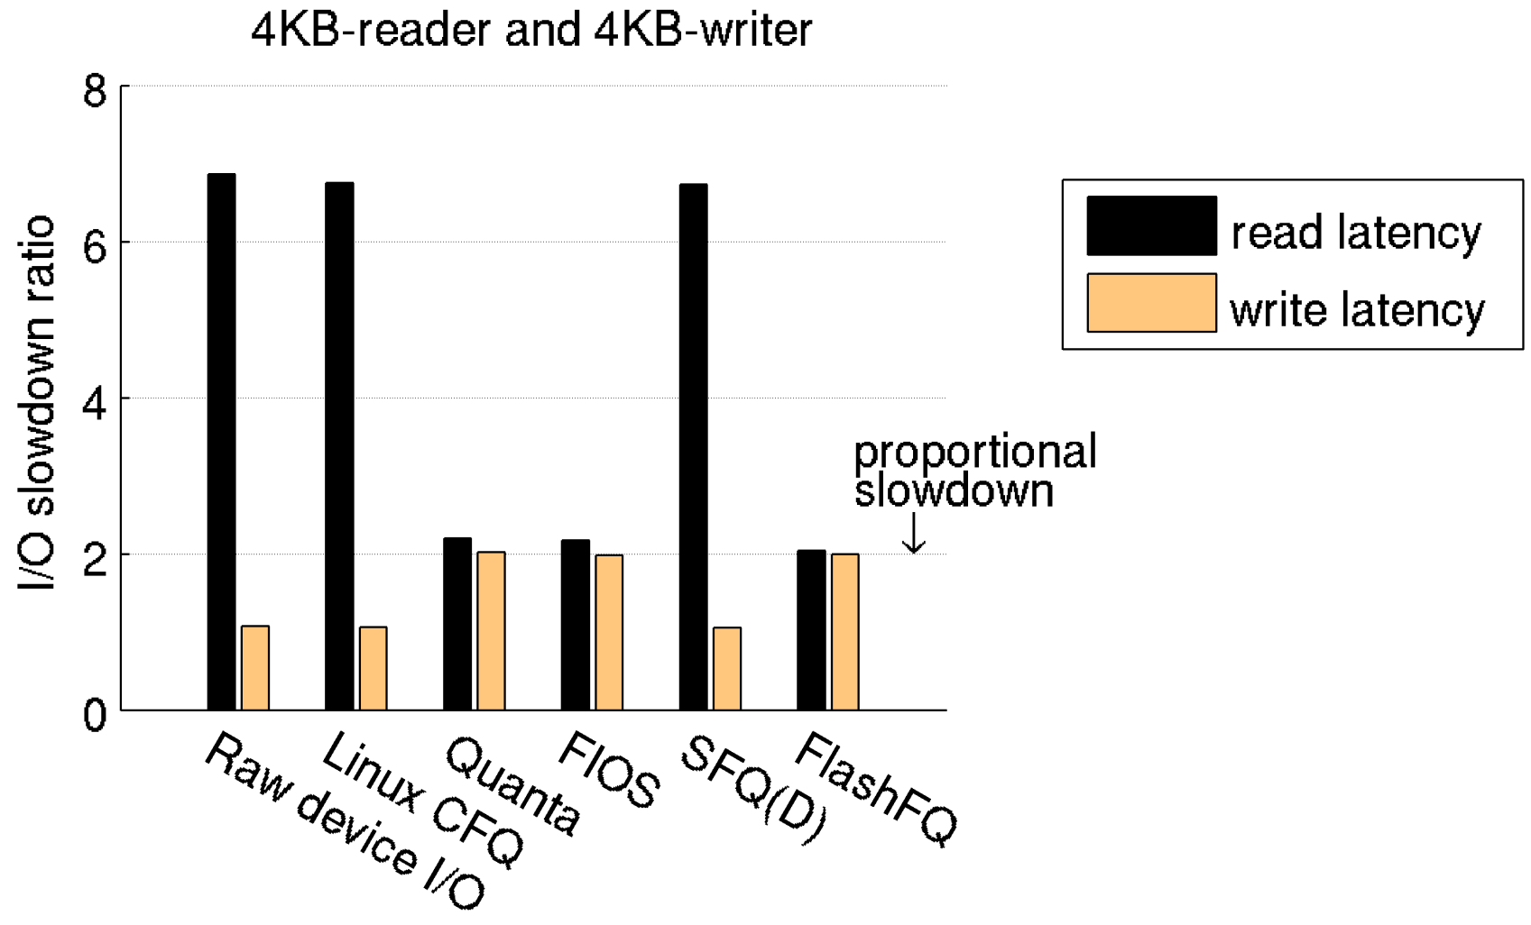
Evaluation on Fairness
Only Quanta, FIOS, and FlashFQ achieve fairness

Slide 15
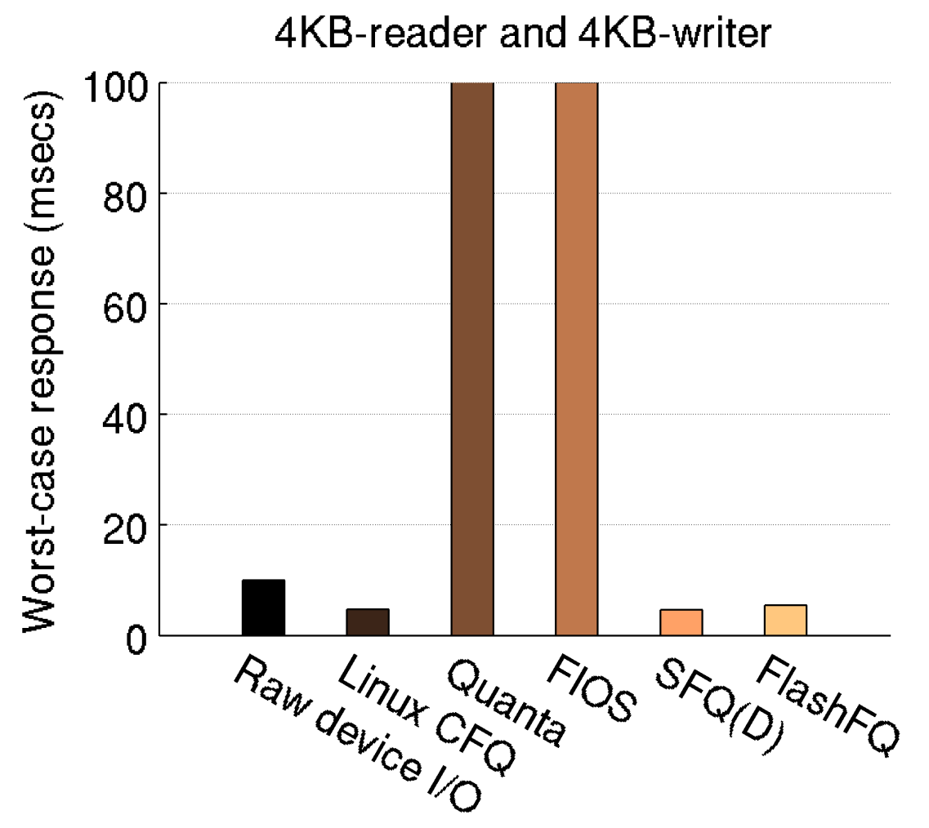
Evaluation on Responsiveness
Only FlashFQ achieves fairness and responsiveness

Slide 16
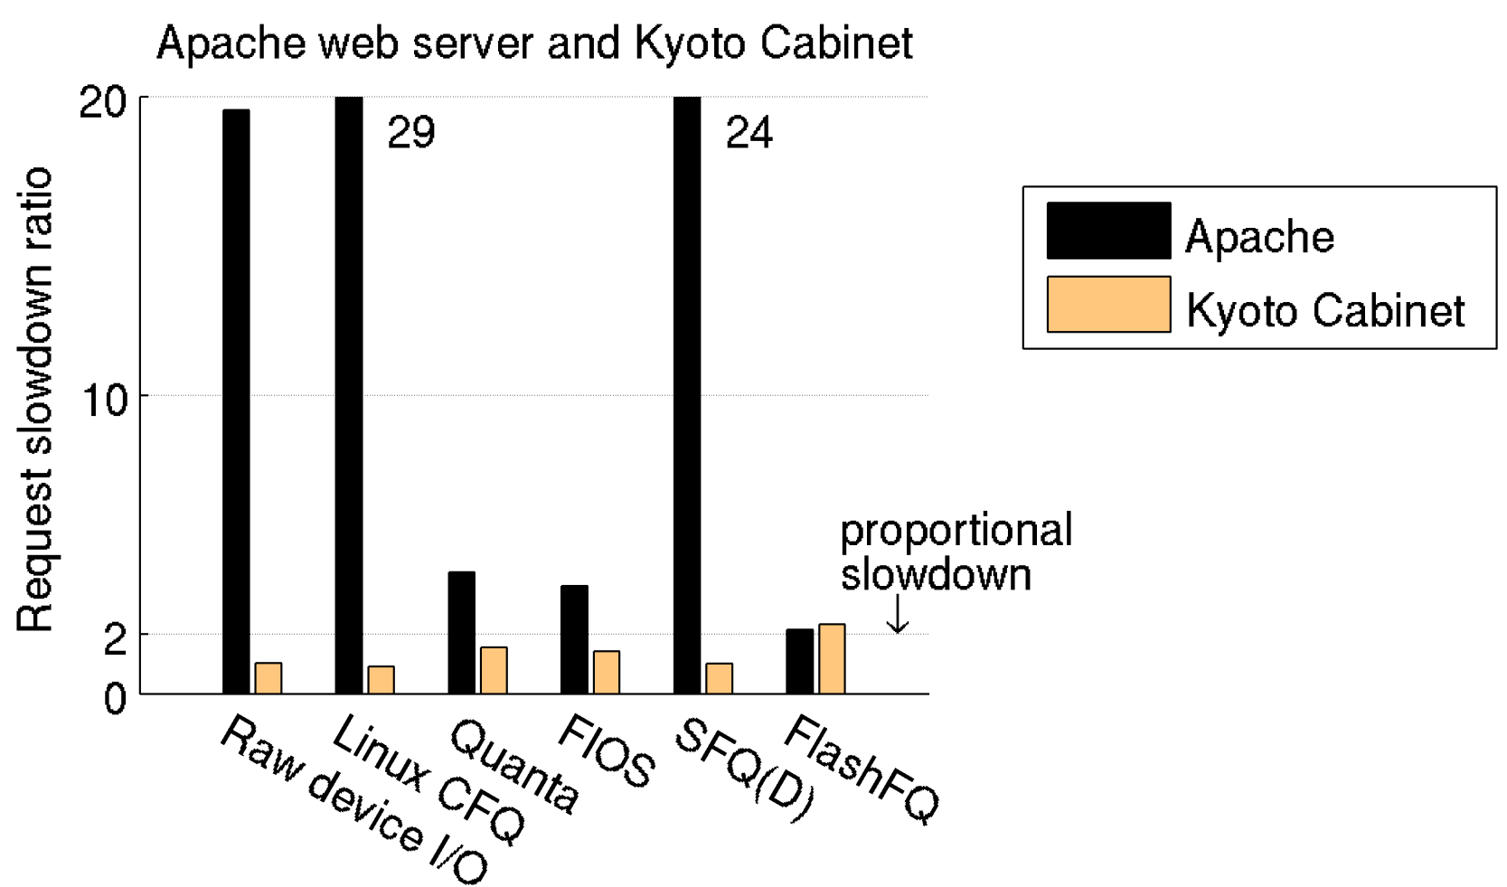
Evaluation with Apache and KyotoCabinet
Apache web server: reading mostly small files
KyotoCabinet key-value store: replacing large (128KB) records

Slide 17
Conclusions
Fair queueing is well suited for Flash I/O scheduling
Mostly work-conserving (efficient), fair, and highly responsive
Support I/O parallelism on Flash
Loss of spatial locality isn’t a big concern on Flash
FlashFQ
Build on classic fair queueing with parallelism
Throttled dispatch to address restricted parallelism on Flash
Anticipation for fairness to address deceptive idleness
Practical lessons
Require knowledge (estimation) of request cost
Linux implementation: queue plugging and request merging, proper I/O context maintenance (journaling)

