Slide 1
Automated Scoring of Picture-based Story Narration
Swapna Somasundaran
Chong Min Lee
Martin Chodorow
Xinhao Wang
Notes:
The work that I’ll be describing was carried out over the past year at Educational Testing Service by Swapna Somasundaran, Chong Min Lee, Xinhao Wang, and me. Our goal was to improve automated scoring of picture-based story narration, which is one type of test item on the TOEFL Junior Comprehensive Test.

Slide 2
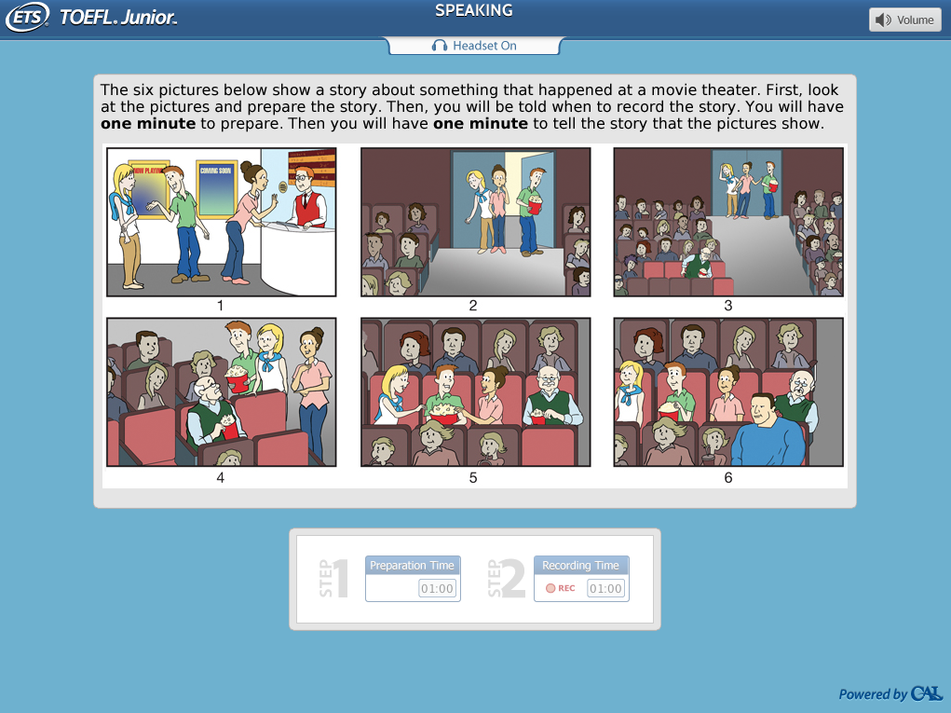
Picture-based Story Narration
Item in ETS’s TOEFL Junior Comprehensive Test
Test for English language skills of non-native middle school students
Test elicits stories based on a series of 6 pictures.
.
Notes:
The TOEFL Junior Comprehensive test is designed for students 11-13 years of age who are studying English as a foreign language. The picture-based story narration is a really interesting task. It’s based on a cartoon without text or captions. Here’s a closer look.

Slide 3
Picture-based Story Narration
Notes:
The instructions for this spoken item are: “ The six ….” At the bottom you see a countdown clock fro the preparation time and another for the recording time of the spoken response.

Slide 4
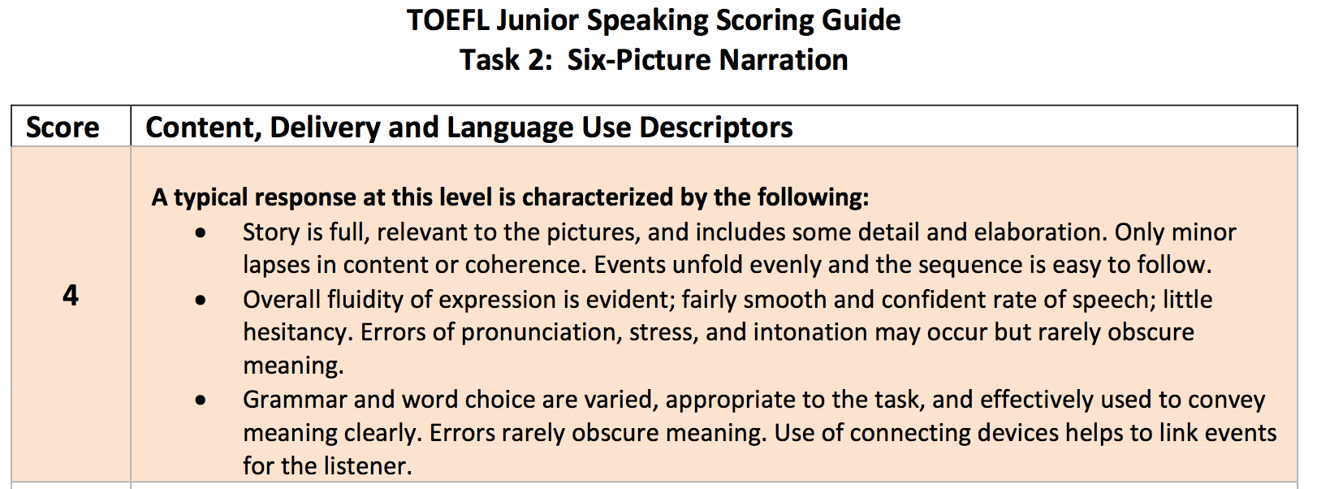
Narrative/ Story Telling
Spoken English
English Language
Responses are scored on a scale from 1 to 4 (best response)
Notes:
The responses are scored on a scale from 1 to 4. At each score point, the scoring rubric lists 3 dimensions of writing, shown as bullet points: Narrative Story Telling, Spoken English quality, and English Language mastery.

Slide 5
Picture-based Story Narration : Evanini and Wang (2013) [EW13]
Fluency
rate of speech, number of words per chunk, average number of pauses, average number of long pauses
Pronunciation
normalized Acoustic Model score, average word confidence, average difference in phone duration from native speaker norms
Prosody
mean duration between stressed syllables
Lexical choice
normalized Language Model score
Notes:
In 2013, Evanini and Wang reported on an automated scoring system for this task that used mainly speech-based measures of fluency (e.g., rate), pronunciation (e.g., AM score), and prosody (e.g., time between stressed syllables), plus a language-model measure of lexical choice. By the way, the word error rate of the automatic speech recognition system they used was for this task about 27%.

Slide 6
Evanini and Wang (2013) Construct coverage
Notes:
The Evanini & Wang feature set addressed only part of the item construct shown here.

Slide 7
Extending the Construct coverage
Notes:
In our work, we have investigated features that we hope will improve the construct coverage. Mainly, we have tried to capture the story-telling aspects of the task.

Slide 8
Features
Sets of features corresponding to parts of the construct
“Story is full, relevant to the pictures”
Relevance
“includes … detail and elaboration”
Detailing
Sentiment
“Use of connecting devices helps to link events ….” “Events unfold evenly and the sequence is easy to follow.”
Discourse
“word choice”
Collocation
Notes:
Quoting from the scoring rubric, we seek to capture the fullness of the story and its relevance to the pictures with a set of features I’ll refer to as “relevance”.
The detail and elaboration in the story will be represented by feature sets “detailing” and “sentiment”.
The event sequencing will be represented by “discourse” features.
And word choice by “collocation” features.
These constitute the 5 feature sets we used in our study.

Slide 9
Features: Relevance
Overlap of the content of the response and the content of the pictures
Content of the pictures: Manually created reference text corpus (per prompt)
detailed description of each picture [objects/events]
an overall narrative that ties together the events in the pictures
Feature: Overlap of the response to the reference corpus
Notes:
Relevance measures the overlap between the response and the content of the pictures.
For each prompt, we asked 10 annotators to provide a detailed description of each picture and an overall narrative of the events in the picture sequence. Our goal here was to collect many independent ways of viewing the pictures and constructing a story consistent with them. These descriptions and stories will assembled into a reference corpus for each prompt.
The relevance feature set measures the overlap between the response and the reference corpus in terms of matching words, synonyms, and other lexical relations described more fully in the paper.
Note:– here I will focus on developing the intuition for our features. The details of how these features are encoded is in the paper

Slide 10
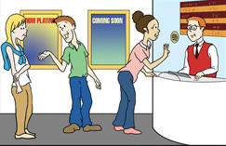
Features: Detailing
Three friends are buying tickets to a movie.
Three friends Anna, John and Mary decided to see a movie. Mary buys tickets from the man in a red vest at the counter.
Notes:
Detailing is the second feature set.
Here are 2 examples showing different levels of detail with respect to the first picture in the sequence.

Slide 11
Features: Detailing
Three friends are buying tickets to a movie
Three friends Anna, John and Mary decided to see a movie. Mary buys tickets from the man in a red vest at the counter
- Adjectives and adverbs come into play in the process of detailing.
- Assigning names to the characters and places results in a higher number of proper nouns (NNPs).

Slide 12
Features: Detailing
Features:
Presence and counts of
Names (NNP)
Adjectives
Adverbs

Slide 13
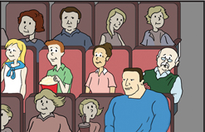
Features: Sentiment
The three friends watched the movie. But Larry could not see as a big man had taken the seat in front of him.
The three friends enjoyed the movie. But Larry struggled to see the screen as a big man had taken the seat in front of him. Poor Larry was very sad.
Notes:
Sentiment is another feature set.
One could just describe what happened as in the first reponse,
or one could describe the affect and experience of the characters,as in the second.

Slide 14
Features: Sentiment
The three friends watched the movie. But Larry could not see as a big man had taken the seat in front of him.
The three friends enjoyed the movie. But Larry struggled to see the screen as a big man had taken the seat in front of him. Poor Larry was very sad.
Subjective language reveals the characters’ private states, emotions and feelings.

Slide 15
Features: Sentiment
Resources
Sentiment lexicon developed in previous work in assessments at ETS (Beigman Klebanov et al., 2013)
MPQA subjectivity lexicon (Wilson et al., 2005)
Features
Presence and count of polar words from both lexicons
Presence and count of neutral words from MPQA lexicon

Slide 16
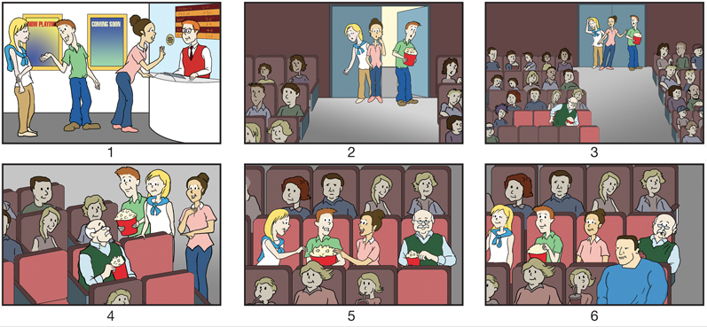
Features: Discourse
Once
When
After (searching)
Soon
Buy tickets
Find theater full
Spot some
seats
Asked to move
Settle in
Movie starts
Unable to see
Move
Eat popcorn
Finally
Eventually
Now that
As soon as
Notes:
Stories are series of events strung together causally and temporally.
Once upon a time three friends Anna, John and Mary decided to go to see the new Star Wars movie. Mary buys the tickets from the man in a red vest at the counter. When they entered the theater, they were disappointed to see that all the good seats were gone. After searching, Mary spotted some seats, but a nice looking gentleman was settling into one of them. They asked him to move, and since Larry was a kind-hearted man, he gladly obliged. Now that they were all settled, they started eating their popcorn. Finally, the movie started. The three friends enjoyed the movie. But Larry struggled to see the screen because a big man had taken the seat in front of him. Poor Larry was very sad.

Slide 17
Features: Discourse
Resource:
Cues from Penn Discourse Treebank
Manually created Discourse Cue lexicon
Features:
Presence and proportion of cues from the lexicons
Presence and proportion of Temporal and Causal cues
Score of Temporal and Causal connectives in the response
Notes:
550 cues
Scores based on probability of each cue being temporal or causal (est. from PDTB)

Slide 18
Features: Collocation
Somasundaran and Chodorow (2014)
PMI values for adjacent words (bigrams and trigrams) are obtained over the entire response and are then assigned to bins.
Features:
proportion of ngrams falling into each bin
Min, Max and Median PMI values
Notes:
We apply features that were developed for a very different task – the task of sentence generation.
PMI based on Google 1T web corpus

Slide 19
Data
3440 responses to 6 prompts
scored by human raters (score from 1 to 4)
automatic speech recognition (ASR) output
 | TOTAL | 1 | 2 | 3 | 4
Train | 877 | 142 | 401 | 252 | 82
Eval | 674 | 132 | 304 | 177 | 61
QWK between human raters for Train is 0.69 and for Eval is 0.70
Notes:
~ 1,500 responses used to build automatic speech recognition model used in Evanini & Wang (2013).
~ 350 responses were non-English or had static or too much background noise.
Here you see the score point distributions for training and testing sets.
Train was used for cross validation experiments as well as for training a final model that was evaluated on Eval evaluation dataset.

Slide 20
Evaluation
Random Forest Learner
Metric: Quadratic Weighted Kappa
Baseline: all features from Evanini and Wang (2013) (EW13)

Slide 21
Results
Feature set | CV | Eval
Relevance | 0.43 | 0.46
Collocation | 0.48 | 0.40
Discourse | 0.25 | 0.27
Details | 0.18 | 0.21
Subjectivity | 0.17 | 0.16
EW13 baseline | 0.48 | 0.52
All Feats | 0.52 | 0.55
AllFeats+EW13 | 0.58 | 0.58

Slide 22
Results
Feature set | CV | Eval
Relevance | 0.43 | 0.46
Collocation | 0.48 | 0.40
Discourse | 0.25 | 0.27
Details | 0.18 | 0.21
Subjectivity | 0.17 | 0.16
EW13 baseline | 0.48 | 0.52
All Feats | 0.52 | 0.55
AllFeats+EW13 | 0.58 | 0.58
None of the individual feature sets performs better than EW13 baseline
Notes:
EW13 baseline is comprised of an array of many features that measures various speech characteristics.
Whereas each individual featureset covers one aspect of a larger dimension.

Slide 23
Results
Feature set | CV | Eval
Relevance | 0.43 | 0.46
Collocation | 0.48 | 0.40
Discourse | 0.25 | 0.27
Details | 0.18 | 0.21
Subjectivity | 0.17 | 0.16
EW13 baseline | 0.48 | 0.52
All Feats | 0.52 | 0.55
AllFeats+EW13 | 0.58 | 0.58
All our features combined are better than EW13 baseline,
but the differences are not statistically significant.

Slide 24
Results
Feature set | CV | Eval
Relevance | 0.43 | 0.46
Collocation | 0.48 | 0.40
Discourse | 0.25 | 0.27
Details | 0.18 | 0.21
Subjectivity | 0.17 | 0.16
EW13 baseline | 0.48 | 0.52
All Feats | 0.52 | 0.55
AllFeats+EW13 | 0.58 | 0.58
The best system combines all our features with EW13.
Its performance is significantly better than EW13 (p< 0.01).
Notes:
For comparison, QWK between 2 human raters scoring Picture-based Story Narration is 0.69.

Slide 25
Conclusions
Explored five linguistic feature types for scoring picture narration
We improved the construct coverage of the automated scoring models.
Our linguistically motivated features allow for interpretation and explanation of scores.
We achieved best performance when combining linguistic and speech-based features.
Notes:
This work iimproved the construct coverage by focusing mainly on the story-telling aspects of the task and incorporating evaluation of elements prescribed in the scoring rubric.
We believe that our features can be used for feedback, and we hope to explore this in the future work.
Finally, the best performance was achieved when linguistic and speech-based features were combined.

Slide 26
Thank You!
Swapna Somasundaran
ssomasundaran@ets.org
Chong Min Lee
clee001@ets.org
Martin Chodorow
martin.chodorow@hunter.cuny.edu
Xinhao Wang
xwang002@ets.org
Notes:
----- Meeting Notes (5/27/15 14:26) -----
word error error rate

Slide 27
Baseline+Feature
Feature set | Performance
EW13 baseline | 0.48
EW13 + Relevance | 0.54
EW13 + Collocation | 0.57
EW13 + Discourse | 0.49
EW13 + Details | 0.50
EW13 + Subjectivity | 0.50

Slide 28
Features: Discourse
Buy tickets
Find theater full
Spot some
seats
Request to move
Settled in
Watch movie

