Slide 1

Automated Evaluation of Scientific Writing:
AESW Shared Task Proposal
Vidas Daudaravičius
vidas.daudaravicius@vtex.lt

Slide 2
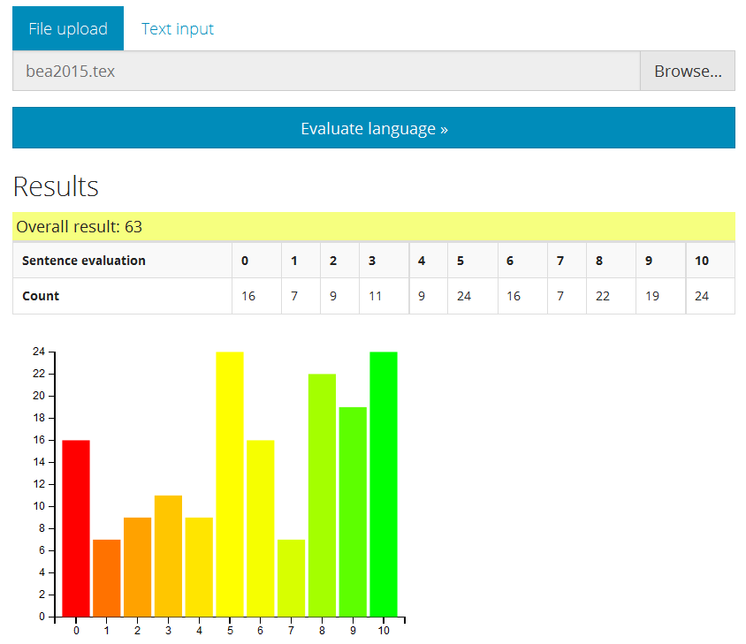

Slide 3
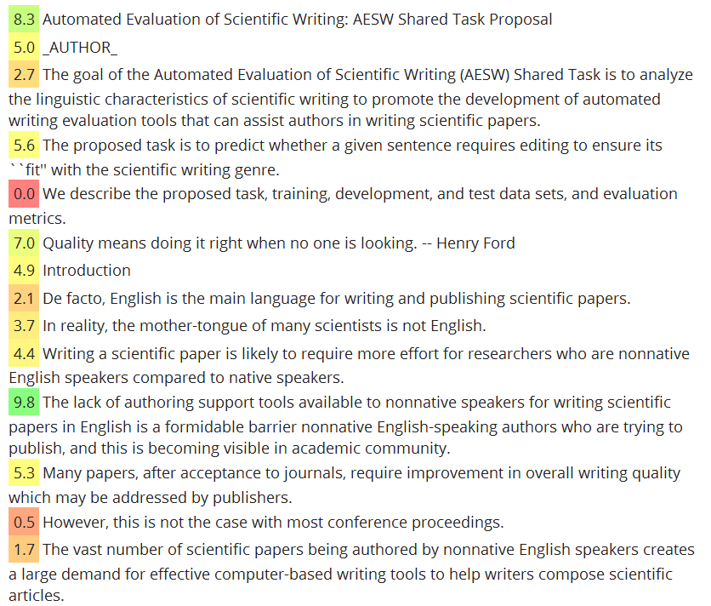

Slide 4
The Task
Predict the class of a sentence:
  accept
  improve
Two tracks
  Boolean Decision
    The prediction of whether a test sentence is
      edited (P(accept) = False), or
      before editing and corrections are needed (P(improve) = True).
  Probabilistic Estimation
    The probability estimation of whether a test sentence is
      edited (P(accept) = 0), or
      before editing and corrections are needed (P(improve) = 1).

Slide 5
The Data
Paragraphs from Springer journals papers that were language edited at VTeX before publishing
Texts before and after language editing
Converted from LaTeX to text with tex2txt
Domains:
  physics, mathematics, engineering, and other
Many technical edits are discarded
  Whitespaces
  ”Table” -> ”Tab.”

Slide 6
The Data
Domain | # Documents | # Paragraphs | # Edits
Physics | 2,788 | 76,655 | 270,972
Mathematics | 2,668 | 103,532 | 254,643
Engineering | 2,163 | 72,291 | 198,899
Computer Science | 1,176 | 48,234 | 115,331
Statistics | 493 | 19,089 | 51,884
Economics and Management | 264 | 9,285 | 23,101
Chemistry | 235 | 3,748 | 13,326
Astrophysics | 184 | 5,001 | 20,778
Human Sciences | 29 | 1,299 | 3,114
Total | 10,000 | 339,134 | 952,048

Slide 7
Data annotation
<paragraph id="12" domain="Engineering">
<sentence id="12.0">The pose of rigid objects (Fig. _REF_a) can be described by a
translation vector _MATH_ and rotation matrix _MATH_ with <del>the </del>
rotation <del>angels</del><ins>angles</ins> _MATH_. </sentence>
<sentence id="12.1">The rotation matrix _MATH_ is defined by three consecutive
rotations about the x-, y-<ins>,</ins> and z-<del>axis</del><ins>axes:</ins>
_MATHDISP_. </sentence>
<sentence id="12.2">Choose _MATH_ such that the _MATH_-value of _MATH_ is as
large as possible. </sentence>
</paragraph>

Slide 8
The Data
Training: 250,000 paragraphs
              Sentences with changes 400,000
              Sentences without changes 600,000
Development: 30,000 paragraphs
              Sentences with changes 50,000
              Sentences without changes 70,000
Test: 30,000 paragraphs
              Sentences with changes 50,000
              Sentences without changes 70,000
The training, development, and test data sets are comprised of independent sets of articles

Slide 9
The Edits
Del Ins #
, 149653
, 52971
<sp> - 47168
the 36432
- <sp> 18956
. 13981
the 12236
: 12000
a 11425
: 8134
, ; 7176
that 5741
and 5398
Del Ins #
- 4173
. 3035
" 2974
's 2341
section Section 2257
an 2188
" 2171
: . 2066
that 2065
the a 2008
a the 1935
a 1906
which that 1866

Slide 10
The Edits
We introduce a new metric named the 3D Normalized Probabilistic Rand Index (3D-NPRI), which outperforms the others in terms of properties and discriminative power.
However, it seems difficult to establish quantitatively the quality of a segmentation only by using such an a priori criteria.
However, they basically remain consistent; the difference just lies in the level of refinement.
We can notice, however, that although the random segmentations are totally different from the ground-truths, the scores of the other metrics are very high (very good) for certain segmentations with degenerative granularity (extreme-high and/or extreme-low).
Initially, only the origin server has the data.

Slide 11
The Edits
Finally, there is also a non-obvious implication in sparsity.
G-band images taken at different times have been aligned by a non-linear mapping program _CITE_.
If the process which follows the segmentation generates better results, it does not necessarily mean that the segmentation results were superior, and vice- versa.
XMOS is featured by non -von Neumann architecture.
The processing core, called Xcore, is an event -driven multi thread processing system.
Some approaches do not guarantee collision -free behavior.
Using the homotopy extension property, a Petri- net is created for the company business model.

Slide 12
The Edits
XMOS XC programsprogram is created for Car Robot.
The second rule letlets Agent move towards Mother when it is smelled.
A large part of these work concernsworks concern the average system performance; for example, minimizing the total accessing cost, or minimizing the total communication cost, etc. Although these metrics are important in the overall system performance, they cannot meet the individual requirement adequately.
Toeplitz matrices hashave a displacement rank of 2 _CITE_.
Also, the block-Toeplitz case areis a practical study in _CITE_.
Although the CDI is not in the same range as the other metrics, the plot still allows us to illustrate the qualitative behavior of this latter index toward the imprecision of cut boundaries.

Slide 13
The Edits
We interpret this characteristic as the evidence of the expansion of coronal loops.
According to this relationship and the observations, the corona contains a negative helicity.
Let _MATH_ be the eigenvectors of an observable _MATH_ with the eigenvalues _MATH_ (i.e., _MATH_).
The second series of simulations used a smaller dataset (_MATH_ particles), but examined the effect of the collision location, the collision geometry (head-on vs. glancing, as described aboveearlier) and the effect of scaling the mass of the remnant planet.
Confirming the collisional origin of the anomalous density of Mercury would go a long way intoward establishing the current model of planetary formation through collisions which predicts giant impacts to happen during the late stages of planetary accretion.

Slide 14
The Edits
Some agent characteristics are described in sectionSection _REF_.
Firstly, procedural memory and semantic memory are represented, as well as their respective ways of learning.
We then define the 3D-NPRI of an automatic segmentation of a given 3D-model as followfollows : _MATHDISP_
Most of the measures introduced in section 2.2 quantify dissimilarity (the lower is the number, the bestbetter is the segmentation result) between segmentations rather than similarity.
Similar argument holds for image description: if one aspect is neglected, e.g.for example, color, the best similarity measure will be not able to properly distinguish between green apples and red tomatoes.
Without loseloss of generality, we assume that server 0 is the origin server.

Slide 15
The Edits
Moreover we study the properties of such spaces, with special reference to ZariskZariski topology.
It begisnbegins with having a replica in every node, then it deletes replicas [...]
We also would like to point out that three-dimentionaldimensional simulations are rather difficult for visualisation.
The selection starts from the server _MATH_ with the largest largest _MATH_, until there is no available capacity on _MATH_, or no server left in _MATH_.
Most graphic formats widely used to share 3D models (OFF, VRML, PLY, ..etc.) encode surface meshes through indexed face sets; specifically, these file formats contain a first block specifying the position of the vertices, and a second block in which each polygon is represented through a sequence of indices of vertices in the first block.

Slide 16
The Edits
OrThen again, they may be isolated streamers or current sheets appearing in regions of large magnetic-field gradients and having higher plasma density.
In the following section we shall proveProof of Theorem _REF_.
We have come to the conclusion that there are three mechanisms for forming such rays: <br/>(1) projection of anthe edge-on streamer -belt area on the plane of the sky; <br/>(2) overlapping of a part of the coronal streamer chain which is nearly parallel to the solar equator and the face-on streamer belt; <br/>(3) electron density increaseincrease of the electron density in areas with small angular sizes in the face-on streamer belt.<br/>However, it is entirely possible that there are other mechanisms for forming bright rays in the corona as well.

Slide 17
The Edits
Generally, the displacement representation (_REF_) arises from other displacement representations, like e.g., the displacement representation of a symmetric Toeplitz matrix or another symmetric structured matrix.
The third step consists of the solution of several triangular linear systems whereas in the last step it is obtained, the solution of the Toeplitz linear system is obtained.
The first 5 stages correspond to step number one1 of Algorithm _REF_.

Slide 18
The Edits
Let _MATH_ isbe an end vertex of the cut edges of _MATH_}.
The first results and applications of hierarchically well separated trees are due to Bartal, see in _CITE_. ItHe generalized the earlier works of Karp _CITE_ and Alon et al _CITE_, in which theythe authors approximated the distances in certain graphs by using randomly selected spanning trees.

Slide 19
Prediction
<paragraph id="12" domain="Engineering">
<sentence id="12.0">The pose of rigid objects (Fig. _REF_a) can be described by a
translation vector _MATH_ and rotation matrix _MATH_ with the
rotation angels _MATH_. </sentence>
<sentence id="12.1">The rotation matrix _MATH_ is defined by three consecutive
rotations about the x-, y- and z-axis _MATHDISP_. </sentence>
<sentence id="12.2">Choose _MATH_ such that the _MATH_-value of _MATH_ is as
large as possible. </sentence>
</paragraph>
improve
accept

Slide 20
Evaluation – Boolean Decision

Slide 21
Evaluation – Probabilistic Estimation
MSE - Mean Squared Error
PE – Probabilistic Estimation
G – Gold Standard
improve = 1
accept = 0

Slide 22
Suggestions
Opinions
Data cleaning contribution
Participate!

Slide 23

Thanks
Joel, Jill and Claudia

Slide 24


The Questions!
I like it.

