Slide 1

Using NLP to Support Scalable Assessment of Short Free Text Responses
Alistair Willis
Department of Computing and Communications,
The Open University, UK

Slide 2
e-assessment at the Open University
Short answer questions
  assess detail and specific knowledge
  ability to verbalise knowledge
  cognitively different from Multiple Choice Questions:
    student is unprompted
Valuable assessment method for distance learning
  eg. Open University
  MOOCS
Open University has large answer sets for training data
  high population courses

Slide 3
e-assessment at the Open University
Online, automatically marked questions in use for Level 1 OU Science
  successful in formative assessment
    positive student feedback
  moving towards summative assessment
BUT
  Existing system uses (simplified) regular expressions
    need to be written by computing expert
  Difficult to write effective marking rules
    (near) impossible for non-computing expert

Slide 4
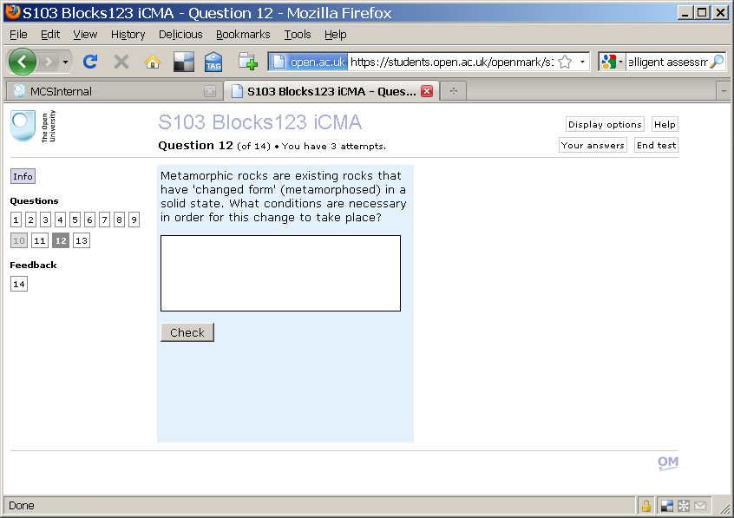
Automatic assessment at the OU

Slide 5
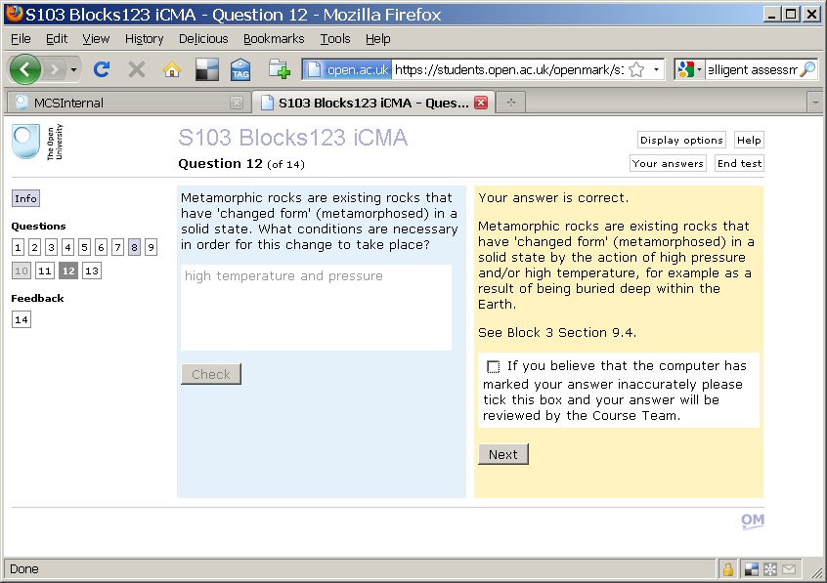
Automatic assessment at the OU

Slide 6
e-assessment architecture
Mark scheme maps student input onto mark
Can we simplify mark scheme authoring?
Student input
Virtual Learning Environment
Answer Server
Mark/ feedback
Question mark scheme

Slide 7
Requirements for automatic assessment system
Award of marks should be:
  consistent
  explanatory
    why was this mark (not) awarded?
  maintainable
    by a domain expert
    not necessarily a computer scientist

Slide 8
Requirements for automatic assessment system
Award of marks should be:
  consistent
  explanatory
    why was this mark (not) awarded?
  maintainable
    by a domain expert
    not necessarily a computer scientist
  “Traceable” (eg. QAA requirement)

Slide 9
NLP for e-assessment
How much linguistic analysis is actually needed?
  bag of words/keyword analysis not good enough
    high temperature and pressure ( ✓ )
    high pressure and temperature ( ✓ )
    temperature and high pressure ( X )
  But deep parsing can overcommit (eg. IAT by Mitchell et al, 2002)
    ( high pressure ) and temperature
    v.
    high ( pressure and temperature )

Slide 10
Marking as Information Extraction
Treat marking as rule-based Information Extraction task
matching rules express the mark scheme (Junker et al 1999)
  keyword recognition + linear word order
  simple spelling correction ( edit distance ≤ 1 )
      term(R, Term, I)
      template(R, Template, I)
      precedes(I1, I2)
      closely_precedes(I1, I2)

Slide 11
Example...
      term(R, oil, I) ∧
      term(R, less, J) ∧
      template(R, dens, K) ∧
      precedes(I, J) ➔ correct(R)
    oil is less dense than water ( ✓ )
    oil has less density than water ( ✓ )
    water is less dense than oil ( X )

Slide 12
Amati
Amati system
  make mark scheme authoring easy for tutors
    domain specialist
    not (necessarily) computing specialist
bootstrapping model
        load an initial set of responses
        mark responses (by hand)
        repeat:
          write/edit rules to reflect marks
          extend set of responses
          apply rules to extended set
          confirm/change assigned marks
        until no further improvement
        apply rules to remaining responses

Slide 14
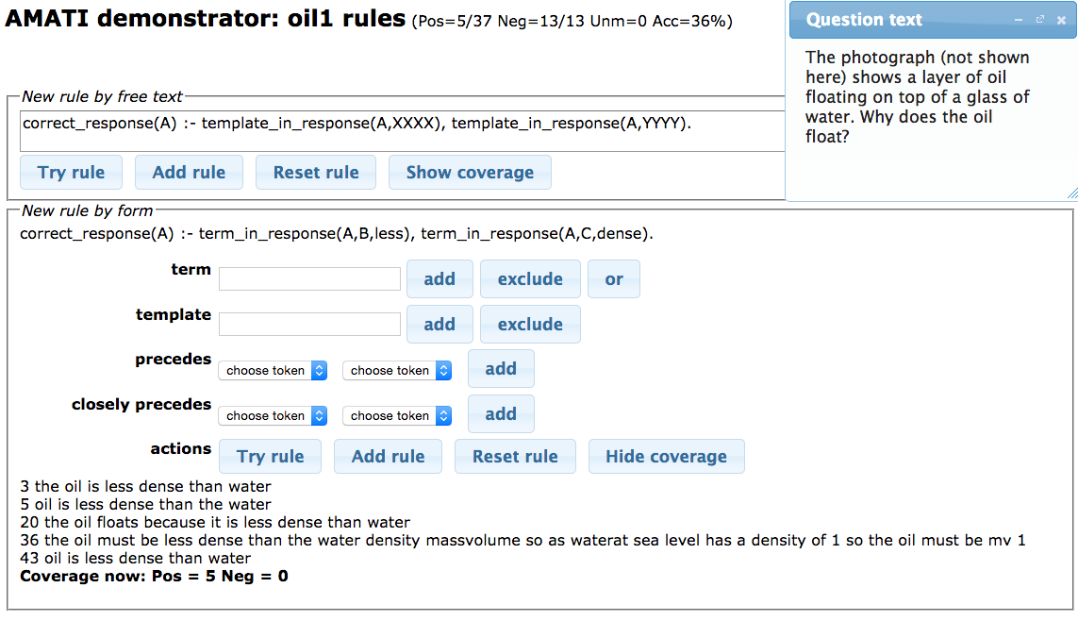

Slide 15
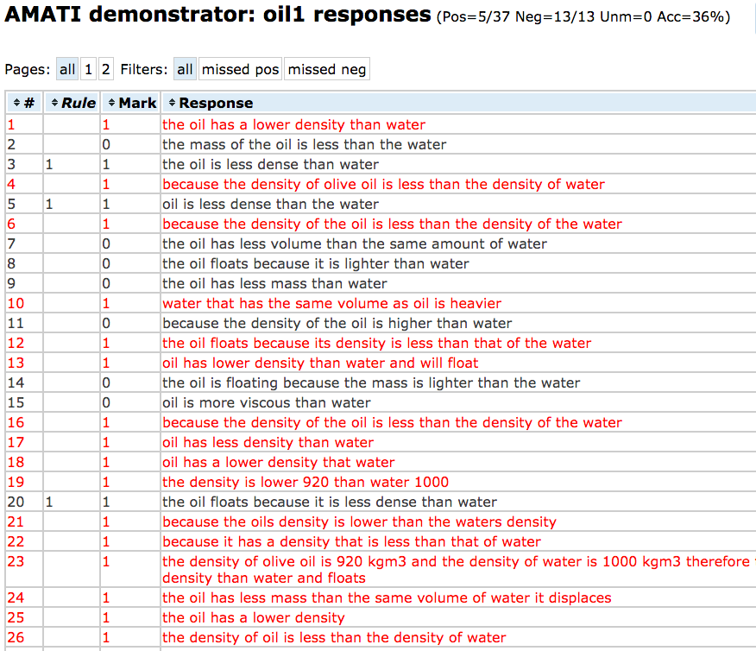

Slide 16
Evaluation
  Is the representation language expressive enough?
  How good are the Amati mark schemes?
    How do they compare to a gold standard?
    How do they compare to a human marker?
  Tested on 6 questions
    Student responses from two presentations (2008/2009)
    Mark scheme built on 2008 responses
    Tested on 2009 responses (unseen)

Slide 17
Test Set Construction
How to get a gold standard/ground truth?
  Human marks can be unreliable
    Low inter-marker agreement
  Multiple-pass annotation
    Initially marked by two subject-specialist tutors
      allowed to confer during marking
    Module chair as final authority
      third marker
      also adjudicates on disagreements

Slide 18
Results
Question | Number of responses | Accuracy / % | α / %
Sandstone | 1711 | 98.4 | 97.5
Snowflake | 2057 | 91.0 | 81.7
Charge | 1127 | 98.9 | 97.6
Rocks | 1429 | 99.0 | 89.6
Sentence | 1173 | 98.2 | 97.5
Oil | 817 | 96.1 | 91.5
High accuracy
  although task is highly constrained
α higher than human inter-marker agreement on the same questions
  71.2% ≤ α ≤ 88.2%

Slide 19
Rule Induction
To induce mark schemes, try Inductive Logic Programming
  Aleph (Srinivasan 2004)
Amati proposes rules from marked responses
Still requires manual post-editing
  eg. predicted rule:
  matches
    high pressure and temperature
    high pressure and heat
  Question author can make more intuitively plausible
    repeated runs improve the overall coverage
term(R, high, A) ∧
term(R, pressure, B) ∧
term(R, and, C) ➔ correct(R)

Slide 20
Some difficult responses
Lack of linguistic knowledge not necessarily a drawback
  The oil floats on the water because it is lighter
  The oil floats on the water because it is heavier
  Applying BOD, mark both correct
    better than attempting to resolve pronoun
      easier with linear word order than syntactic analysis

Slide 21
Some difficult responses
Hard to mark where students can give particular examples
  A snowflake falls vertically with a constant speed. What can you say about the forces acting on the snowflake?
  abstract answers easy to mark
    They are equal and opposite
    no net forces
    all forces cancel out
      etc.
  Much harder to predict all specific examples
    the gravity and air resistance are the same
    gravity is counteracted by drag
      etc.

Slide 22
Discussion
Ongoing work
  User studies
    Formal comparison of responses marked “by hand” and with Amati
    Compare time to mark and inter-marker agreement
  Linguistic complexity
    Multiple-mark responses
    Better synonym handling
    Feedback generation

Slide 23
Thank you!

