Slide 1
AutoLearn’s authoring tool€
A piece of cake for teachers
Martí Quixal
Fundació Barcelona Media – Universitat Pompeu Fabra
Co-authors: Susanne Preuß, Beto Boullosa and David García-Narbona
Joint work with Toni Badia, Mariona Estrada, Raquel Navarro, John Emslie, Alice Foucart, Mike Sharwood Smith, Paul Schmidt, Isin Bengi-Öner and Nilgün Firat
€ Research funded by the Lifelong Learning Programme 2007-2013 (2007-3625/001-001)

Slide 2
Outline
Motivation and goal
A tool for authoring ICALL materials
Using and evaluating of AutoTutor
Concluding remarks

Slide 3
Outline
Motivation and goal
A tool for authoring ICALL materials
Using and evaluating of AutoTutor
Concluding remarks

Slide 4
Motivation: ICALL’s irony
ICALL figures
119 projects from 1982 to 2004 (Heift & Schulze, 2007)
Half a dozen ICALL systems are continuously used in real-life instruction settings (Amaral & Meurers, submitted; Heift & Schulze 2007)
Crucial aspects
Appropriate integration in the learning context (Levy 1997, 200-203)
Successfully restrict learner production in terms of NLP complexity (Amaral and Meurers, submitted)
Notes:
ICALL figures
119 projects between 1982-2004 (Heift & Schulze, 2007)
Only a few (three to five) used in real-life instruction settings (Amaral & Meurers, submitted; Heift & Schulze 2007)
Crucial for success are:
Integration in the learning context is critical (Levy 1997, 200-203; Polisca 2006)
Successfully restrict learner production in terms of NLP complexity by limiting the scope of the learning activities (Amaral and Meurers, submitted)

Slide 5
Motivation: FLTL requirements
ICALL meeting FLTL
Feedback has to be coherent with
  syllabus,
  teaching approach, and
  activity goals (focus on form/content)
Ideally has to respond to real-life needs
(Amaral 2007)
Notes:
ICALL figures
119 projects between 1982-2004 (Heift & Schulze, 2007)
Only a few (three to five) used in real-life instruction settings (Amaral & Meurers, submitted; Heift & Schulze 2007)
Crucial for success are:
Integration in the learning context is critical (Levy 1997, 200-203; Polisca 2006)
Successfully restrict learner production in terms of NLP complexity by limiting the scope of the learning activities (Amaral and Meurers, submitted)

Slide 6
Motivation: involve FLTL practitioners
FLTL experience
Integration of out-of-class work thoughtfully and coherently designed – with the needs of the learner in mind (Levy and Stockwell, 2006: p. 11 – 12)
CALL tradition
Authoring tools have a long tradition in CALL, but practically inexistent for ICALL
(Levy 1997, chap. 2, Toole and Heift 2002)
Notes:
Teachers, who better know their learners, are the most appropriate to develop/adapt them.

Slide 7
Goal: one NLP response
to shape language technology to the needs of the teachers (and learners) by
  allowing for feedback generation focusing both on form and on meaning
  providing a tool and a methodology for teachers to author/adapt ICALL materials autonomously

Slide 8
Outline
Motivation and goal
A tool for authoring ICALL materials
  General functionalities (and GUI)
  Answer specifications
  NLP-resource generation
Using and evaluating of AutoTutor
Concluding remarks

Slide 9
Context: AutoLearn project
Goals
Integrate existing ICALL technology in Moodle
  (ALLES project, Schmidt et al. 2004, Quixal et al. 2006)
Evaluate such an FLTL paradigm for different learning scenarios
Participants
Fundació Barcelona Media Universitat Pompeu Fabra, Barcelona (coord., NLP-based applications, HCI)
Institut für Angewandte Informationsforschung, Saarbrücken (NLP)
Heriot-Watt University, Edinburgh (FLTL, SLA)
Bogazici University, Istanbul (FLTL practice)

Slide 10
AutoTutor: ICALL for Moodle
Definition
A web-based software solution to assist non-NLP experts in the creation of language learning materials using NLP-intensive processing techniques
Teacher perspective
A tool to create, manage, and track ICALL activities including (NLP-based) feedback on form/content
Learner perspective
To do the exercises and get feedback
To track own activity

Slide 11
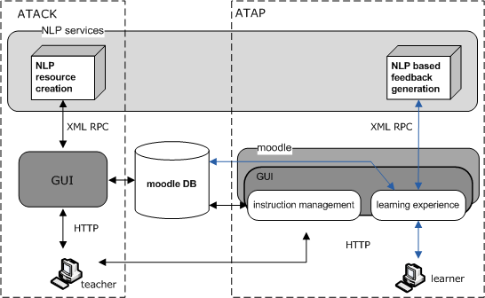
AutoTutor: architecture and process

Slide 12
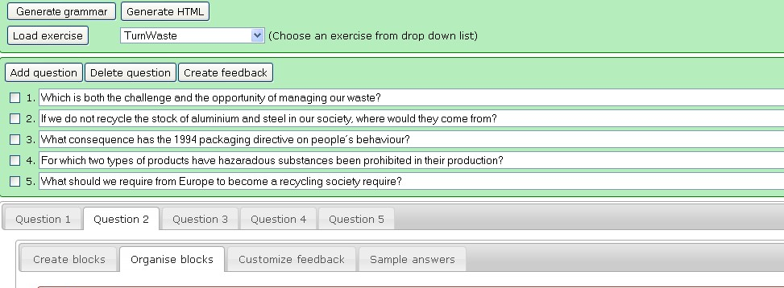
AutoTutor: functionalities (I)
Teacher perspective
ERROR MODEL
ANSWER MODEL

Slide 13
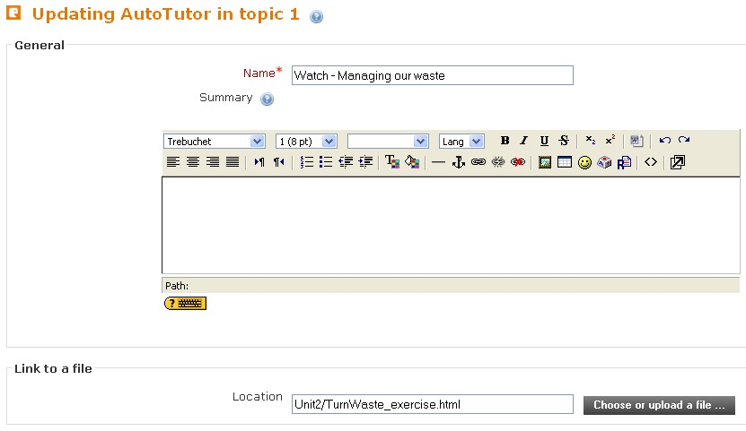
AutoTutor: functionalities (II)
Teacher perspective

Slide 14
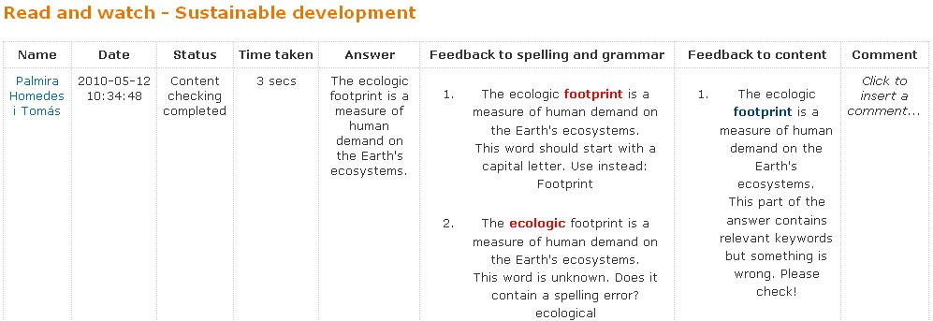
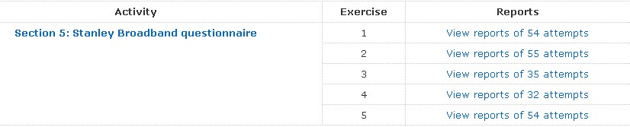
AutoTutor: functionalities (III)
Teacher perspective

Slide 15
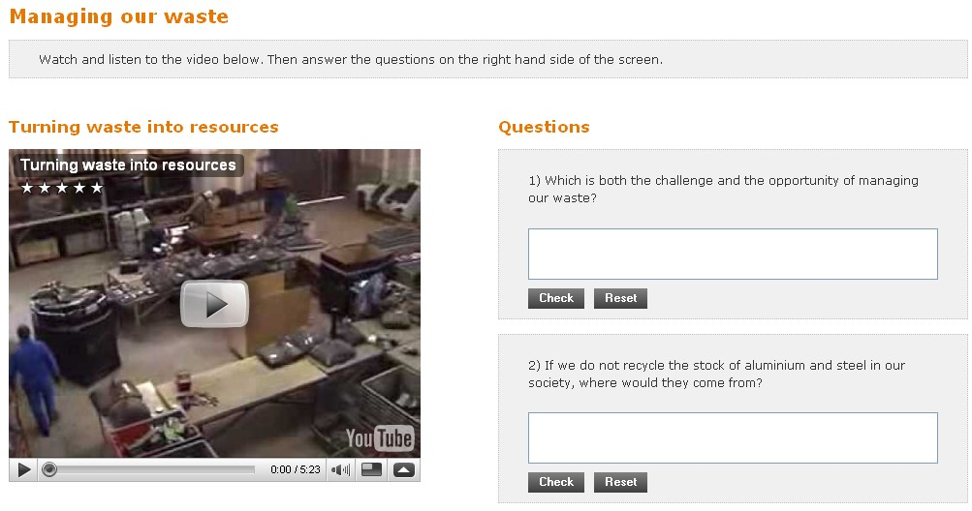
AutoTutor: doing activities
Learner perspective

Slide 16
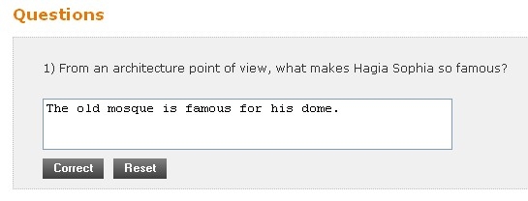
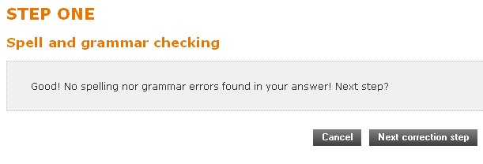
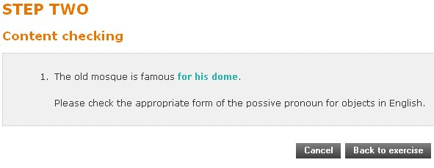
AutoTutor: immediate feedback
Learner perspective

Slide 17
Short () on the NLP side
Step one: general language checking
Tokenizer
Morph. analysis
Spell checking
Content matching
Customized specific checking
General content evaluation
Grammar checking
Specific form checking
Lexicon
Exercise-specific lexicon
Step two: specific language checking

Slide 18
ATACK: answer specification (I)
A question
Define the ecological footprint in your own words.
Possible answers
The ecological footprint relates to the impact of human activities on our environment.
It is an indicator that measures the surface needed to produce our resources and absorb the waste we generate.
Notes:
Match settings performs a low-level morphosyntactic analysis of the teacher input, with no proper disambiguation. For each block, the corresponding matching layers (KURD rules in the content matching) are generated so that several missing, incorrect, extra stuff can be handled. The system is a buggy rule one, where the actual words, lemmas or part-of-speech items to be used are empty slots which are filled in using the info provided by teachers through the GUI. This same rules analyse certain linguistic (formal) aspects of the answer that later on are matched with the exercise-specific error checking to detect problemes in determiner (some/any, little/few) or preposition usage, for instance.
Content matching performs a sort of low-level semantic parsing which then is used by the content evaluation module to check for completeness and right order in the learner’s answer.
18

Slide 19
ATACK: answer specification (II)
Divide answers into blocks (or chunks)
The ecological footprint relates to the impact of human activities on our environment.
It refers to an indicator that estimates the surface needed to produce our resources and absorb the waste we generate.
Divide answers into blocks (or chunks)
A
B1
B2
C
D
E
Notes:
Parcheesi (US), Ludo (UK)
Match settings performs a low-level morphosyntactic analysis of the teacher input, with no proper disambiguation. For each block, the corresponding matching layers (KURD rules in the content matching) are generated so that several missing, incorrect, extra stuff can be handled. The system is a buggy rule one, where the actual words, lemmas or part-of-speech items to be used are empty slots which are filled in using the info provided by teachers through the GUI. This same rules analyse certain linguistic (formal) aspects of the answer that later on are matched with the exercise-specific error checking to detect problemes in determiner (some/any, little/few) or preposition usage, for instance.
Content matching performs a sort of low-level semantic parsing which then is used by the content evaluation module to check for completeness and right order in the learner’s answer.
19

Slide 20
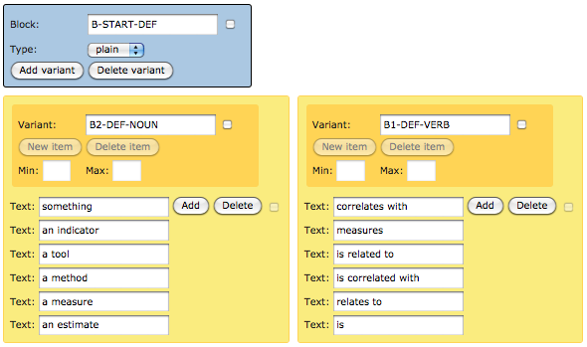
ATACK: answer specification (III)
B
B1
B2

Slide 21
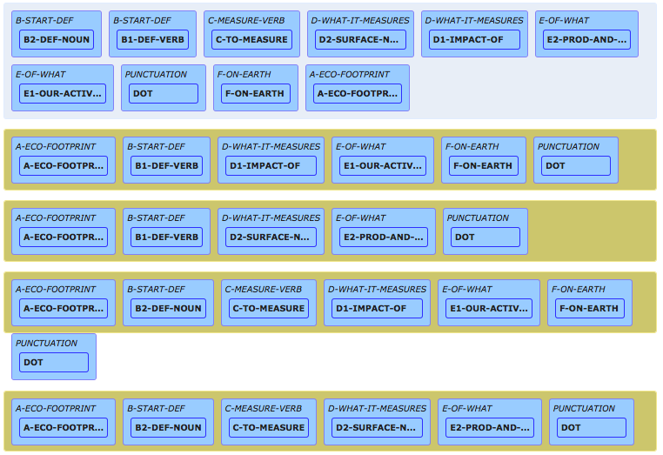
ATACK: answer specification (IV)
A
B1
E
A
B2
C
D
E
Notes:
Parcheesi, Ludo

Slide 22
ATACK: NLP resource generation
Blocks (chunks)
Match settings
Content matching
Block order
Exercise-specific lexicon
Exercise-specific error checking
Global answer well-formedness
Morphological analysis
Teacher GUI
ANSWER MODEL
ERROR MODEL
Error patterns
Morphological analysis
Desambiguation of lemma
Customized feedback
Notes:
Match settings performs a low-level morphosyntactic analysis of the teacher input, with no proper disambiguation. For each block, the corresponding matching layers (KURD rules in the content matching) are generated so that several missing, incorrect, extra stuff can be handled. The system is a buggy rule one, where the actual words, lemmas or part-of-speech items to be used are empty slots which are filled in using the info provided by teachers through the GUI. This same rules analyse certain linguistic (formal) aspects of the answer that later on are matched with the exercise-specific error checking to detect problemes in determiner (some/any, little/few) or preposition usage, for instance.
Content matching performs a sort of low-level semantic parsing which then is used by the content evaluation module to check for completeness and right order in the learner’s answer.
22

Slide 23
ATACK’s underlying NLP strategy
Technical aspects
Processing is a pipeline (no stand-off annotation)
Shallow template-based (info) chunking using both relaxation techniques and buggy rules
KURD: constraint-based formalism – Finite State Automaton enhanced with unification
(Carl and Schmidt-Wigger 1998)

Slide 24
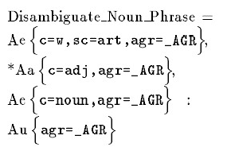
ATACK: underlying NLP formalism (I)
Markers
Description part
Quantifiers
Operators
Action part
Variables
Notes:
Match settings performs a low-level morphosyntactic analysis of the teacher input, with no proper disambiguation. For each block, the corresponding matching layers (KURD rules in the content matching) are generated so that several missing, incorrect, extra stuff can be handled. The system is a buggy rule one, where the actual words, lemmas or part-of-speech items to be used are empty slots which are filled in using the info provided by teachers through the GUI. This same rules analyse certain linguistic (formal) aspects of the answer that later on are matched with the exercise-specific error checking to detect problemes in determiner (some/any, little/few) or preposition usage, for instance.
Content matching performs a sort of low-level semantic parsing which then is used by the content evaluation module to check for completeness and right order in the learner’s answer.
24

Slide 25
ATACK: underlying NLP formalism(II)
two-level analysis
a1
a1
a2
a2
...
...
b1
b1
b2
b2
...
...
D1
A
B1
a1
a1
...
...
a2
a2
b1
b1
...
...
b2
b2
E
...
...
...
...
B2
C
D2
Notes:
Match settings performs a low-level morphosyntactic analysis of the teacher input, with no proper disambiguation. For each block, the corresponding matching layers (KURD rules in the content matching) are generated so that several missing, incorrect, extra stuff can be handled. The system is a buggy rule one, where the actual words, lemmas or part-of-speech items to be used are empty slots which are filled in using the info provided by teachers through the GUI. This same rules analyse certain linguistic (formal) aspects of the answer that later on are matched with the exercise-specific error checking to detect problemes in determiner (some/any, little/few) or preposition usage, for instance.
Content matching performs a sort of low-level semantic parsing which then is used by the content evaluation module to check for completeness and right order in the learner’s answer.
25

Slide 26
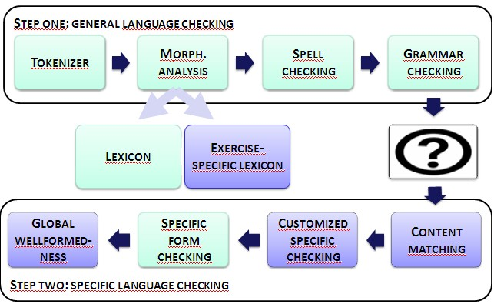
ATACK: “info” chunker
For each “info”-chunk a corresponding analysis rule is created
Word-level
Word level with extra-stuff
Lemma-level
Lemma-level with extra stuff
Lemma-level with stuff missing
Some “key” words (concept words)
“an indicator”
LemmaStuffMissing =
?$-1a{tag~:c1_},
^Aa{lu=a;the,disc=_},
Ba{lu=indicator,disc=_} :::
Ar{disc=C,tag=b10}g{flaga=small,flage=an},
Br{disc=C,tag=b10}g{flaga=small;det_a, flagb=noun_sg,flage=indicator},
j(rule=@end10).
Notes:
The features flage and flagb in the action part of the rule are created to remind us, later on during the analysis/error diagnosis process, that such an analysis succeeded thanks to a “relaxed” version of the expected linguistic structure.
Match settings performs a low-level morphosyntactic analysis of the teacher input, with no proper disambiguation. For each block, the corresponding matching layers (KURD rules in the content matching) are generated so that several missing, incorrect, extra stuff can be handled. The system is a buggy rule one, where the actual words, lemmas or part-of-speech items to be used are empty slots which are filled in using the info provided by teachers through the GUI. This same rules analyse certain linguistic (formal) aspects of the answer that later on are matched with the exercise-specific error checking to detect problemes in determiner (some/any, little/few) or preposition usage, for instance.
Content matching performs a sort of low-level semantic parsing which then is used by the content evaluation module to check for completeness and right order in the learner’s answer.
26

Slide 27
ATACK: “global” well-formedness
Block order combinations are checked for (deviant structures inc.)
Correct block order
Correctness within block
Blending structures
Missing blocks
ori_chunked_gap_no_need=
?$-1a{chunked=a_G_A_C2_D2_F_E_;a_G_A_C1_D1_D1_E_; a_G_A_H_B1_C2_D2_F_E_;a_G_A_H_B1_C1_D1_D1_E_; a_C2_D2_F_E_;a_C1_D1_D1_E_},
+Aa{flagc~=_,lu~=@;&at,snr~=1000}e{flagc=g,style=no_need} ::: Ar{style=no_need,bstyle=no_need,estyle=no_need},
$-1g{style=no_need}.
Notes:
Match settings performs a low-level morphosyntactic analysis of the teacher input, with no proper disambiguation. For each block, the corresponding matching layers (KURD rules in the content matching) are generated so that several missing, incorrect, extra stuff can be handled. The system is a buggy rule one, where the actual words, lemmas or part-of-speech items to be used are empty slots which are filled in using the info provided by teachers through the GUI. This same rules analyse certain linguistic (formal) aspects of the answer that later on are matched with the exercise-specific error checking to detect problemes in determiner (some/any, little/few) or preposition usage, for instance.
Content matching performs a sort of low-level semantic parsing which then is used by the content evaluation module to check for completeness and right order in the learner’s answer.
27

Slide 28
Outline
Motivation and goal
A tool for authoring ICALL materials
Using and evaluating of AutoTutor
Concluding remarks

Slide 29
AutoLearn: testing in real-life (I)
78% would only use ICALL materials if ready-made.
Preparation of testing
Recruiting: two workshops with over 60 participants
System usage
Material development (training plus development)
Material selection
Testing action preparation (book PC-labs, etc.)
Analysis of testing action
Questionnaires for learners
Questionnaires and interviews with teachers

Slide 30
AutoLearn: testing in real-life (II)
Participants in testing
3 universities: 5 different classes (EN, DE)
7 secondary school teachers: 10 classes (EN)
5 language school teachers: 5 classes (EN)

Slide 31
AutoLearn: training ICALL developers
4-hour course (2 sessions), plus 4 control meetings (and individual work)
  How to plan, pedagogically speaking, a learning sequence including ICALL materials?
  What can NLP do for you?
  How do you use ATACK’s GUI?

Slide 32
Learnt from cooperation with teachers
Designing FLT materials knowing in advance that they will be part of an ICALL system is more difficult than selecting activities from books
  The notion of time
  The notion of space
The lack of expertise in using ICALL/NLP results into overdemanding or not challenging NLP tasks

Slide 33
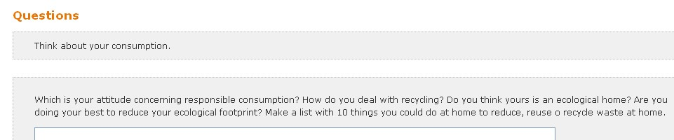
Learning to restrict NLP complexity (I)
Which is your attitude concerning responsible consumption? How do you deal with recycling? Do you think yours is an ecological home? Are you doing your best to reduce your ecological footprint? Make a list of 10 things you could do to reduce, reuse or recycle your waste at home.
Notes:
33

Slide 34
Learning to restrict NLP complexity (II)
Which is both the challenge and the opportunity of managing our waste?
If we do not recycle the stock of aluminium and steel in our society, where would they come from?
What consequence has the 1994 packaging directive on people’s behaviour?
For which two types of products have hazaradous substances been prohibited in their production?
What should we require from Europe to become a recycling society?
Notes:
34

Slide 35
Analysing AutoTutor’s performance
Activity type: reading comprehension
Q1: Explain in your words what the ecological footprint is.
Q2: What should be the role of retailers according to Timo Mäkelä?
Question | Inv. | Tot
1st | 2 | 73
2nd | 21 | 100
Notes:
35

Slide 36
Building a “gold standard”
Out of 173 manually reviewed attempts
Question | Corr. | Part. | Incorr. | Inv. | Tot
1st | 36 | 23 | 12 | 2 | 73
2nd | 14 | 29 | 36 | 21 | 100

Slide 37
Quantitative analysis (accuracy)
 | MESSAGES |  | REAL ERRORS |  | PERCENTAGE
 | Form | Cont | Form | Cont | Form | Cont
CORRECT ANSWERS | 31 | 139 | 15 | 71 | 48,4 | 51,1
PARTIALLY CORRECT | 8 | 84 | 7 | 42 | 87,5 | 50
INCORRECT ANSWERS | 41 | 30 | 39 | 18 | 95,1 | 60
 | MESSAGES |  | REAL ERRORS |  | PERCENTAGE
 | Form | Cont | Form | Cont | Form | Cont
CORRECT ANSWERS | 6 | 45 | 8 | 20 | 100 | 44,4
PARTIALLY CORRECT | 29 | 110 | 18 | 57 | 62,1 | 51,8
INCORRECT ANSWERS | 20 | 93 | 21 | 77 | 100 | 82,8

Slide 38
Main causes of misbehaviour
MISBEHAVIOUR | PHASE 1 | PHASE 2
Connection failed | 1 | 0
Bad use of the system | 1 | 1
System misleading learner | 4 | 2
False positive (L1-driven, OOV) | 22 | 33
Inappropriate focus on form | 35 | 21
Artificial separation of messages | 0 | 61
Poor specifications | 1 | 62
TOTAL | 64 | 180

Slide 39
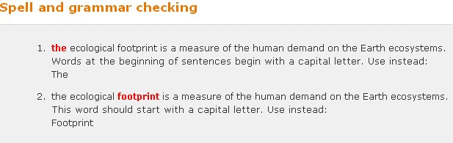
Misbehaviour in formal aspects
Inappropriate focus on form
“Rare” entries

Slide 40
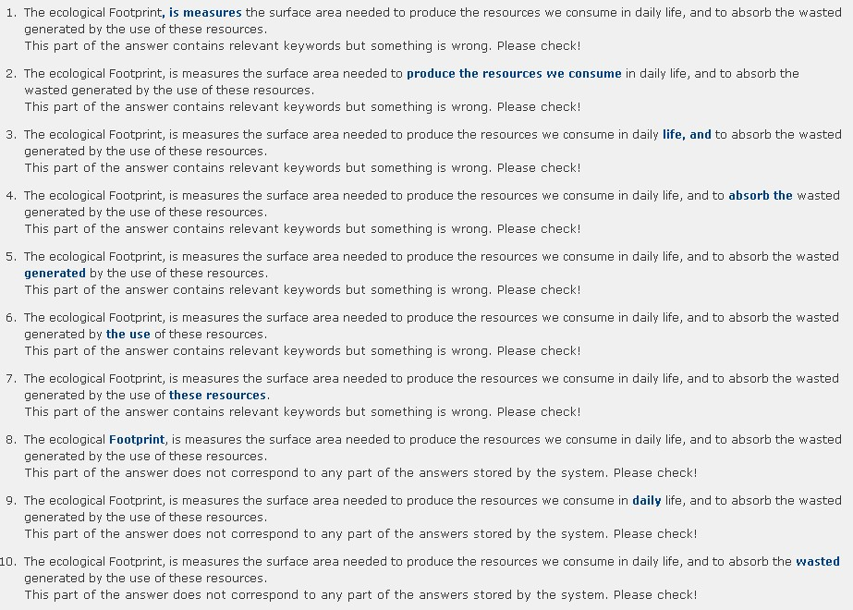
Artificial separation

Slide 41
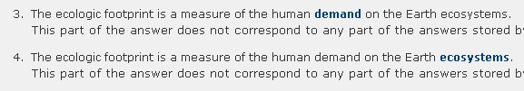
Poor specifications
Semantic extension of answer
Syntactic flexibility

Slide 42
Outline
Motivation and goal
A tool for authoring ICALL materials
Using and evaluating of AutoTutor
Concluding remarks

Slide 43
Conclusions: improve coverage
To reduce the effects of poor specifications
Support material designers with semantic driven techniques for expansion of their possible answers → RTE-like?
Add functionalities to teacher interface to easily extend exercise models or specific feedback messages using learner answers inappropriately handled by the system

Slide 44
Conclusions: improve accuracy
To reduce false positives
Adapt general (non-customizable) NLP resources to better handle L2 learner profiles
To reduce the effects of artificial separation
Better exploit the information provided by teachers in the block definition process
Use a parser that allows for the grouping of syntactic or/and informational units

Slide 45
Conclusions: general message
It was
  Feasible to overcome ICALL’s irony
  Possible to meet some FLTL requirements
  Incredibly useful to involve real-life teachers and learners in testing
NLP developers need to work closely together with FLTL trainers if we want to promote the use of ICALL

Slide 46
Thanks for your attention!
Questions or remarks?
http://autolearn.barcelonamedia.org/
http://parles.upf.edu/autolearn/
http://parles.upf.edu/autolearnTutorKit
Martí Quixal (marti.quixal@barcelonamedia.org)
Fundació Barcelona Media – Universitat Pompeu Fabra
Diagonal 177, planta 10
E-08018 Barecelona
Acknowledgements: thanks to Holger Wunsch, Ramon Ziai and Detmar Meurers for their very useful comments on a rehearsal of this presentation

Slide 47
References
Luiz Amaral. Designing Intelligent Language Tutoring Systems: integrating Natural Language Processing technology into foreign language teaching. PhD thesis, The Ohio State University, 2007.
Luiz Amaral and Detmar Meurers: “On Using Intelligent Computer-Assisted Language Learning in Real-Life Foreign Language Teaching and Learning”. ReCALL Vol 23, No 1. 2011.
J. Burstein, S. Wolff, and C. Lu, Using lexical semantic techniques to classify free-responses, 227–244, in Breadth and depth of semantic lexicons, ed. by Evelyne Viegas, Kluwer, Dordrecht, 1997.
Michael Carl and Antje Schmidt-Wigger. Shallow Postmorphological Processing with KURD. In Proceedings of NeMLaP3/CoNLL98, pages 257-265, 1998.
Kathleen Graves. Designing Language Courses: A Guide for Teachers. Boston, MA: Heinle & Heinle, 2000.
Trude Heift. Error-Specic and Individualized Feedback in a Web-based Language Tutoring System: Do They Read It? ReCALL, 13(2): 129-142, 2001.
Trude Heift and Mathias Schulze. Errors and Intelligence in Computer-Assisted Language Learning: Parsers and Pedagogues. Routledge, 2007.

Slide 48
References II
Trude Heift. Multiple Learner Errors and Meaningful Feedback: A Challenge for ICALL Systems. CALICO Journal, 20(3):533{548, 2003.
Michael Levy. Computer-Assisted Language Learning: Context and Conceptualization. Oxford University Press, New York, 1997.
Michael Levy and Glenn Stockwell. CALL Dimensions: Options and Issues in Computer-Assited Language Learning. Lowrence Erlbaum Associates, Publishers, New Jersey, 2006.
Joan-Tomas Pujola. Did CALL Feedback Feed Back? Researching Learners‘ Use of Feedback. ReCALL, 13(1):79{98, 2001.
Joan-Tomas Pujola. CALLing for help: researching language learning strategies using help facilities in a web-based multimedia program. ReCALL, 14:235{262, November 2002.
Quixal, M., T. Badia, B. Boullosa, L. Díaz, and A. Ruggia. (2006). Strategies for the Generation of Individualised Feedback in Distance Language Learning. In Proceedings of the Workshop on Language-Enabled Technology and Development and Evaluation of Robust Spoken Dialogue Systems of ECAI 2006. Riva del Garda, Italy, Sept. 2006.
Toole, J. & Heift, T. (2002). The Tutor Assistant: An Authoring System for a Web-based Intelligent Language Tutor. Computer Assisted Language Learning, 15(4), 373-86.

Slide 49
References III
Schmidt, P., S. Garnier, M. Sharwood, T. Badia, L. Díaz, M. Quixal, A. Ruggia, A. S. Valderrabanos, A. J. Cruz, E. Torrejon, C. Rico, J. Jimenez. (2004) ALLES: Integrating NLP in ICALL Applications. In Proceedings of Fourth International Conference on Language Resources and Evaluation. Lisbon, vol. VI p. 1888-1891. ISBN: 2-9517408-1-6.
Ramon Ziai. A Flexible Annotation-Based Architecture for Intelligent Language Tutoring Systems. Master's thesis, Universität Tübingen, Seminar für Sprachwissenschaft, April 2009.

