Slide 1
Towards Using Structural Events To Assess Non-Native Speech
Lei Chen, Joel Tetreault, Xiaoming Xi
Educational Testing Service (ETS)
The 5th Workshop on Innovative Use of NLP for Building Educational Applications
June 5th 2010

Slide 2
Introduction
Structural events in spontaneous speech
Sentences, clauses, and disfluencies
Important components of conversations
A burst of research in the last decade
Automatic speech assessment
Mainly use information and measures derived from word level
Very primitive disfluency measurements
Can we use structural events in speech assessment?

Slide 3
Previous Research
NLP
A large amount of research on detecting sentence boundaries, discourse markers, and disfluencies
Second Language Acquisition (SLA)
Syntactic complexity of writing data (Ortega, 2003)
Syntactic complexity of speech (Iwashita 2006)
Some measurements, e.g., T-unit length, # of clauses per T-unit, # of independent clauses per T-unit, were good at predicting learners’ proficiency levels
Disfluencies (Lennon 1990)
Significant differences in filled pauses per T-unit were found across proficiency levels
Mizera 2006
Disfluency related features had a high correlation with proficiency (about -.45)
Yoon 2009
Notes:
Yoon implemented an automated disfluency detection method and found that disfluency-related features lead to the moderate improvement in the automated speech proficiency scoring.

Slide 4
Motivation
Limitations in using the features reported in these SLA studies for standardized language tests
Only a very small number of subjects (from 20 to 30 speakers) were used
Speaking content is different from that elicited by test tasks
Therefore, we conducted a study using a much larger data set obtained from a large-scale speaking test
Notes:
Narrations of picture books – story retelling task

Slide 5
Outline
Annotation Scheme
Data Collection & Annotation
Features
Experiment
Discussion

Slide 6
Annotation Scheme
Based on previous literature, we developed an annotation manual and had the following syntactic structures annotated for the TOEFL Practice Online (TPO) test data:
Simple sentence (SS)
Independent clause (I)
Subordinate clauses
Noun clause (NC)
Adjective (ADJ)
Adverb (ADV)
Coordinate clause (CC)
Adverbial phrase (ADVP)
Notes:
SS contains a contains a subject and a verb, and expresses a complete idea.
I is the main clause that can stand alone syntactically as a complete sentence
Subordinate clause is a clause in a complex sentence that cannot stand alone as a complete sentence and that functions within the sentence as a noun, a verb complement, and adjective or an adverb.
Coordinate clause (CC) is a clause in a compound sentence that is grammatically equivalent to the main clause that that performs the same grammatical function
Adverbial phrase (ADVP) is a separate clause from the main clause that contains a non-finite verb (a verb that doesn’t show tense, person, or singular/plural).

Slide 7
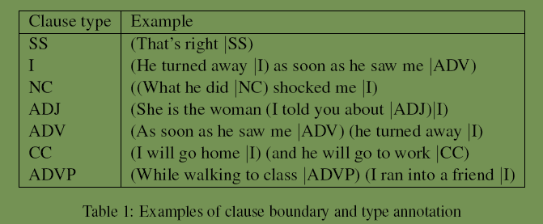
Clause Boundary Annotation Examples
Notes:
SS: simple sentence
I: independent clause
NC: subordinate clause as a noun
ADJ: subordinate clause as an adjective
ADV: subordinate clause as an adverb
CC: coordinate clause
ADVP: adverbial phrase

Slide 8
Disfluencies
A speech disfluency contains:
Reparandum, the speech portion that will be repeated, corrected, or even abandoned
Editing phrase, optional inserted words, e.g., um
Correction, the speech portion that repeats, corrects, or even starts new content
An example
He is a * very mad * % er % $ very bad $ cop

Slide 9
Data Collection and Annotation
TPO data
About 1,300 speech responses from TPO (45-60sec)
Each response was double-scored by experienced human raters using a 4-point scale.
Responses were transcribed by a professional agency
Annotation
Two annotators with linguistics training annotated the entire set with several subsets double-annotated to compute kappa for quality check

Slide 10
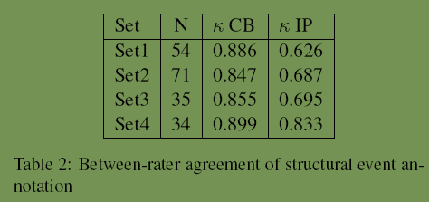
Evaluation of Annotation
We used Cohen’s kappa on clause boundary (CB) and interruption point (IP) tokens to measure annotation quality

Slide 11
Features
Frequency counts
T-unit (T): SS, I, and CC
Dependent clauses (DEP): NC, ADJ, ADV, and ADVP
Clauses (C): T, DEP, and fragments (F)
Features
Mean length of clause (MLC) = #words/#clauses
Dependent clause per clause (DEPC) = #depclauses/#clauses
Interruption point per clause (IPC) = #IP/#clauses
Notes:
Since simple sentence (SS), independent clause (I), and coordinate clause (CC) represent a complete idea, we treat them as an approximate to a T-Unit (T).
The clauses that have no complete idea, are dependent clauses (DEP), including NC, ADJ, ADV, and ADVP
F is fragment; it is either a subordinate clause that doesn’t have a corresponding independent clause or a string a words without a subject or a verb that doesn’t express a complete thought.

Slide 12
Normalization of IPC
Factors impacting disfluency frequency
Speakers’ proficiency levels
The syntactic complexity of the speech produced
Roll et. al. 2007
Complexity of expression computed based on the language’s parsing tree structure influenced the frequency of disfluencies
Normalize IPC to account for syntactic complexity
IPCn1 = IPC/MLC
IPCn2 = IPC/DEPC
IPCn3 = IPC/MLC/DEPC

Slide 13
Experiment
Procedure
For each response, if the two raters had good agreement (perfect or adjacent agreement) put it into a pool.
The pool contained 1257 responses.
Identified speakers with more than three item responses from the pool
175 speakers were selected
For each speaker, used annotations on all items to extract the proposed features
Compute Pearson correlations (rs) with the averaged human scores

Slide 14
Results
Notes:
-Relying on three simple structural event annotations, i.e., clause boundaries, dependent clauses, and interruption points in speech disfluencies, some promising features were found
-Between two syntactic complexity measurements, DEPC is better than MLC (|r| = 0.284 > 0.211)
-Disfluency profile has more information than syntactic complexity related entities (|r| >= 0.344)
-IPC normalization further improves its predictive ability in speech assessment (|r| has been increased from 0.344 to 0.462)

Slide 15
Discussion
Disfluency-related features have higher correlations with human holistic scores, which confirms previous results (Mizera, 2006)
Normalized using syntactic complexity measures (e.g., DEPC, MLC) , IPC was further improved (a 34.30% relative correlation increase from IPC to IPCn3=IPC/MLC/DEPC)
This study conducted on a large set of standardized speaking test data suggests that structural events beyond words are potentially useful in predicting overall speaking proficiency

Slide 16
Future works
On non-native speech data to automatically detect structural events
Utilize these new features related to structural events in automatic speech assessment research to extend the construct coverage.

