Slide 1

Question Ranking and Selection in Tutorial Dialogues
Lee Becker¹, Martha Palmer¹, Sarel van Vuuren¹, and Wayne Ward^{1,2}
¹
²
Boulder Language Technologies

Slide 2
Selecting questions in context
Given a tutorial
dialogue history:
Choose the best question from a predefined
set of questions:
Tutor:
?
?
?
?
?
?
Student: …
?
?
?
Tutor:
?
?
?
Student: …

Slide 3
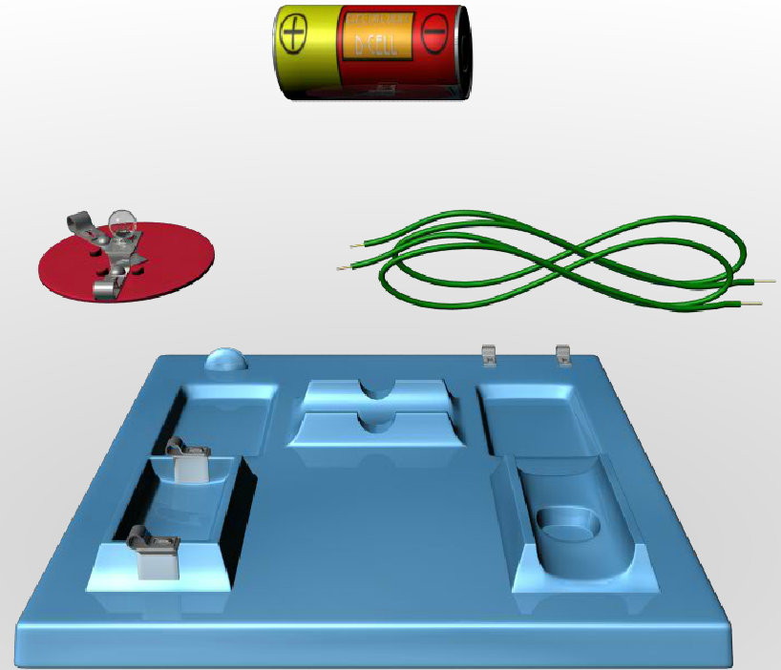
What question would you choose?
Tutor: | Roll over the d-cell in this picture. What can you tell me about this?
Student: | The d cell is the source of power
Tutor: | Let’s talk about wires. What’s up with those?
Student: | Wires are able to take energy from the d cell and attach it to the light bulb
Dialogue History
Q1 | What about the bulb? Tell me a bit about that component.
 | …
Q5 | So the wires connect the battery to the light bulb. What happens when all of the components are connected together?
Candidate Questions
Notes:
Q5 agreed upon by our raters, but big variation in choosing others. Lots of things going on here.
Different wording, different things being elicited. Different strategies that may depend on the skill level of the student and the point in the dialogue.
The student offers up the answer right away. Tutor must decide whether it’s better to keep pounding on a point or to move on.
Q5 has revoicing a nice way of engaging the student.
Choosing different subject matter.
Picking requires understanding what action is accomplished by the question

Slide 4
This talk
Using supervised machine learning for question ranking and selection
  Introduce the data collection methodology
  Demonstrate the importance of a rich dialogue move representation

Slide 5
Outline
Introduction
Tutorial Setting
Data Collection
Ranking Questions in Context
Closing thoughts

Slide 6
Tutorial Setting

Slide 7
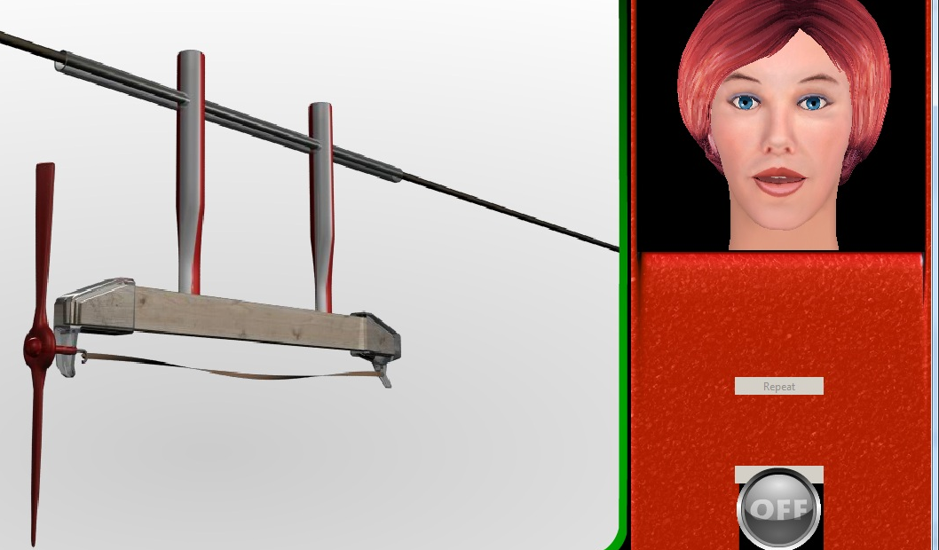
My Science Tutor (MyST)
A conversational multimedia tutor for elementary school students. (Ward et al. 2011)

Slide 8



MyST WoZ Data Collection
MyST
Speech Recognition
Student talks and interacts with MyST
Phoenix Parser
Suggested
Tutor Moves
Phoenix DM
Accepted
or overriden
tutor Moves
Notes:
Two conditions for data collection

Slide 9
Data Collection

Slide 10
Question Rankings as Supervised Learning
Training Examples:
  Per context set of candidate questions
  Features extracted from the dialogue context and the candidate questions
Labels:
  Scores of question quality from raters (i.e. experienced tutors)

Slide 11
Building a corpus for question ranking
Extract and author
candidate questions
(5-6 per context, 1156 total)
WoZ Transcripts
(122 total)
Manually select dialogue context
(205 contexts)
Collect
Ratings
T: ______
S: ______
T: ______
S: ______
T: ______
S: ______
T: ______
S: ______
T: ______
S: ______
T: ______
S: ______
Q1: ______?
1
T: ______
S: ______
T: ______
S: ______
T: ______
S: ______
T: ______
S: ______
T: ______
S: ______
T: ______
S: ______
Q2: ______?
2
Author
DISCUSS
Annotation
DISCUSS
Annotation
Q3: ______?
5
Q4: ______?
3
Extract
Q5: ______?
8

Slide 12
Question Authoring
About the author:
  Linguist trained in MyST pedagogy (QtA + FOSS)
Authoring Guidelines
  Suggested Permutations:
    QtA tactics
    Learning Goals
    Elaborate vs. wrap-up
    Lexical and syntactic structure
    Dialogue Form (DISCUSS)
Notes:
Note that this could someday become a Question Generation Process
Question authoring context – explain how I chose it --- point in a dialogue where you could conceivably have a follow up question, not saying hello goodbye or some metastatement

Slide 13
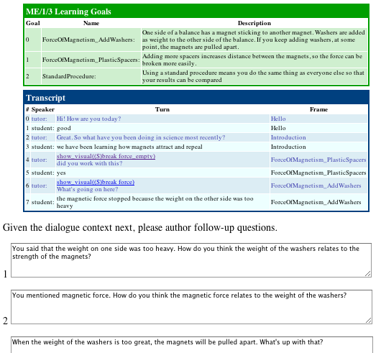
Question Authoring
Learning
Goals
Dialogue
Context
Authored
Questions
+ Original
Question
…

Slide 14
Question Rating
About the raters
  Four (4) experienced tutors who had previously conducted several WoZ sessions.
Rating
  Shown same dialogue history as authoring
  Asked to simultaneously rate candidate questions
  Collected ratings from 3 judges per context
  Judges never rated questions for sessions they had themselves tutored

Slide 15
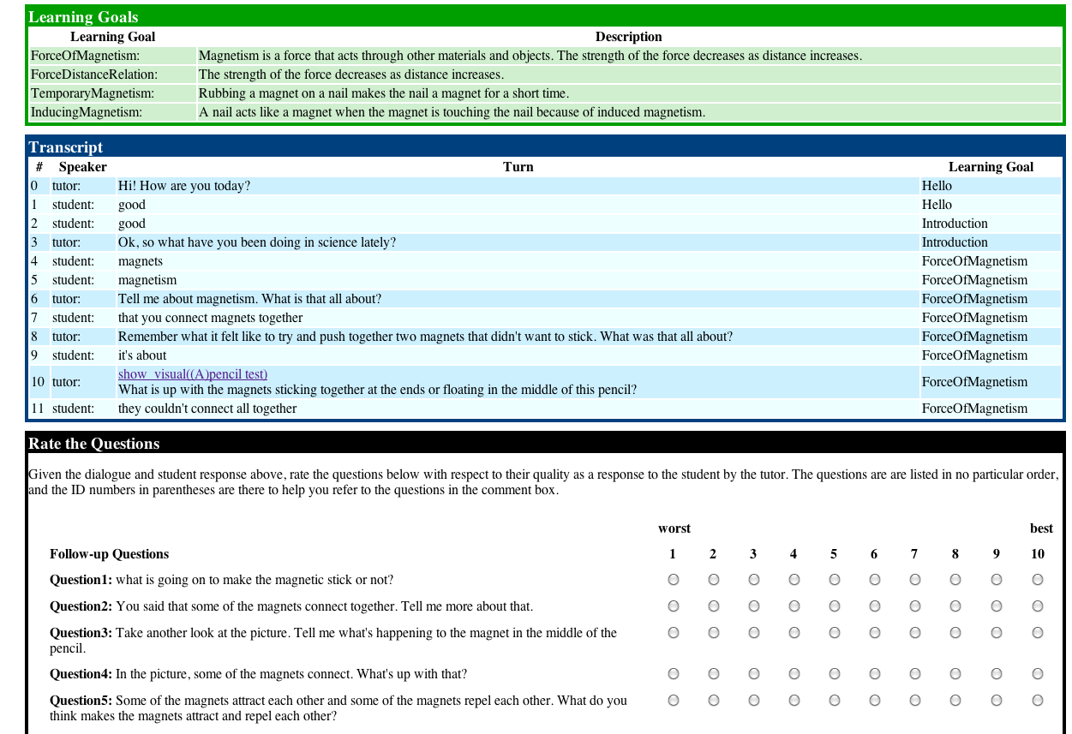
Ratings Collection
Notes:
Why this approach. Wanted to allow us to do lots with the data whether it be ranking, scoring, or pairwise. Simultaneity creates inherent ranking.

Slide 16
Question Rater Agreement
Assess agreement in ranking
  Raters may not have the same scale in scoring
  More interested in relative quality of questions
Kendall’s Tau Rank Correlation Coefficient
  Statistic for measuring agreement in rank ordering of items
  (perfect disagreement) -1 ≤ τ≤ 1 (perfect agreement)
Average Kendall’s Tau across all contexts and all raters
  τ=0.148
Notes:
Should note that Kendall’s Tau tends to be lower when there are a small number of items, unlike say information retrieval

Slide 17
Ranking Questions in Context

Slide 18
Automatic Question Ranking
Learn a preference function [Cohen et al. 1998]
For each question q_{i} in context C extract feature vector
For each pair of questions q_{i,}q_{j} in C create difference vector:
For training:

Slide 19
Automatic Question Ranking
Train a classifier to learn a set of weights for each feature that optimizes the pairwise classification accuracy
Create a rank order:
  Classify each pair of questions
  Tabulate wins
vs | q₁ | q₂ | q₃ | q₄
q₁ | X | q₁ | q₃ | q₄
q₂ | q₁ | X | q₃ | q₄
q₃ | q₃ | q₂ | X | q₃
q₄ | q₄ | q₄ | q₄ | X
 | wins
q₁ | 2
q₂ | 1
q₃ | 4
q₄ | 5
 | rank
q₁ | 3
q₂ | 4
q₃ | 2
q₄ | 1

Slide 20
Features
Feature Class | Example Features
Surface Form Features | # words in question Wh-words Bag-of-POS-tags
Lexical Overlap | Unigram/Bigram Word/POS Question & Prev. Student Turn Question & Current Learning Goal Question & Other Learning Goal
Dialogue Move (DISCUSS) | Next slides

Slide 21
DISCUSS
(Dialogue Schema Unifying Speech and Semantics)
A multidimensional dialogue move representation that aims to capture the action, function, and content of utterances
 | Dialogue Act (Action) | Rhetorical Form (Function) | Predicate Type (Content)
Example tags | Assert Ask Answer Mark Revoice … | Describe Define Elaborate Identify Recap … | CausalRelation Function Observation Procedure Process …
(Becker et al. 2010)
Notes:
Simply point out that the transcripts and questions were annotated with this.

Slide 22
DISCUSS Examples
Utterance | Dialogue Act (DA) | Rhetorical Form (RF) | Predicate Type (PT)
Can you tell me what you see going on with the battery? | Ask | Describe | Observation
The battery is putting out electricity | Answer | Describe | Observation
Which one is the battery? | Ask | Identify | Entity
The battery is the one putting out electricity | Answer | Identify | Entity
You said “putting out electricity”. Can you tell me more about that. | Mark Ask | -- Elaborate | -- Process

Slide 23
DISCUSS Features
Bag of Labels
  Bag of Dialogue Acts (DA)
  Bag of Rhetorical Forms (RF)
  Bag of Predicate Types (PT)
  RF matches previous turn RF (binary)
  PT matches previous turn PT (binary)
Context Probabilities
  p(DA,RF,PT_{question}|DA,RF,PT_{prev_student_turn})
  p(DA,RF_{question}|DA,RF_{prev_student_turn})
  p(PT_{question}|PT_{prev_student_turn})
  p(DA,RF,PT_{question}|% slots filled in current task-frame)
Notes:
Give intuition, that this allows us to drive at the purpose of the question in a way we can’t do with just the words.

Slide 24
DISCUSS Bag Features Example
Utterance | Dialog Act (DA) | Rhetorical Form (RF) | Pred. Type (PT)
Prev. Student Turn: i noticed that the circuit with the light bulb the with the the one light bulb is brighter and the circuit with the two light bulbs is not is | Answer | Describe | Visual
Candidate Question: So when there are two light bulbs hooked up to a single battery in series, the bulbs are dimmer? What's up with that? | Revoice Ask | - Elaborate | - Config
DA Revoice | DA Ask | DA Mark | RF Elaborate | RF Describe | PT Config | PT Visual | DA+RF Ask/Elaborate | RF-Match | PT match | …
1 | 1 | 0 | 1 | 0 | 1 | 0 | 1 | 0 | 0 | …

Slide 25
DISCUSS Context Feature Example
Learning Goal:
  Electricity flows from the positive terminal of a battery to the negative terminal of the battery
Slots:
  [Electricity]
  [Flows]
  [FromNegative]
  [ToPositive]
P(DA/RF/PT| % slots filled)
DA | RF | PT | % slots filled | p(DA/RF/PT)
Ask | Describe | Visual | 0-25% | 0.10
Ask | Describe | Function | 0-25% | 0.01
Ask | Describe | Visual | 25-50% | 0.05
Ask | Describe | Function | 25-50% | 0.12
Probability Table

Slide 26
Results
Model | Features | Mean Kendall’s Tau | 1/MRR
MaxEnt | Baseline + DISCUSS | 0.211 | 1.938
SVMRank | Baseline + DISCUSS | 0.190 | 1.801
SVMRank | Baseline | 0.108 | 2.114
MaxEnt | Baseline | 0.105 | 2.232
Baseline: Surface Form Features + Lexical Overlap Features
Notes:
Be clear about what MRR and Kendall’s Tau are.

Slide 27
Results
Distribution of per-context Kendall’s Tau values
BASELINE
+
DISCUSS
BASELINE

Slide 28
Results
Distribution of per-context Invers Mean Reciprocal Ranks
BASELINE
+
DISCUSS
BASELINE

Slide 29
System vs Human Agreement
Best System Tau | 0.211
Human ratings vs Avg. Tutor Ratings (all raters) | 0.259 – 0.362
Human ratings vs Avg. Tutor Ratings (no self) | 0.152 – 0.243

Slide 30
Closing Thoughts

Slide 31
Contributions
Methodology for ranking questions in context
Illustrated the utility of a rich dialogue move representations for learning and modeling real human tutoring behavior
Defined a set of features that reflect the underlying criteria used in selecting questions
Framework for learning tutoring behaviors from 3rd party ratings

Slide 32
Future Work
Train and evaluate on individual tutors’ preferences (Becker et al. 2011, ITS)
Reintegrate with MyST
Fully automatic question generation

Slide 33



Acknowledgments
National Science Foundation
  DRL-0733322
  DRL-0733323
Institute of Education Sciences
  R3053070434
DARPA/GALE
  Contract No. HR0011-06-C-0022

Slide 34
Backup Slides

Slide 35
Related Works
Tutorial Move Selection:
  Reinforcement Learning (Chi et al. 2009, 2010)
  HMM + Dialogue Acts (Boyer et al. 2009, 2010)
Question Generation
  Overgenerate + Rank (Heilman and Smith 2010)
  Language Model Ranking (Yao, 2010)
  Heuristics Based Ranking (Agarwal and Mannem, 2011)
Sentence Planning (Walker et al. 2001, Rambow et al. 2001)

Slide 36
Question Rater Agreement
Mean Kendall’s Tau Rank Correlation Coefficients
 | Rater A | Rater B | Rater C | Rater D
Rater A | -- | 0.259 | 0.142 | 0.008
Rater B | 0.259 | -- | 0.122 | 0.237
Rater C | 0.142 | 0.122 | -- | 0.054
Rater D | 0.008 | 0.237 | 0.054 | --
Mean | 0.136 | 0.206 | 0.106 | 0.100
Self | 0.480 | 0.402 | 0.233 | 0.353
Averaged across all sets of questions (contexts)
Averaged across all raters: tau=0.148
Notes:
Summarize what we see. Some raters agree with others more, Shows how subjective this is. Explain how that for small range of options tau tends to be smaller.
Emphasize that even within a given pedagogy there are equally valid options.
Stories: Rater C and D are less consistent internally.

Slide 37
DISCUSS Annotation Project
122 Wizard-of-Oz Transcripts
  Magnetism and Electricity – 10 units
  Measurement – 2 units
5977 Linguist-annotated Turns
15% double annotated
 | DA | RF | PT
Kappa | 0.75 | 0.72 | 0.63
Exact-Agreement | 0.80 | 0.66 | 0.56
Partial Agreement | 0.89 | 0.77 | 0.68
Notes:
Need to be here by 15-20 minutes

Slide 38
Results
Model | Features | Pairwise Acc. | Mean Kendall’s Tau | MRR
MaxEnt | CONTEXT+DA+PT+MATCH+POS- | 0.616 | 0.211 | 0.516
SVMRank | CONTEXT+DA+PT+MATCH+POS- | 0.599 | 0.190 | 0.555
MaxEnt | CONTEXT+DA+RF+PT+MATCH+POS- | 0.601 | 0.185 | 0.512
MaxEnt | DA+RF+PT+MATCH+POS- | 0.599 | 0.179 | 0.503
MaxEnt | DA+RF+PT+MATCH+ | 0.591 | 0.163 | 0.485
MaxEnt | DA+RF+PT+ | 0.583 | 0.147 | 0.480
MaxEnt | DA+RF+ | 0.574 | 0.130 | 0.476
MaxEnt | DA+ | 0.568 | 0.120 | 0.458
SVMRank | Baseline | 0.556 | 0.108 | 0.473
MaxEnt | Baseline | 0.558 | 0.105 | 0.448

Slide 39
DISCUSS Examples
Utterance | Dialogue Act (DA) | Rhetorical Form (RF) | Predicate Type (PT)
Can you tell me what you see going on with the battery? | Ask | Describe | Observation
The battery is putting out electricity | Answer | Describe | Observation
Which one is the battery? | Ask | Identify | Entity
The battery is the one putting out electricity | Answer | Identify | Entity
You said “putting out electricity”. Can you tell me more about that. | Mark Ask | -- Elaborate | -- Process
It sounds like you’re talking about what a battery does. What’s that all about? | Revoice Ask | -- Describe | -- Function

Slide 40
Example MyST Dialogue
1. Tell me about these things. What are they?
2. a wire a light bulb a battery a motor a switch and the boards basically
3. Good. These components can all be made into circuits. Let's talk more about them. So, for a review, tell me what the d cell is all about?
4. it's a battery and it has one positive side and one negative
5. Check this out. Mouse over the d-cell. So, what can you tell me about the d-cell now?
6. it's one positive side and one negative side and it generates magnetism
7. What is the d-cell all about when getting the motor to spin or lightbulb to light?
8. A circuit electricity
9. Tell me more about what the d-cell does.
Notes:
http://discussweb.leebecker.com/view_transcript/ME_2_2_CV485_SB__01-21-2010.ilog
Use this as an example of:
MyST Woz dialogue
But also an example of how the tutor is really trying to elicit the concept of a battery as a provider of energy.
Use this to drive what the conversation really is

