Slide 1
Automated Essay Scoring for Swedish
André Smolentzov
Department of Linguistics
Stockholm University
Robert Östling Björn Tyrefors Hinnerich Erik Höglin
Department of Linguistics Department of Economics National Institute of Economic Research
Stockholm University Stockholm University

Slide 2
Background to the study
Dept. of Economics is studying gender/ethnic biases in essay grades in Swedish national high school tests
Dept. of Linguistics is investigating the possibility to use AES for essay scoring

Slide 3
Essay data
Random sample with 1702 essays from high school national tests in Swedish
Scores with four levels: fail, pass, pass with distinction, excellent
Each essay has two (independent) scores
  Class teacher
  Blind raters
Large discrepancy between class teachers and blind raters
Essay tokens automatically annotated with lemma and POS information

Slide 4
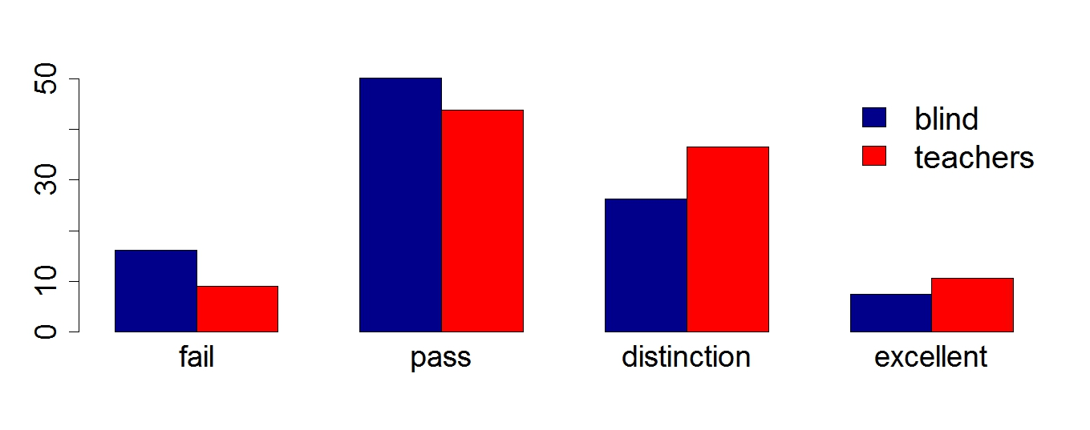
Distribution of human raters scores
Frequencies of scores
in percent of total
Scores

Slide 5
Reference data
News text
  200 million words
  Annotated with lemma and POS
  Model for written language norms
Blogs
  200 million words
  Annotated with lemma and POS
  Deviates from written language norms
SALDO wordlist
  127, 000 entries
  1,800,000 word types/forms

Slide 6
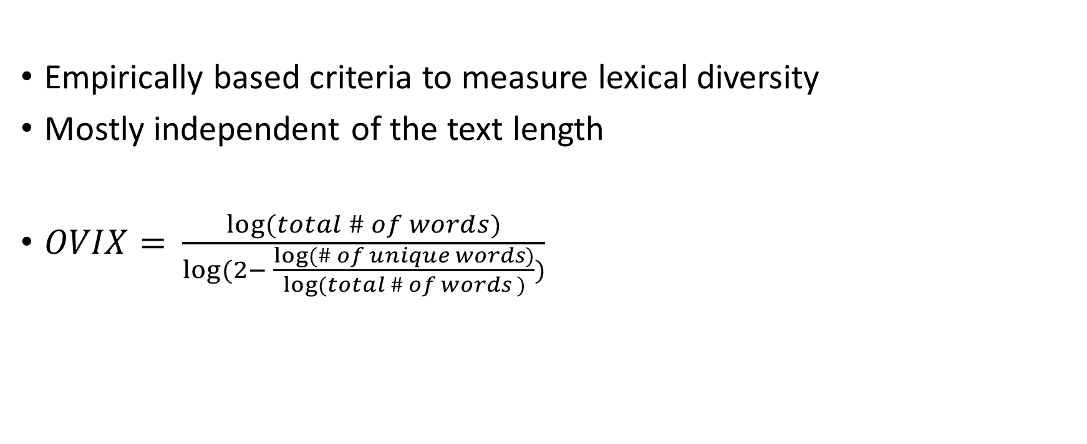
Lexical diversity based on OVIX
Empirically based criteria to measure lexical diversity
Mostly independent of the text length
$OVIX=$ $\frac{log⁡(total \# of words)}{log⁡(2− \frac{log⁡(\# of unique words)}{log⁡(total \# of words )})}$

Slide 7
Split compound errors
Compound words are common in Swedish
Compounds are normally concatenated in Swedish
Splitting the segments of a compound word is a typical written error
Error if a bigram (w1+w2) in the essay corresponds to a unigram (w1w2) in the News text and the bigram is not present
Feature: # of split compound errors relative to total # of words

Slide 8
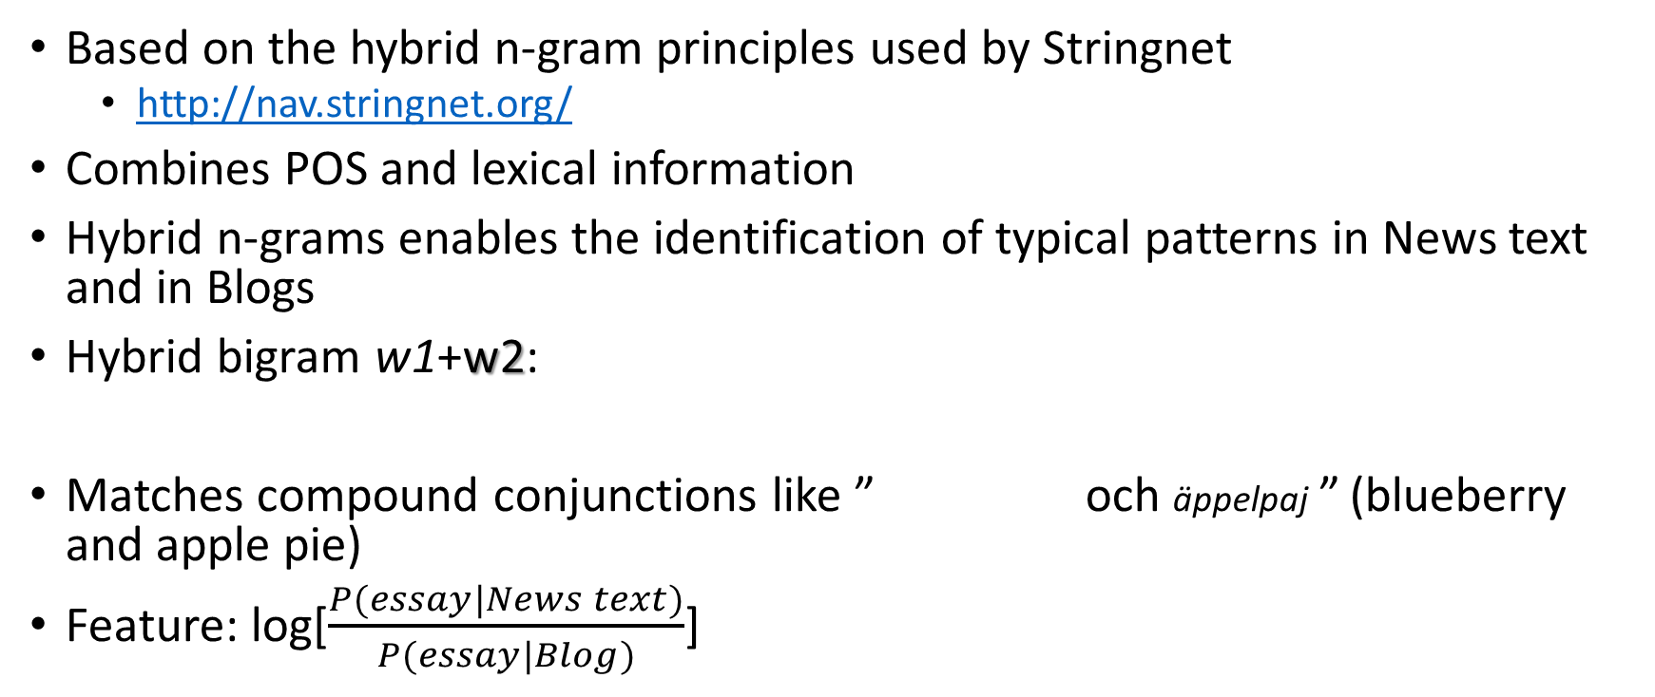
Hybrid n-gram
Based on the hybrid n-gram principles used by Stringnet
  http://nav.stringnet.org/
Combines POS and lexical information
Hybrid n-grams enables the identification of typical patterns in News text and in Blogs
Hybrid bigram w1+w2:
Matches compound conjunctions like ” och äppelpaj ” (blueberry and apple pie)
Feature: log[$\frac{P(essay|News text)}{P(essay|Blog)}$]
W1
W2
[Noun, compound] + och [Conjunction ]
blåbärs-

Slide 9
Cross entropy
The cross entropy of the essay using a trigram language model of part of speech tags trained on the News corpus
Difference of vocabulary cross entropies of the essay given two unigram language models. One model trained on News text and the other on Blog

Slide 10
Supervised machine learning
Linear Discriminant Analysis Classifier (LDAC)
Multiclass with 4 levels of scores
Cross validation using leave one out
Target scores
  Average scores of teacher’s and blind rater’s rounded down
  Blind rater’s scores
  Teacher’s scores
Evaluation of results using linear weighted kappa and overall accuracy

Slide 11
Agreement Results
 | AES/human average scores | AES/blind scores | AES/teachers scores | Teacher’s and blind raters
Overall Accuracy Exact agreement | 62.2% | 57.6% | 53.6% | 45.8%
Linear weighted kappa | 0.399 | 0.369 | 0.345 | 0.276

Slide 12
Feature correlations
Feature | Correlation with averaged human scores
Fourth root of # of tokens | 0.535
# of tokens | 0.502
Hybrid n-gram | 0.363
Vocabulary cross entropy | 0.361
Average word length | 0.307
OVIX | 0.304
# of long tokens relative to total # of tokens | 0.284
Spelling errors | -0.257
POS cross-entropy | 0.216
Split compound errors | -0.208

Slide 13
Summary
First attempt to develop Swedish language AES for high school essays
Features based on Blog and News text corpora
AES–human agreements better than teacher-blind rater agreement
Insufficient accuracy for scoring high-stakes exams
Could be used to identify essays that are candidates for regrading

Slide 14
Future work
Collect more training data
  Several blind scores
  Less discrepancy in scores
Investigate other classifier solutions
Investigate features related to the discourse structure

Slide 15
Demo System
A demo system with a web interface available
http://www.ling.su.se/aes

