Slide 1
Evaluating Unsupervised Language Model Adaption Methods for Speaking Assessment
ShaSha Xie* Lei Chen
Microsoft ETS
6/13/2013

Slide 2
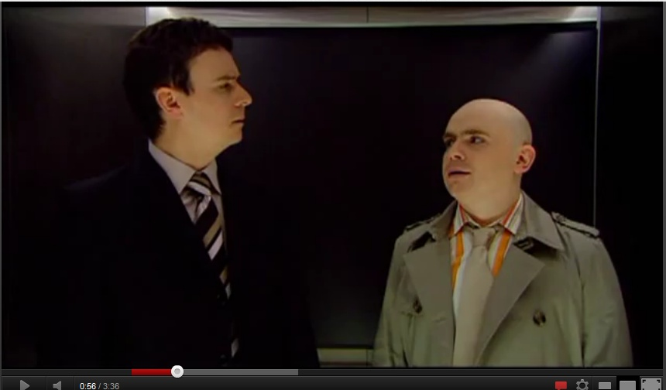
Model Adaptation, Key to ASR Success
http://youtu.be/5FFRoYhTJQQ

Slide 3
Adaptation
Modern ASR systems are statistics-rich
  Acoustic model (AM) uses GMM or DNN
  Language model (LM) uses n-gram (n can be large)
Parameters needed be adjusted to meet new accent, speakers, environment, content domains, etc.
Adaptation is important for achieving satisfactory recognition accuracy
Need and prefer using large-sized transcribed speech files

Slide 4
LM Adaptation Methods
Supervised LM adaptation
  A large amount of in-domain human annotated transcripts
Unsupervised LM adaptation
  No human transcripts
Using web data to support LM adaptation
  Large-amount, no cost, up-to-date, but noisy
Semi-supervised LM adaptation
  Minimize the human supervision
  A small amount of human transcripts

Slide 5
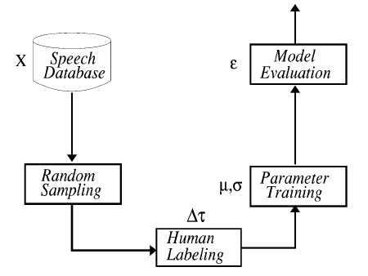
Supervised Adaptation
Given a large amount of in-domain speech recordings
Random sampling
Obtain the human transcripts of selected speech
Model adaptation
The figure is from Riccardi, Giuseppe, and Dilek Hakkani-Tur. "Active learning: Theory and applications to automatic speech recognition." Speech and Audio Processing, IEEE Transactions on 13.4 (2005): 504-511.

Slide 6
Unsupervised Adaptation
ASR transcripts of in-domain data
Use of ASR transcripts
  All of the transcripts
  Random selection (Bacchiani and Roark, 2003)
  Selected ASR transcripts with fewer recognition errors (Gretter and Riccardi, 2001)
ASR Transcripts
Selection

Slide 7
Using Web Data in LM Adaptation
Use Web data to obtain in-domain LM training material
From ASR tasks, generate search queries and use search engines, i.e., Google or Bing, to retrieve a large amount of LM training data (noisy) in a very fast and economical way
Searching Web to collect LM training data

Slide 8
Semi-supervised LM Adaptation
Using active learning to allow human transcribers to focus on “critical” utterances
Run the seed ASR on the entire un-transcribed adaptation data set
Select the utterances that are poorly recognized for being transcribed
This can be an iterative process
Based on seed ASR performance to sample responses for being transcribed

Slide 9
Related works
Michiel Bacchiani, and Brian Roark, “Unsupervised Language Model Adaptation”, ICASSP, 2003.
Giuseppe Riccardi, and Dilek Hakkani-Tur, “Active Learning: Theory and Applications to Automatic Speech Recognition”, IEEE Transactions on Speech and Audio Processing, Vol. 13, No. 4, 2005.
Roberto Gretter, and Giuseppe Riccardi, “On-line Learning of Language Models with Word Error Probability Distributions”, ICASSP, 2001.
Ng, T., Ostendorf, M., Hwang, M. Y., Siu, M., Bulyko, I., & Lei, X. (2005). Web-data augmented language models for Mandarin conversational speech recognition. Proc. ICASSP (Vol. 1, pp. 89–593).

Slide 10
Experiment Setup
Data
  In-domain data: TOEIC ®, work place English assessment
  Out-of-domain data: TOEFL ®, academic English assessment
Seed ASR
  A state-of-the-art HMM ASR trained on TOEFL data
  WER of 33.0% is found when being tested on in-domain data

Slide 11
Experiment of Unsupervised Adaptation
Data
  Training data for the seed ASR: ~700 hrs (out-of-domain)
  Adaptation: 1,470 responses, about 24.5 hrs (in-domain)
  Testing: 184 responses, about 3 hrs (in-domain)
Baselines
  No-adaptation 42.8% WER
  Supervised adaptation 34.7% WER
Selection method
  Average word confidence scores
  Duration-based confidence scores

Slide 12
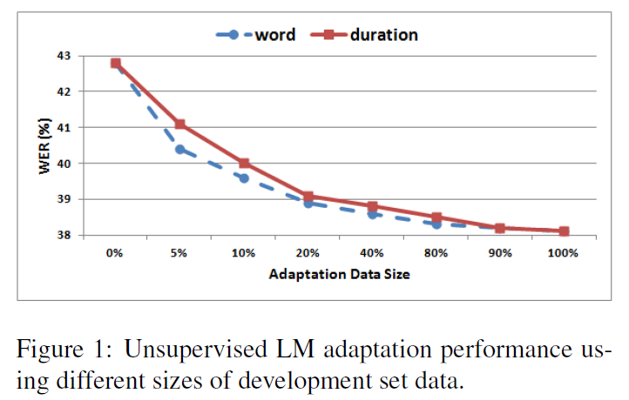
Experimental Results

Slide 13
Using Web as a corpus
A recent trend in NLP & ASR research fields is to use Web as a corpus
For example, (Ng et al. 2005) used Chinese data collected from Web to do topic adaption, they achieved 28% reduction in LM perplexity and 7% in character recognition.

Slide 14

Using Web data in LM adaptation
Create query terms based on test prompts
Using search engine to find URLs
Collect and process the text content in those URLs
Apply the collected Web texts on LM adaptation task

Slide 15
An example
Prompt
  Do you agree or disagree with the following statement? Advances in technology have made the world a better place. Use specific reasons and examples to support your opinion
Query
  "advances in technology" made "the world" "a better place“

Slide 16
An example (continuing)
Cleaned URLs
  http://answers.yahoo.com/question/index?qid=20090205084424AA0PrID
  http://thichnhattim.wordpress.com/2011/08/08/why-did-the-world-stop
  http://www.allfreeessays.com/topics/advancement-in-technology/0
  http://www.allfreeessays.com/topics/how-technology-destroy-our-world/0
  http://www.crcpd.org/national_radiation_protection_week.aspx
  http://www.cyberessays.com/lists/modern-technology-has-made-life-easier-and-safer/page0.html
  http://www.dontread.org
  http://www.english-test.net/forum/ftopic52466.html
  http://www.oppapers.com/subjects/how-wireless-technology-has-changed-the-world-page5.html
  http://www.urch.com/forums/twe/2430-081-technology-has-made-world-better-place.html

Slide 17
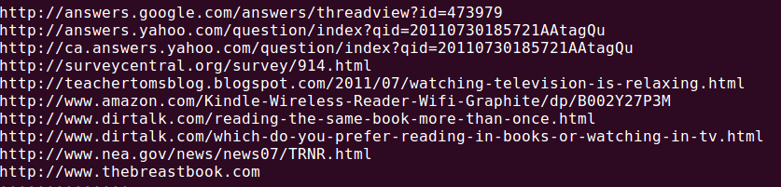
A More promising collection
Query:
  “reading a book is more relaxing than watching television”
Returned URLs
  Several Q/A posts are related to the prompt

Slide 18
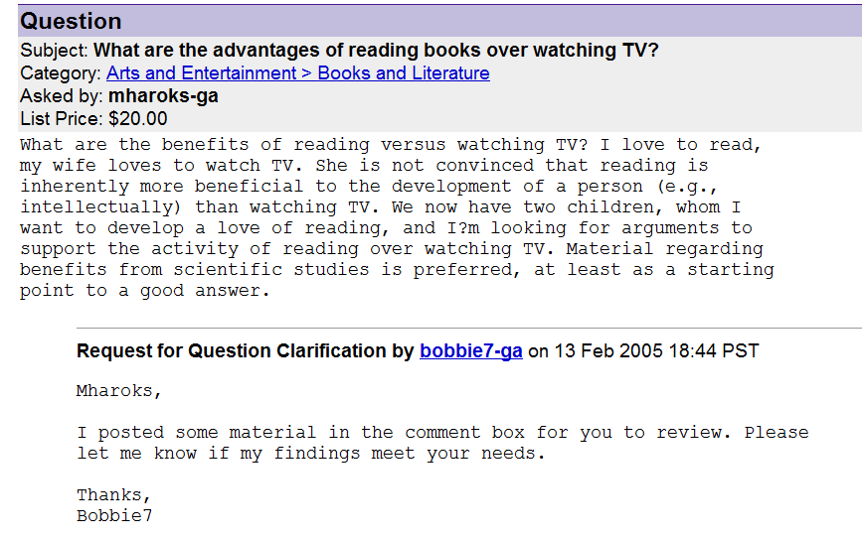

Slide 19
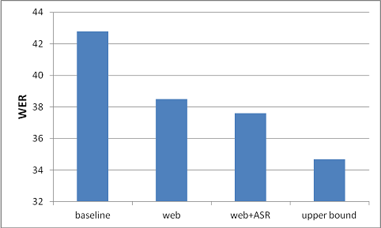
Experimental results
Web: using 5,312 utterances collected web
Web + ASR: Using both unsupervised data and web data

Slide 20
Semi-Supervised Adaptation
Our approaches
  Initial ASR system trained on out-of-domain data
  Obtain the ASR transcripts of adaptation data
  Selecting low certainty responses, and replacing the ASR transcripts with human transcripts
    Average confidence scores
    Duration-based confidence scores
  Adaptation
    ASR transcripts with high certainty
    + Human transcripts of selected responses

Slide 21
Semi-Supervised Adaptation
Experimental Results
  Similar performance for two selection methods: average and duration-based confidence score
  Significant WER reduction by only using human transcripts of ~130 responses

Slide 22
Summary of Results

Slide 23
Conclusions
Several of unsupervised LM adaptation methods that have been actively investigated in the ASR field have been tried on the ASR improvement task needed by speaking assessment
These methods are found to be useful for achieving a faster and more economical LM adaptation
  Unsupervised => no need of transcription
  Web-as-a-corpus => even can pass pre-tests
  Semi-supervised => jointly use machine efficiency and human wisdom

Slide 24
Future works
Multiple iterations of active learning
More refined web-resource collection methods
  Such as query formation, web data cleaning
Try some other new subset-selection methods (I just saw in NAACL 2013)

