Slide 1


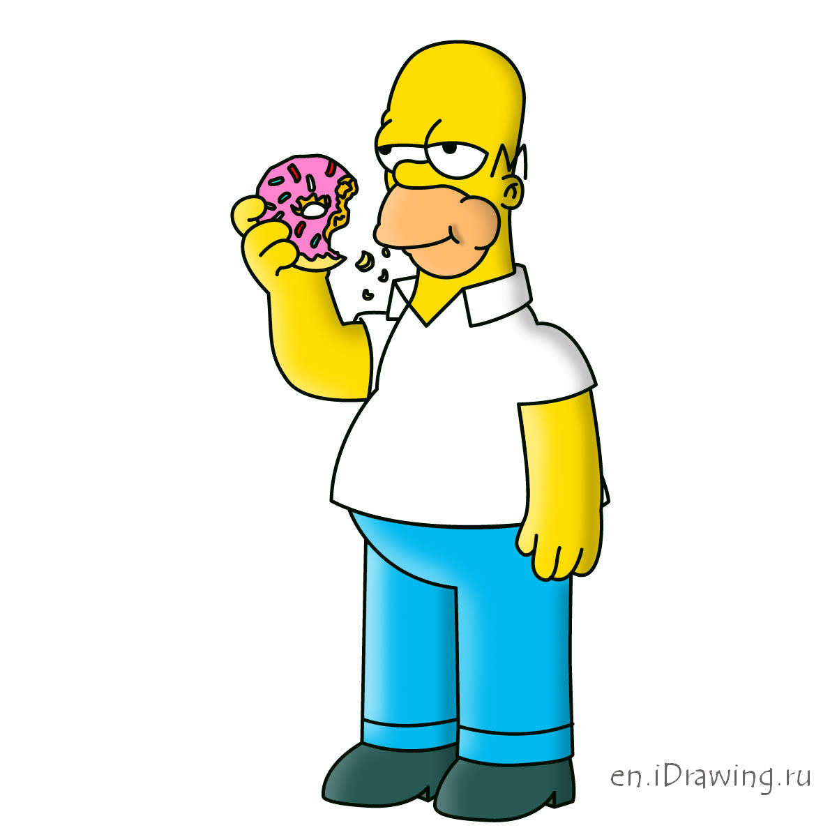

Dear Sir or Madam, May I Introduce the GYAFC Dataset:
Corpus, Benchmarks and Metrics for Formality Style Transfer
Sudha Rao Joel Tetreault
University of Maryland, College Park* Grammarly
1. Introduction
2. Corpus
3. Models
I’d say it is punk though.
Motivation:
Accurate expression of style or tone is important for effective communication
Formality is an important form of style
Automatically making content more formal is a useful writing assistance tool
GYAFC: Grammarly’s Yahoo Answers Formality Corpus
Extract informal sentences from Yahoo Answers (Entertainment & Music, Family & Relationships)
Collect formal rewrite for each informal sentence using Amazon Mechanical Turk
Each domain: 52k train, 3k tune, 1.5k test
For access to GYAFC see: https://github.com/raosudha89/GYAFC-corpus
Rule-based method (RBM): Capitalization, remove repeated punctuations, expand contractions, etc
However, I do believe it to be punk.
Gotta see both sides of the story.
Phrase-based Machine Translation (PBMT)
Self-training train on ~50K & translate large amount of informal to formal
Sub-selection using edit distance
Data duplication by up-weighing original ~50K
You have to consider both sides of the story.
Key Contributions:
Largest style transfer dataset containing 110K informal-formal pairs.
Benchmarks inspired by work in low resource machine translation (MT)
Assess evaluation metrics for measuring formality, fluency and meaning preservation.
5. Results
Neural Machine Translation (NMT)
Baseline Bi-directional LSTM (long-short term memory) encoder-decoder model with attention
Copy mechanism learns when to copy from source
Use PBMT model output to increase data size
Back-translation to translate large amount of formal to informal and use these as additional training data
E & M | F & R
(2.03) Reference | (2.13) Reference
(2.47) PBMT | (2.38) PBMT
(2.48) NMT | (2.38) NMT
(2.54) RBM | (2.56) RBM
 | E & M | F & R
Formality | 0.47 | 0.45
Fluency | 0.48 | 0.46
Meaning | 0.33 | 0.30
BLEU | 0.48 | 0.43
TERp | 0.31 | 0.30
PINC | -0.11 | -0.08
4. Evaluation Metrics
Human-based evaluation
Use Amazon Mechanical Turk
500 sentences, 5 judgments per sentence
Criteria: Formality, Fluency, Meaning preservation and Overall Ranking
Automatic metric based evaluation
Formality: Pavlick & Tetreault (2016)
Fluency: Heilman et al. (2014)
Meaning Preservation: He et al. (2015)
Overall: BLEU, TERp and PINC
Overall system ranking
6. Conclusion
Spearman rank correlation between human & automatic
Original Informal | i hardly everrr see him in school either usually i see hima t my brothers basketball games.
Reference Formal | I hardly ever see him in school. I usually see him with my brothers playing basketball.
PBMT | I hardly see him in school as well, but my brothers basketball games.
NMT | I rarely see him in school either usually I see him at my brothers basketball games.
Model | Formality [ -3 to +3] |  | Fluency [1 to 5] |  | Meaning [1 to 6]
 | Human | PT16 | Human | H14 | Human | He15
Original Informal | -1.23 | -1.00 | 3.90 | 2.89 | -- | --
Formal Reference | 0.38 | 0.17 | 4.45 | 3.32 | 4.57 | 3.64
RBM | -0.59 | -0.34 | 4.00 | 3.09 | 4.85 | 4.41
PBMT | -0.19 | 0.00 | 3.96 | 3.28 | 4.64 | 4.19
NMT | -0.16 | 0.00 | 4.09 | 3.27 | 4.46 | 4.20
Low-resource MT techniques effective
Training on more data obtained artificially helps
Automatic metrics correlate moderately with humans, but more work necessary
* Work done while first author was at Grammarly for a research internship.

