Slide 1





An Analysis of Statistical Models and Features for Reading Difficulty Prediction
Michael Heilman, Kevyn Collins-Thompson, Maxine Eskenazi
Language Technologies Institute
Carnegie Mellon University

Slide 2
The Goal: To predict the readability of a page of text.
Grade 3
Grade 7
Grade 11
…From far out in space, Earth looks like a blue ball…
…Like the pioneers who headed west in covered wagons, Mir astronauts have learned to do the best they can with what they have…
… All the inner satellites and all the major satellites in the solar system have synchronous rotation and revolution because they are tidally coupled to their planets…

Slide 3
Prior Work on Readability
Measure | Approx. Year | Lexical Features | Grammatical Features
Flesch-Kincaid | 1975 | Syllables per word | Sentence length
Lexile (Stenner, et al.) | 1988 | Word frequency | Sentence length
Collins-Thompson & Callan | 2004 | Lexical Unigrams | -
Schwarm & Ostendorf | 2005 | Lexical n-grams, … | Sentence length, distribution of POS, parse tree depth, …
Heilman, Collins-Thompson, Callan, & Eskenazi | 2007 | Lexical Unigrams | Manually defined grammatical constructions
(this work) | 2008 | Lexical Unigrams | Automatically Defined, Extracted syntactic sub-tree features
Notes:
Picked baselines that are widely used:
-FK in word processing applications
-Lexical in K-12 schools
-Language Modeling in the REAP system
Heilman et al 2007 focused a lot on readability for ESL. Constructions were extracted from an ESL grammar textbook.
Schwarm and Ostendorf 2005: didn’t have easy access.
Experimented with some of their grammatical features in preliminary tests.
It would certainly be interesting to perform that comparison.

Slide 4
Outline
Introduction
Lexical & Grammatical Features
Scales of Measurement & Statistical Models
Experimental Evaluation
Results & Discussion

Slide 5
Lexical Features
relative frequencies of 5000 most common word unigrams
Morphological stemming and stopword removal
…The continents look brown, like small islands floating in the huge, blue sea….
blue
sea
small
huge
look
float
continent
brown
island

Slide 6
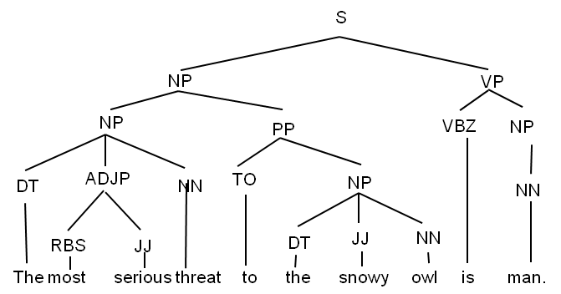
Grammatical Features: Syntactic Subtrees
Level 2 Feature
Level 1 Feature
Includes grammatical function words but not content words.
PP
Level 0 Feature
S
TO
NP
ADJP
NP
VP
JJ
NN
to
DT

Slide 7
Grammatical Features
Frequencies of the 1000 most common subtrees were selected as features.
Level | Number Selected | Example
0 | 64 | PP
1 | 334 | (VP VB PP)
2 | 461 | (VP (TO to) (VP VB PP))
3 | 141 | (S (VP (TO to) (VP VB PP)))

Slide 8
Extracting Grammatical Feature Values
INPUT TEXT
…It was the first day of Spring. Stephanie loved spring. It was her favorite season of the year. It was a beautiful sunny afternoon. The sky was a pretty shade of blue. There were fluffy, white clouds in the sky….
PARSE TREES
S
VP
S
NP
VP
ADJP
NP
N
V
N
ADV
ADJ
DET
N
V
NP
…
DET
N
FREQUENCIES OF
SUBTREES
SUBTREE FEATURES
S
(S NP VP) | 0.022
(NP DET JJ NN) | 0.033
(S (NP NN) (VP VBD NP)) | 0.055
(VP) | 0.111
… | …
VP
S
NP
VP
ADJP
NP
N
V
N
ADV
ADJ
DET
N
V
NP
…
DET
N

Slide 9
Outline
Introduction
Lexical & Grammatical Features
Scales of Measurement & Statistical Models
Experimental Evaluation
Results & Discussion

Slide 10
Scales of Measurement
Different statistical models are appropriate for different types of data (scales of measurement).
What is the appropriate scale for readability?

Slide 11


Scales of Measurement
 | Natural ordering? | Evenly Spaced? | Meaningful Zero Point? | Examples
Nominal
Ordinal
Interval
Ratio
apples and oranges
Severity of Illness:
Mild, moderate, severe, …
Years on a calendar
Annual income

Slide 12
Statistical Modeling Approaches
Compared 3 standard statistical modeling approaches for interval, ordinal, nominal data.
  different assumptions, numbers of parameters and intercepts
More parameters allow more complex models, but may be harder to estimate.

Slide 13
Linear Regression
Well-suited for interval data.
Reading level is linear function of feature values.
Single set of parameters for features
Single intercept

Slide 14
Proportional Odds Model
Log-linear model for ordinal data
Single set of parameters for features
Intercept for each level
Estimated probability of text being level j: difference between levels j and j + 1.

Slide 15
Multi-class Logistic Regression
Log-linear model for nominal data
Set of parameters for features for each level but one.
Intercept for each level
Sum over all levels

Slide 16
Estimation and Regularization
Parameters were estimated using L₂ regularization.
Regularization hyper-parameter for each model was tuned with simple grid search and cross validation.

Slide 17
Hypothesis
The Proportional Odds Model using both lexical and grammatical features will perform best.
  Difference between reading ability between grades 1 & 2 should be larger than between 10 & 11.
  Both Lexical & Grammatical features play a role.

Slide 18
Outline
Introduction
Lexical & Grammatical Features
Scales of Measurement & Statistical Models
Experimental Evaluation
Results & Discussion

Slide 19
Evaluation Corpus
Source:
  Content text from set of Web pages.
Reading level labels for grades 1-12:
  Indicated by Web page or link to it.
  Half authored by students.
  Half labeled by teachers or authors.
289 texts, 150,000 words
Various topics
Even distribution across levels (+/- 3)
Adapted from previous work:
  Collins-Thompson & Callan, 2005
  Heilman, Collins-Thompson, Callan, & Eskenazi, 2007

Slide 20
Evaluation Metrics
Measure | Description | Details | Range
Pearson’s Correlation Coefficient | Strength of linear relationship between predictions and labels. | Measures trends, but not the degree to which values match in absolute terms. | [0, 1]
Adjacent Accuracy | Proportion of predictions that were within 1 of label. | Intuitive Near miss predictions are treated the same as predictions that are ten levels off. | [0, 1]
Root Mean Square Error | square root of mean squared difference of predictions from labels. | strongly penalizes bad errors. “average difference from true level” | [0, ∞)

Slide 21
Evaluation Procedure
Randomly split corpus into training set (75%) and test set (25%).
Ten-fold stratified cross-validation on training set for model selection and hyper-parameter tuning.
Test Set Validation: Compared each statistical model & feature set pair (or baseline) to hypothesized best model, the proportional odds model with combined feature set.

Slide 22
Outline
Introduction
Lexical & Grammatical Features
Scales of Measurement & Statistical Models
Experimental Evaluation
Results & Discussion

Slide 23
Comparison of Feature Sets
*
Proportional Odds Model: Lexical Features
Proportional Odds Model: Grammatical Features
Proportional Odds Model: Combined Features
* p < .05

Slide 24
Comparison of Modeling Approaches
*
*
*
*
Linear Regression: Combined Features
Multi-Class Logistic Regression: Combined Features
Proportional Odds Model: Combined Features
* p < .05

Slide 25
Comparison to Baselines
Compared Proportional Odds Model with Combined Features to:
  Flesch-Kincaid
  Implementation of Lexile
  Collins-Thompson and Callan’s language modeling approach
PO model performed as well or better in almost all cases.

Slide 26
Findings: Feature Sets
Grammatical features alone can be effective predictors of readability.
Compared to (Heilman et al., 2007), uses more comprehensive & detailed set of grammatical features.
  Does not require extensive linguistic knowledge and effort to manually define grammatical features.

Slide 27
Findings: Modeling Approaches
Results suggest that reading grade levels lie on an ordinal scale of measurement.
Proportional odds model for ordinal data lead to the most effective predictions in general.
  More complex multi-class logistic regression did not lead to better predictions.

Slide 28
Questions?

Slide 29
Proportional Odds Model Intercepts
PO intercepts estimate log odds ratio of a text being at or above a level compared to below that level.
  Are the intercept values a linear function of grade levels?
  Is there value in the ability to model ordinal data?
Grade Level | Model Intercept | Difference Compared to Intercept for Previous Grade
1 | N/A | N/A
2 | 3.1289 | N/A
3 | 2.1237 | 1.0052
4 | 1.2524 | 0.8713
5 | 0.5268 | 0.7256
6 | -0.0777 | 0.6045
7 | -0.6812 | 0.6035
8 | -1.1815 | 0.5003
9 | -1.7806 | 0.5991
10 | -2.4195 | 0.6389
11 | -3.0919 | 0.6724
12 | -4.0528 | 0.9609

Slide 30
Null Hypothesis Testing
Used Bias-Corrected and Accelerated (BC_{a})Bootstrap (Efron & Tibshirani, 1993) to estimate 95% confidence intervals for differences in evaluation metrics for each model from the PO Model with Combined Features.
The bootstrap performs random sampling with replacement of the held-out test dataset to create thousands of bootstrap replications. It then computes a statistic for each replication to estimate the distribution of that statistic.

Slide 31
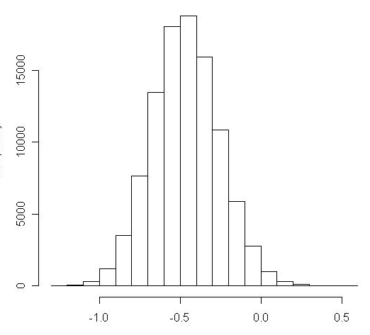
Bootstrap Histogram Example
Distribution of difference in RMSE between PO model with combined features and implementation of Lexile:
A difference of 0.0 corresponds to the null hypothesis

Slide 32
Comparison to Baselines
*
*
*
Lexile-like measure (Stenner et al., 1988)
Lang. Modeling (Collins-Thompson & Callan, 2005)
Flesch-Kincaid
Proportional Odds Model: Combined Features
* p < .05

Slide 33
Simplified Linear Regression Example
4
Freq. of Adverbial Phrases
3
2
1
Freq. of Embedded Clauses
j
(Prototypical Text at Level j)

Slide 34
Simplified PO Model Example
4
3
Freq. of Adverbial Phrases
2
1
Freq. of Embedded Clauses
j
(Prototypical Text at Level j)

Slide 35
Simplified Logistic Regression Example
2
Freq. of Adverbial Phrases
3
1
4
Freq. of Embedded Clauses
j
(Prototypical Text at Level j)

