Slide 1
CSC 282: Design & Analysis of Efficient Algorithms
Graph Algorithms
Shortest Path Algorithms
Fall 2013

Slide 2
Path Finding Problems
Many problems in computer science correspond to searching for paths in a graph from a given start node
  Route planning
  Packet-switching
  VLSI layout
  6-degrees of Kevin Bacon
  Program synthesis
  Speech recognition

Slide 3
Application: Robot Planning
A huge graph may be implicitly specified by rules for generating it on-the-fly
Blocks world:
  vertex = relative positions of all blocks
  edge = robot arm stacks one block
stack(blue,table)
stack(green,blue)
stack(blue,red)
stack(green,red)
stack(green,blue)

Slide 4
Iterative Depth-First Search Path Finding
procedure DFS_Path(G, s)
stack: open
for each u in V: u.visited = false
open.push(s)
while not open.empty():
u = open.pop()
for each (u,v) in E:
if not v.visited then
v.prev = u
open.push(v)
end

Slide 5
Iterative Breadth-First Search Path Finding
procedure BFS_Path(G, s)
queue: open
for each u in V: u.visited = false
open.enqueue(s)
while not open.empty():
u = open.dequeue()
for each (u,v) in E:
if not v.visited then
v.prev = u
open.enqueue(v)
end

Slide 6
Example DFS Path Finding
Rochester
Seattle
Salt Lake City
San Francisco
Dallas

Slide 7
Example DFS Path Finding
Rochester
Seattle
Salt Lake City
San Francisco
Dallas

Slide 8
Example DFS Path Finding
Rochester
Seattle
Salt Lake City
San Francisco
Dallas

Slide 9
DFS BFS
O(|G|)
Shortest paths?
O(|G|)
Shortest paths?

Slide 10
DFS BFS
O(|G|)
Shortest paths? NO
O(|G|)
Shortest paths? YES

Slide 11
Lengths on Edges
Path length: the number of edges in the path
Path cost: the sum of the costs of each edge
3.5
Chicago
Seattle
2
2
2
Salt Lake City
2.5
2.5
2.5
3
San Francisco
Dallas

Slide 12
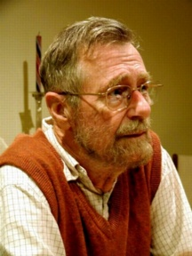
Edsger Wybe Dijkstra
(1930-2002)
Invented concepts of structured programming, synchronization, weakest precondition, and "semaphores" for controlling computer processes. The Oxford English Dictionary cites his use of the words "vector" and "stack" in a computing context.
Believed programming should be taught without computers
1972 Turing Award
“In their capacity as a tool, computers will be but a ripple on the surface of our culture. In their capacity as intellectual challenge, they are without precedent in the cultural history of mankind.”
Notes:
To move to weighted graphs, we appeal to the mighty power of Dijkstra.
This is one of those names in computer science you should just know! Like Turing or Knuth.
So, here’s the super-brief bio of Dijkstra.
Look him up if you’re interested in more.

Slide 13
Dijkstras Algorithm for
Single Source Shortest Path
Similar to breadth-first search, but uses a heap instead of a queue:
  Always select (expand) the vertex that has a lowest-cost path to the start vertex
Correctly handles the case where the shortest path to a vertex is not the one with fewest edges
Notes:
Among the wide variety of things he has done, he created Dijkstra’s algorithm more than 30 years ago.
Dijkstra’s algorithm is a greedy algorithm (like Huffman encoding), so it just makes the best local choice at each step.
The choice it makes is which shortest path to declare known next.
It starts by declaring the start node known to have a shortest path of length 0. Then, it updates neighboring node’s path costs according to the start node’s cost.
Then, it just keeps picking the next shortest path and fixing that one until it has all the vertices.

Slide 14
Dijkstra’s Algorithm
procedure Dijkstra(G, s)
heap: open
for each u in V: u.dist = infinity
s.dist = 0
for each u in V: open.insert(u, u.dist)
while not open.empty():
u = open.deleteMin()
for each (u,v) in E:
if v.dist > u.dist + length(u,v) then
v.dist = u.dist + length(u,v)
v.prev = u
open.decreaseKey(v)
end

Slide 15
Demo
http://www.unf.edu/~wkloster/foundations/DijkstraApplet/DijkstraApplet.htm

Slide 16
Analyzing Dijkstra’s Algorithm
To create the heap, insert each node
This happens |V| times
Once a vertex is removed from the head, the cost of the shortest path to that node is known
This happens |V| times
While a vertex is still in the heap, another shorter path to it might still be found
This happens at most |E| times

Slide 17
Run Time Analysis
|V|O(insert) + |V|O(delete) + |E|O(decreaseKey)
Binary heap:
|V|O(log|V|) + |V|O(log|V|) + |E|O(log|V|)
= O((|V|+|E|) log|V|)
Array:
|V|O(1) + |V|O(|V|) + |E|O(1)
= O(|V|²)

Slide 18
Finding Paths in Very Large Graphs
It is expensive to find optimal paths in large graphs using BFS or Dijkstra’s algorithm
If we only care about paths to a goal node, when should we stop?
If the graph is generated “on the fly” as it is searched, how do we avoid needing to generate all nodes when initializing the heap?

Slide 19
Dijkstra’s Algorithm with Goal
procedure Dijkstra(G, s, g)
heap: open
s.dist = 0
open.insert(s, s.dist)
while not open.empty():
u = open.deleteMin()
if u = g then return
for each (u,v) in E: // might create v
if v is newly created then v.dist = infinity
if v.dist > u.dist + length(u,v) then
v.dist = u.dist + length(u,v)
v.prev = u
if open.contains(v) then
open.decreaseKey(v, v.dist)
else open.insert(v, v.dist)
end

Slide 20
Finding Paths in Very Large Graphs
It is expensive to find optimal paths in large graphs using BFS or Dijkstra’s algorithm
If we only care about paths to a goal node, when should we stop?
If the graph is generated “on the fly” as it is searched, how do we avoid needing to generate all nodes when initializing the heap?
How can we use search heuristics?

Slide 21
Best-First Search
The Manhattan distance is an estimate of the distance to the goal
  It is a search heuristic
  It is optimistic (never overestimates)
Best-First Search
  Order nodes in priority to minimize estimated distance to the goal
Compare: BFS / Dijkstra
  Order nodes in priority to minimize distance from the start

Slide 22
Example
53nd St
52nd St
G
51st St
S
50th St
10th Ave
9th Ave
8th Ave
7th Ave
6th Ave
5th Ave
4th Ave
3rd Ave
2nd Ave
Plan a route from 9th & 50th to 3rd & 51st

Slide 23
Example
53nd St
52nd St
G
51st St
S
50th St
10th Ave
9th Ave
8th Ave
7th Ave
6th Ave
5th Ave
4th Ave
3rd Ave
2nd Ave
Plan a route from 9th & 50th to 3rd & 51st

Slide 24
Best First Search
procedure best_first(G, s, g)
heap: open
open.insert(s, heuristic(s,g))
while not open.empty():
u = open.deleteMin()
u.visited = true
if u = g then return
for each (u,v) in E:
if v is newly created then v.visited = false
if not v.visited then
v.prev = u
open.insert(v, heuristic(v,g))
end

Slide 25
Non-Optimality of Best-First
Path found by Best-first
53nd St
52nd St
S
G
51st St
50th St
10th Ave
9th Ave
8th Ave
7th Ave
6th Ave
5th Ave
4th Ave
3rd Ave
2nd Ave
Shortest Path

Slide 26
Improving Best-First
Best-first is often tremendously faster than BFS/Dijkstra, but might stop with a non-optimal solution
How can it be modified to be (almost) as fast, but guaranteed to find optimal solutions?
A* - Hart, Nilsson, Raphael 1968
  One of the first significant algorithms developed in AI
  Widely used in many applications

Slide 27
A*
Exactly like Best-first search, but using a different criteria for the priority queue:
minimize (distance from start) +
(estimated distance to goal)
priority f(n) = g(n) + h(n)
  f(n) = priority of a node
  g(n) = true distance from start
  h(n) = heuristic distance to goal

Slide 28
A*
procedure aStar(G, s, g)
heap: open
s.dist = 0
open.insert(s, s.dist+heuristic(s,g))
while not open.empty():
u = open.deleteMin()
if u = g then return
for each (u,v) in E:
if v is newly created then v.dist = infinity
if v.dist > u.dist + length(u,v) then
v.dist = u.dist + length(u,v)
v.prev = u
if open.contains(v) then
open.decreaseKey(v, v.dist+heuristic(v,g))
else open.insert(v, v.dist+heuristic(v,g))
end

Slide 29
A* in Action
h=6+2
h=7+3
53nd St
52nd St
S
G
51st St
50th St
10th Ave
9th Ave
8th Ave
7th Ave
6th Ave
5th Ave
4th Ave
3rd Ave
2nd Ave
H=1+7

Slide 30
Applications of A*: Planning
A huge graph may be implicitly specified by rules for generating it on-the-fly
Blocks world:
  vertex = relative positions of all blocks
  edge = robot arm stacks one block
stack(blue,table)
stack(green,blue)
stack(blue,red)
stack(green,red)
stack(green,blue)

Slide 31
Blocks World
Blocks world:
  distance = number of stacks to perform
  heuristic lower bound = number of blocks out of place (on wrong thing)
# out of place = 1, true distance to goal = 3

Slide 32
Demo
http://www.cs.rochester.edu/u/kautz/MazesOriginal/search_algorithm_demo.htm

Slide 33
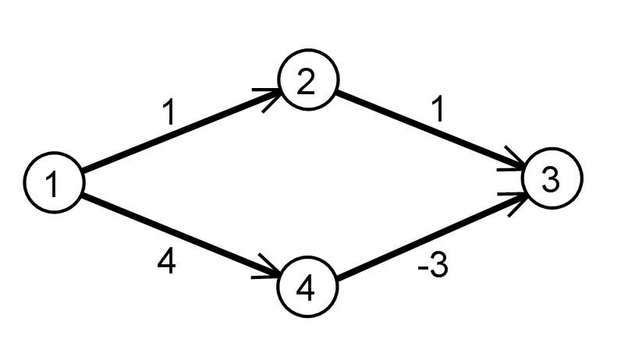
Negative Lengths on Edges
Suppose we allow negative lengths on edges?
Dijkstra: Can fail to find shortest path
A*: Can fail to terminate if there is a negative cycle

Slide 34
Bellman-Ford
procedure BellmanFord(G, s)
for each u in V: u.dist = infinity
s.dist = 0
repeat |V|-1 times:
for each (u,v) in E:
if v.dist > u.dist + length(u,v) then
v.dist = u.dist + length(u,v)
v.prev = u
end
Run time:

Slide 35
Bellman-Ford
procedure aStar(G, s)
for each u in V: u.dist = infinity
s.dist = 0
repeat |V|-1 times:
for each (u,v) in E:
if v.dist > u.dist + length(u,v) then
v.dist = u.dist + length(u,v)
v.prev = u
end
Run time: O(|V||E|)

Slide 36
Summary: Graph Search
Depth First
  Little memory required
  Might find non-optimal path
Breadth First
  Much memory required
  Always finds optimal path
Dijskstra’s Short Path Algorithm
  Like BFS for weighted graphs
Best First
  Can visit fewer nodes
  Might find non-optimal path
A*
  Can visit fewer nodes than BFS or Dijkstra
  Optimal if heuristic has certain common properties
Bellman-Ford
  Handles negative edges
  Not as efficient as Dijsktra for positive only graphs

