Slide 1
linear programming: lp_solve, max flow, dual
CSC 282
Fall 2013

Slide 2
lp_solve
lp_solve is a free linear (integer) programming solver based on the revised simplex method and the Branch-and-bound method for the integers
http://lpsolve.sourceforge.net/

Slide 3
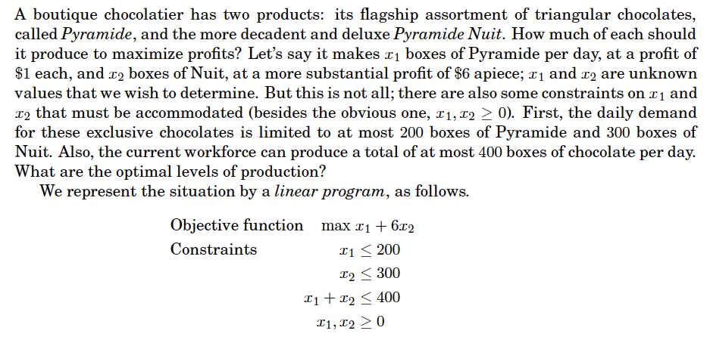
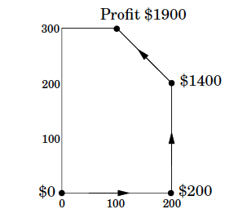
Example: Profit Maximization

Slide 4
run lp_solve

Slide 5
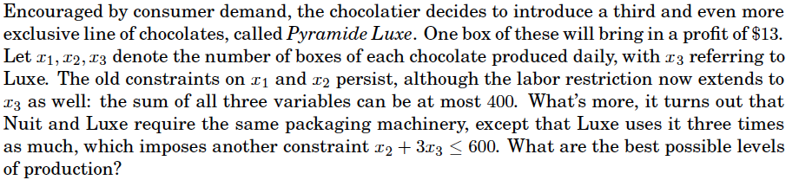
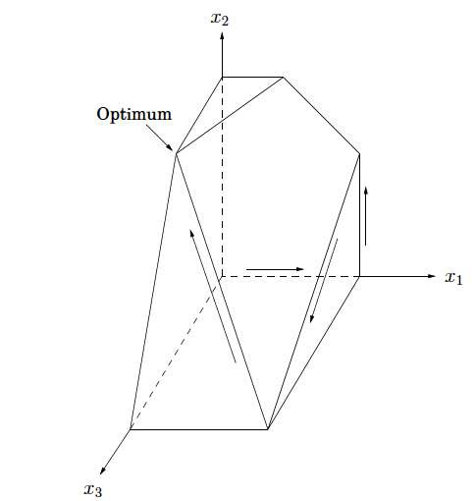
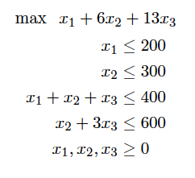

Slide 6
run lp_solve

Slide 7
lp_solve
free variable – may be negative
    free x1, x2 ;
converting ratios to LP:
    (a1 + a2) / (b1 + b2) <= 10
    where b1 and b2 are positive becomes
    (a1 + a2) <= 10 (b1 + b2)
integer and binary variables
    int r1;
    bin b1;

Slide 8
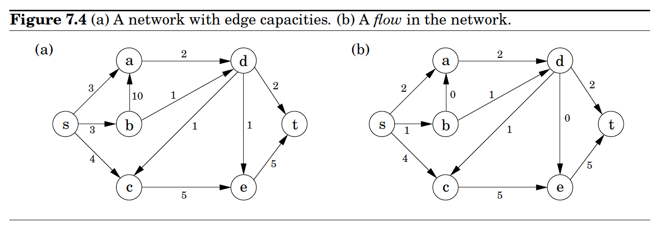
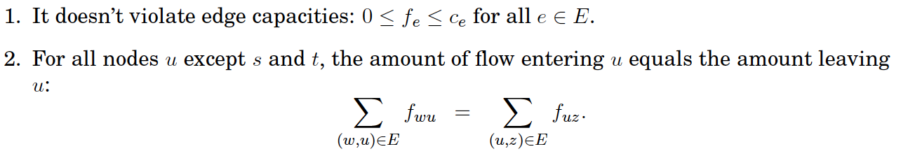

Flows in Networks
Flow Constraints
Maximizing Flow

Slide 9
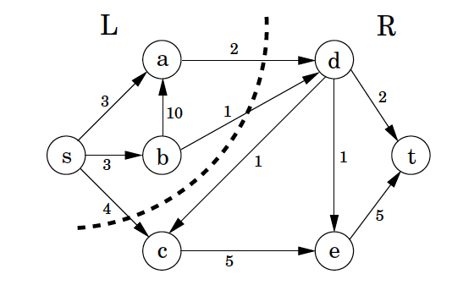
Certificate of Optimality
A solution returned by simplex can be converted into a short proof of optimality
s-t cut: disjoint partitioning of vertices into sets L and R
capacity of a cut: total capacity of edges from L to R
optimal flow size(f) ≤ capacity(L,R) for any s-t cut
max-flow min-cut theorem: size of the max flow equals capacity of smallest s-t cut

Slide 10
Duality
In flow networks
  flows are smaller than cuts, but
  max flow = min cut
This is a general property of LP
  Every LP max problem has a dual min problem
  The solution to the min problem is a proof of optimality of the max problem, and vice-versa

Slide 11
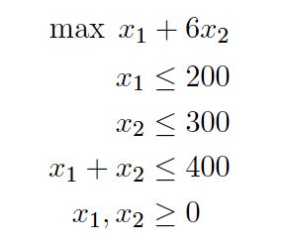

Example
(x1,x2) = (100, 300) with objective value 1900 is solution found by simplex to:
Multiplying the three inequalities by 0, 5, 1 respectively and adding them up gives:

