Slide 1
Journaling of Journal Is (Almost) Free
Kai Shen Stan Park* Meng Zhu
University of Rochester
*Currently affiliated with HP Labs

Slide 2
Journaling of Journal (JoJ)
Lightweight databases and key-value stores manage the consistency of their data through redo or undo logging
They store database and logs as files; file system journaling further protects file system structure and metadata

Slide 3
Journaling of Journal (JoJ)
It violates the classic end-to-end argument [Stonebraker 1981]:
  Low-level implementation of a function (OS-level failure-atomic data protection in this case) is incomplete and hurts performance
High costs of adding Ext4 file system journaling to SQLite:
  Our experiments show up to 73% slowdown
Existing solutions:
  Use log-structured file systems [Kim et al. 2012; Jeong et al. 2013]
  Put file system journal on an external device [Jeong et al. 2013]
  New database storage layout to sync less frequently [Kim et al. 2014]
We look into the file system journaling implementation and configuration

Slide 4
Our Results
Additional file system journaling costs due to more I/O operations; and larger I/O sizes
We show that these costs can be substantially mitigated with simple implementation/configuration adjustments
  Minimize the number of device writes on commit synchronous path
  Adaptive journaling to allow custom journaling modes for files (particularly applicable to redo/undo log files)
We utilize simple methods to highlight new direction for JoJ
  Not intend to propose the best file system journaling optimizations

Slide 5
Single-I/O Data Journaling
Minimize the number of device writes on journal commit’s critical path
Under full data journaling:
  Data and metadata of the transaction are journaled synchronously (single device write)
  Checkpointing occurs asynchronously and may never have to be done if data/file is overwritten or deleted soon
Problem:
  Linux ext4_sync_file() implementation sometimes checkpoints data on the critical path unnecessarily
   easily fixed after discovery

Slide 6
Adaptive Journaling
Data journaling writes in a large volume
  Primarily due to page-granularity journal records in Ext4
  Large write incurs high cost in performance and wear on Flash
Adaptive journaling [Prabhakaran et al. 2005]
  Select journaling mode for each transaction (e.g., use Ext4 ordered journaling if it would perform sequential I/O under ordered journaling)
  But may reorder writes improperly in the case of overwrites
  In the following example, if T1/T2 overlap in their data writes, a recovery will leave T1’s data write as the final state.
Journal
T1 (file-data/metadata journaling)
T2 (metadata only journaling)

Slide 7
File-Adaptive Journaling
File-adaptive journaling
  Journaling mode is chosen on a file-by-file basis
  Easy to implement, less cost of journaling mode switching
Effective for journaling of journal situations (SQLite):
  Write-ahead log is written sequentially with little metadata changes  desire Ext4 ordered journaling
  Rollback-recovery log deletes or truncates log file frequently  desire data journaling

Slide 8
Applicability
Recent JoJ studies target smartphone workloads on Android
Our own experiments found that typical smartphone workloads are more dominated by network delay (even when using WiFi)
  We don’t claim JoJ is a critical problem for most smartphone workloads
  I/O optimization matters mostly to workloads whose performance is dominated by I/O activities
  We target general I/O-intensive workloads on server and client systems

Slide 9
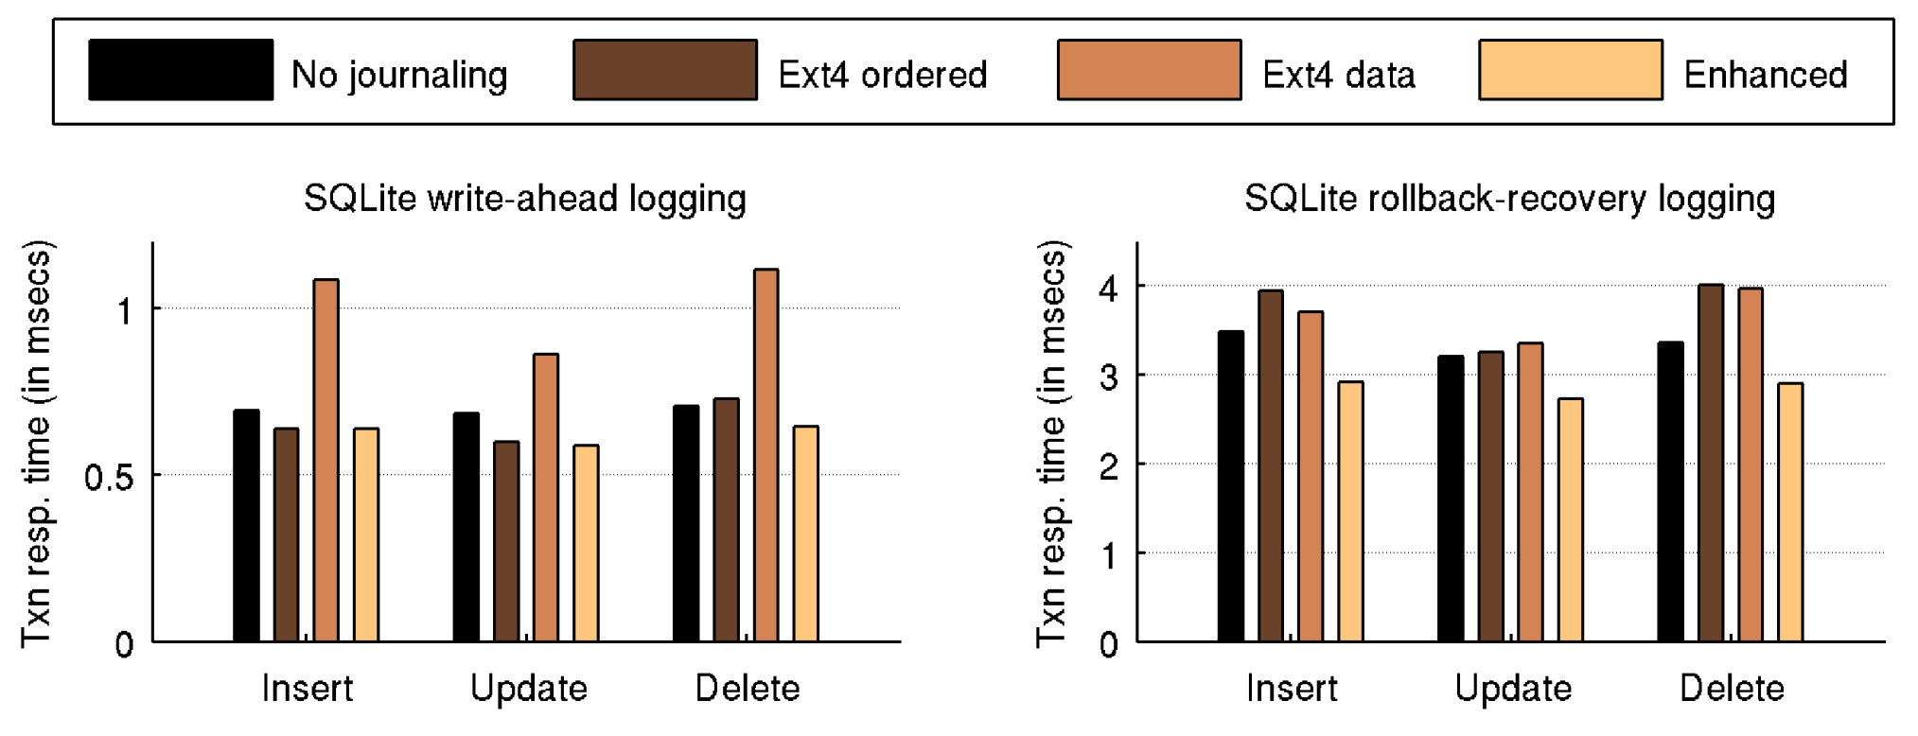
Evaluation (Intel 311 SSD)
Compared to no file system journaling
  Ext4 ordered journaling incurs up to 19% slowdown; data journaling incurs up to 58% slowdown
  Our enhanced journaling incurs no cost (in fact improvement)

Slide 10
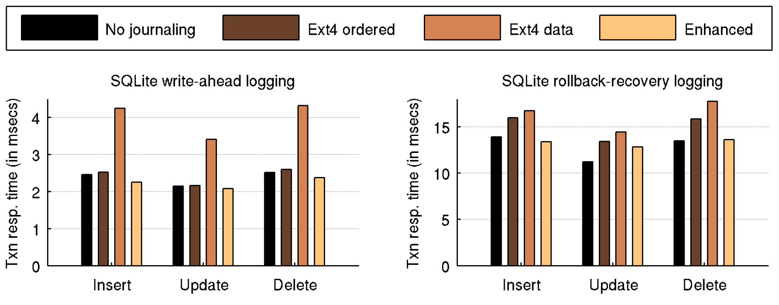
Evaluation (Nexus7 running Ubuntu)
Compared to no file system journaling
  Ext4 ordered journaling incurs up to 20% slowdown; data journaling incurs up to 73% slowdown
  Our enhanced journaling incurs very little cost

Slide 11
Conclusion and Discussions
For applications that protect their own data, there is fundamentally little cost of adding file system journaling
Simple implementation/configuration enhancements
  Single device write on the journal commit critical path
  File-adaptive journaling
Alternative approach for data protection: OS exposes failure-atomic I/O API and the OS alone protects the consistency for application data and file system structure
  I/O transactions [Sears and Brewer 2006; Porter et al. 2009]
  Failure-atomic msync() [Park et al. 2013]
   require OS API changes and programming changes

