Slide 1
User Input and Interactions on Microsoft Research ESL Assistant
Claudia Leacock, Butler Hill Group
Michael Gamon, Microsoft Research
Chris Brockett, Microsoft Research

Slide 2
... and
William B. Dolan, Jianfeng Gao, Dmitriy Belenko, Lucy Vanderwende (Microsoft Research)
Alexandre Klementiev (University of Illinois at Urbana Champaign)

Slide 3
Outline
Who is using it and how often
How users are interacting with the system
Does it help the users to improve their writing?

Slide 4
Most frequent errors made by East Asian non-native speakers
Noun Related: Articles (inclusion & choice), Noun Number, Noun of Noun
I think it’s *a/the best way to resolve issues like this.
Conversion always takes a lot of *efforts/effort.
Please send the *feedback of customer/customer feedback to me by mail.
Preposition Related: inclusion & choice
It seems ok and I did not pay much attention *on/to it.
I should *to ask/ask a rhetorical question.
Verb Related: Gerund/Infinitive Confusion, Auxiliary Verb Error, Verb Formation Errors (6), Cognate/ Verb confusion, Irregular Verbs
On Saturday, I with my classmate went *eating/to eat.
Hope you will *happy/be happy in Taiwan.
I *teached/taught him all the things I know.
Adjective Related: Adjective Confusion (4), Adjective Order
She is very *interesting/interested in the problem.
So *Korea/Korean Government is intensely fostering trade.

Slide 5
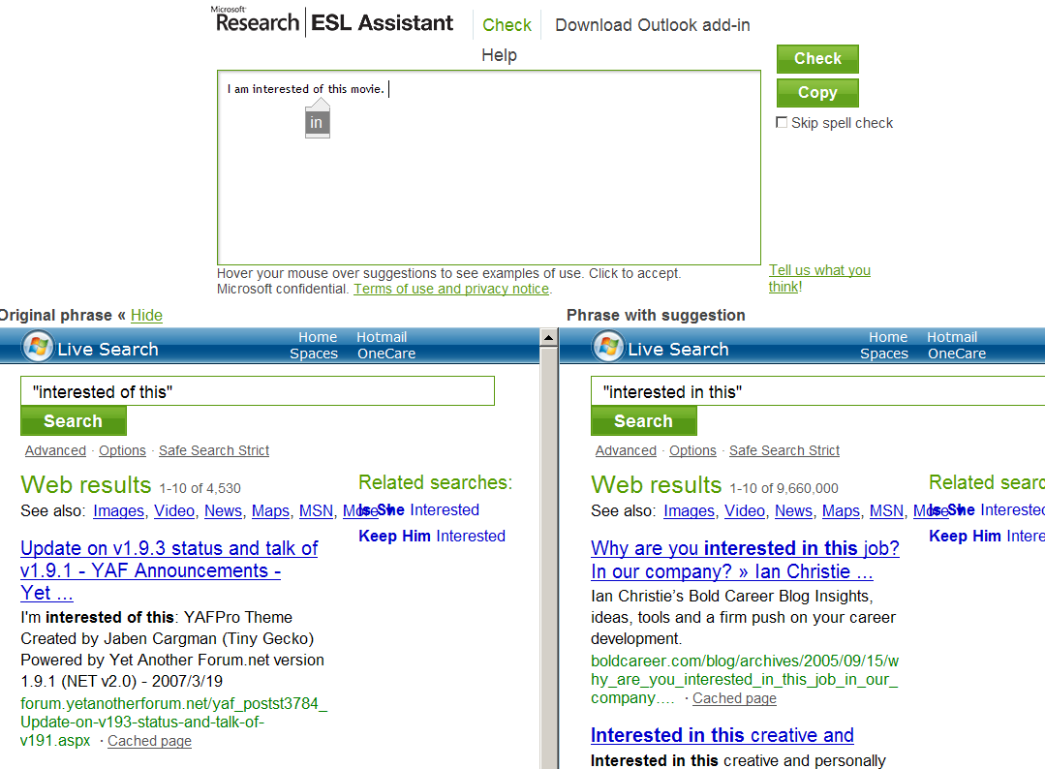
User Interface Deployed 6/2008

Slide 6
Page Views per Week

Slide 7
User Locations
1. | China | 59,276 | 17.9% | 10. | Japan | 5,941 | 1.8%
2. | United States | 55,104 | 16.6% | 11. | Spain | 5,924 | 1.8%
3. | Taiwan | 47,159 | 14.2% | 12. | United Kingdom | 5,828 | 1.8%
4. | Korea - South | 18,730 | 5.6% | 13. | Russian Federation | 5,454 | 1.6%
5. | Hong Kong | 14,259 | 4.3% | 14. | France | 3,971 | 1.2%
6. | Brazil | 8,444 | 2.5% | 15. | Saudi Arabia | 3,893 | 1.2%
7. | Germany | 8,219 | 2.5% | 16. | Mexico | 3,878 | 1.2%
8. | Canada | 7,634 | 2.3% | 17. | Netherlands | 3,330 | 1.0%
9. | Italy | 6,880 | 2.1% | 18. | Thailand | 3,207 | 1.0%

Slide 8
Repeat Users

Slide 9
Frequent Users (4/21/09)
.
Frequent Users | 854
Sessions | 8,339
Session-Unique Sentences | 66,765
Grammatical Error Flags | 22,542

Slide 10
Collected Data (4/21/09)

Slide 11
User Interaction 1: Responses to “Tell us what you think!”
Some users wrote: | Other users wrote:
“This is awesome! It works really well.” | “It didn’t work at all.”
“I found the tool very useful.” | “I hate it.”
“Great tool in general – thank you!!!!!!!” | “Terrible job.”
“I love the feature where it looks for a phrase in web pages.” | “The microsoft search results below confuses me.”
Bug reports: “When I first opened it, it wouldn’t let me type in any characters at all.”
“What wearies me is the message ‘Server is temporarily unavailable’.”
Suggestions: “There should be some indication that the check is done.”
“I would like a filter for business and personal use.”

Slide 12
Users Examine 83% of Suggestions
Conclusion: A significant number of users are inspecting the suggested rewrites and making a deliberate choice to accept it or not accept it.
Inspect >18.3K Flags to Accept 7.6K

Slide 13
Do users make the right choices?
Evaluated ~900 complete user sessions: 6K flags
Calculate system performance for ALL suggestions.
Calculate performance for ONLY suggestions that were accepted.
Compare ratios of good and bad flags.

Slide 14
Evaluation Categories
Evaluation | SubEval | Description
Good | Correct Flag | The correction fixes a problem in the user input.
Neutral | Both Good | The suggestion is a legitimate alternative of a well-formed original input. Ex: I like working/to work.
 | Misdiagnosis | The original input contained an error but the suggested rewrite neither improves nor further degrades the user input. Ex: If you have fail machine on hand.
 | Non-ascii | A non-ascii or text processing mark-up character is in the immediate context. (Only applies to user data)
Bad | False Flag | The suggestion resulted in an error or would otherwise lead to a degradation over the original user input.

Slide 15
Are users accepting good suggestions? All significant in the Wilcoxin’s signed-ranks test.
Noun-related | Prep-related | Verb-related | Adj-related

Slide 16
By Domain: All significant in the Wilcoxin’s signed-ranks test.
Email | Non-technical | Technical

Slide 17
What do users do with neutral flags?

Slide 18
Neutral Flags not accepted but sentence edited to produce no flag
I don't know that you knew or not , this early morning i got a from head office ...
suggestion: delete “from”
I don't know that you knew or not , this early morning I heard from the head office ...
Please play with the software and Friday I will be by to work with any questions you may regarding it.
suggestion: regarding→regard
Please play with the software and Friday I will be by to work with any questions you may have regarding it.
From 1,349 sentences with neutral flags found 215 subsequently submitted “similar” strings with no error flag.
Users not accept suggestion but did something ELSE to make the flag go away.

Slide 19
Users improve 40% of the time
Identifying the location of an error can help the user.

Slide 20
Conclusions
Traffic: There is an interest in ESL proofing tools
Even current state-of-the-art error correction can be useful for ELLs:
Users do not accept proposed corrections blindly – they are selective in their behavior
Users make informed choices – they can distinguish correct suggestions from incorrect ones
Sometimes just identifying the location of an error enables the users to repair the problem themselves

Slide 21
New Interface

Slide 22
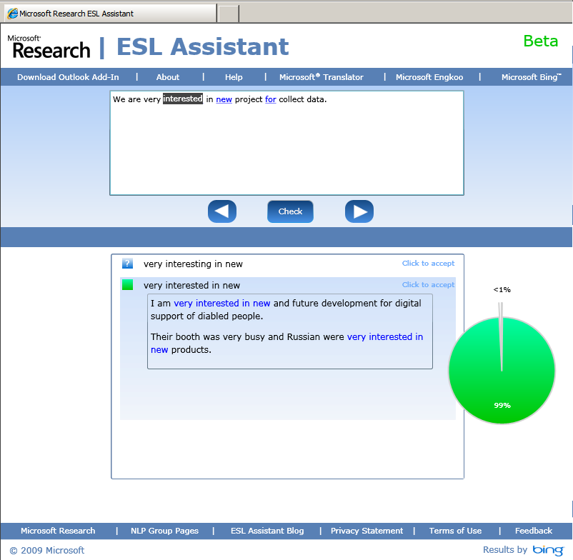

Slide 23
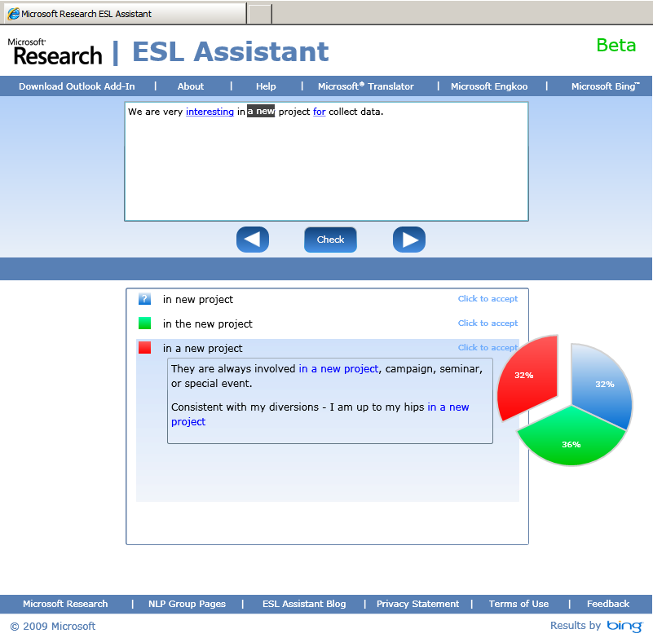

Slide 24
www.eslassistant.com

