Slide 1
Readability Assessment for Text Simplification
Sandra Aluisio¹, Lucia Specia²,
Caroline Gasperin¹, Carolina Scarton¹
¹University of São Paulo, Brazil
²University of Wolverhampton, UK

Slide 2
Motivation
Develop technology to benefit low literacy readers
INAF levels
68%
Rudimentary: studied up to 4 years; can find explicit information in short and familiar texts
Basic: studied between 4 and 8 years; can read and understand texts of average length, and find information even when it is necessary to make some inference

Slide 3
Readability Assessment
To assess the readability level of a text
  Three levels of readability: INAF levels
  Rudimentary – Basic – Advanced
To supplement our text simplification technology
  Two levels of simplification: degree of application of simplification operations
    STRONG: operations are applied to all complex syntactic phenomena present
    NATURAL: operations are applied selectively, only when the resulting text remains “natural”
→ RUDIMENTARY
→ BASIC

Slide 4
Text Simplification Scenario
Authoring tool for creating simplified texts
  Author inputs text
  Author receives suggestions of possible simplifications: may accept or not
    Lexical substitutions
    Syntactic simplification
  Author does not know if the text is simple enough for his audience
Feedback: Readability assessment
SIMPLIFICA

Slide 5
Readability Assessment System
Machine learning
  Classes = 3 INAF levels
  Trained on corpus of manually simplified texts
    Original text + natural and strong simplifications
  Extensive set of features
    Cognitively-motivated: Coh-Metrix [Graesser et al., 2004]
    Syntactic: occurrence of complex phenomena
    Language model: up to trigrams
  3 paradigms: Classification, Ordinal Classification, Regression [Heilman et al., 2007]

Slide 6
Corpora
Training and testing corp
  General news: Zero Hora (ZH) newspaper
  Popular science news: Caderno Ciencia (CC)
  3 versions for each text: original, natural, strong
Corpus | Documents | Sentences | Words | Avg. words p. text (std. deviation) | Avg. words p. sentence
ZH original | 104 | 2184 | 46190 | 444.1 (133.7) | 21.1
ZH natural | 104 | 3234 | 47296 | 454.7 (134.2) | 14.6
ZH strong | 104 | 3668 | 47938 | 460.9 (137.5) | 13.0
CC original | 50 | 882 | 20263 | 405.2 (175.6) | 22.9
CC natural | 50 | 975 | 19603 | 392.0 (176.0) | 20.1
CC strong | 50 | 1454 | 20518 | 410.3 (169.6) | 14.1
CH | 130 | 3624 | 95866 | 737.4 (226.1) | 26.4

Slide 7
Features
1 | Number of words | 21 | Number of high level constituents | 41 | Adverb ambiguity ratio
2 | Number of sentences | 22 | Number of personal pronouns | 42 | Adjective ambiguity ratio
3 | Number of paragraphs | 23 | Type-token ratio | 43 | Incidence of clauses
4 | Number of verbs | 24 | Pronoun-NP ratio | 44 | Incidence of adverbial phrases
5 | Number of nouns | 25 | Number of “e” (and) | 45 | Incidence of apposition
6 | Number of adjectives | 26 | Number of “ou” (or) | 46 | Incidence of passive voice
7 | Number of adverbs | 27 | Number of “se” (if) | 47 | Incidence of relative clauses
8 | Number of pronouns | 28 | Number of negations | 48 | Incidence of coordination
9 | Average number of words per sentence | 29 | Number of logic operators | 49 | Incidence of subordination
10 | Average number of sentences per paragraph | 30 | Number of connectives | 50 | Out-of-vocabulary words
11 | Average number of syllables per word | 31 | Number of positive additive connectives | 51 | LM probability of unigrams
12 | Flesch index for Portuguese | 32 | Number of negative additive connectives | 52 | LM perplexity of unigrams
13 | Incidence of content words | 33 | Number of positive temporal connectives | 53 | LM perplexity of unigrams, no line break
14 | Incidence of functional words | 34 | Number of negative temporal connectives | 54 | LM probability of bigrams
15 | Raw Frequency of content words | 35 | Number of positive causal connectives | 55 | LM perplexity of bigrams
16 | Minimal frequency of content words | 36 | Number of negative causal connectives | 56 | LM perplexity of bigrams, no line break
17 | Average number of verb hypernyms | 37 | Number of positive logic connectives | 57 | LM probability of trigrams
18 | Incidence of NPs | 38 | Number of negative logic connectives | 58 | LM perplexity of trigrams
19 | Number of NP modifiers | 39 | Verb ambiguity ratio | 59 | LM perplexity of trigrams, no line break
20 | Number of words before the main verb | 40 | Noun ambiguity ratio

Slide 8
Feature Analysis
Pearson correlation between features and literacy levels
 | Feature | Correlation
1 | Words per sentence | 0.693
2 | Incidence of apposition | 0.688
3 | Incidence of clauses | 0.614
4 | Flesch index | 0.580
5 | Words before main verb | 0.516
6 | Sentences per paragraph | 0.509
7 | Incidence of relative clauses | 0.417
8 | Syllables per word | 0.414
9 | Number of positive additive connectives | 0.397
10 | Number of negative causal connectives | 0.388

Slide 9
Predicting readability Levels
Features | Class | F | Corr. | MAE
All | original | 0.913 | 0.84 | 0.276
 | natural | 0.483
 | strong | 0.732
Language Model | original | 0.669 | 0.25 | 0.381
 | natural | 0.025
 | strong | 0.221
Basic | original | 0.846 | 0.76 | 0.302
 | natural | 0.149
 | strong | 0.707
Syntactic | original | 0.891 | 0.82 | 0.285
 | natural | 0.32
 | strong | 0.74
Coh-Metrix-PORT | original | 0.873 | 0.79 | 0.290
 | natural | 0.381
 | strong | 0.712
Flesch | original | 0.751 | 0.52 | 0.348
 | natural | 0.152
 | strong | 0.546
Features | Class | F | Corr. | MAE
All | original | 0.904 | 0.83 | 0.163
 | natural | 0.484
 | strong | 0.731
Language Model | original | 0.634 | 0.49 | 0.344
 | natural | 0.497
 | strong | 0.05
Basic | original | 0.83 | 0.73 | 0.231
 | natural | 0.334
 | strong | 0.637
Syntactic | original | 0.891 | 0.81 | 0.180
 | natural | 0.382
 | strong | 0.714
Coh-Metrix-PORT | original | 0.878 | 0.8 | 0.183
 | natural | 0.432
 | strong | 0.709
Flesch | original | 0.746 | 0.56 | 0.310
 | natural | 0.489
 | strong | 0
Classification
Weka SVM
Ordinal Classification
Weka Pairwise SVM

Slide 10
Predicting readability Levels
Features | Corr. | MAE
All | 0.8502 | 0.3478
Language Model | 0.6245 | 0.5448
Basic | 0.7266 | 0.4538
Syntactic | 0.8063 | 0.3878
Coh-Metrix-PORT | 0.8051 | 0.3895
Flesch | 0.5772 | 0.5492
Regression
Weka SVM-reg, RBF Kernel
Best correlation: Regression
Lowest MAE: Ordinal Classification
Combination of all features consistently yields better results: more robust
Syntactic features achieve the best correlation scores
Language model features performed the poorest

Slide 11
Conclusions
It is possible to predict with satisfactory performance the readability level of texts according to our three classes of interest
Ordinal Classification seems to be the most appropriate model to use
  High correlation, lowest error rate (MAE)
Combination of all features is best

Slide 12
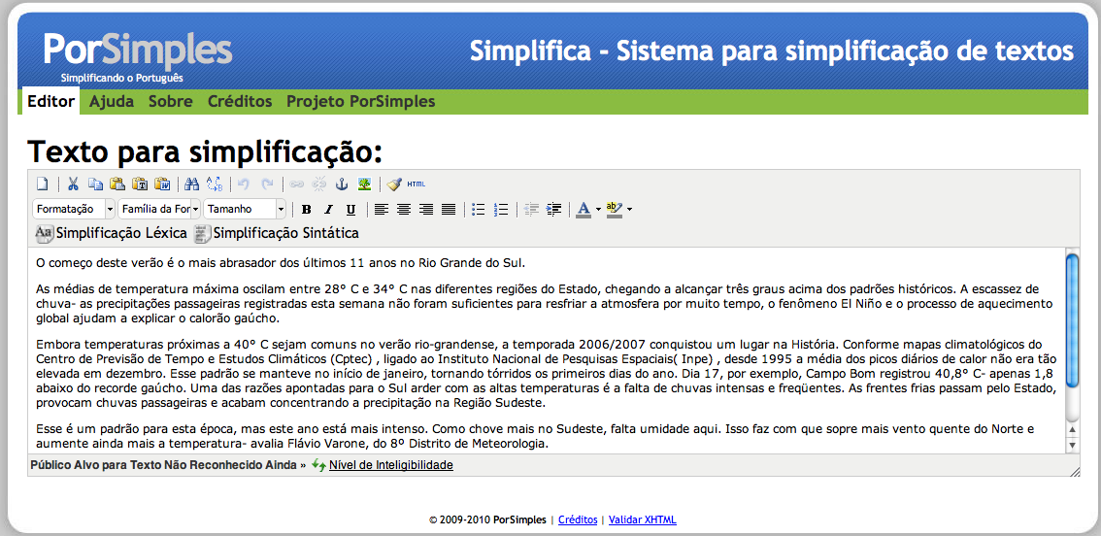
SIMPLIFICA Tool
Integration of classification model
  Simplest model, highest F-measure, comparable correlation scores

Slide 13
Future Work
Add deeper cognitive features, e.g. semantic, coreference, latent semantics metrics
User evaluation: authors

Slide 14
Thanks!
PorSimples project
http://caravelas.icmc.usp.br/

