Slide 1
Rethinking Grammatical Error Detection and Evaluation with the Amazon Mechanical Turk
Joel Tetreault [Educational Testing Service]
Elena Filatova [Fordham University]
Martin Chodorow [Hunter College of CUNY]

Slide 2
3
13
Preposition Selection Task
Preposition Error Detection Task

Slide 3
Error Detection in 2010
Much work on system design for detecting ELL errors:
  Articles [Han et al. ‘06; Nagata et al. ‘06]
  Prepositions [Gamon et al. ’08]
  Collocations [Futagi et al. ‘08]
Two issues that the field needs to address:
  Annotation
  Evaluation

Slide 4
Annotation Issues
Annotation typically relies on one rater
  Cost
  Time
But in some tasks (such as usage), multiple raters are probably desired
  Only relying on one rater can skew system precision as much as 10%
  [Tetreault & Chodorow ’08: T&C08]
  Context can license multiple acceptable usages
Aggregating multiple judgments can address this, but is still costly

Slide 5
Evaluation Issues
To date, none of the preposition or article systems have been evaluated on the same corpus!
  Mostly due to proprietary nature of corpora (TOEFL, CLC, etc.)
Learner corpora can vary widely:
  L1 of writer?
  Proficiency of writer?
  How advanced the writer is?
  ESL or EFL?

Slide 6
Evaluation Issues
A system that performs at 50% on one corpus may actually perform at 80% on another
Inability to compare systems makes it difficult for the grammatical error detection field to move forward

Slide 7
Goal
Amazon Mechanical Turk (AMT)
  Fast and cheap source of untrained raters
Show AMT to be an effective alternative to trained raters on the tasks of preposition selection and ESL error annotation
Propose a new method for evaluation that allows two systems evaluated on different corpora to be compared

Slide 8
Outline
Amazon Mechanical Turk
Preposition Selection Experiment
Preposition Error Detection Experiment
Rethinking Grammatical Error Detection

Slide 9
Amazon Mechanical Turk
AMT: service composed of requesters (companies, researchers, etc.) and Turkers (untrained workers)
Requesters post tasks or HITS for workers to do, with each HIT usually costing a few cents

Slide 10
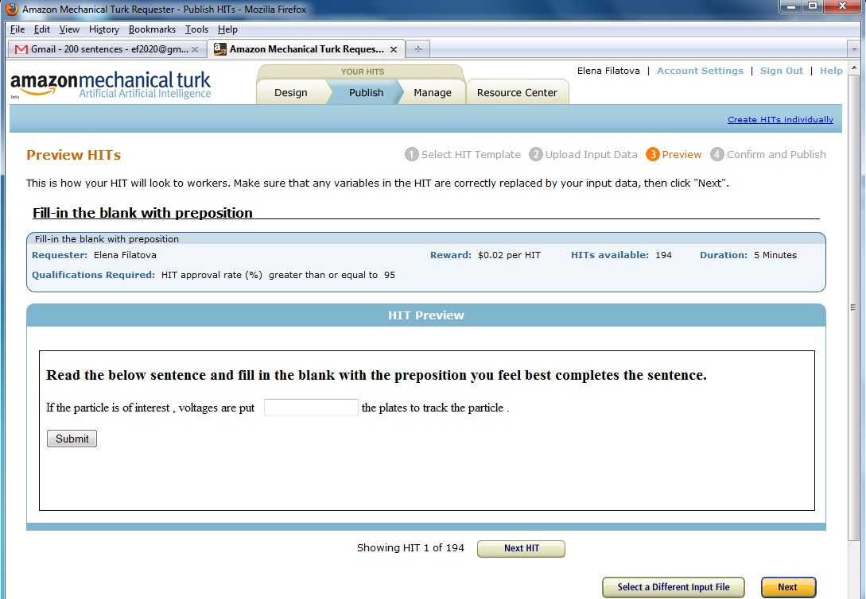

Slide 11
Amazon Mechanical Turk
AMT found to be cheaper and faster than expert raters for NLP tasks:
  WSD, Emotion Detection [Snow et al. ‘08]
  MT [Callison-Burch ‘09]
  Speech Transcription [Novotney et al. ’10]

Slide 12
AMT Experiments
For preposition selection and preposition error detection tasks:
  Can untrained raters be as effective as trained raters?
  If so, how many untrained raters are required to match the performance of trained raters?

Slide 13
Preposition Selection Task
Task: how well can a system (or human) predict which preposition the writer used in well-formed text
  “fill in the blank”
Previous research shows expert raters can achieve 78% agreement with writer [T&C08]

Slide 14
Preposition Selection Task
194 preposition contexts from MS Encarta
Data rated by experts in T&C08 study
Requested 10 Turker judgments per HIT
Randomly selected Turker responses for each sample size and used majority preposition to compare with writer’s choice

Slide 15
Preposition Selection Results
3 Turker responses > 1 expert rater

Slide 16
Preposition Error Detection
Turkers presented with a TOEFL sentence and asked to judge target preposition as correct, incorrect, ungrammatical
152 sentences with 20 Turker judgments each
0.608 kappa between three trained raters
Since no gold standard exists, we try to match kappa of trained raters

Slide 17
Error Annotation Task
13 Turker responses > 1 expert rater

Slide 18
Rethinking Evaluation
Prior evaluation rests on the assumption that all prepositions are of equal difficulty
However, some contexts are easier to judge than others:
Easy
“It depends of the price of the car”
“The only key of success is hard work.”
Hard
“Everybody feels curiosity with that kind of thing.”
“I am impressed that I had a 100 score in the test of history.”
“Approximately 1 million people visited the museum in Argentina in this year.”

Slide 19
Rethinking Evaluation
Corpus A
33% Easy Cases
Corpus B
66% Easy Cases
Easy
Hard
Difficulty of cases can skew performance and system comparison
If System X performs at 80% on corpus A, and System Y performs at 80% on corpus B →
  …Y is probably the better system
  But need difficulty ratings to determine this

Slide 20
Rethinking Evaluation
Group prepositions into “difficulty bins” based on AMT agreement
  90% bin: 90% of the Turkers agree on the rating for the prepositions (strong agreement)
  50% bin: Turkers are split on the rating for the preposition (low agreement)
Run system on each bin separately and report results

Slide 21
Conclusions
Task | Total HITS | Judgments per HIT | Cost | Total Cost | # of Turkers | Time
Selection | 194 | 10 | $0.02 | $48.50 | 49 | 0.5hrs
Error | 152 | 20 | $0.02 | $76.00 | 74 | 6.0hrs
Annotation: showed AMT is cheaper and faster than expert raters:
  Selection Task: 3 Turkers > 1 expert
  Error Detection Task: 13 Turkers > 3 experts
Evaluation: AMT can be used to circumvent issue of having to share corpora: just compare bins!
  But…both systems must use same AMT annotation scheme

Slide 22
Future Work
Experiment with guidelines, qualifications and weighting to reduce the number of Turkers
Experiment with other errors (e.g., articles, collocations) to determine how many Turkers are required for optimal annotation

