Slide 1


Predicting Cloze Task Quality for
Vocabulary Training
Adam Skory, Maxine Eskenazi
Language Technologies Institute
Carnegie Mellon University
{askory,max}@cs.cmu.edu
Notes:
1
1

Slide 2
Overview
● Goal:
A system to generate high quality cloze tasks
Not an authoring tool; the output is given directly to students
● This presentation:
Predicting generated cloze quality
Evaluating cloze quality with crowdsourcing
Notes:
2
2

Slide 3
Background on Cloze Tasks
●This is an __example__ cloze task.
Notes:
3
3

Slide 4
Background on Cloze Tasks
●This is an ___________ cloze task.
the stem
Notes:
4
4

Slide 5
Background on Cloze Tasks
●This is an __example__ cloze task.
the key
Notes:
5
5

Slide 6
Background on Cloze Tasks
●This is an cloze task.
the blank
Notes:
6
6

Slide 7
Background on Cloze Tasks: Assessment
Cloze tasks can be used to test for:
●Constituents of word lexical knowledge (Bachman, 1982).
Orthographic
Phonetic
Syntactic
Semantic
●Dale’s four levels of word knowledge (Dale, 1965)
●Grammatical knowledge, without using syntactic terminology.
Notes:
7
7

Slide 8
Automatic Generation of Cloze Tasks
● Cloze tasks are generated by modifying existing texts.
● The focus has been on producing cloze sentences for assessment.
(Pino et al, 2008; Higgins 2006; Liu et al, 2005...)
● Instruction uses passage-based cloze
deletion is manual, random, periodic; not algorithmic.
● Primarily “authoring tools”, involve human evaluation and
input between system and students.
Notes:
8
8

Slide 9
Automatic Generation of Cloze Tasks
●Liu et al. (2005): Search interface to find sentences on (key, POS) with results filtered by word sense using words in the stem and WordNet.
●Hoshino & Nakagawa (2005): Naïve Bayes and KNN classifiers to identify most likely blanks in passages.
●Higgins (2006): Regular expression engine for content creators to search by word text, tags, for specific constructions.
●Pino et al (2009): Incorporates parse complexity and co-occurrence frequencies of words in the stem.
Notes:
9
9

Slide 10
Filtering Approach to Cloze Task Generation
raw corpus
target words
sentence length
well-formedness
what else?
Notes:
10
10

Slide 11
Filtering Approach to Cloze Task Generation
Filtering Step | Number of Sentences
100K+ webpages | millions
Notes:
11
11

Slide 12
Filtering Approach to Cloze Task Generation
Assumption: a fixed set of target words is pre-defined
Filtering Step | Number of Sentences
100K+ webpages | millions
20 target words | 201,025
Notes:
12
12

Slide 13
Filtering Approach to Cloze Task Generation
25 word length chosen after review of sample standardized tests
Filtering Step | Number of Sentences
100K+ webpages | millions
20 target words | 201,025
sentence length <= 25 words | 136,837
Notes:
13
13

Slide 14
Filtering Approach to Cloze Task Generation
Strict threshold on probability of best parse –
low recall, high precision
Filtering Step | Number of Sentences
100K+ webpages | millions
20 target words | 201,025
sentence length <= 25 words | 136,837
probabilistic parsing | 29,439
Notes:
14
14

Slide 15
Filtering Approach to Cloze Task Generation
Filtering Step | Number of Sentences
100K+ webpages | millions
20 target words | 201,025
sentence length <= 25 words | 136,837
probabilistic parsing | 29,439
reading level | 540
Notes:
15
15

Slide 16
Reading Level and Transfer Features
Ranking of individual words according to comprehension difficulty
The information available about a blank is a function of the lexical transfer features in the stem. (Finn, 1978)
Words of higher reading level have more complex semantic feature sets
Notes:
16
16

Slide 17
Reading Level: Formulation and Evaluation
● Unigram model
-generated from labeled documents
-each word assigned reading level from 1 to 12
● A sentence is assigned the reading level of the highest
level word near the key.
“This is a demonstrative (example) sentence.”
Notes:
17
17

Slide 18
Reading Level: Formulation and Evaluation
●Unigram model
-generated from labeled documents
-each word assigned reading level from 1 to 12
●A sentence is assigned the reading level of the highest level word near the key.
“This is a demonstrative (example) sentence.”
5
Notes:
18
18

Slide 19
Reading Level: Formulation and Evaluation
●Unigram model
-generated from labeled documents
-each word assigned reading level from 1 to 12
●A sentence is assigned the reading level of the highest level word near the key.
“This is a demonstrative (example) sentence.”
11 5
Notes:
19
19

Slide 20
Reading Level: Formulation and Evaluation
●Unigram model
-generated from labeled documents
-each word assigned reading level from 1 to 12
●A sentence is assigned the reading level of the highest level word near the key.
“This is a demonstrative (example) sentence.”
“This is a good (example) sentence.”
3 5
Notes:
20
20

Slide 21
Filtering Approach to Cloze Task Generation
Filtering Step | Number of Sentences
100K+ webpages | millions
20 target words | 201,025
sentence length <= 25 words | 136,837
probabilistic parsing | 29,439
co-occurrence score | 540
Notes:
21
21

Slide 22
Co-occurrence Scores: Concept
●Define a fixed window of n words before and after the blank.
●Given a sentence, find the frequency of each word in same size windows with same key throughout the corpus.
●Highly co-occurrent words lead to higher cloze quality.
(Pino et al 2009)
Notes:
22
22

Slide 23
Co-occurence Score: Formulation
“This is a good (example) sentence.”
Window size = 3
Notes:
23
23

Slide 24
Co-occurence Score: Formulation
“This is a good (example) sentence.”
Window size = 3
Number of times 'good' is within 3-word window around 'example' = 234
Notes:
24
24

Slide 25
Co-occurence Score: Formulation
“This is a good (example) sentence.”
Window size = 3
Frequency of 'good' within 3-word window around 'example' = 234
Frequency of 'sentence’ within 3-word window around 'example' = 17
Notes:
25
25

Slide 26
Co-occurence Score: Formulation
“This is a good (example) sentence.”
Window size = 3,
Frequency of 'good' is within 3-word window around 'example' = 234
Frequency of 'sentence' within 3-word window around 'example' = 17
Frequency of all words within 3-word window around 'example' = 304,354
Notes:
26
26

Slide 27
Co-occurence Score: Formulation
“This is a good (example) sentence.”
Window size = 3,
Frequency of 'good' is within 3-word window around 'example' = 234
Frequency of 'sentence' within 3-word window around 'example' = 17
Frequency of all words within 3-word window around 'example' = 304,354
Co-occurrence score = (234 + 17) / 304,354 = 8.2x10⁻⁴
Notes:
27
27

Slide 28
Evaluation of Cloze Tasks: Concept
● Previous evaluation has been done manually by expert
teachers; good, but slow and expensive.
● Is crowdsourcing a faster, cheaper alternative?
Notes:
28
28

Slide 29
Evaluation of Cloze Tasks: Crowdsourcing on AMT
● Amazon Mechanical Turk (AMT) is an online marketplace for “human intelligence tasks” (HITs)
● Requesters design and price HITs
● Workers preview, accept, and complete HITs
Notes:
29
29

Slide 30
Evaluation: Procedure
Submit sentences as open cloze to workers on AMT
-Workers see one sentence for each target
(20 sentences total)
-Workers cannot see the target – only a blank in its position
Allow multiple responses per cloze
Notes:
30
30

Slide 31
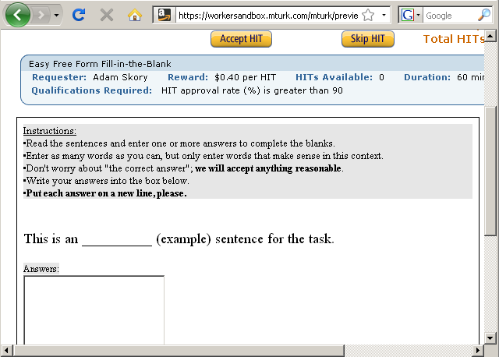
Notes:
31
31

Slide 32
Evaluation: Procedure
● Two measures of workers’ responses:
Cloze Easiness (Finn, 1978): The percent of responses containing original key
Context Restriction on n: number of responses containing n or fewer words (we use n=2)
Notes:
32
32

Slide 33
Evaluation: Example
Stem | Key | Worker 1 | Worker 2 | … | Cloze Easiness | Context Restriction
The king wanted to know how many ______ he ruled. | Citizens | people, good people, men | citizens Dollars | … | 64% | 72%
Later I attended _______ and graduate school | College | college, university | university, college, High | … | 92% | 87%
Notes:
33
33

Slide 34
Evaluation: Results
 | Reading Level | Co-occurrence
Context Restriction
Cloze Easiness
Notes:
34
34

Slide 35
Evaluation: Results
 | Reading Level | Co-occurrence
Context Restriction | PCC = 0.07 P(H₀)=0.1038
Cloze Easiness
Notes:
35
35

Slide 36
Evaluation: Results
 | Reading Level | Co-occurrence
Context Restriction | PCC = 0.07 P(H₀)=0.1038 | PCC = 0.0649 P(H₀)=0.1317
Cloze Easiness
Notes:
36
36

Slide 37
Evaluation: Results
 | Reading Level | Co-occurrence
Context Restriction | PCC = 0.07 P(H₀)=0.1038 | PCC = 0.0649 P(H₀)=0.1317
Cloze Easiness | PCC = 0.0671 P(H₀)=0.1193
Notes:
37
37

Slide 38
Evaluation: Results
 | Reading Level | Co-occurrence
Context Restriction | PCC = 0.07 P(H₀)=0.1038 | PCC = 0.0649 P(H₀)=0.1317
Cloze Easiness | PCC = 0.0671 P(H₀)=0.1193 | PCC = 0.2043 P(H₀)=1.6965e-06
Notes:
38
38

Slide 39
Comparison to Gold Standard
●Co-occurrence score and Cloze Easiness correlate significantly, but is that correlation really cloze quality?
●Corroborate with a known evaluation
●An expert English teacher preferred the cloze sentences chosen by co-occurrence score and Cloze Easiness.
Notes:
39
39

Slide 40
Comparison to Gold Standard
For each of these metrics 20 best sentences were chosen
 | Expert evaluation on 5-point Scale
 |  | Mean | Standard Deviation
20 best sentences as determined by: | Maximum grade level | 3.15 | 1.2
 | Context restriction | 3.05 | 1.36
 | Cloze Easiness and co-occurrence score | 2.25 | 1.37
Notes:
40
40

Slide 41
Conclusion
● Reading level not shown to be effective.
● Filter-based approach can be used over different corpora, and can include different filtering criteria
● AMT fast, cheap and effective to evaluate cloze quality
● Co-occurrence score remains best predictor of cloze quality
Notes:
41
41

Slide 42
Future Directions:
Make AMT task more specific to elicit less variance in context restriction.
Give workers same rating task as experts.
Apply measures of well-formedness beyond probabilistic parsing.
Instead of a pre-defined set of targets, focus use of cloze to teach highly co-occurrent words.
Notes:
42
42

Slide 43
Thank you ______ much!
Notes:
43
43

Slide 44
Predicting Cloze Task Quality for Vocabulary Training
Adam Skory, Maxine Eskenazi, 2010-06-05
Background on Cloze Tasks: Assessment
●“Lexical quality” is based on the knowledge of constituents of a word and the integration of those consituents. (Perfetti & Hart, 2001)
●(Possible) constituents of word lexical knowledge:
►Orthographic
►Phonetic
►Syntactic
►Semantic
Notes:
44
44

Slide 45
Predicting Cloze Task Quality for Vocabulary Training
Adam Skory, Maxine Eskenazi, 2010-06-05
Background on Cloze Tasks: Assessment
●Word knowledge level can be described according to Dale (1965)
(1) Word has never been seen or heard.
(2) Word is recognized, but meaning is unknown.
(3) Word is recognized and meaningful in some contexts
(4) Meaning is known in all contexts, and word can be used
appropriately.
Notes:
45
45

Slide 46
Predicting Cloze Task Quality for Vocabulary Training
Adam Skory, Maxine Eskenazi, 2010-06-05
Background on Cloze Tasks: Assessment
●Cloze tasks can be used to test for specific constituents of lexical
knowledge (Bachman, 1982).
●Closed cloze (multiple choice) can test for knowledge level 2 or 3.
●Open cloze (write-in) can test for knowledge level 4.
●Cloze tasks can test grammatical knowledge without using syntactic
terminology.
Notes:
46
46

Slide 47
Predicting Cloze Task Quality for Vocabulary Training
Adam Skory, Maxine Eskenazi, 2010-06-05
Automatic Generation of Cloze Tasks
●Liu et al. (2005):
○Sentences from a corpus of newspaper text are tagged for POS.
○Individual words are tagged by lemma.
○Sentences are found by searching on (key, POS).
○Results are filtered for proper word sense by comparing other
words in the stem with data from WordNet and HowNet.
Notes:
47
47

Slide 48
Predicting Cloze Task Quality for Vocabulary Training
Adam Skory, Maxine Eskenazi, 2010-06-05
Automatic Generation of Cloze Tasks
●Higgins (2006):
○Sentences from a many corpora are tagged for POS.
○A regular expression engine allows content creators to search by literal word text, tags, or both for highly specific
constructions.
Notes:
48
48

Slide 49
Predicting Cloze Task Quality for Vocabulary Training
Adam Skory, Maxine Eskenazi, 2010-06-05
Automatic Generation of Cloze Tasks
●Pino et al (2009):
○Sentences taken from REAP corpus.
○Stanford parser used to detect sentences within a desired range
of complexity and likely well-formedness.
○Co-occurrence frequencies of words in the REAP corpus were
calculated and keys were compared to other words in the stem to
determine cloze quality.
Notes:
49
49

Slide 50
Predicting Cloze Task Quality for Vocabulary Training
Adam Skory, Maxine Eskenazi, 2010-06-05
Co-occurence Score: Example
If our corpus consisted of the single sentence
“This is a good example sentence.”:
C−1 (w = good, k = example) = 1
C1 (w = sentence, k = example) = 1
P (w = good | k = example, m = 3) = 1 / (1+1)= .5
Notes:
50
50

Slide 51
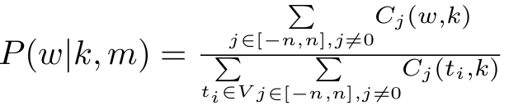
Predicting Cloze Task Quality for Vocabulary Training
Adam Skory, Maxine Eskenazi, 2010-06-05
Co-occurrence Scores: Procedure
(1) For some key k , word w, and window-size m :
Cj(w, k) := count of times w found j words from the position of k, within the same sentence.
(2) For a vocabulary V and for some positive integer window-size m, let n = (m-1) / 2, then:
The overall score of the sentence is taken to be the mean of the skip bigram probabilities of all words in context of the key.
Notes:
51
51

Slide 52
Predicting Cloze Task Quality for Vocabulary Training
Adam Skory, Maxine Eskenazi, 2010-06-05
Co-occurence Score: Example
If our corpus consisted of the single sentence
“This is a good example sentence.”:
C−1 (w = good, k = example) = 1
C1 (w = sentence, k = example) = 1
P (w = good | k = example, m = 3) = 1 / (1+1)= .5
Notes:
52
52

Slide 53
Predicting Cloze Task Quality for Vocabulary Training
Adam Skory, Maxine Eskenazi, 2010-06-05
Reading Level and Transfer Features: Example
super and sub-classes
'book' (superclass with a subset of features) and
'encyclopedia' (subclass with a superset of features)
transfer features and information about blank
The person is driving a(n) _______.
The paramedic is driving a(n) ________.
The paramedic is flying a(n) ________.
Notes:
53
53

Slide 54
Predicting Cloze Task Quality for Vocabulary Training
Adam Skory, Maxine Eskenazi, 2010-06-05
AMT Cloze Evaluation: Example
“Take this cloze sentence, for _________ (example) .”
A = {
A1={example, free, fun, me}
A2={example,instance}
A3={instance}
}
Cloze Easiness => |{A1,A2}| / |A| ≈ .67
Context restriction (on one or two words) => |{A2,A3}| / |A| ≈ .67
Notes:
54
54

Slide 55
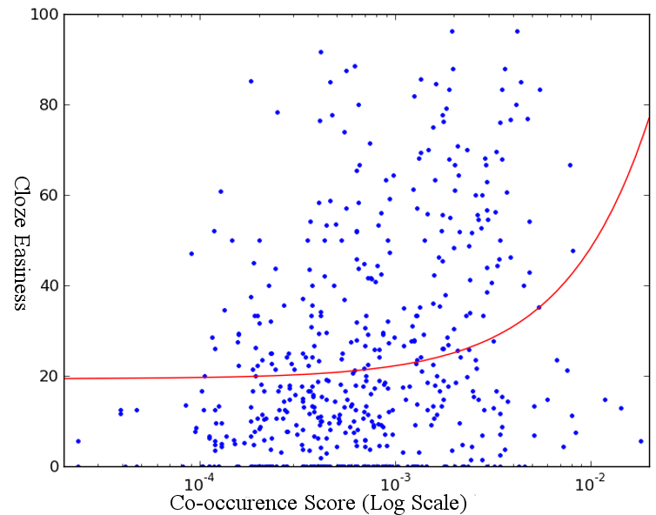
Notes:
55
55

