Slide 1

Automated Measures of Specific Vocabulary Knowledge from Constructed Responses
(“Use These Words to Write a Sentence Based on this Picture”)
Swapna Somasundaran
ssomasundaran@ets.org
Martin Chodorow
martin.chodorow@hunter.cuny.edu

Slide 2
Test
Write a Sentence Based on a Picture
Directions: write ONE sentence that is based on a picture. With each picture you will be given TWO words or phrases that you must use in your sentence. You can change the forms of the words and you can use the words in any order.

Slide 3
Goals
Create an automated scoring system to score the test.
Investigate if grammar, usage, and mechanics features developed for scoring essays can be applied to short answers, as in our task
Explore new features for assessing word usage using Pointwise Mutual Information (PMI)
Explore features measuring the consistency of the response to a picture

Slide 4
Outline
Goals
Test
System
Experiments and Results
Related work
Summary
Notes:
Elaborate on our goals
Then we will see some test examples and how they are scored, after which I will talk about our system designed to score them.
Then I will present our experiments, and very briefly touch upon related work before concluding.

Slide 5
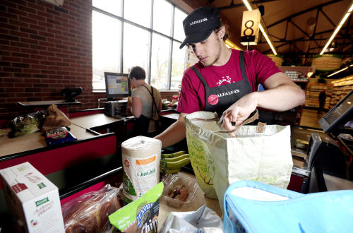
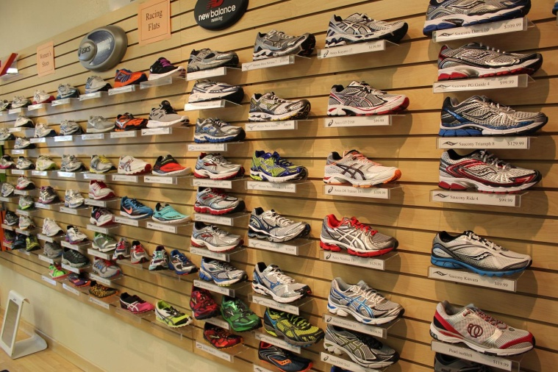
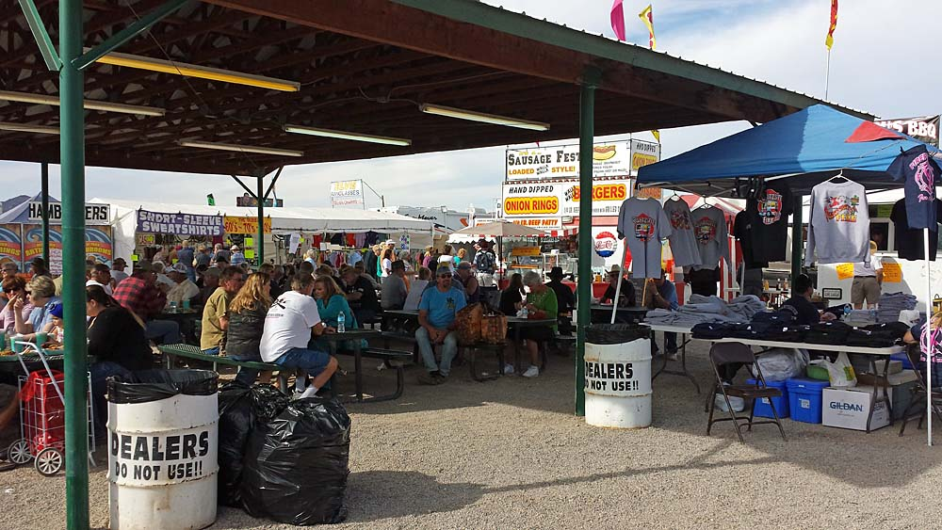

Test: prompt examples
Noun/noun
Adjective/noun
food/bag
different/shoe
Verb/conjunction
Noun/verb
sit/and
woman/read
Notes:
The prompt consists of a picture and two words.
Here are 4 examples of prompts. Note that due to the propriety nature of our data, these are not the pictures in operational use. I pulled these out from the web to very closely resemble the prompts we worked with.
The first picture is that of a grocery store… and the words are food and bag.
The second is that of a show store display…
The third is of a market place and the fourth is that of a woman reading a book.
Notice that the prompt words could be any POS.
Also, there is a wide variety in the types of pictures -- they could be very dense with a lot of information/ or very sparse with just one or two objects or object types.

Slide 6
Test: prompt examples
People are sitting and eating at the market.
Customers are sitting and enjoying the warm summer day.
The man in the blue shirt is sitting and looking at the t-shirts for sale.
There are garbage bags and trash cans close to where the people are sitting.
The woman is reading a book.
Food/bag
Different/shoe
sit/and
woman/read
Notes:
The woman in smiling while reading a book by the river. .. There is not a whole lot that a response can deviate from this.

Slide 7
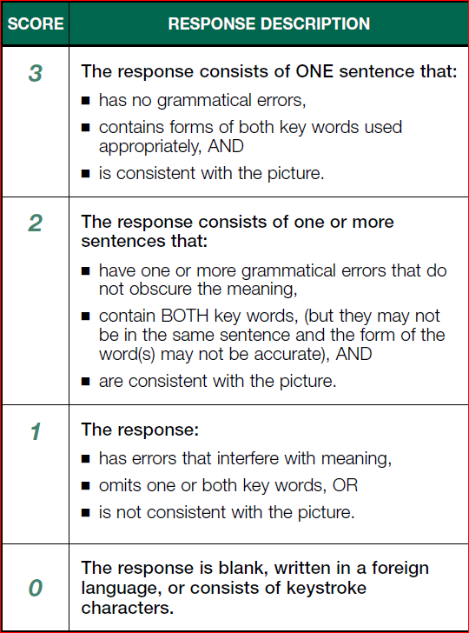
Test: Operational Scoring Rubric
Subject-verb
Grammar errors
and their severity
article
preposition
…
Word usage
Consistency with picture
Machine learning
Straightforward rules
Notes:
.. That is used by the human annotators. Our decisions about scoring system design are based on the scoring guide and its criteria.
There are 4 score points 0-3. Score 0 is straightforward, while the other three scores are a mix of different factors.
For score points 1,2,3 there are a mix of variety of factors, and these can affect the scores to different extents
Grammar – what is tricky is that we have to determine severity, and that there are various types of grammar errors
So the best way to model how these different factors come into play in the human scoring is by using a supervised machine learning framework.

Slide 8
System Architecture
Text responses
Word associations database
Foreign language detector (Rule-based scorer)
Spell check
Rubric-based Features
Content relevance Features
Awkward word usage Features
Grammar Features
Reference Corpus
Machine learner
model
Score prediction
Notes:
The responses that are not scored as zero go into the machine learning module. Here there are 4 different feature sets.

Slide 9
System Architecture
Text responses
Word associations database
Foreign language detector (Rule-based scorer)
Spell check
Rubric-based Features
Content relevance Features
Awkward word usage Features
Grammar Features
Reference Corpus
Machine learner
model
Score prediction

Slide 10
Foreign language detector
(Rule-based scorer)
Assigns a zero score if
  Response is blank
  Response is non-English
Performance
Precision = # assigned zero correctly / # assigned zero by system
= 82.9%
Recall = # assigned zero correctly / # assigned zero by human
= 87.6%
Fmeasure = 2*Precision*Recall/(Precision+Recall)
= 85.2%
Notes:
This is determined based on PMI of bigrams and trigrams over a word association database. If the PMI is less than a threshold more than a few times, the sentence is tagged as non-english

Slide 11
System Architecture
Text responses
Word associations database
Foreign language detector (Rule-based scorer)
Spell check
Rubric-based Features
Content relevance Features
Awkward word usage Features
Grammar Features
Reference Corpus
Machine learner
model
Score prediction

Slide 12
Rubric-based Features
(for Machine Learning)
Binary features
  Is the first keyword from the prompt present?
  Is the second keyword from the prompt present?
  Are both keywords from the prompt present?
  Is there more than one sentence in the response?
  4 features forming the rubric featureset

Slide 13
System Architecture
Text responses
Word associations database
Foreign language detector (Rule-based scorer)
Spell check
Rubric-based Features
Content relevance Features
Awkward word usage Features
Grammar Features
Reference Corpus
Machine learner
model
Score prediction

Slide 14
Grammar Features
e-rater® (Attali and Burstein, 2006)
  Run-on Sentences
  Subject Verb Agreement Errors
  Pronoun Errors
  Missing Possessive Errors
  Wrong Article Errors
  ..
  113 features forming the grammar featureset
Notes:
ERAter generates a number of grammar, usage and mechanics features that detect and quantify different types of English usage errors in essays.
We selected from these 113 features that looked applicable for our task. For example, features based on multiple sentences were discarded.

Slide 15
System Architecture
Text responses
Word associations database
Foreign language detector (Rule-based scorer)
Spell check
Rubric-based Features
Content relevance Features
Awkward word usage Features
Grammar Features
Reference Corpus
Machine learner
model
Score prediction

Slide 16
Content relevance Features: Reference Corpus
Measure the relevance of the response to the prompt picture
  A reliable and exhaustive textual representation of each picture
Employ a manually constructed Reference Text Corpus for each picture
Performed manual annotation spanning about a month
  Instructions:
    List the items, setting, and events in the picture
    Describe the picture
Notes:
automated methods of image recognition are error prone and would result in a noisy reference corpus. Additionally, automated
approaches would, at best, give us a (noisy) list of items that are present in the picture, but not
the overall scene or event depicted

Slide 17
Content relevance Features
  Man ~ boy ~ person ~clerk
Expand the reference corpus using
  Lin’s thesaurus
  Wordnet synonyms, hypernyms, hyponyms
  All thesauri
Features:
  Proportion of overlap between lemmatized content words of the response and the lemmatized version of the corresponding reference corpus (6 features, based on the expansion type)
  Prompt id
7 features forming the relevance featureset
Notes:
Now, let us revisit our prompt. The person behind the counter could be referred to as a Man….
In order to capture all the variations that could be used in the responses, we expand the reference corpus.
The prompt ID captures the complexity of the prompt.

Slide 18
System Architecture
Text responses
Word associations database
Foreign language detector (Rule-based scorer)
Spell check
Rubric-based Features
Content relevance Features
Awkward word usage Features
Grammar Features
Reference Corpus
Machine learner
model
Score prediction

Slide 19
Awkward word usage Features: from Essay Scoring
Collocation quality features in e-rater® (Futagi et al., 2008).
  Collocations
  Prepositions
2 features forming the colprep featureset

Slide 20

Awkward word usage Features:
New Features
Find PMI of all adjacent word pairs (bigrams), as well as all adjacent word triples (trigrams) from the response, based on the Google 1T web corpus
Bin PMI values for the response
Features
  counts and percentages in each bin
  max, min and median PMI for the response
  null PMI for words not found in the database
40 features forming the pmi featureset
-20
-10
-1
0
1
10
20
Lower than chance
Independent
Higher than chance
Notes:
Higher than chance likelihood of association, according to the web corpus, indicating typical use in daily life.
Lower than chance likelihood of association, indicating awkward or ill-formed usages

Slide 21
System Architecture
Text responses
Word associations database
Foreign language detector (Rule-based scorer)
Spell check
Rubric-based Features
Content relevance Features
Awkward word usage Features
Grammar Features
Reference Corpus
Machine learner: Logistic Regression (sklearn)
model
Score prediction

Slide 22
Experiments: data
58K responses to 434 picture prompts all of which were human scored operationally
  2K responses were used for development
  56K responses were used for evaluation
17K responses were double annotated
  Inter-annotator agreement using quadratic weighted kappa (QWK) was 0.83
Data Distribution by score point
0 | 1 | 2 | 3
0.4% | 7.6% | 31% | 61%
Notes:
Quadratic weighted kappa penalizes disagreements that are farther apart more than disagreements that are by just one scorepoint.

Slide 23
Experiments: Results
 | Accuracy (%) | Agreement (QWK)
Baseline (Majority Class) | 61 | --
System | 76 | .63
Human | 86 | .83
15 percentage point improvement over baseline,
but 10 percentage points below human performance
Notes:
Which is often considered substantial agreement

Slide 24
Experiments: Individual feature sets
Feature set | Accuracy (%)
Overall (all features) | 76
grammar | 70
pmi | 67
rubric | 65
relevance | 63
colprep | 61
Baseline | 61
Notes:
We also experimented using individual feature sets alone, to see if and by how much each is able to improve over baseline.
Here in the table, the top row is the performance of the system with all the features and the bottom row is the baseline performance.

Slide 25
Experiments: Individual feature sets
Feature set | Accuracy (%)
Overall (all features) | 76
grammar | 70
pmi | 67
rubric | 65
relevance | 63
colprep | 61
Baseline | 61
(almost) all individual features are better than the baseline, but not as good as all features combined
Notes:
This indicates that there is value in putting these features together.

Slide 26
Experiments: Individual feature sets
Feature set | Accuracy (%)
Overall (all features) | 76
grammar | 70
pmi | 67
rubric | 65
relevance | 63
colprep | 61
Baseline | 61
Grammar features developed for essays can be applied to our task

Slide 27
Experiments: Individual feature sets
Feature set | Accuracy (%)
Overall (all features) | 76
grammar | 70
pmi | 67
rubric | 65
relevance | 63
colprep | 61
Baseline | 61
Collocation features developed for essays do not transfer well to our task

Slide 28
Experiments: Individual feature sets
Feature set | Accuracy (%)
Overall (all features) | 76
grammar | 70
pmi | 67
rubric | 65
relevance | 63
colprep | 61
Baseline | 61
Features explored in this work show promise.

Slide 29
Experiments: Feature set combinations
Feature set | Accuracy (%)
Overall (all features) | 76
pmi + relevance + rubric | 73
grammar + colprep | 70
grammar | 70
pmi + relevance | 69
pmi | 67
colprep + pmi | 67
rubric | 65
relevance | 63
colprep | 61
Baseline | 61
New features explored
All features from essay scoring
All word usage features

Slide 30
Experiments: Feature set combinations
Feature set | Accuracy (%) | QWK | Rank(Acc) | Rank(QWK)
Overall (all features) | 76 | 0.630 | 1 | 1
pmi + relevance + rubric | 73 | 0.589 | 2 | 2
grammar + colprep | 70 | 0.338 | 3.5 | 5.5
grammar | 70 | 0.338 | 3.5 | 5.5
pmi + relevance | 69 | 0.340 | 5 | 4
colprep + pmi | 67 | 0.285 | 6.5 | 7
pmi | 67 | 0.281 | 6.5 | 8
rubric | 65 | 0.427 | 8 | 3
relevance | 63 | 0.164 | 9 | 9
colprep | 61 | 0.003 | 10.5 | 10
Baseline | 61 |  | 10.5
Notes:
Here are the quadratic weighted kappas for the same systems. And the ranks according to accuracy and qwk
What is worth noting here is that a system’s rank according to accuracy may not always be the same according to quadratic weighted kappa.
There are systems for which the ranks obtained by QWK performance is lower than their corresponding ranks for accuracy.
These are systems where, either they exactly agree with the human, and when they are wrong, they are off by a lot.
On the other hand, there are 2 systems where the opposite is true -- even when they are wrong, they are not off by a lot.

Slide 31
Experiments: Score-level Performance
(overall)
Score | Precision | Recall | F-measure
0 | 84.2 | 68.3 | 72.9
1 | 78.4 | 67.5 | 72.6
2 | 70.6 | 50.4 | 58.8
3 | 77.8 | 90.5 | 83.6
Notes:
It does well for 3 but badly for score point 2.
Particularly, the recall of score point 2 is bad.

Slide 32
Experiments: Confusion matrix
 |  | System (all features)
 |  | 0 | 1 | 2 | 3 | Total
human | 0 | 0.03 | 0.01 | 0.00 | 0.00 | 0.05
 | 1 | 0.00 | 5.09 | 1.39 | 1.06 | 7.54
 | 2 | 0.00 | 0.69 | 15.72 | 14.78 | 31.19
 | 3 | 0.00 | 0.69 | 5.14 | 55.38 | 61.22
 | Total | 0.04 | 6.49 | 22.25 | 71.22 | 100.00
Notes:
The confusion matrix provides insights to this --- from the off diagonals (shown in bold red, depending on their severity), we see that the system has difficulty distinguishing between scores 2 and 3.
It classifies a lot of cases with score 2 as 3.

Slide 33
Related Work
Semantic representations of picture descriptions
  King and Dickinson (2013)
Crowd sourcing to collect human labels for images
  Rashtchian et al. (2010), Von Ahn and Dabbish (2004), Chen and Dolan (2011)
Automated methods for generating descriptions of images
  Kulkarni et al., 2013;Kuznetsova et al., 2012; Li et al., 2011; Yao et al., 2010; Feng and Lapata, 2010a; Feng and Lapata, 2010b; Leong et al., 2010; Mitchell et al.,2012
Notes:
We do not explicitly model the semantic representations of the pictures, but rather our goal in this work is to ascertain if a response is relevant to the picture
We employ human annotators and use word similarity measures to obtain alternative forms of description because the proprietary nature of our
data prevents us from releasing our pictures to the public.
For a high-stakes assessment, it would be highly undesirable to have any noise in the gold-standard reference picture descriptions. Hence we chose to use manual description for creating our reference corpus.

Slide 34
Summary and Future Direction
Investigated different types of features for automatically scoring a test which requires the test-taker to use two words in writing a sentence based on a picture.
Showed an overall accuracy in scoring that is 15 percentage points above the majority class baseline and 10 percentage points below human performance.
  Grammar features from essay scoring can be applied to our task
  PMI-based features, rubric-based features, relevance features based on reference corpus are useful
Explore the use of our features to provide feedback in low stakes practice environments

Slide 35
Questions?
ssomasundaran@ets.org
martin.chodorow@hunter.cuny.edu

Slide 36
Extra slides

Slide 37
Reference Corpus Creation
One human annotator was given the picture and the two key words
Instructions
  Part-1: List the items, setting, and events in the picture List, one by one, all the items and events you see in the picture. These may be animate objects (e.g. man), inanimate objects (e.g. table) or events (e.g. dinner).(10-15 items)
  Part:2 Describe the picture. Describe the scene unfolding in the picture. The scene in the picture may be greater than the sum of its parts (5-7 sentences)
Coverage Check: proportion of content words in the responses (separate dev set) that were found in the reference corpus
If Coverage < 50%, use second annotator
Merge the corpus for the prompt from multiple annotators

Slide 38
Statistical Significance of Results.
Test of proportions
Feature set | Accuracy (%)
Overall (all features) | 76
grammar | 70
pmi | 67
rubric | 65
relevance | 63
colprep | 61
Baseline | 61
1120 additional responses correct
p<0.001
Notes:
We did not run statistical tests for the paper, but we were curious, so we ran Test of proportions.
with 56,000 responses , even an improvement of 1% is 560 additional correctly scored response, and is likely to be significant. Test of proportions -- p<0.001

Slide 39
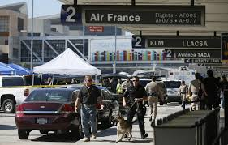
Test: prompt examples
airport/ so
Notes:
The prompt consists of a picture and two words. In this case, the words are airport and so. Notice that the one of the words is a content word, and the other is a function word

Slide 40
Experiments: Results
Score point | Precision | Recall | Fmeasure
0 | 84 | 68 | 73
1 | 78 | 68 | 73
2 | 71 | 50 | 59
3 | 78 | 91 | 84

Slide 41
Related Work
Automated scoring focusing on grammar and usage errors
  Leacock et al., 2014; Dale et al.,2012; Dale and Narroway, 2012; Gamon, 2010;Chodorow et al., 2007; Lu, 2010
Work on evaluating content
  Meurers et al., 2011; Sukkarieh and Blackmore, 2009; Leacock and Chodorow, 2003
Assessment measures of depth of vocabulary knowledge
  Lawless et al., 2012; Lawrence et al., 2012
Notes:
We employ grammar errors as one of the dimensions that reveal lack of proficiency in constructing a sentence.
Our task is different in that We evaluate content in terms of relevancy to a picture, and not in terms of for example, knowledge of a scientific concept.
…Where Lawless et al measure, using test items if vocabulary knowledge is idiomatic, topical or definitional.
Assigning the depth of knowledge of the key words is not the focus of our task, though our PMI features implicitly captures idiomatic associations.

