Slide 1
Using exemplar responses for training and evaluating automated speech scoring systems
Anastassia Loukina, Klaus Zechner, James Bruno, Beata Beigman Klebanov

Slide 2
Context
English language proficiency tests often include speaking section
Different types of tasks: read aloud, sentence repeat, picture description, dialogue tasks …
This talk: Tasks that elicit spontaneous speech for about 1 minute
The response is recorded and sent for scoring

Slide 3
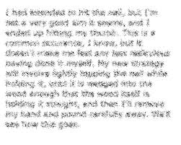
Automated speech scoring
ASR
Scoring model
ML algorithm trained on human scores
Feature computation
Number of pauses,
similarity to native model, vocabulary complexity, grammatical complexity etc.
Score
or NaN
Other signal processing
Filtering model
Set of rules and classifiers to identify non-scoreable responses
Pitch Amplitude
Formants

Slide 4
Problem
Obtaining reliable human scores for constructed responses is hard:
Response factors: multidimensional production mapped to a single scale
Rater factors
Ensuring reliability for spoken responses even harder
Relatively low human-human agreement at the level of individual response (r=0.55-0.65).

Slide 5
Solution
Human scoring:
Test-takers answer several questions
Responses from the same test taker are scored by a different raters
The final aggregated score is highly reliable (r>0.9)
Automated scoring:
Engines are trained using human scores at response level
Previous studies suggest that removing low-agreement (“hard”) cases from the training set may improve system performance (Beigman Klebanov & Beigman 2014, Jamison & Gurevych 2015).
Can we improve system performance by training on clean data?

Slide 6
Data
Exemplar corpus
Main corpus
Randomly sampled from responses to a large-scale language proficiency assessment
6 different types of questions eliciting spontaneous speech (1,140 different questions)
683,694 responses scored on a scale 1-4.
8.5% double scored: r=0.59
Exemplar responses from the same assessment selected for rater training/monitoring
Same 6 types of questions (800 different questions)
16,257 responses sampled to obtain the same score distribution as in the main corpus
Only includes responses where multiple experts agree on the same score

Slide 7
Model building
70 features extracted for each response:
Delivery: fluency, pronunciation, prosody
Language Use: vocabulary, grammar
7 different machine learning algorithms:
OLS, Elastic Net, Random Forest, Multilayer perceptron regressor…
Separate models trained for 6 types of questions
Main train
Exemplar train
Main test
Exemplar test

Slide 8
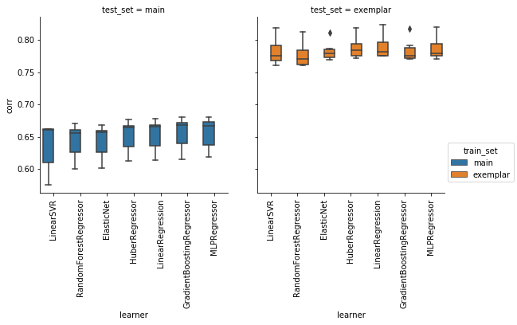
Model performance: within corpus
Model trained and evaluated on exemplar responses consistently outperform those trained and evaluated on the main corpus
There is no major difference between different learners
r=0.66
r = 0.79

Slide 9
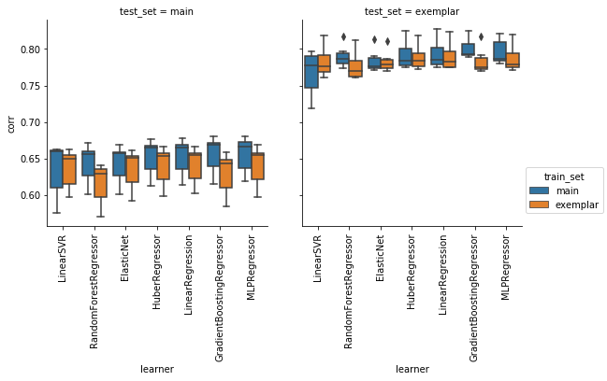
Model performance: across corpora
Training on exemplar responses does not lead to improvement in performance on the main corpus
Training on main corpus does not lead to degradation in performance on exemplar responses
Main: r = .66
Exemplar: r = .64
Exemplar: r = .79
Main: r = .8

Slide 10
Difference in N in training set
Exemplar corpus
Main corpus
Randomly sampled from responses to a large-scale language proficiency assessment
683,694 responses
Only includes responses where multiple experts agree on the same score
16,257 responses sampled to obtain the same score distribution as in the main corpus.
Main* corpus
Randomly sampled from the training partition of the Main corpus
Same N as in the training partition of the exemplar corpus: 12,398 responses

Slide 11
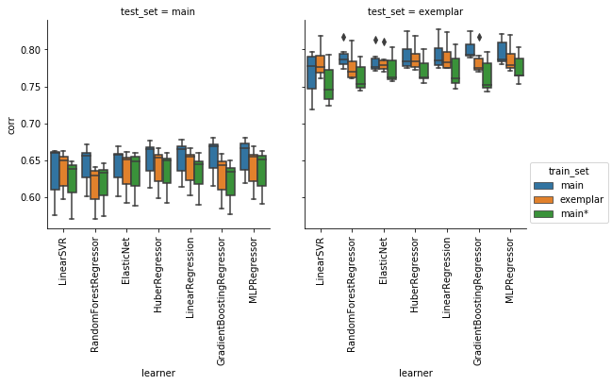
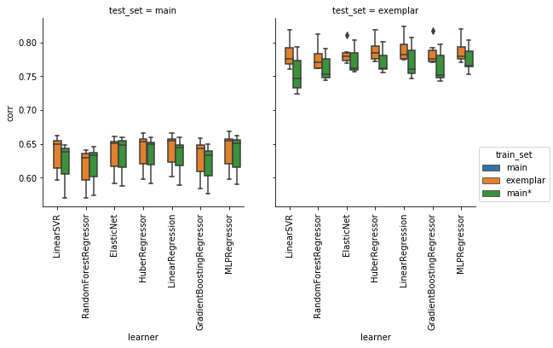
Main* vs. Exemplar
There is no difference when models are evaluated on the main corpus
Training on exemplar responses leads to a better performance on exemplar responses
Large training set gives the best performance
Main: r = .66
Exemplar: r = .64
Main*: r = .64
Main: r = .8
Exemplar: r = .79
Main*: r = .77

Slide 12
Modelling the differences (N=4,686,507)
Error² ~ learner + train_set * test_set + (1|response) + (1| model)
 | Coefficient 0.291***
Intercept
test_set.Exemplar | -0.105**
train_set.main | -0.014***
train_set.main* | -0.002*
Learner.HuberRegressor | -0.001***
Learner.MLPRegressor | -0.001***
Learner.ElasticNet | 0.002***
learner.GradientBoostingRegressor | 0.003***
Learner.LinearSVR | 0.007***
Learner.RandomForestRegressor | 0.008***
train_set.main:test_setExemplar | 0.016**
train_set.main*:test_set.Exemplar | 0.018**

Slide 13
What if we had more exemplar responses?
Training on Exemplar responses has a small advantage for a very small N but not when the training set is sufficiently large.
Training on Exemplar responses has a clear advantage for small N. This decreases with the increase in the size of the training set.

Slide 14
Do the models generate different predictions?
Different learners trained on the same data sets:
r = .97 (min r = .92).
Same learner trained on different datasets:
r = .98 (min r = .95).
Different learners trained on different corpora seem to be producing essentially the same predictions

Slide 15
Conclusions
As long as you have enough training data it doesn't matter whether you train on exemplar responses or random sample, at least if the response-level noise is random.
The choice of training set (exemplar vs. random) has a major effect on the estimates of model performance
Unless the number of available responses is really small (~1K), the cost of creating an Exemplar corpus is likely to outweigh benefits. “Cleaning up” the evaluation set or collecting a larger set of training responses is likely to be more useful.

Slide 16
Thank you!

Slide 17
Further error analysis (Main corpus)
Sources of errors for 80 responses with the highest scoring error:
30% Noise in human labels.
22.5% Errors in pipeline: inaccurate ASR
30% Responses differentiated along dimensions not measured by features

