Slide 1
Estimating Linguistic Complexity for Science Texts
Farah Nadeem and Mari Ostendorf
farahn@uw.edu, ostendor@uw.edu
TIAL Lab, Department of Electrical Engineering
University of Washington
Notes:
Hello everyone, my name is Farah. I am from the university of Washington, and I am going to present the work on estimating linguistic complexity for science texts done with my advisor Mari Ostendorf.

Slide 2
Linguistic Complexity
Linguistic complexity is used…
as a measure of proficiency in language acquisition
in readability assessment to find texts suitable for a given audience
We consider the problem of how difficult a text is to read and understand
“A tree is a plant. A tree is the biggest plant that grows.” vs.
“From the meanderings of a pond’s edge to the branching of trees and the intricate forms of snowflakes….”
Notes:
In the context of education, linguistic complexity is used as a metric of proficiency in language acquisition, particularly second language acquisition.
It is also used to find reading materials suitable for a given audience based on their reading skill level.
In our work we consider the problem of how difficult a text is to read and understand. As an example, here are two texts, where the first is easier to understand than the second, given comparable subject matter/length.
A straight-line is whatever lies evenly with points upon itself

Slide 3
Presentation overview
Background
Proposed approach
Data sets
Neural models
Results and analysis
Conclusion
Notes:
In the presentation I will go over the background, which covers related work and motivation.
I will follow that with our proposed methods, and the data sets we have used, rounding up with results and conclusion.

Slide 4
Why science texts?
Most text complexity work is with non-technical texts
English language learners (ELLs) and students with learning difficulties are impacted by complex texts in all subjects
In STEM classrooms
Teachers aren’t trained for identifying appropriate “levelled” texts
Teachers use texts from various sources
Linguistic complexity of assessments can negatively impact ELLs
Having tools to automatically identify text complexity would help students and educators
Notes:
Typically, linguistic complexity and readability analysis is tied to language learning and teaching. So why science? For students who are not proficient in English, particularly English language learners or ELLs, or students who have learning difficulties, text complexity has an impact for all subjects, including STEM subject.
And this is particularly challenging in the stem classrooms, since teachers are not typically trained to find appropriate levelled texts, unlike language teachers. This issue gets worsened by the fact that teachers use materials from various sources including online ones, which are not levelled, as opposed to just grade specific text books.
Another important aspect is how text difficulty of assessment questions impacts ELLs, regardless of subject proficiency.
In this context having tools to automatically identify text complexity would help both students and educators, which include both teachers and assessment writers.

Slide 5
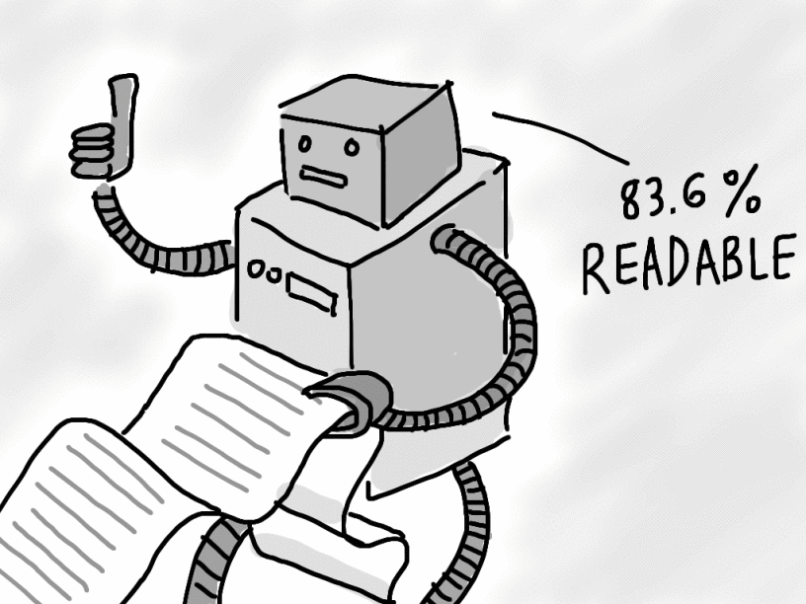
Automated analysis of text difficulty
Traditional metrics for text readability level
Based on counts of surface features
Genre independent (but not really)
Examples include Flesch-Kincaid, Coleman–Liau index, Lexile®
Automated feature-based readability models
Hand-crafted feature set used as input to models to predict reading level e.g. linear regression and SVMs
Genre-dependent (depends on training data)
Work better for longer texts
Notes:
In the existing space of automatic analysis of text difficulty, there are two main bodies of work. The first set is of traditional readability metrics, which use formulas based on surface features, such as length of words and sentences, to give a number that quantifies readability.
These metrics and independent of genre, but work has shown that they often tend to over predict reading level of technical/informational texts.
Some examples include Flesch Kincaid, coleman liau, and the most commonly used, lexile.
The second set of work includes feature based models that go beyond surface level features, in an attempt to provide better analysis. These models typically use hand crafted lexical, syntactic, morphological and other features, and predict the reading level using models such as linear regression and support vector machines. These models are trained on specific training sets, which makes them genre dependent. Due to the feature engineering process, we have found out that these models work better for longer texts. And shorter texts are also important, particularly in the context of assessments.

Slide 6
Impact on student assessment
Impact of linguistic features in assessment questions
Research on ELL performance in math and other subjects
Lexical, syntactic and other features studied
Impact of individual features varies with grade, subject and test
National Research Council report, 2000
“A test […] cannot provide valid information about a student’s knowledge or skills if a language barrier prevents the students from demonstrating what they know and can do”
Notes:
In terms of how complexity of questions impacts ELLs, there has been extensive research, particularly on math word problems as well as other subjects. A large body of work has demonstrated that different linguistic features, including lexical, syntactic, correlate with low performance by ELLs. However, the features that seem to be impactful varies across subject, grade level and even type of test. The only consistent feature is length, which almost always correlates with language difficulty perceived by ELLs.
This is important since it impacts the validity of measurements obtained from these assessments. As pointed out by the national research council, assessments cannot provide valid measurements if students cannot demonstrate their learning due to a language barrier. This is a recurring theme that has been coming in national reports, more recently with the introduction of the next generation science standard.

Slide 7
Our work
Goal: build an estimator of text complexity for…
science and other informational texts
short length texts
Approach: a recurrent neural network (RNN) to predict linguistic complexity
No hand engineered features, input is text
Training on science and other informational texts
Grade level of data is used as a proxy for linguistic complexity
Metrics: Spearman rank correlation and accuracy
Notes:
Within this context, the focus of our work is basically to build an estimator for text complexity specifically for science and other informational texts. The goal is to build systems that work for shorter texts.
The approach we have adopted is to use a recurrent neural network with text as input. We don’t use had-engineered features for this work. To make the model specific to science and other informational texts, we train on science texts. For labels, we take the grade level of the textbooks as labels. A caveat is that our labels are noisy, since not all text in a, say 5th grade textbook, is at 5th grade level.
The metrics we use for evaluation are spearman rank correlation and accuracy.

Slide 8
Building the data set
No available set of short stand alone science/informational texts
Train set
Paragraphs from online textbooks: Science, history and social studies for grades K-12
Additional data from the WeeBit corpus² (Vajjala and Meurers, 2012)
Test sets
Common Core Standards (CCS) sample texts, document and paragraph level
Chapters of open source textbooks broken into paragraphs
Set of 5470 publicly available middle school science assessment questions
2. Weekly reader and BBC Bitesize articles
Notes:
One of the biggest challenges we faced is that there is no data set available for short stand alone science texts. We worked around this problem, using various online sources to build both the train and test sets.
For the train set we took textbooks for grades k-12 available online. We also took additional data from the weebit corpus, which is a collection of weekly reader and bbc bitesize articles.
Putting together a test set that lines up with our goals was also challenging, so we used three different test sets:
The first was a set of sample texts for grades 2-12 from the common core standards. There are mixed genre texts
The second was a set of chapters from the open source textbooks we collected. Since the books are published under the creative commons licence, the same chapters were replicated in various books. We took care to make sure the test chapters do not appear in the training set.
The third set was middle school science assessment questions for grades 6-8. They include released items from state and national tests.

Slide 9
Model
Input is pre-trained word embeddings¹
Different RNN variants are used to learn a document representation
Document vector is used to predict reading level using ordinal regression, trained end-to-end
1. Glove embeddings (Pennington et al., 2014)
Notes:
Here is a look at the model we used. It can be broken down into three parts:
The input, which is pre-trained word embeddings for the words in the document.
The RNN and attention mechanism, which is used to learn a document representation. We use different configurations of bi-directional RNNs in our work.
The document vector is then used to predict reading/grade level using ordinal regression.
The entire system is trained end to end.

Slide 10
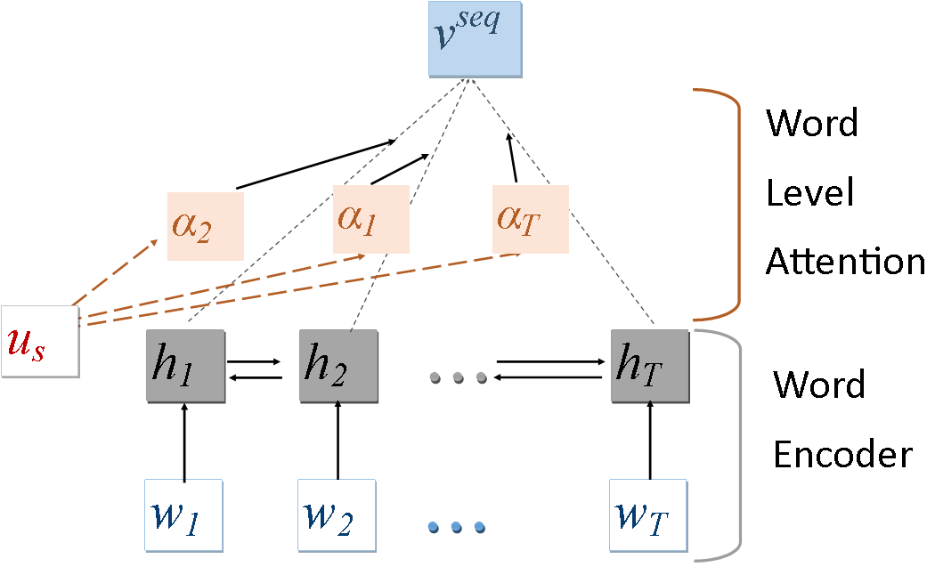
Basic RNN architecture
For each word $w_{k}$, we learn a forward $\vec{h_{k}}$ and backward representation $\overset{⃖}{h_{k}}$ using GRUs
$$h_{k}=[\vec{h_{k}},\overset{⃖}{h_{k}}]$$
Attention is computed over the word sequence $α_{k}$
$$u_{k}=\tanh\left(W_{s}h_{k}+b_{s}\right)$$
$α_{k}=\frac{exp⁡(u_{k}^{T}u_{s})}{\sum_{ik}{exp⁡(u_{k}^{T}u_{s})}}$
$α_{k}$is used to compute the sequence representation $v_{}^{seq}$
$$v_{}^{seq}=\sum_{k}{α_{k}h_{k}}$$
Notes:
Before I go into the various structures of RNNs we have used, I will describe the basic RNN structure. For each word in a sequence, we use a bi-directional GRU to learn a forward and backward representation. These concatenated form the word representation h_k.
Attention, alpha_k, is computed over the sequence, using the vector u_s. This attention vector is then used to compute the document representation by weighing the hidden states by corresponding attention weight and taking the average. The vector U_s is learned during training.

Slide 11
RNN structures
Sequential RNN
Sentences joined to form one sequence
Hierarchical attention network
RNN at word and sentence level to capture document structure
Multi-head hierarchical attention network
As above, but multiple sentence level RNNs to capture different aspects at the document level
Bidirectional context with attention
Captures discourse across adjacent sentences in a hierarchical structure
Notes:
Using the same basic architecture as I just explained, we used four RNN variants in our work.
The simplest architecture we use is sequential, where we take the entire document as a sequence, and learn a document representation using attention.
To capture structure in multi-sentence documents, we use a hierarchical attention network. Word level input is used to learn sentence level representation, which is used to build a document level representation.
In this work we study three variants of hierarchical networks: basic, multi-head and with bi-directional context. For multi-head attention we learn multiple document level vectors using the word level RNN representation. In both these models, the sentences are encoded independently; in an attempt to capture information flow across sentences, we introduce context from adjacent sentences in the encoding process.

Slide 12
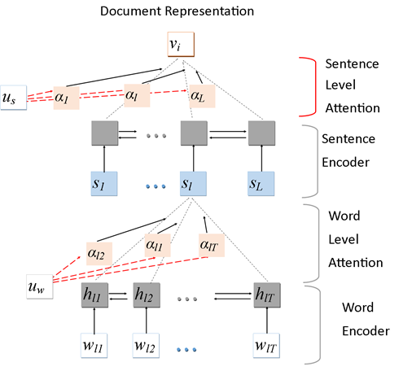
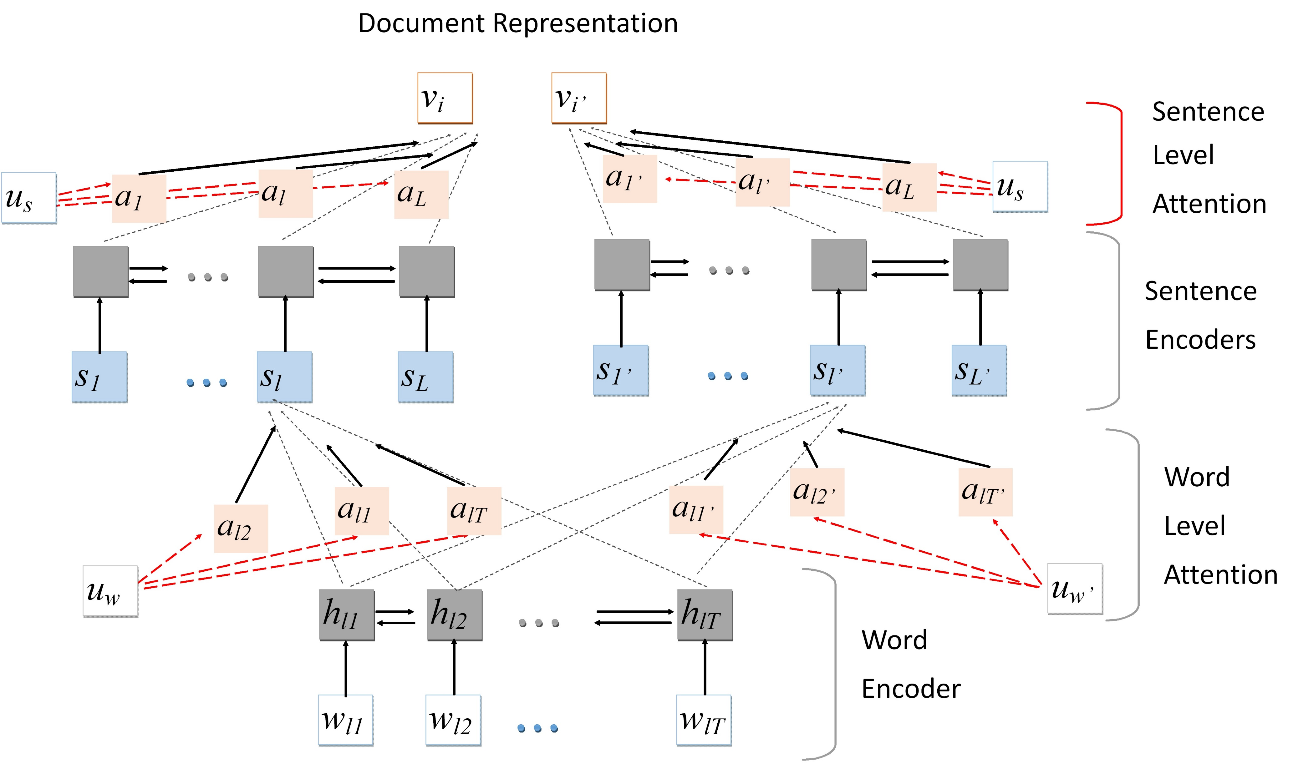
Hierarchical RNNs
Hierarchical attention network
(Yang et al. 2016)
Multi-head hierarchical attention network
Notes:
These are the first two hierarchical networks; in both cases we use bi-directional GRUs to learn a word level representation, which is used to create a sentence level representation, which is then used for creating a document level representation.
For the multihead case we use multiple, in this case 2, sets of attention mechanisms to learn two sentence level representations, leading to two document level vectors, which we concatenate to form the document representation.

Slide 13
Bidirectional context with attention
Bi-directional context with attention (BCA)
Hierarchical network with cross attention between adjacent sentences
For each word, find similarity with all words in the previous sentence
$$s\left(h_{lt},h_{\left(l−1\right)t}\right)=h_{lt}W_{α}h_{\left(l−1\right)t}^{T}$$
Compute look-back context $c_{l−1}$ using attention $α_{(l−1)}$ from the similarity scores
For each word $w_{lt}$a new hidden state $h_{lt}′$
$$h_{lt}^{′}=[c_{l−1},h_{lt},c_{l+1}]$$
Notes:
In both the previous models, each sentence is encoded independently of other sentences. To capture the flow of information across sentences, we introduce bi-directional context:
For each word in a sentence, we find the similarity with all the words in the previous sentence, use this to build an attention vector for the previous sentences. We then average the words in the previous sentence using this attention to find the look back context vector.
In a similar way we find the look ahead context vector, and concatenate the context vectors with the word representation to form a new representation, which is used to create the sentence representation.

Slide 14
Results
Baseline-WeeBit hand-engineered features linear regression(Vajjala & Meurers, 2014)
Two models trained on different training data sets
$D_{1}$: all textbook data used for training
$D_{2}$: some chapters of textbooks held out for test data, the rest used for training
Spearman Rank Correlation
Model | Test set | WeeBit | RNN | RNN 600 | Hierarchical attention | Bidirectional context | Multi-head
$$D_{1}$$ | CCS Documents | 0.69 | 0.28 | 0.43 | 0.47 | 0.55 | 0.42
 | CCS Paragraphs | 0.36 | 0.30 | 0.25 | 0.29 | 0.32 | 0.28
$$D_{2}$$ | CCS Documents | 0.69 | 0.34 | 0.38 | 0.43 | 0.48 | 0.43
 | CCS Paragraphs | 0.36 | 0.27 | 0.26 | 0.24 | 0.30 | 0.29
 | Science Texts | 0.22 | 0.51 | 0.60 | 0.60 | 0.62 | 0.60
WeeBit does better at CCS, RNN with bidirectional context does better at science
Notes:
We compare our results for the four RNN variants with a feature based linear regression baseline, the WeeBit model, on two data sets. One is the Common core sample texts, which we predict levels for both at the document and paragraph level. The second is a set of chapters from information texts. On the common core set which is mixed genre, the baseline performs better than all RNN variants. Of the RNN variants, the addition of context from adjacent sentences does the best.
For the science texts, the RNN models do better than the baseline, with the best performance again being for the model with context. To get a sense of what is happening, we look at the results versus text length.

Slide 15
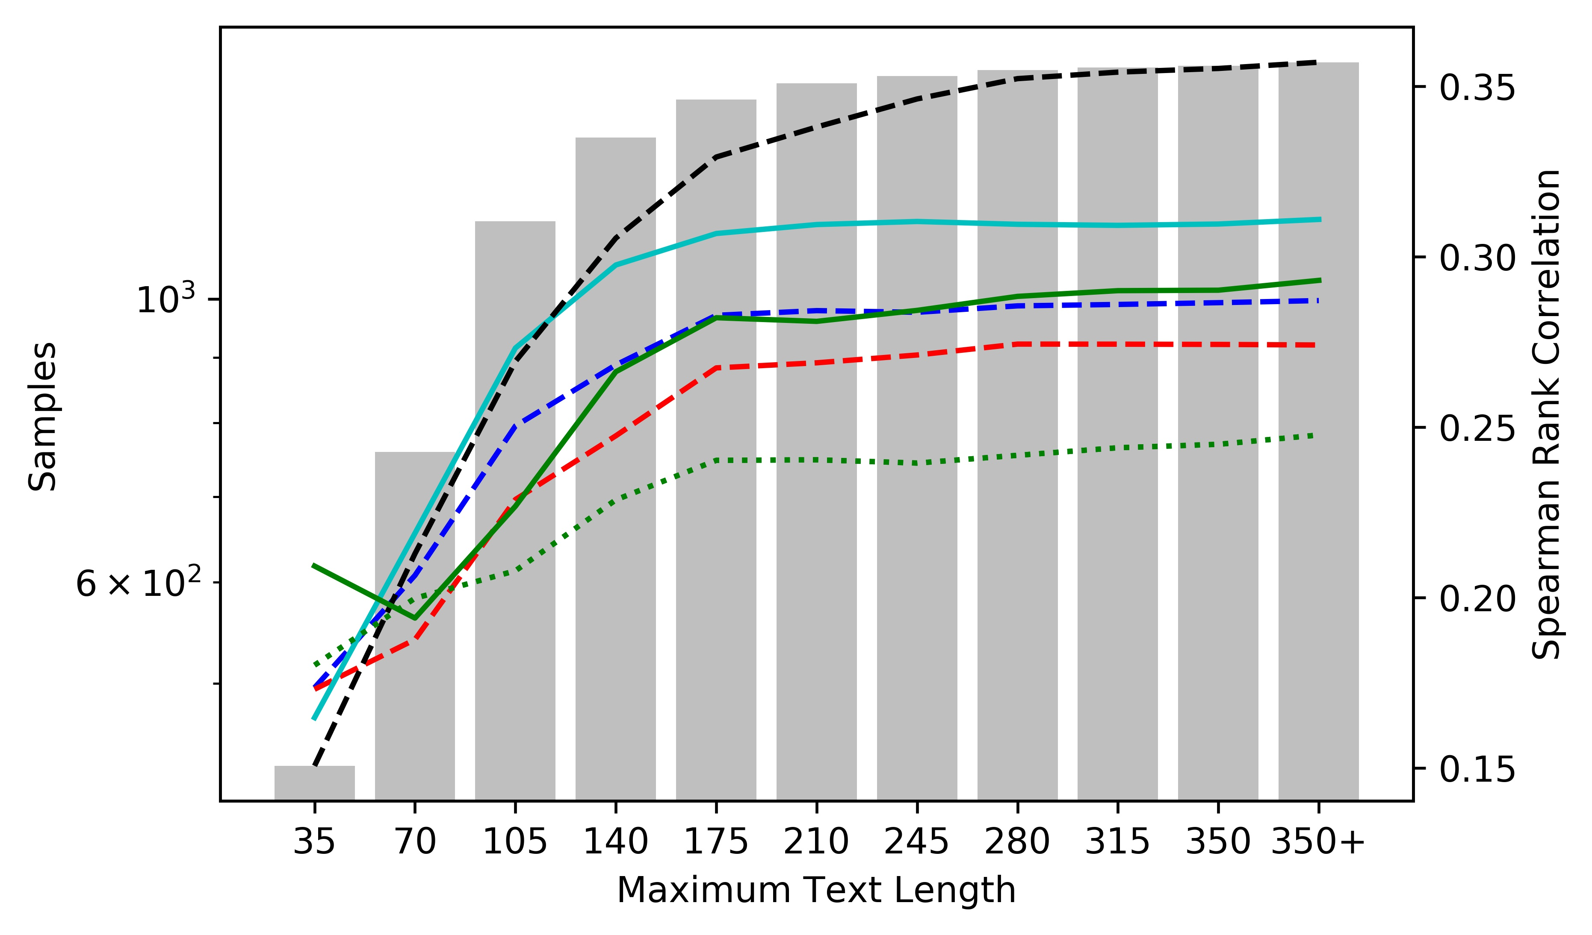
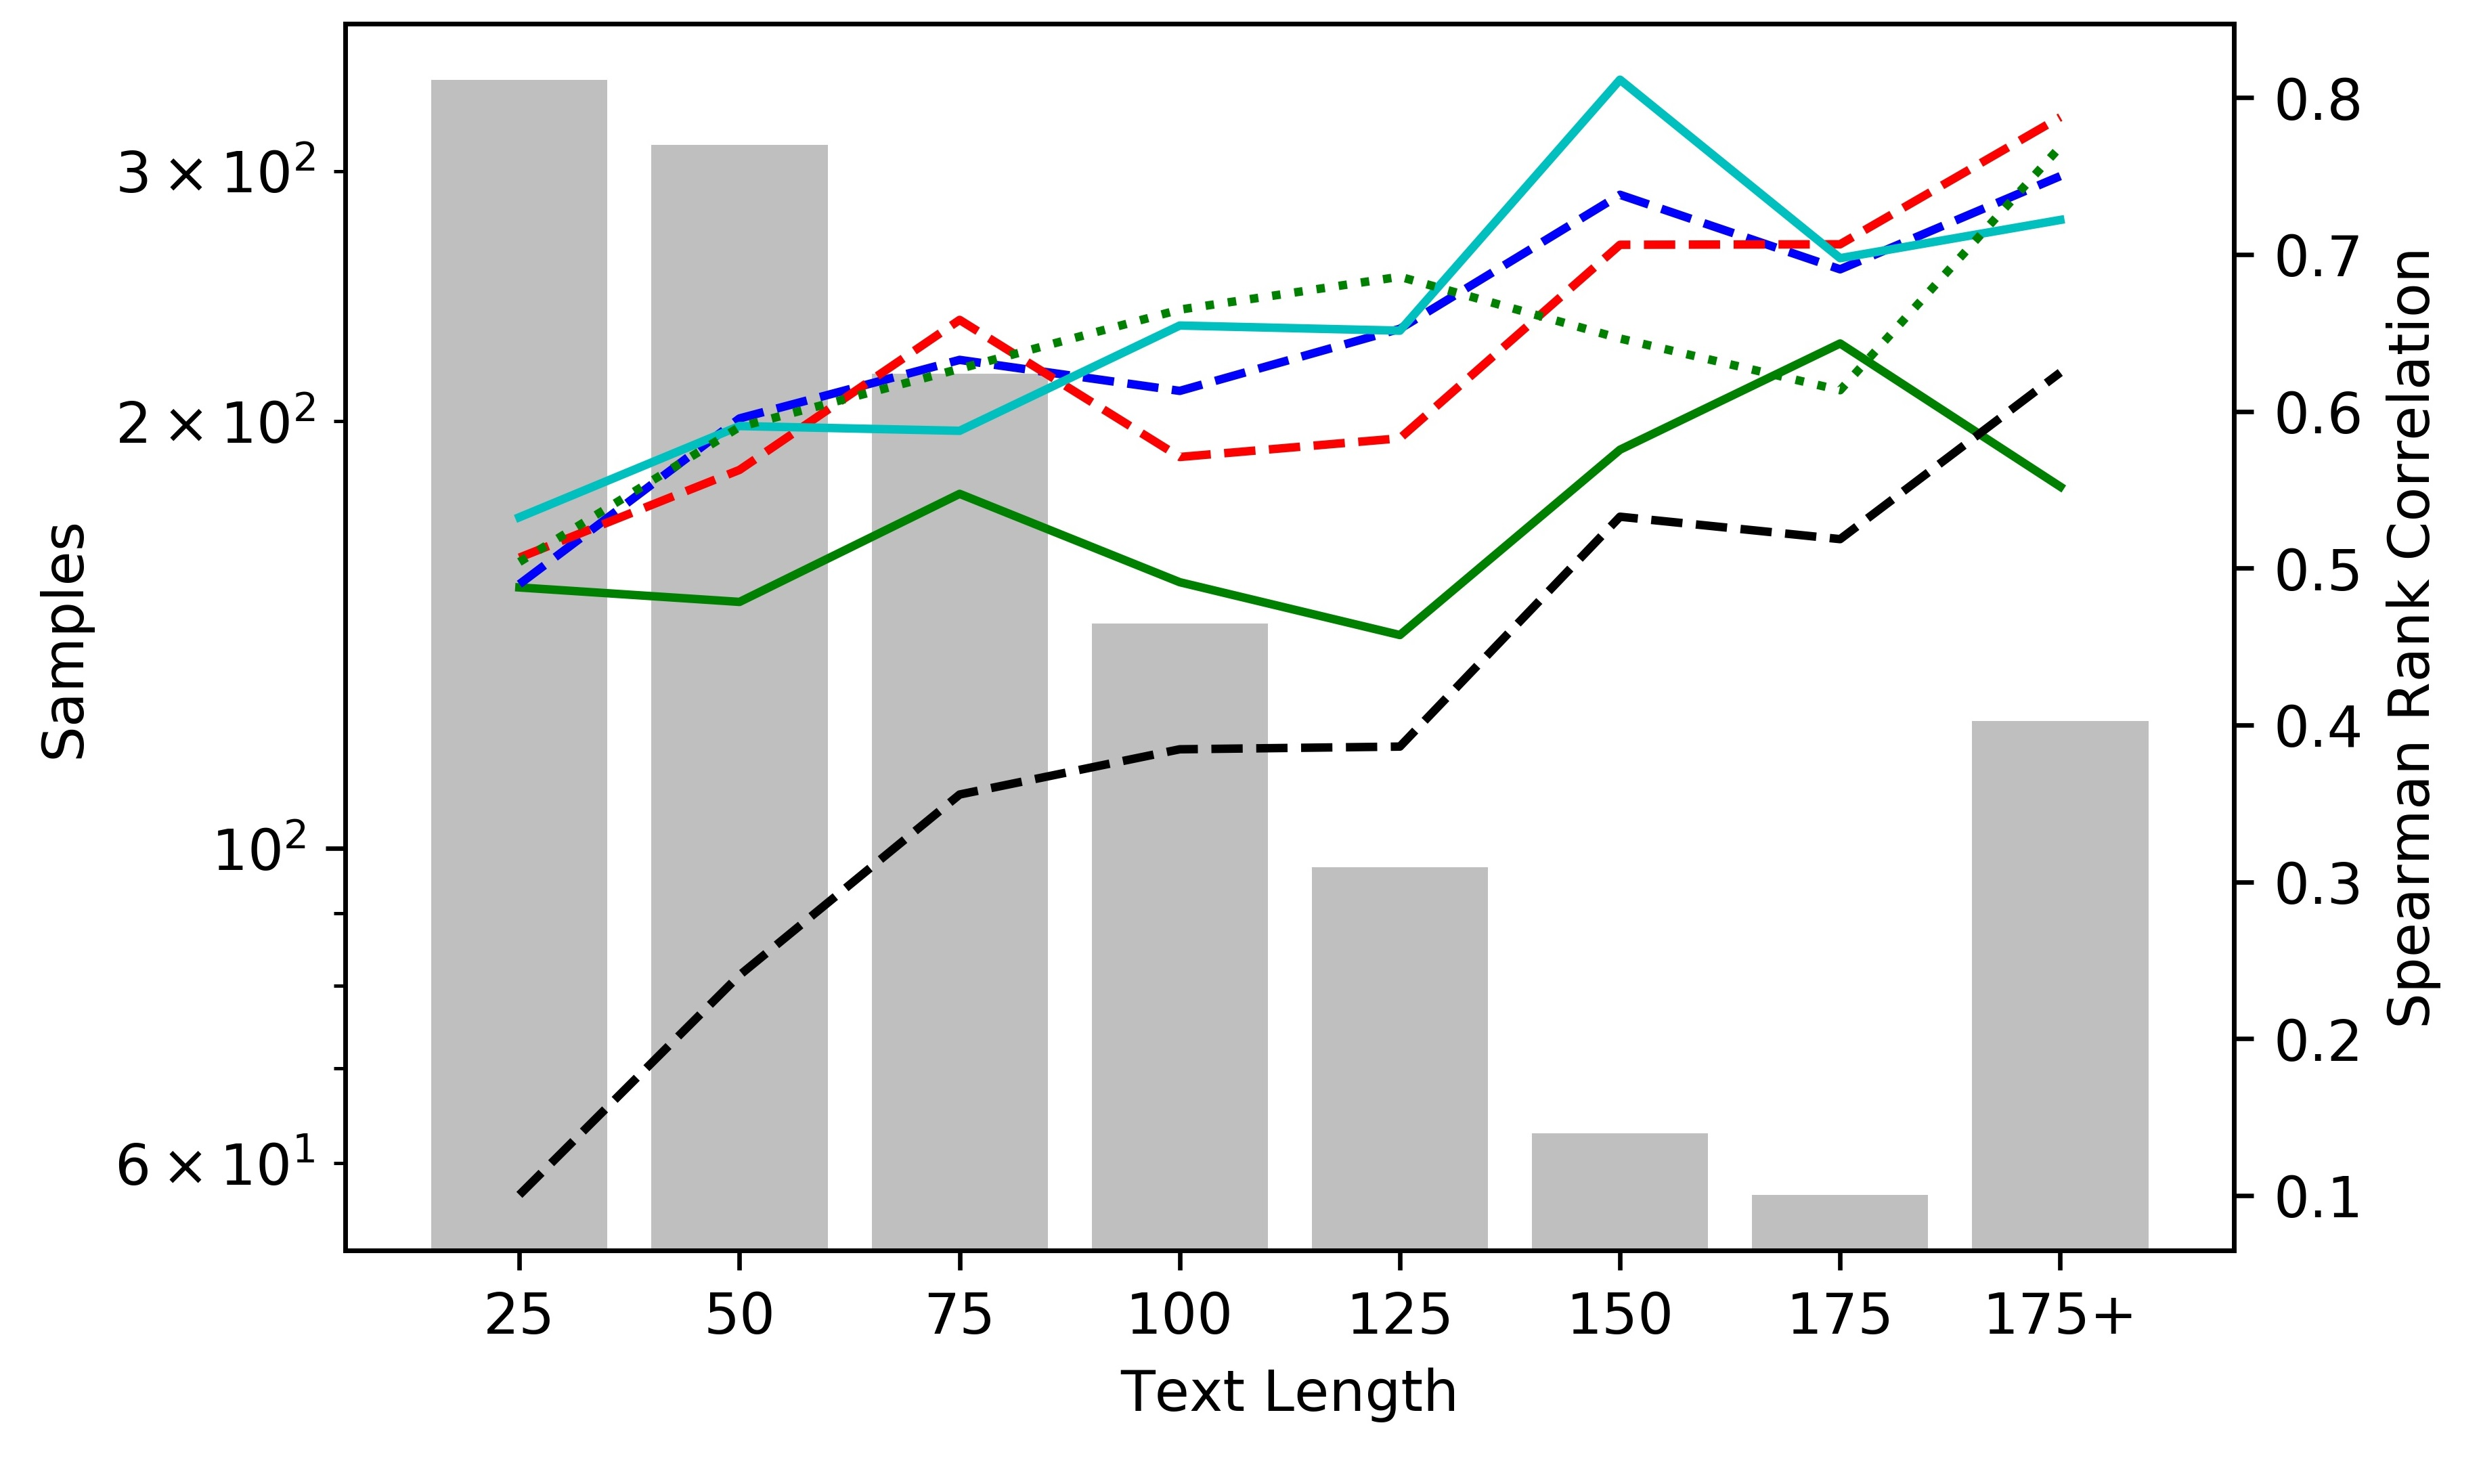
Results by length
Performance vs. maximum text length for CCS paragraphs BCA ($D_{1}$)
Performance vs. text length for informational paragraphs BCA ($D_{2}$)
BCA does better for texts < 100 words for all data sets
WeeBit percentage of zero valued features for CCS document vs. paragraphs: 28% vs. 44%
Notes:
On the left we have the results for common core, paragraph level, plotted against maximum text length. We see that upto roughly 100 words, the RNN with bidirectional context does better than the baseline. On the right we have the performance for informational texts against text length. Here we see that the baseline performance steadily improves as text length increase. The performance of the sequential RNN falls with length, while the hierarchical models performance does not suffer. Again, for the shortest texts, having context helps.
To explore the baseline results further, we compare the sparsity of feature vectors for document vs. paragraph level texts. For document level, the average percentage of xero valued features is 28%, while it is 44% for paragraph level texts. This might in part explain the lower performance for shorter texts.

Slide 16
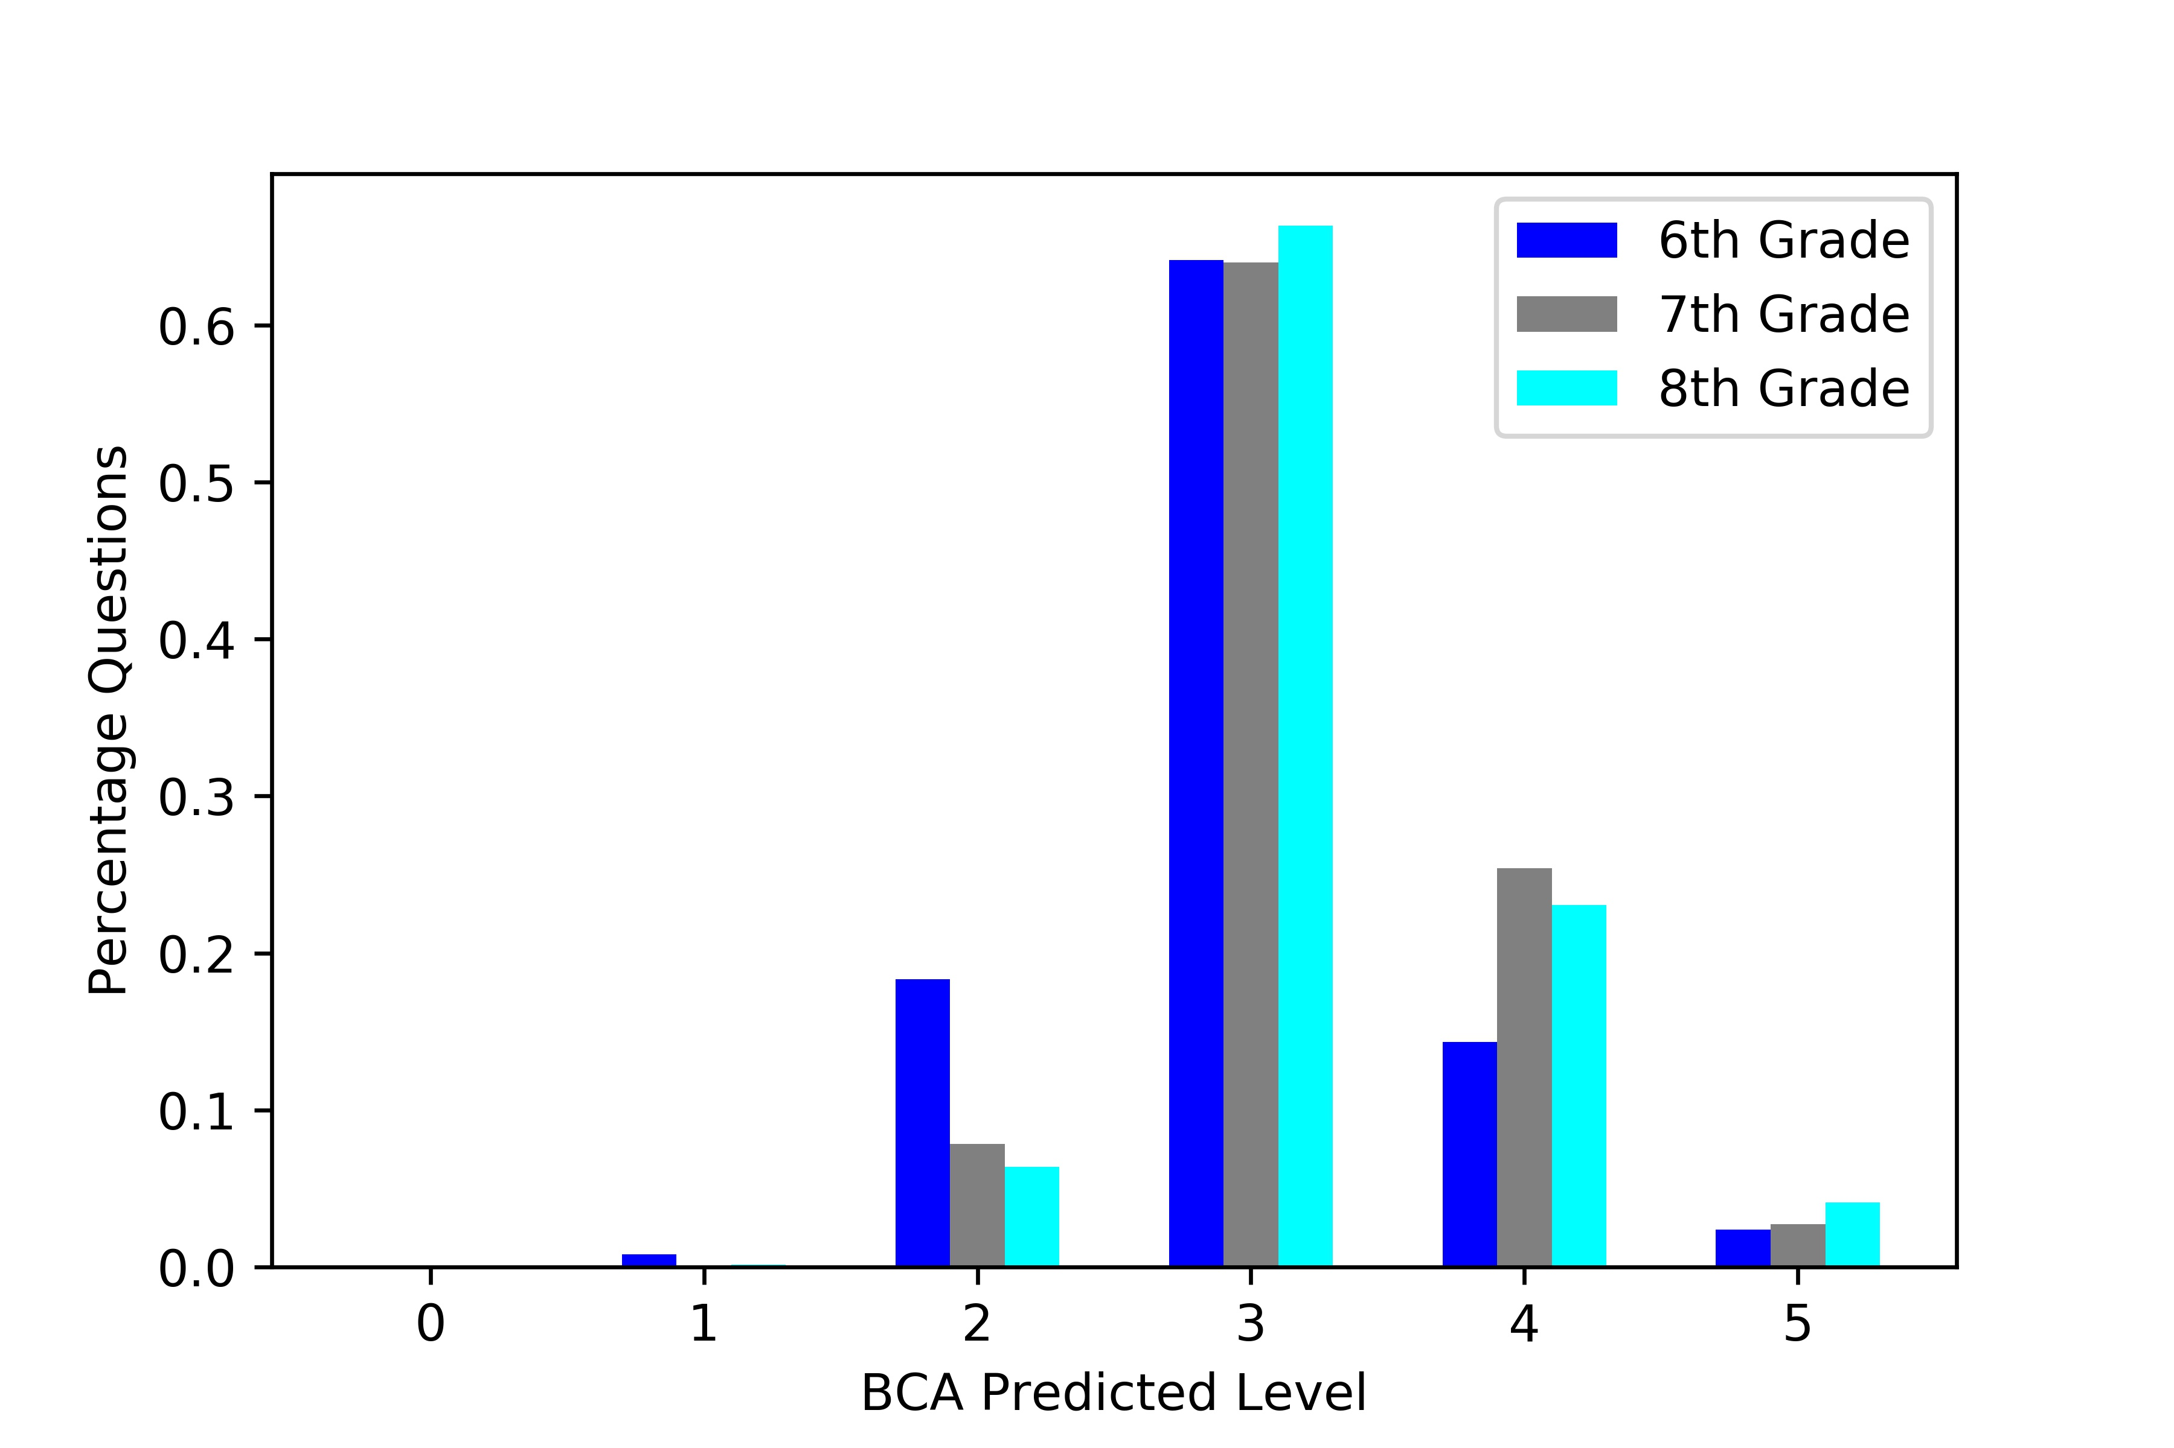
Results on Middle School Science Items
Results on 5470 assessment items from MCAS, NAEP, TIMMS etc.
Average item length is 49 words
RNN Predictions better match the reported level of questions
Baseline System
Our System
Notes:
As a case for seeing how the model works for actual stand alone short science texts, we use the model to get predictions for middle school science assessment questions from various national and state level tests. We again compare against the baseline. The average length of questions is 49 words.
The red square indicates the true level for the questions. Our results better match the true value. We also see the expected trend, i.e. 6th grade questions are more likely to be predicted as having a lower reading level, while 8th grade questions are more likely to be predicted as having a higher reading level.

Slide 17
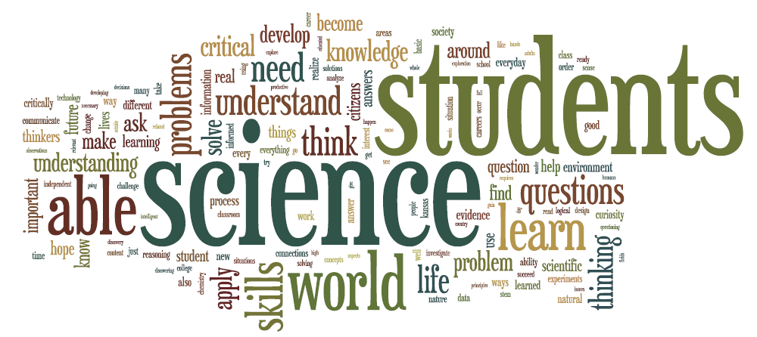
Conclusion
Neural models offer better accuracy on texts shorter than 100 words
Hierarchical models with bidirectional sentence context have the best results
Future work
Explore model interpretability: identify features that contribute to complexity
Incorporate morphological, discourse and syntactic features
Work with actual students’ test results to see how model predictions correlate with student performance and ELL status
Notes:
To round up, our work has shown that for shorter, genre specific texts, neural models work better than feature based models. Having both hierarchical structure and context from adjacent sentences gives the best performance.
There are some aspects that need to be considered, the first is the aspect of making the model interpretable in terms of identifying features that contribute more to linguistic complexity.
It would also be good to incorporate other features, such as morphological, syntactic and discourse level features.
AN important aspect of validating this work is to see how our predictions correlate with actual student performance and ELL status.

Slide 18
Thank you!

Slide 19
Select References
Zichao Yang, Diyi Yang, Chris Dyer, Xiaodong He, Alexander J Smola, and Eduard H Hovy. 2016. Hierarchical attention networks for document classification. In HLT-NAACL, pages 1480–1489.
Sowmya Vajjala and Detmar Meurers. 2012. On improving the accuracy of readability classification using insights from second language acquisition. In Proceedings of the Seventh Workshop on Building Educational Applications Using NLP, pages 163–173. Association for Computational Linguistics.
Sowmya Vajjala and Detmar Meurers. 2014. Readability assessment for text simplification: From analysing documents to identifying sentential simplifications. ITL-International Journal of AppliedLinguistics, 165(2):194–222.
Mart´ın Abadi, Ashish Agarwal, Paul Barham, Eugene Brevdo, Zhifeng Chen, Craig Citro, Greg S Corrado, Andy Davis, Jeffrey Dean, Matthieu Devin, et al. 2016. Tensorflow: Large-scale machine learning on heterogeneous distributed systems. arXiv preprint arXiv:1603.04467.
Jeffrey Pennington, Richard Socher, and Christopher Manning. 2014. Glove: Global vectors for word representation. In Proceedings of the 2014 conference on empirical methods in natural language processing (EMNLP), pages 1532–1543.

Slide 20
Data
Grade level | Train samples | Mean length
K-1 | 739 | 24.42
2-3 | 723 | 62.05
4-5 | 4570 | 63.82
6-8 | 1590 | 74.79
9-10 | 3051 | 68.24
11-12 | 2301 | 75.28
Grade level | All chapters | Test set chapters
K-1 | 25 | -
2-3 | 22 | 2
4-5 | 53 | 9
6-8 | 165 | 12
9-10 | 48 | 5
11-12 | 28 | 3
Training data ($D_{1}$) with mean length of text in words
Training data ($D_{2}$) Chapter-based test data split

Slide 21
Implementation Details
The implementation is done via the Tensorflow library (Abadi et al., 2016)
Regularization was done via drop out.
The validation set was used to do hyper-parameter tuning
Final parameters:
batch size of 10
dropout rate of 0.5-0.7
cell size of 75-250 for the word-level GRU, and 40-75 for the sentence-level GRU
Vocabulary size of 65000-75000

Slide 22
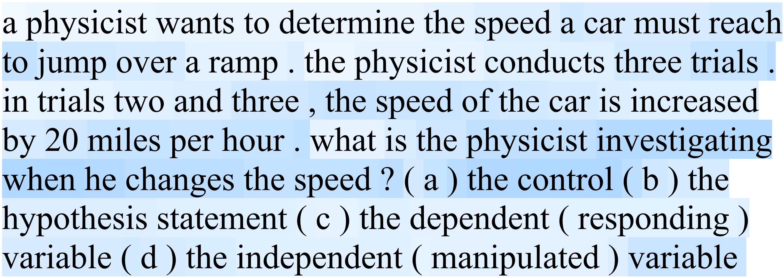
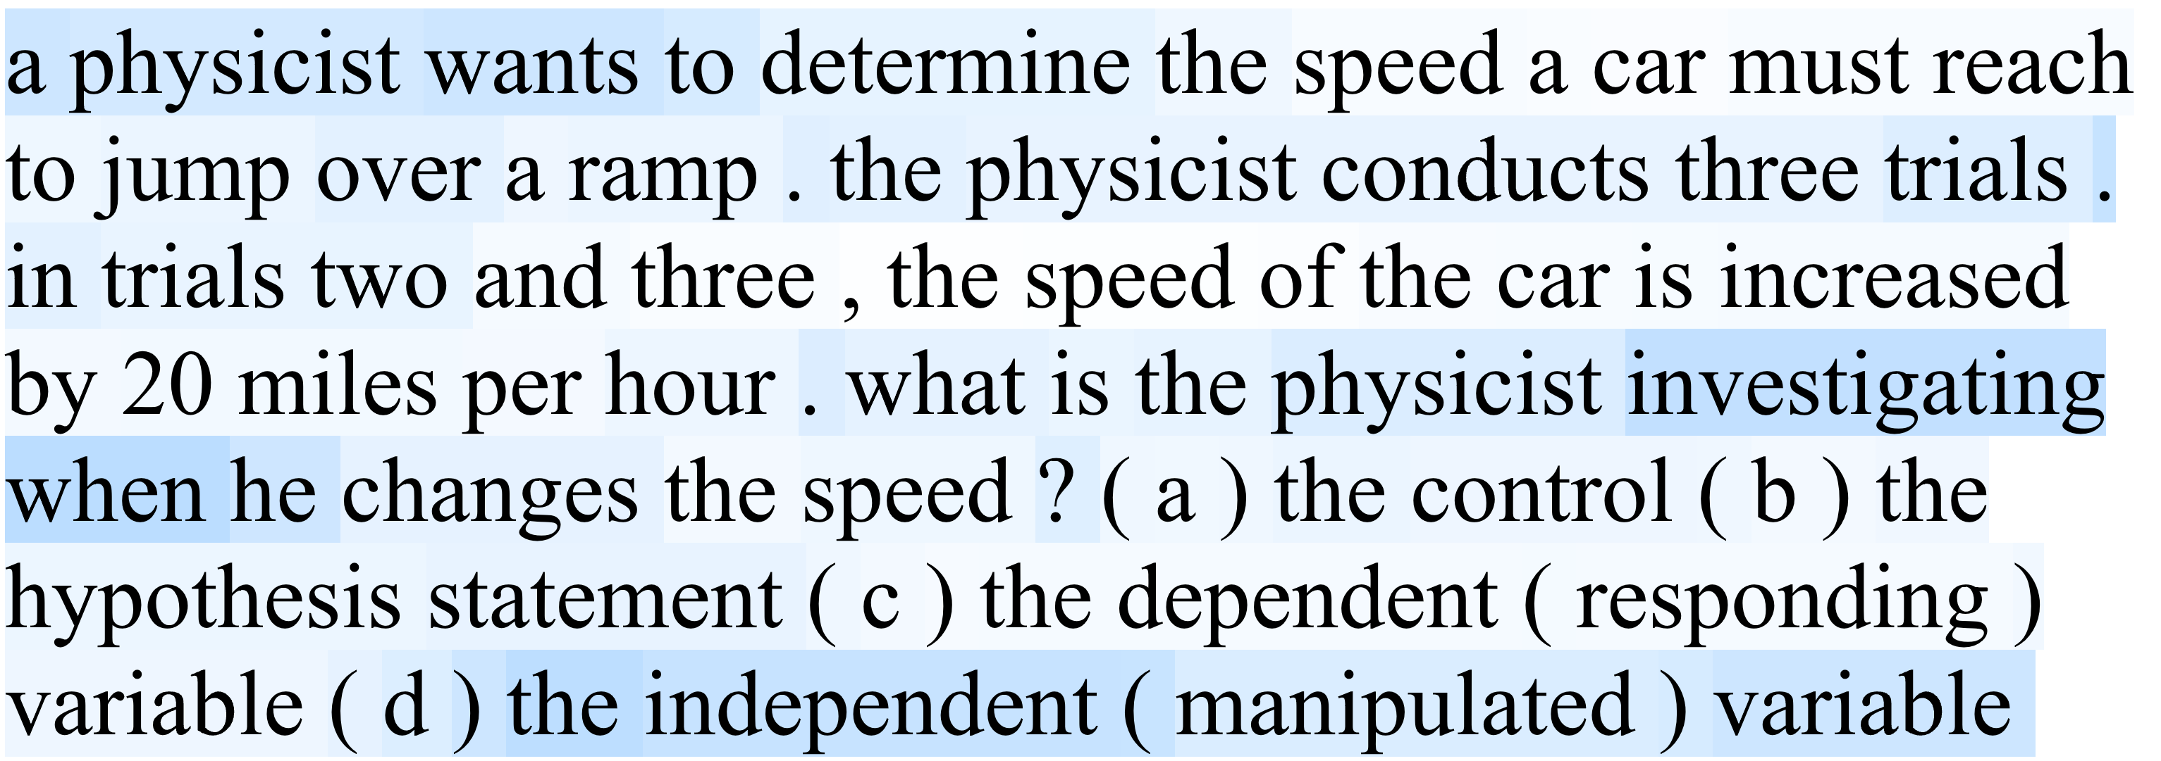
Attention Visualization
Maximum and minimum values of attention
as a function of word count for BCA
Word level attention visualization for BCA (top) and HAN (bottom) for a middle school science assessment question

Slide 23
Results by Genre
Informational texts are over-predicted
All other genres have roughly unbiased predictions
Error distribution for the CCS documents
BCA ($D_{1}$)

